Slide 1
SAML basics
A technical introduction to the Security Assertion Markup Language
Eve Maler
XML Standards Architect
XML Technology Center
Sun Microsystems, Inc.
Notes:
Abstract: “This session will provide a technical overview of SAML, the XML-based Security Assertion Markup Language being standardized at OASIS. It will discuss how SAML enables Single Sign-On and other security scenarios, and provide details about the authentication, attribute, and authorization information that SAML can convey. It will also cover the protocol by which security information can be requested from SAML Authorities and the practical realities of how this information can be transported securely across domains.”
Audience: Technically knowledgeable IT people; doesn’t assume any special security or provisioning knowledge, but the audience should be at least a little familiar with directories, XML concepts, and authentication and authorization concepts.

Slide 2
Agenda
I’m hoping to cover a lot in an hour!
The problem space
SAML concepts
Walking through scenarios
Status of SAML and related standards efforts
  (thanks to Prateek Mishra (Netegrity) and RLBob Morgan (UWashington) for some material in this presentation)

Slide 3
Agenda
The problem space
  Why invent SAML at all?
SAML concepts
Walking through scenarios
Status of SAML and related standards efforts

Slide 4
What problems does SAML try to solve?
Permissions management data is shared in mostly proprietary ways
  Integrating new security features may require developing a lot of new code
  The different systems that generate and use security data are very tightly coupled
Web-based applications show the need for more federation
  We need to cross domains more easily

Slide 5
Two common web application scenarios
Logged-in users of analyst research site SmithCo are allowed access to research produced by sister site JonesCo
Employees at SmithCo are allowed to order office supplies from OfficeBarn if they are authorized to spend enough
Notes:
I will use these examples very loosely in some of the scenarios going forward.

Slide 6
SAML use cases in more detail
SAML developed three “use cases” to drive its requirements:
  Single sign-on (SSO)
  Authorization service
  Back office transaction
Each use case has one or more “scenarios” that provide a more detailed roadmap of interaction
Notes:
The SAML “use cases” are reminiscent of aggregations of UML-style use cases, rather than individual ones, so the name isn’t quite accurate.
The “scenarios” are message flow diagrams that have quite a bit of detail in them.
Ultimately, these (developed as part of our requirements-gathering process) are being turned into designs for what SAML calls “profiles”.

Slide 7
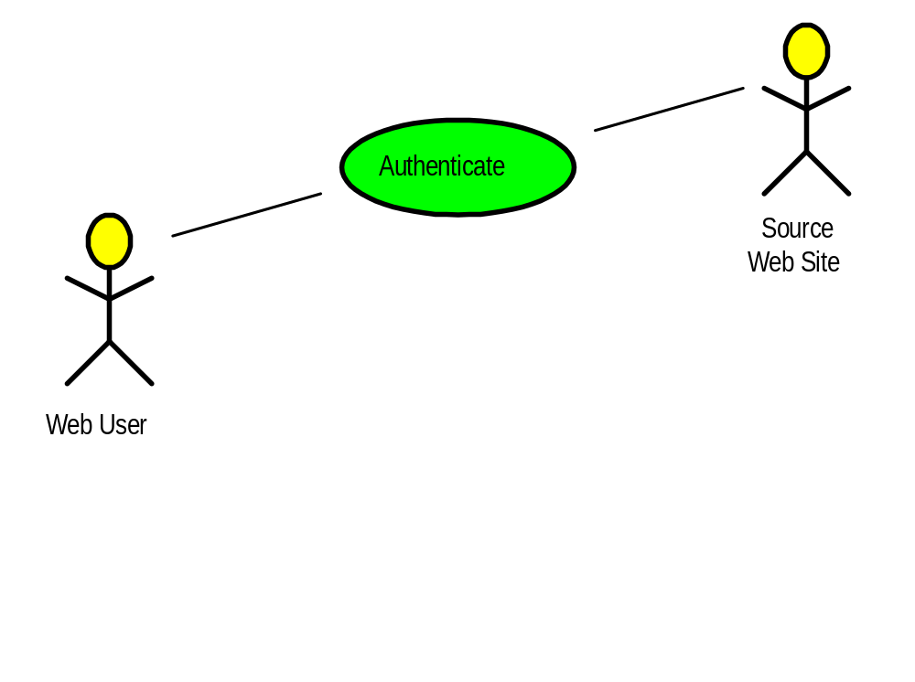
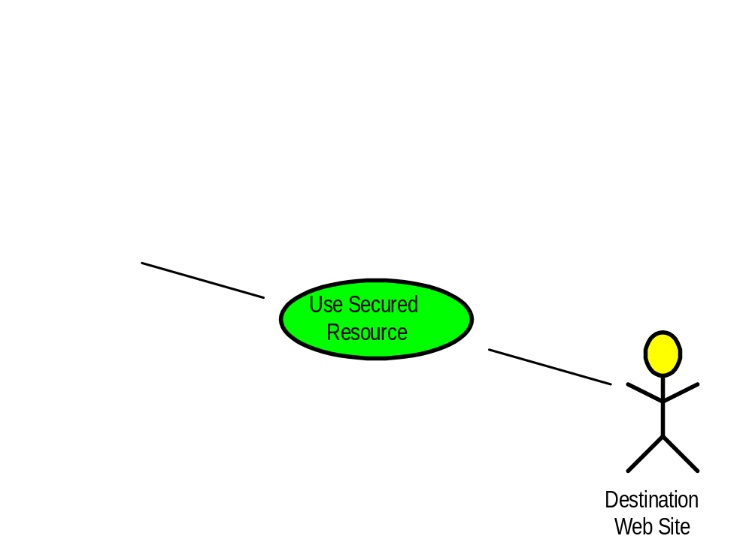
SSO use case
Notes:
Steps:
Web user authenticates to the source Web site.
Web user uses a secured resource at the destination Web site.
This use case has specific push and pull scenarios.
Harking back to our web application scenario a few slides back: Logged-in users of analyst research site SmithCo are allowed access to research produced by sister site JonesCo.

Slide 8
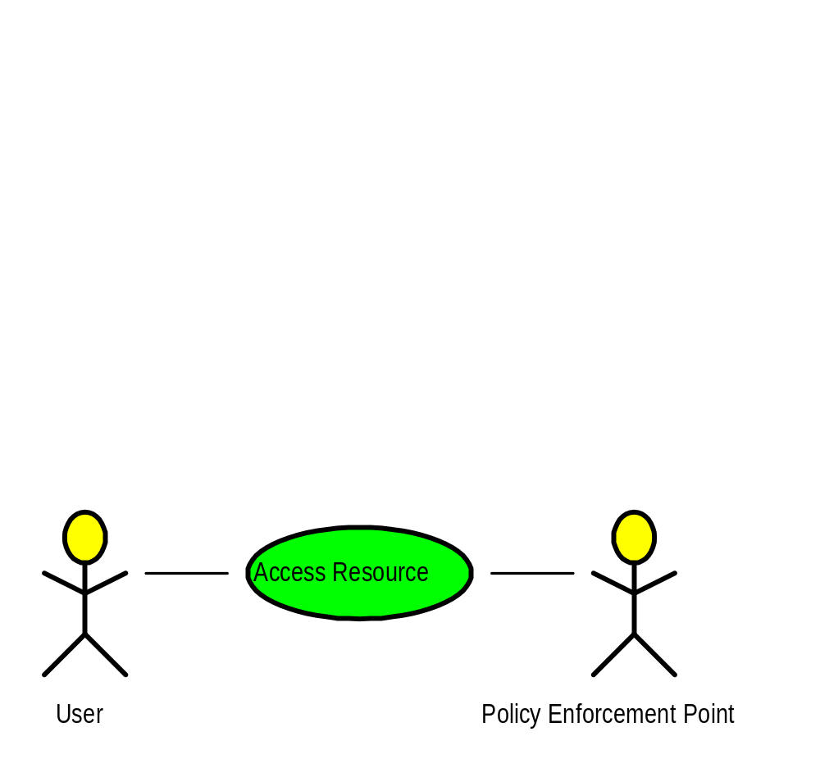
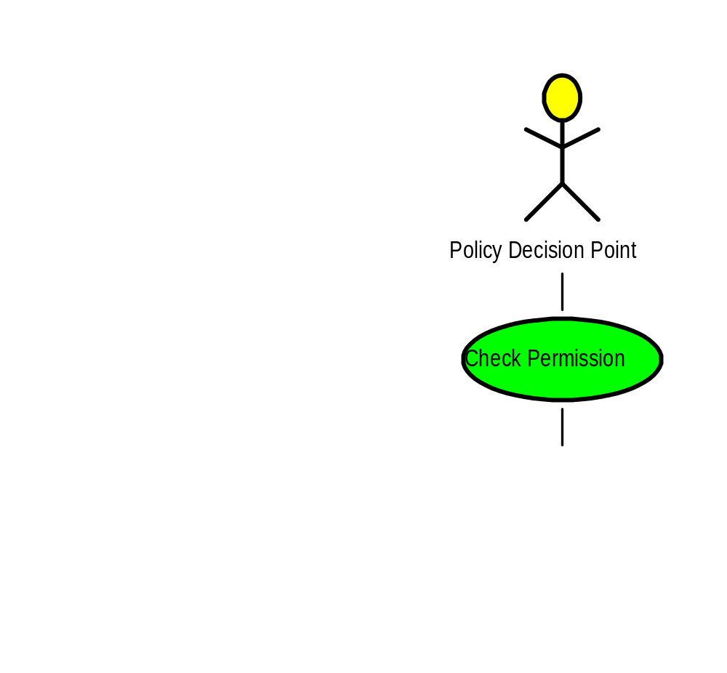
Authorization service use case
Notes:
Steps:
User accesses a resource controlled by PEP.
PEP checks permission for user to access resource with PDP.

Slide 9
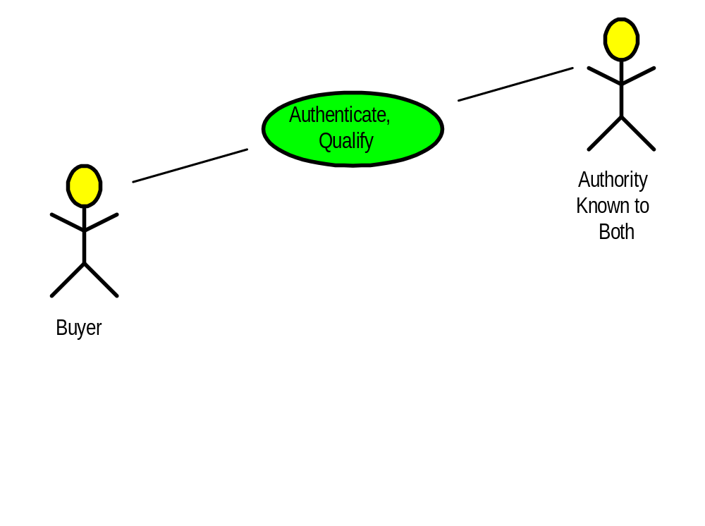
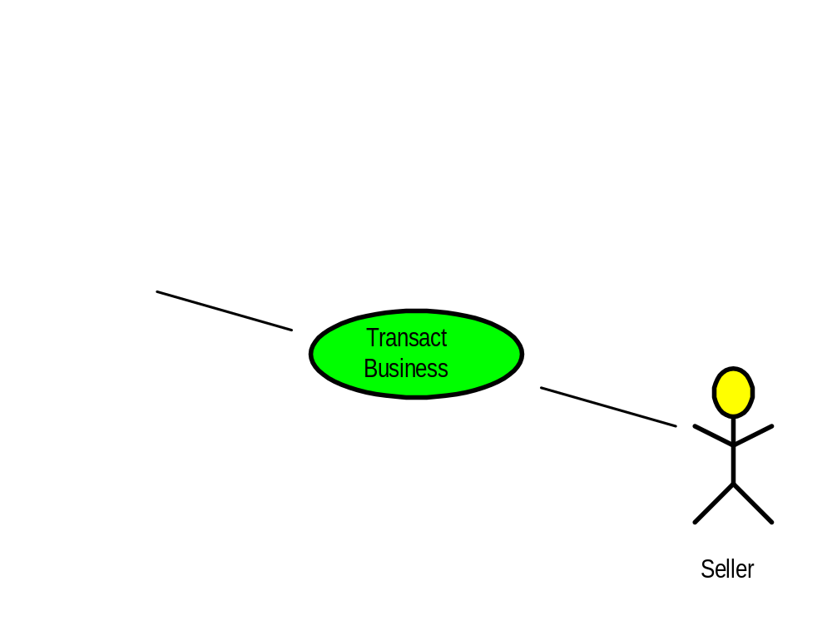
Back office transaction use case
Notes:
Harking back to our web application scenarios a few slides back: Employees at SmithCo are allowed to order office supplies from OfficeBarn if they are authorized to spend enough.
This is a modification of the original use case in the SAML requirements document. It was developed with the help of the editor of the SAML bindings document.

Slide 10
What’s needed
A standard XML message format
  It’s just data traveling on any wire
  No particular API mandated
  Lots of XML tools available
A standard message exchange protocol
  Clarity in orchestrating how you ask for and get the information you need
Rules for how the messages ride “on” and “in” transport protocols
  For better interoperability
Notes:
With XML, you often see standards that are simply wire protocols; no API is mandated, and in some cases no binding to some transport mechanism (such as HTTP or SMTP or whatever) is provided. We felt that the latter is definitely needed so that proprietary mechanisms don’t creep in.

Slide 11
Agenda
The problem space
SAML concepts
  SAML in a nutshell
  Producers and consumers of assertions
  Message exchange protocol
  Bindings and profiles
Walking through scenarios
Status of SAML and related standards efforts

Slide 12
SAML in a nutshell
It’s an XML-based framework for exchanging security information
  XML-encoded security “assertions”
  XML-encoded request/response protocol
  Rules on using assertions with standard transport and messaging frameworks
It’s an emerging OASIS standard
  Vendors and users are involved
  Codifies current system outputs rather than inventing new technology
Notes:
Original SAML players: Netegrity and Securant (since acquired by RSA) contributed the initial specifications (S2ML, AuthXML). There were other contributions as well that were more peripheral to SAML’s core purpose.
Other major vendors/contributors: These include, for example, Baltimore, BEA, Entrust, Entegrity, HP, IBM/Tivoli, Oblix, Sun, VeriSign, Jamcracker, and Internet2/Shibboleth.
Areas of expertise: Distributed systems development, PKI, and XML.
What about Microsoft? They didn't participate in our early work, but they received some "encouragement" to take a look at SAML later. They have contributed design ideas, mostly about Kerberos support. A subcommittee has formed to pursue this more. The latest .NET/Passport story addresses "federated" functions, based on Kerberos. They have made no commitment to SAML, but the lines of communication have been opened.

Slide 13
Agenda
The problem space
SAML concepts
  SAML in a nutshell
  SAML assertions
  Producers and consumers of assertions
  Message exchange protocol
  Bindings and profiles
Walking through scenarios
Status of SAML and related standards efforts

Slide 14
SAML assertions
An assertion is a declaration of fact about a subject, e.g. a user
  (according to some assertion issuer)
SAML has three kinds, all related to security:
  Authentication
  Attribute
  Authorization decision
You can extend SAML to make your own kinds of assertions
Assertions can be digitally signed
Notes:
Typically a subject is human -- it’s somebody who is trying to accomplish some task on a computer and who needs to be checked out before they’re allowed to proceed. But a subject can equally well be another computer/program.
SAML has the XML Signature standard from W3C/IETF baked into it.

Slide 15
All assertions have some common information
Issuer and issuance timestamp
Assertion ID
Subject
  Name plus the security domain
  Optional subject confirmation, e.g. public key
“Conditions” under which assertion is valid
  SAML clients must reject assertions containing unsupported conditions
  Special kind of condition: assertion validity period
Additional “advice”
  E.g., to explain how the assertion was made
Notes:
If an assertion is a declaration of fact according to some issuer, then it’s really important to document who said something.
Validity periods become important because not all assertions will be good forever. It’s an important security consideration in SAML to make the validity period be as short as is practicable.
SAML conditions are a little bit like SOAP mustUnderstand. You can add you own conditions on top of SAML. Such a feature can be open to abuse and lock-in by proprietary systems. Ideally new conditions will be standardized or at least openly published.

Slide 16
Authentication assertion
An issuing authority asserts that:
  subject S
  was authenticated by means M
  at time T
Caution: Actually checking or revoking of credentials is not in scope for SAML!
  Password exchange
  Challenge-response
  Etc.
It merely lets you link back to acts of authentication that took place previously
Notes:
It was a hard decision not to put credential passing in scope for SAML 1.0 (for example, S2ML does it), but we probably would never finish because the whole problem is hard. We are examining credential pass-through to increase SAML’s utility in this area marginally.
A frequently asked question is: How secure is it to have this disconnect between the actual authentication and the sending of an authentication assertion? It is up to the system who needs the information to decide what authentication assertion issuers it chooses to trust.
The means of ensuring that the entity making a request and the entity referred to by an assertion are one and the same is dependent on the environment and protocols being used. The general mechanism provided is the SubjectConfirmation element, which is intended carry data appropriate to the environment (such as a public key).

Slide 17
Example authentication assertion* *draft syntax
<saml:Assertion
MajorVersion=“1” MinorVersion=“0”
AssertionID=“128.9.167.32.12345678”
Issuer=“Smith Corporation“
IssueInstant=“2001-12-03T10:02:00Z”>
<saml:Conditions
NotBefore=“2001-12-03T10:00:00Z”
NotAfter=“2001-12-03T10:05:00Z” />
<saml:AuthenticationStatement
AuthenticationMethod=“password”
AuthenticationInstant=“2001-12-03T10:02:00Z”>
<saml:Subject>
<saml:NameIdentifier
SecurityDomain=“smithco.com”
Name=“joeuser” />
</saml:Subject>
</saml:AuthenticationStatement>
</saml:Assertion>
Notes:
The saml: namespace corresponds to an XML Schema that just focuses on assertions.
So far, we have decided that unique identifiers like AssertionID are essentially opaque to SAML; it’s up to you to ensure that they’re unique in the domain you care about.

Slide 18
Attribute assertion
An issuing authority asserts that:
  subject S
  is associated with attributes A, B, …
  with values “a”, “b”, “c”…
Typically this would be gotten from an LDAP repository
  “john.doe” in “example.com”
  is associated with attribute “Department”
  with value “Human Resources”

Slide 19
Example attribute assertion
<saml:Assertion …>
<saml:Conditions …/>
<saml:AttributeStatement>
<saml:Subject>
<saml:NameIdentifier
SecurityDomain=“smithco.com”
Name=“joeuser” />
</saml:Subject>
<saml:Attribute
AttributeName=“PaidStatus”
AttributeNamespace=“http://smithco.com”>
<saml:AttributeValue>
PaidUp
</saml:AttributeValue>
</saml:Attribute>
</saml:AttributeStatement>
</saml:Assertion>
Notes:
SAML requires attribute names to be qualified as being in a “namespace” (not an XML namespace), so that you can indicate the universe in which the attributes of interest were defined. This makes SAML neatly extensible in this area.

Slide 20
Authorization decision assertion
An issuing authority decides whether to grant the request:
  by subject S
  for access type A
  to resource R
  given evidence E
The subject could be a human or a program
The resource could be a web page or a web service, for example

Slide 21
Example authorization decision assertion
<saml:Assertion …>
<saml:Conditions …/>
<saml:AuthorizationStatement
Decision=“Permit”
Resource=“http://jonesco.com/rpt_12345.htm”>
<saml:Subject>
<saml:NameIdentifier
SecurityDomain=“smithco.com”
Name=“joeuser” />
</saml:Subject>
</saml:AuthorizationStatement>
</saml:Assertion>

Slide 22
Agenda
The problem space
SAML concepts
  SAML in a nutshell
  SAML assertions
  Producers and consumers of assertions
  Message exchange protocol
  Bindings and profiles
Walking through scenarios
Status of SAML and related standards efforts

Slide 23
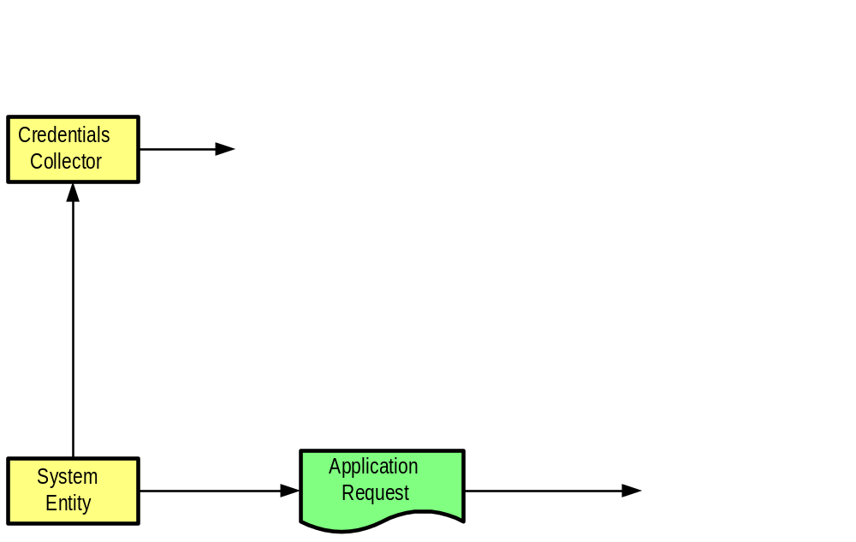
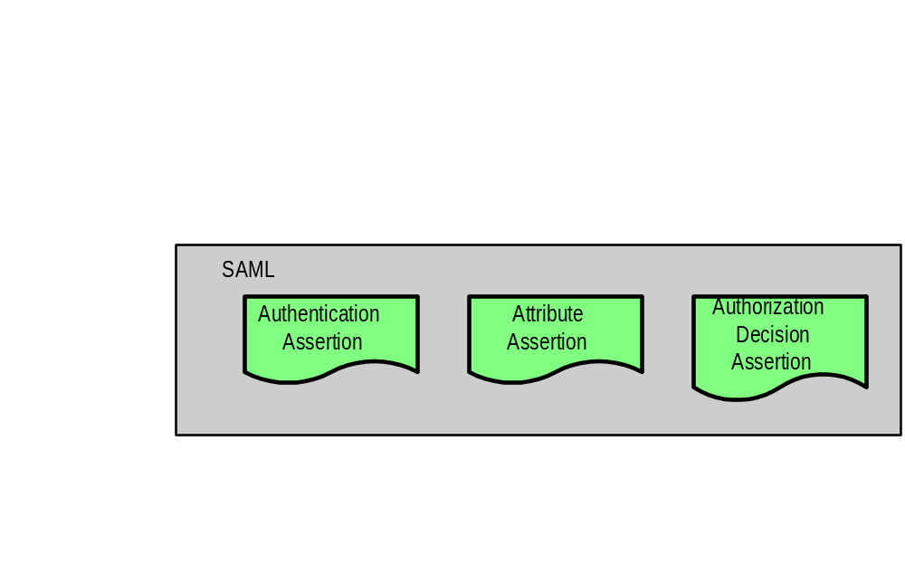
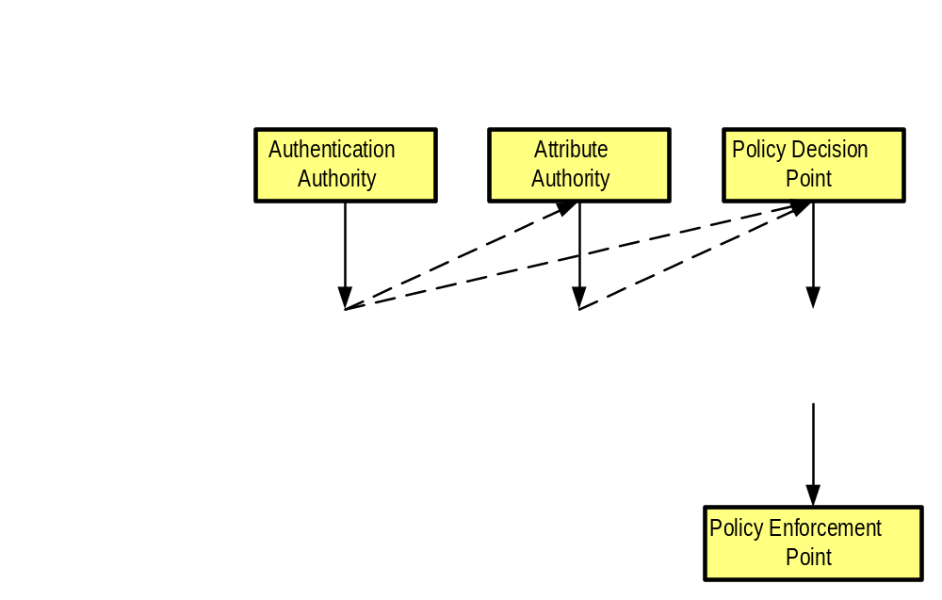
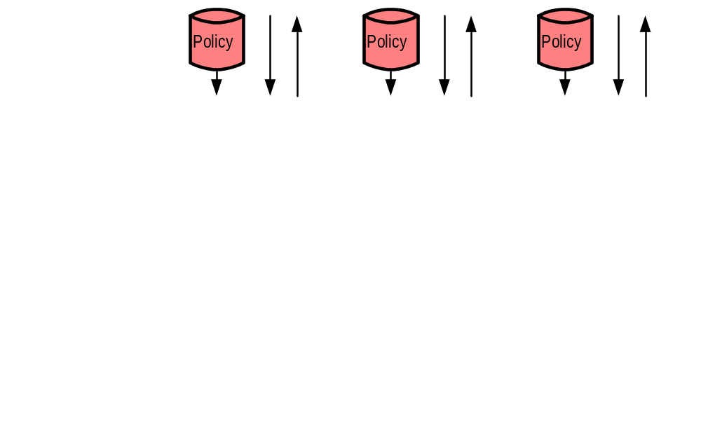
SAML producer-consumer model
Notes:
We’ve already shown examples of XML documents containing SAML assertions. The stuff in the gray box is standardized by the SAML specifications. But something has to produce them, and something has to consume them. The model I’ll flesh out for you here was developed to help the committee understand the basic inputs and outputs.
Assertions are produced (issued) by authorities. An authentication authority produces authentication assertions, an attribute authority produces attribute assertions, and a policy decision point or PDP (in other words, an authorization decision authority) produces authorization decision assertions.
But these authorities don’t live in a vacuum. They may each get various kinds of data from the “outside”, and this data may reside in a separate or integrated policy store. For example, a PDP might have to look up a policy statement about Joe User and check the current date to know whether Joe can look at the report he wants.
And here’s the rest of the picture. This just shows that credential checking happens outside the scope of SAML (this was a big point of contention) and that it all starts with some kind of system entity (a human or program) that wants to accomplish something. Note that the policy enforcement point (PEP) is just a special name for the particular kind of requester that wants the things that a PDP produces.

Slide 24
This model is conceptual only
In practice, multiple kinds of authorities may reside in a single software system
  SAML allows, but doesn’t require, total federation of these jobs
Also, the arrows may not reflect information flow in real life
  Information can be pulled or pushed
  Not all assertions are always produced
  Not all potential consumers (clients) are shown

Slide 25
Agenda
The problem space
SAML concepts
  SAML in a nutshell
  SAML assertions
  Producers and consumers of assertions
  Message exchange protocol
  Bindings and profiles
Walking through scenarios
Status of SAML and related standards efforts

Slide 26
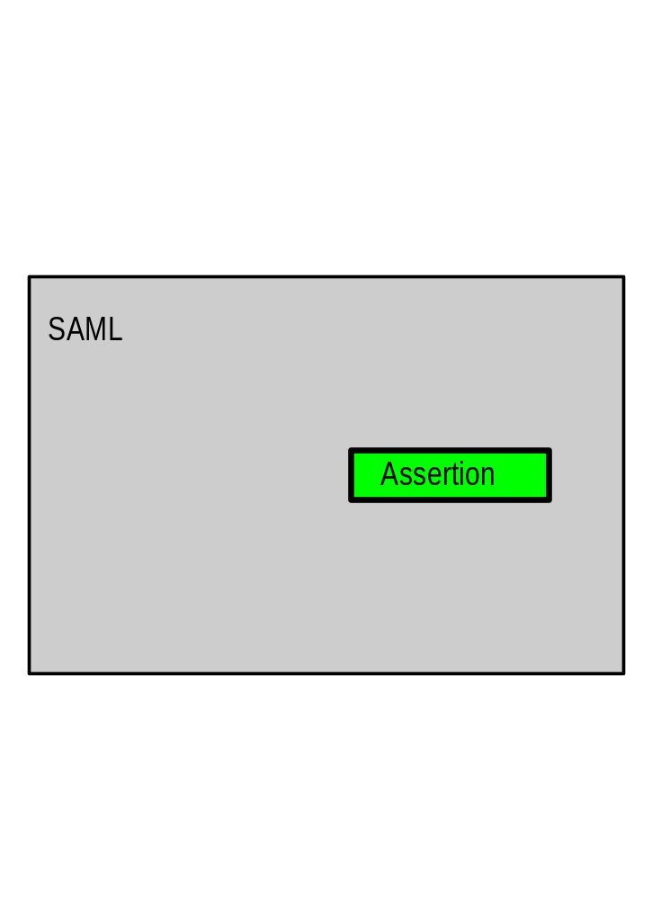
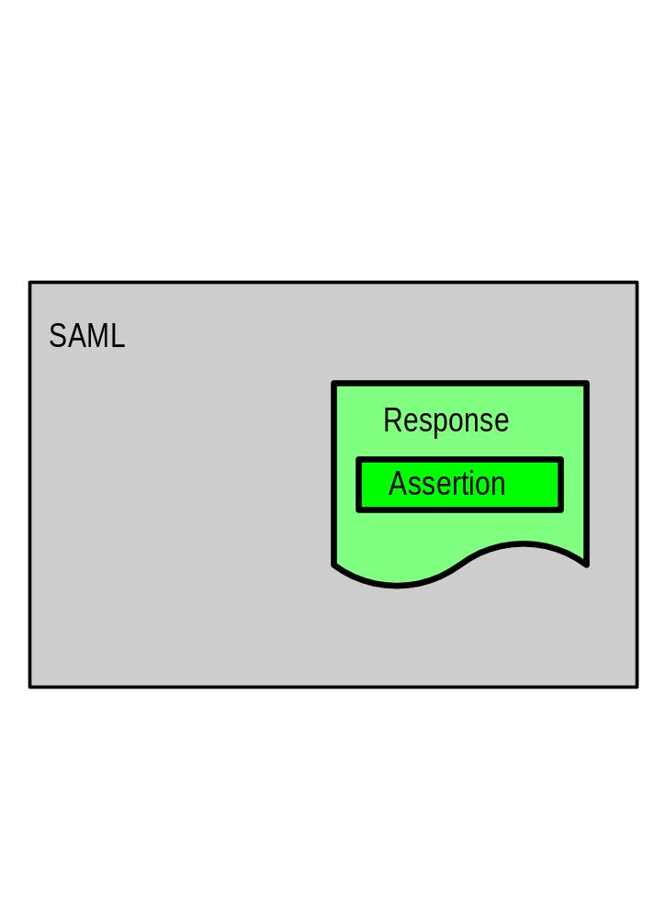
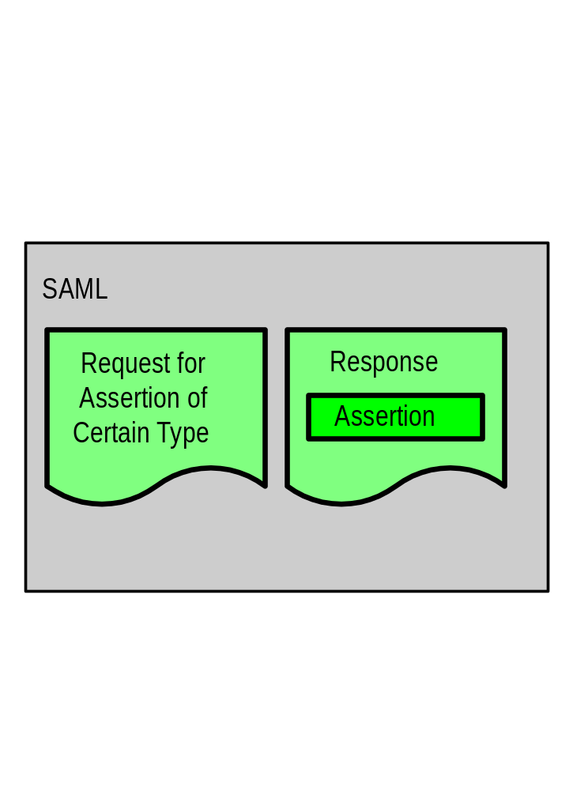
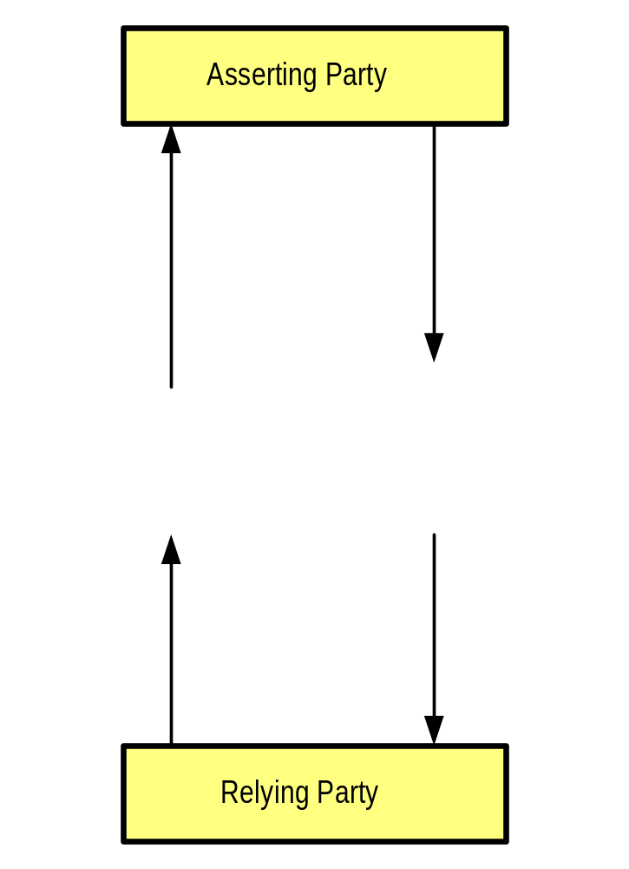
SAML protocol for getting assertions
Notes:
We’re already familiar with assertions. They’re in the gray box here because SAML specifies them.
But they have to be delivered by authorities somehow; this is done in an XML document called a SAML response.
Of course, a response is produce in response to something. That something is an XML document called a SAML request.
And finally, these don’t live in a vacuum. We introduced the “authority” terminology a moment ago; a generic way of viewing issuers/producers/authorities is as asserting parties, and a generic way of viewing the systems that need, request, and use the assertions is as relying parties.

Slide 27
Assertions are normally provided in a SAML response
Existing tightly coupled environments may need to use their own protocol
  They can use assertions without the rest of the structure
The full benefit of SAML will be realized where parties with no direct knowledge of each other can interact
  Via a third-party introduction
Notes:
Some scenarios for using SAML have, as part of their flow, raw assertions attached to other data. There’s nothing wrong with this, but if the SAML request-response protocol could be used for basic querying of authorities and isn’t, you might very well be missing an opportunity to interoperate with other systems.

Slide 28
Authentication assertion request
“Please provide the authentication information for this subject, if you have any”
It is assumed that the requester and responder have a trust relationship
  They are talking about the same subject
  The response with the assertion is a “letter of introduction” for the subject

Slide 29
Example authentication assertion request
<samlp:Request
MajorVersion=“1” MinorVersion=“0”
RequestID=“128.14.234.20.12345678” >
<samlp:AuthenticationQuery>
<saml:Subject>
<saml:NameIdentifier
SecurityDomain=“smithco.com”
Name=“joeuser” />
</saml:Subject>
</samlp:AuthenticationQuery>
</samlp:Request>

Slide 30
Attribute assertion request
“Please provide information on the listed attributes for this subject”
If the requester is denied access to some of the attributes, there are options for what gets returned
  Only the partial list of accessible attributes
  Either all of the attributes requested, or none

Slide 31
Example attribute assertion request
<samlp:Request … >
<samlp:AttributeQuery
CompletenessSpecifier=“Partial”>
<saml:Subject>
<saml:NameIdentifier
SecurityDomain=“smithco.com”
Name=“joeuser” />
</saml:Subject>
<saml:AttributeDesignator
AttributeName=“PaidStatus”
AttributeNamespace=“http://smithco.com”>
</saml:AttributeDesignator>
</samlp:AttributeQuery>
</samlp:Request>

Slide 32
Authorization decision assertion request
“Is this subject allowed to access the specified resource in the specified manner, given this evidence?”
This type of request is the most complex

Slide 33
Example authorization decision assertion request
<samlp:Request …>
<samlp:AuthorizationQuery
Resource=“http://jonesco.com/rpt_12345.htm”>
<saml:Subject>
<saml:NameIdentifier
SecurityDomain=“smithco.com”
Name=“joeuser” />
</saml:Subject>
<saml:Actions Namespace=“http://…”>
<saml:Action>Read</saml:Action>
</saml:Actions>
<saml:Evidence>
<saml:Assertion>
…some assertion…
</saml:Assertion>
</saml:Evidence>
</samlp:AuthorizationQuery>
</samlp:Request>
Notes:
Just as for attributes, the potential actions are governed in a way that allows SAML not to be dependent on a “closed set” of them.

Slide 34
Example response
<samlp:Response
MajorVersion=“1” MinorVersion=“0”
RequestID=“128.14.234.20.90123456”
InResponseTo=“128.14.234.20.12345678”
StatusCode=“Success”>
<saml:Assertion
MajorVersion=“1” MinorVersion=“0”
AssertionID=“128.9.167.32.12345678”
Issuer=“Smith Corporation">
<saml:Conditions
NotBefore=“2001-12-03T10:00:00Z”
NotAfter=“2001-12-03T10:05:00Z” />
<saml:AuthenticationStatement …>
</saml:AuthenticationStatement>
</saml:Assertion>
</samlp:Request>
Notes:
Responses aren’t very exciting to look at. They just contain assertions and some response metadata.
I haven’t covered the boxcarring of assertions here.

Slide 35
Agenda
The problem space
SAML concepts
  SAML in a nutshell
  SAML assertions
  Producers and consumers of assertions
  Message exchange protocol
  Bindings and profiles
Walking through scenarios
Status of SAML and related standards efforts

Slide 36
Bindings and profiles connect SAML with the wire
This is where SAML itself gets made secure
A “binding” is a way to transport SAML requests and responses
  SOAP-over-HTTP binding is a baseline
  Other bindings will follow, e.g., raw HTTP
A “profile” is a pattern for how to make assertions about other information
  Web browser profile for SSO
  SOAP profile for securing SOAP payloads
Notes:
Profiles are sort of like choreography templates. SAML is very flexible; profiles give you a way to standardize on particular flows of SAML-related data in order to secure some other traffic.
The SAML committee is standardizing some of these, but we have every intention of seeing more created by others. We hope that these will be standardized by some body, or at least openly specified.

Slide 37
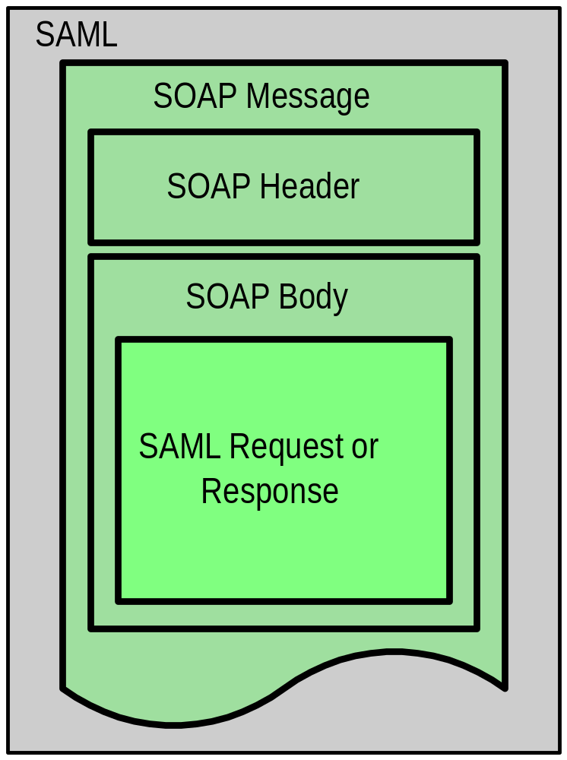
The SOAP-over-HTTP binding
Notes:
This just amounts to using SOAP to query a SAML authority and get back a response.

Slide 38
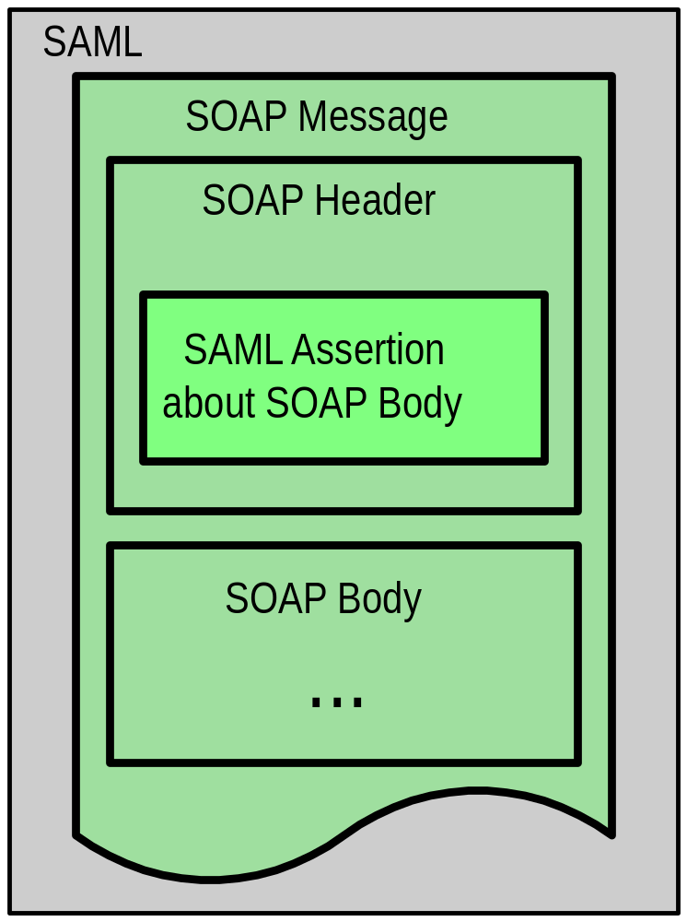
By contrast, the SOAP profile
Notes:
On the other hand, this is a canonical way to provide assertions about some resource that is in the body of the same SOAP document that the assertions are in.

Slide 39
Web browser profiles
These profiles assume:
  A standard commercial browser and HTTP(S)
  User has authenticated to a local source site
  Assertion’s subject refers implicitly to the user
When a user tries to access a target site:
  A tiny authentication assertion reference travels with the request so the real assertion can be dereferenced
  Or the real assertion gets POSTed
Notes:
The web browser profile is really a couple of different sub-profiles. They mostly deal with SSO. The trick is to convey an authentication assertion safely. You can simply POST it, or you can send a little reference to it in a small string such as a URL and then get asked for the real thing.

Slide 40
Agenda
The problem space
SAML concepts
Walking through scenarios
  SSO pull using web browser profile
  Back office transaction using SOAP binding and SOAP profile
Status of SAML and related standards efforts

Slide 41
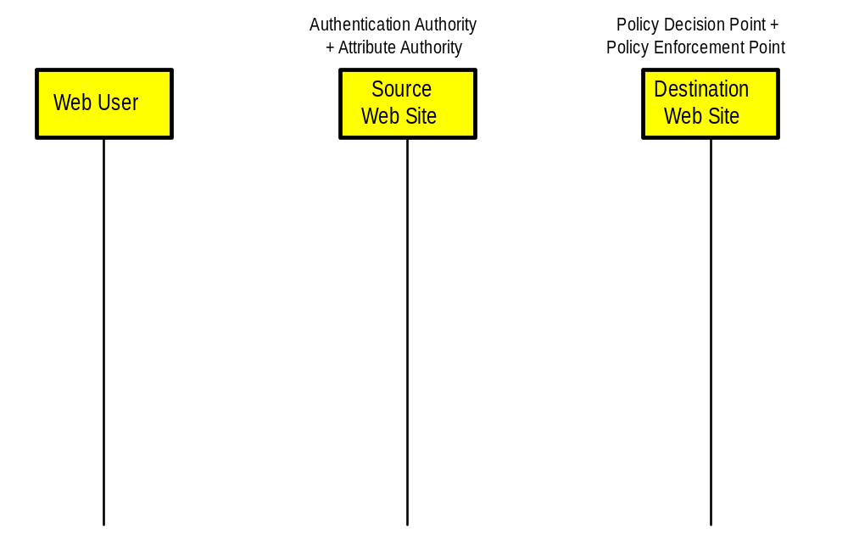
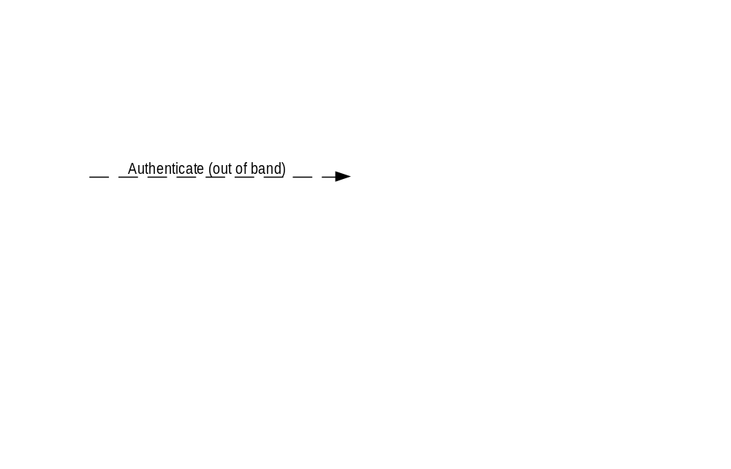
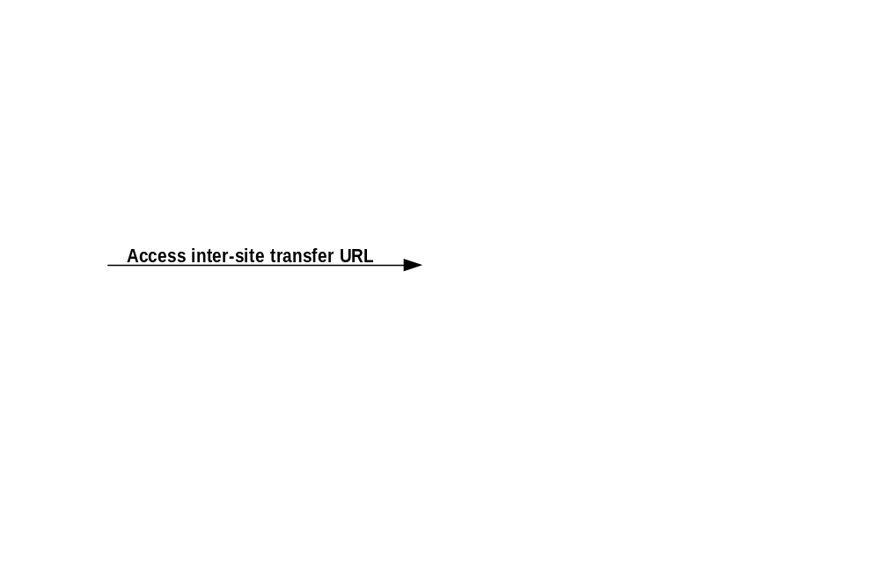
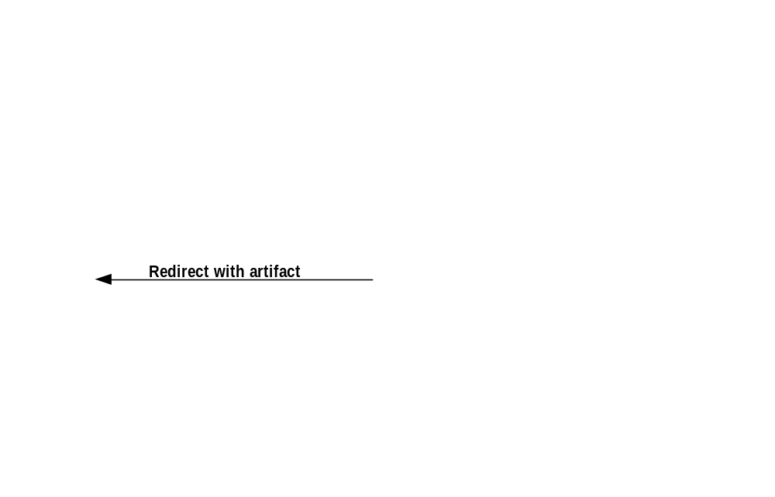
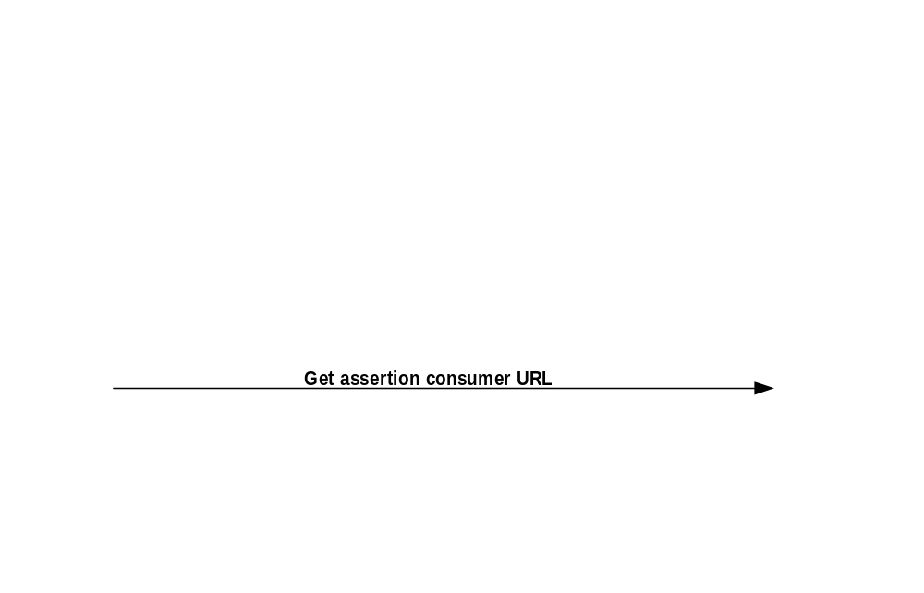
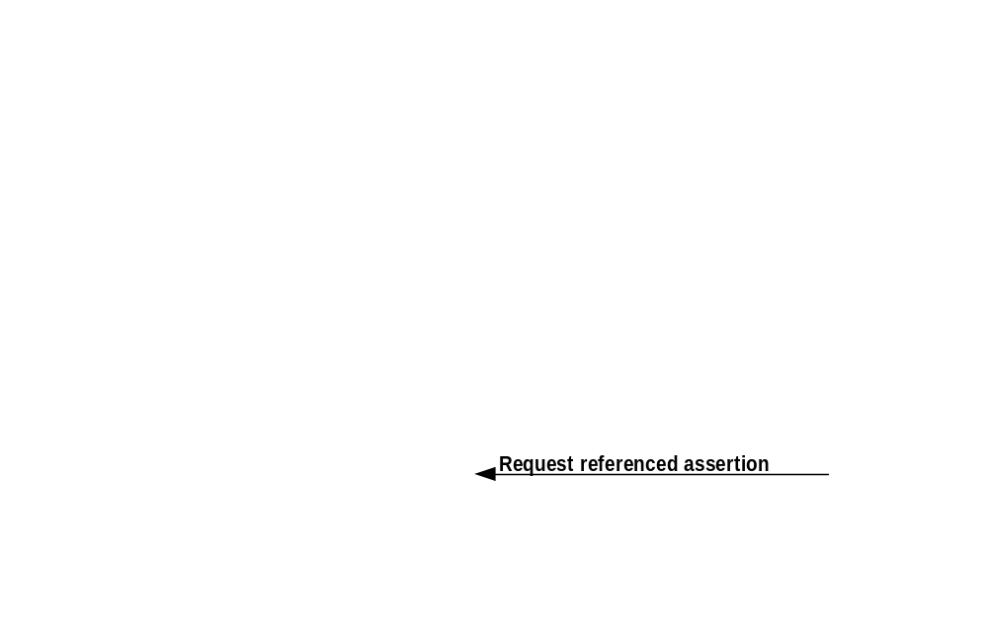
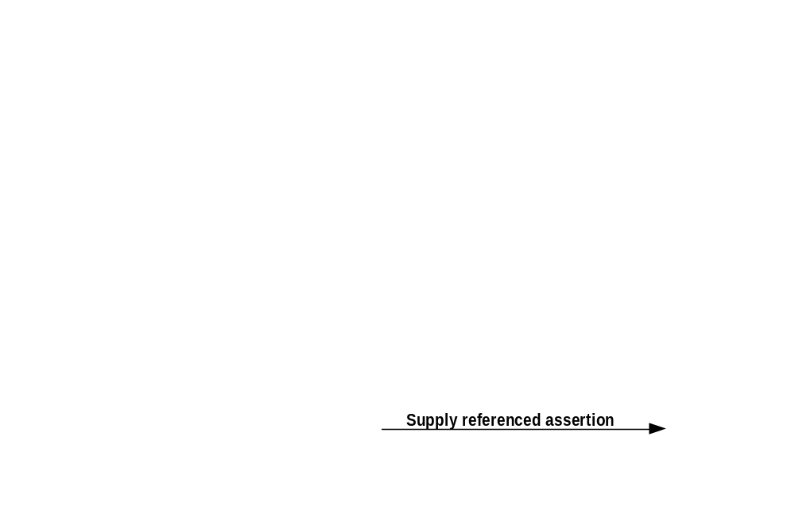
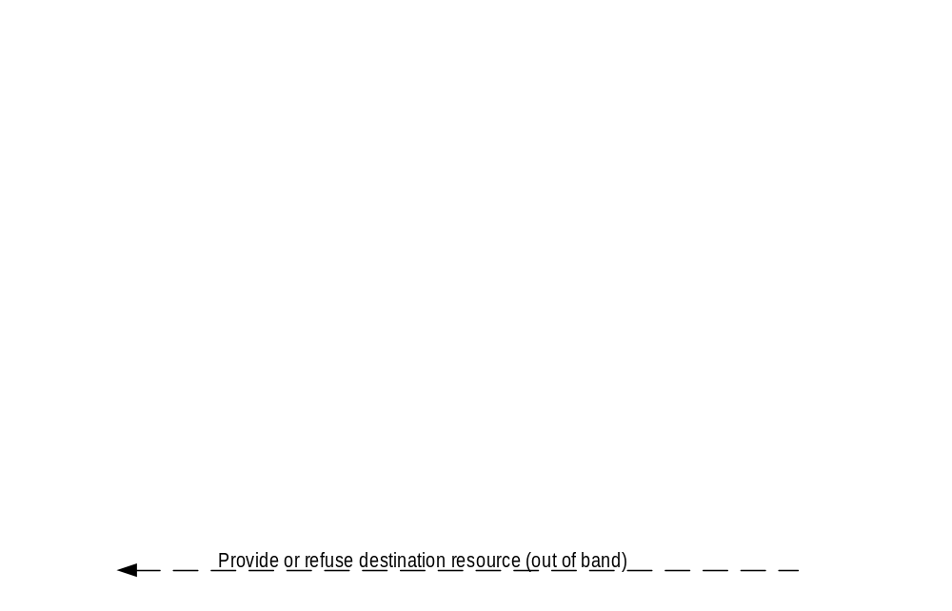
SSO pull scenario
Notes:
Here’s an example of the full-blown web browser profile at work. Jane User, who logs in to SmithCo.com, wants a research report residing at JonesCo. She clicks on the appropriate link, and then a bunch of stuff happens that is transparent to her but is fairly complex.
She logs in to SmithCo.
She clicks on what looks like the link to the research report.
She gets redirected to a way-station and a little “artifact” gets created that references her authentication assertion.
The way-station sends her on her way, with the artifact in tow.
The destination site sees the artifact and asks for the real assertion.
Having gotten it, the site decides whether to let Jane in.

Slide 42
More on the SSO pull scenario
“Access inter-site transfer URL” step:
  User is at: http://smithco.com
  Clicks on a link that looks like it will take her to http://jonesco.com
  It really takes her to inter-site transfer URL: https://source.com/intersite?dest=jonesco.com
“Redirect with artifact” step:
  Reference to user’s authentication assertion is generated as a SAML “artifact” (8-byte base64 string)
  User is redirected to assertion consumer URL, with artifact and target attached: https://jonesco.com?SAMLart=<artifact>
Notes:
Let’s look at some mockups of URLs.

Slide 43
Agenda
The problem space
SAML concepts
Walking through scenarios
  SSO pull using web browser profile
  Back office transaction using SOAP binding and SOAP profile
Status of SAML and related standards efforts

Slide 44
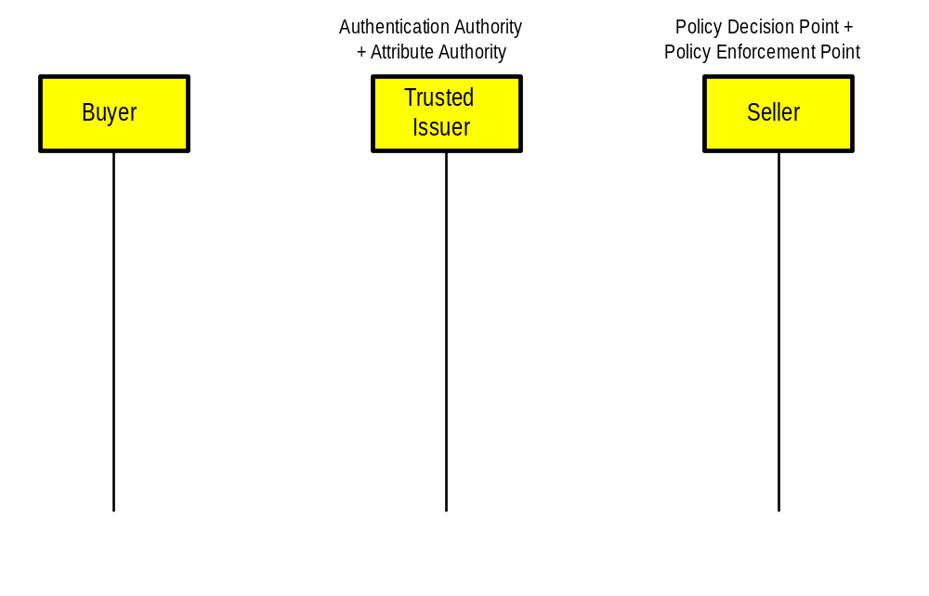
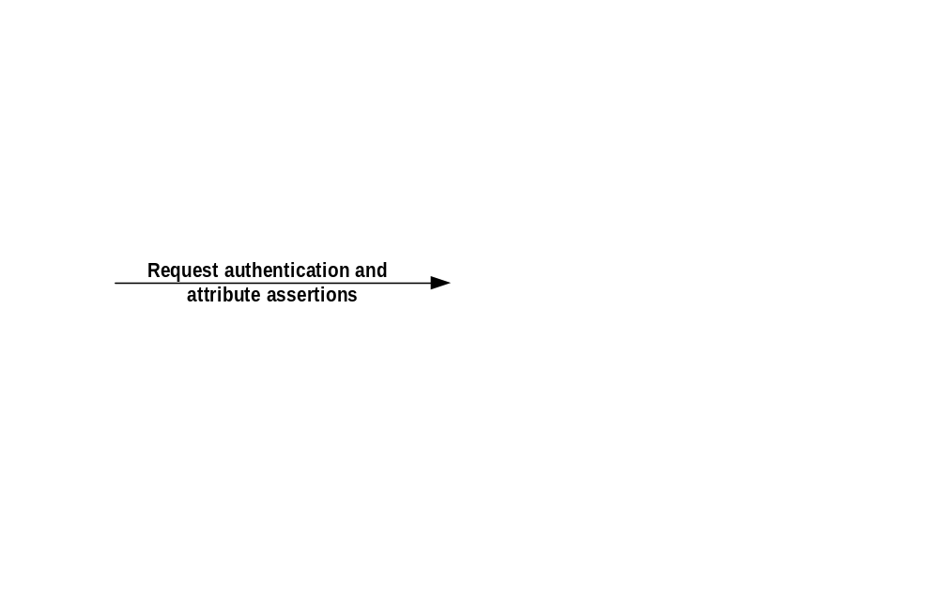
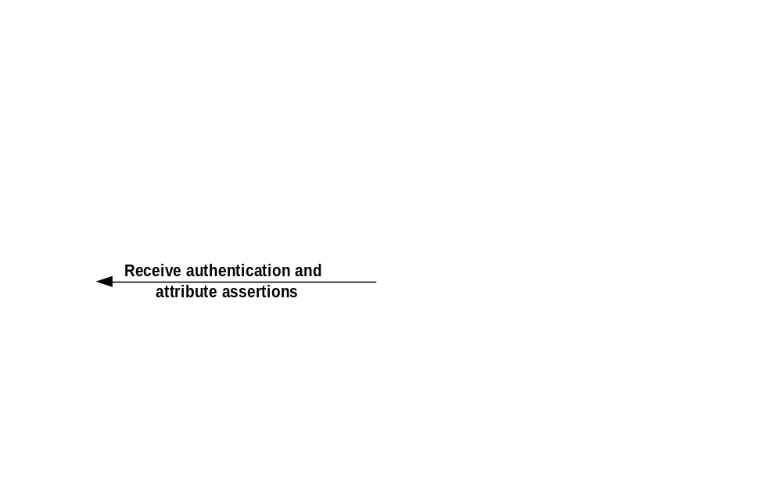
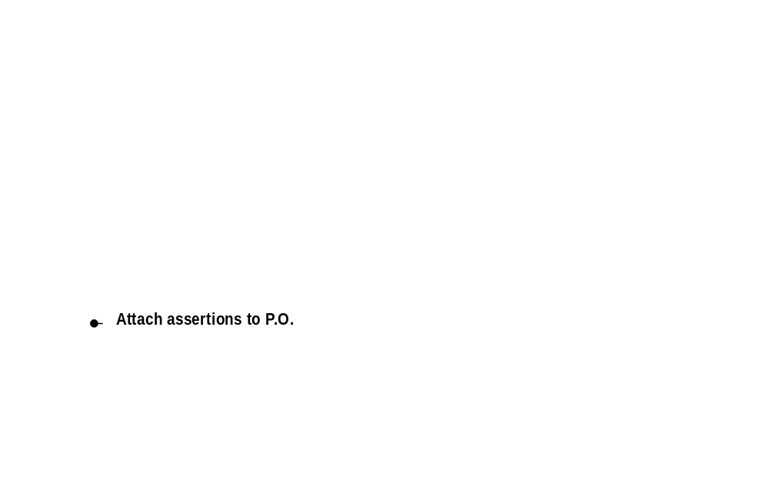
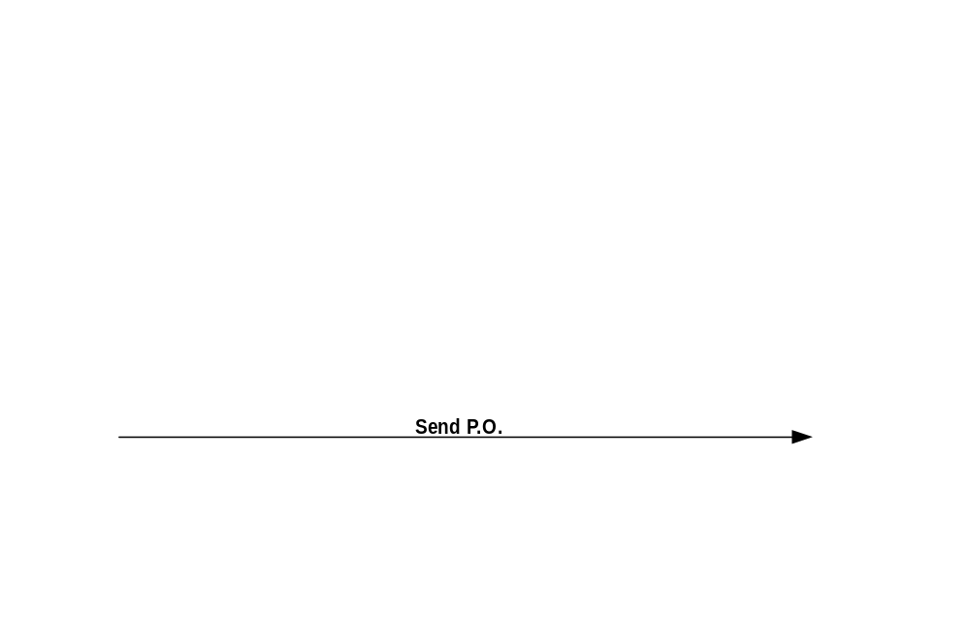
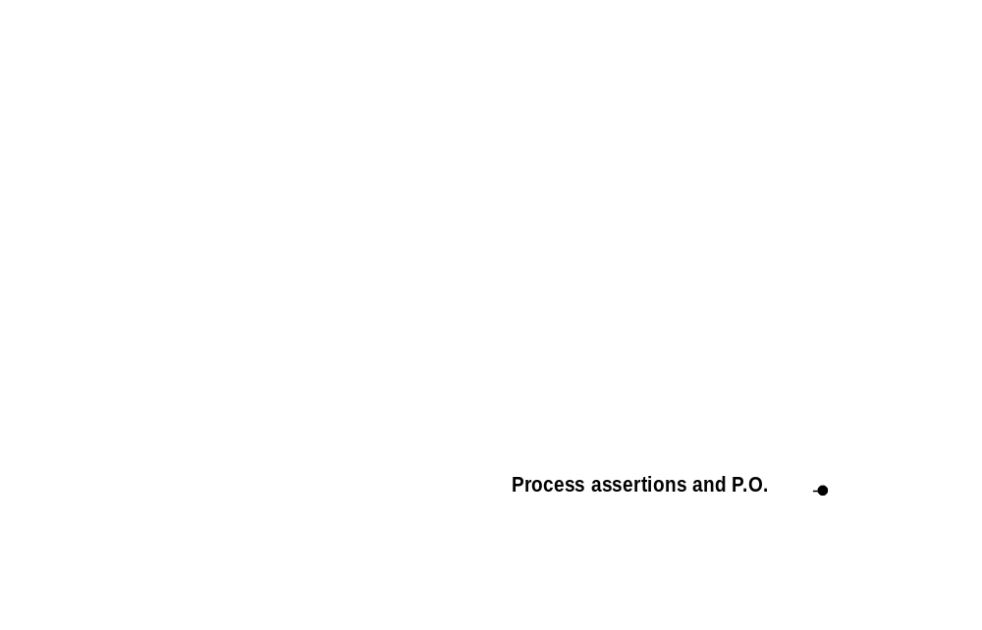
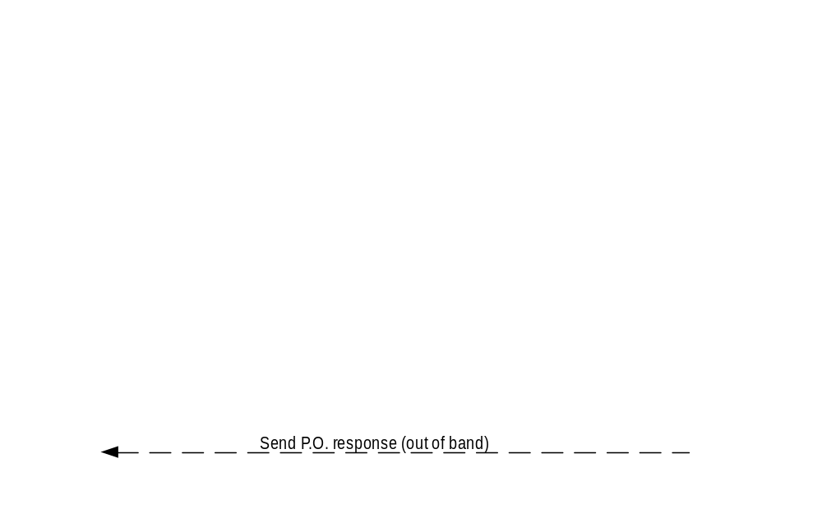
Back office transaction scenario
Notes:
This scenario has a different function and different players, but the flow is actually basically the same.
This time Joe User of SmithCo is trying to order some supplies from OfficeBarn. Joe knows about OfficeBarn, but OfficeBarn isn’t all that familiar with Joe.
The key here is that both Joe/SmithCo and OfficeBarn have an authentication/attribute authority that they’re both willing to trust.
Joe logs in.
He asks for and gets the assertions that say he’s logged in (authentication) and that he’s got a corporate spending limit of $500 (attribute).
These get attached to the purchase order he sends to OfficeBarn.
OfficeBarn looks everything over.
Then it acts appropriately.

Slide 45
More on the back office transaction scenario
An example of attaching SAML assertions to other traffic
Asymmetrical relationship is assumed
  Seller is already known to buyer, but buyer is not known to seller, a common situation
  E.g., server-side certificates might be used to authenticate seller
If it were symmetrical, additional SAML steps would happen on the right side too
  This would likely be a different scenario
Notes:
The typical business case is asymmetrical in that it involves (fewer) well-known sellers and many buyers, not all of whom have a direct relationship to the seller.
The symmetric case is a different business model. I send my RFQ (Request for Quote) with attached assertions to an aggregator who sends it out to many different business entities. The business entities respond with Quotations and include attached assertions to qualify and validate their quotations. I evaluate the returned Quotations and Assertions and choose a vendor.

Slide 46
Agenda
The problem space
SAML concepts
Walking through scenarios
Status of SAML and related standards efforts

Slide 47
SAML status
Work started on 9 January 2001
  From a base of S2ML and AuthXML
“Beta” specs are due by end of December
  “Core” assertion and protocol spec
  Bindings/profiles spec
  Conformance spec
  Security/privacy considerations spec
  Glossary
  www.oasis-open.org/committees/security/
Implementations are starting to appear
  JSAML Toolkit from Netegrity
  www.netegrity.com
Notes:
There are also two other useful documents:
Requirements and use cases
Domain model

Slide 48
Important efforts related to SAML
IETF/W3C XML Signature
  Built into SAML for digitally signing assertions
  www.w3.org/Signature/
W3C XML Encryption and Canonicalization
  Not quite ready yet, but encryption will be important
  www.w3.org/Encryption/2001/
XKMS and its relatives
  An XML-based mechanism for doing PKI
  SAML traffic might be secured by XKMS-based PKI, by other PKI, or by other means entirely
  www.w3.org/TR/xkms/

Slide 49
More efforts related to security and identity
OASIS XACML
  XML-based access control/policy language
  Could be the way PDPs talk to back-end policy stores
  www.oasis-open.org/committees/xacml/
OASIS Provisioning
  XML-based framework for user, resource, and service provisioning
  www.oasis-open.org/committees/provision/
Liberty Alliance
  Identity solution for SSO of consumers and businesses
  www.projectliberty.org
Internet2
  Higher-ed effort to develop advanced network applications and technologies
  http://www.internet2.edu/

Slide 50
Agenda
The problem space
SAML concepts
Walking through scenarios
Status of SAML and related standards efforts
Questions?

Slide 51
Thank you
Eve Maler
eve.maler@sun.com

