Slide 1
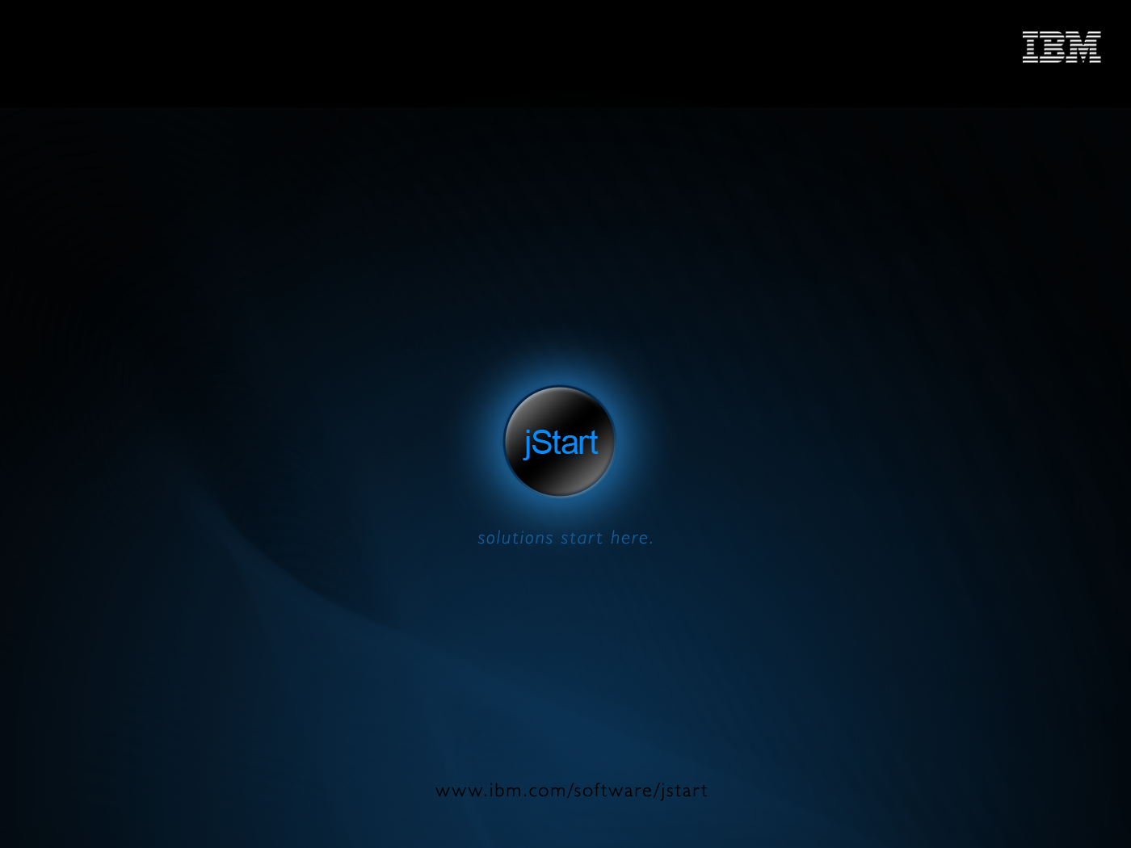

Slide 2
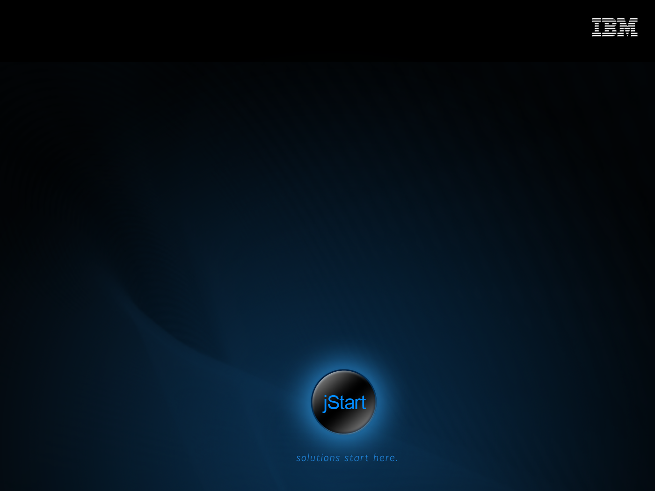
iWidgets development
How to create a widget
Vasyaichev Sergei
IBA Internet Technologies Department
SVasyaichev@gomel.iba.by

Slide 3
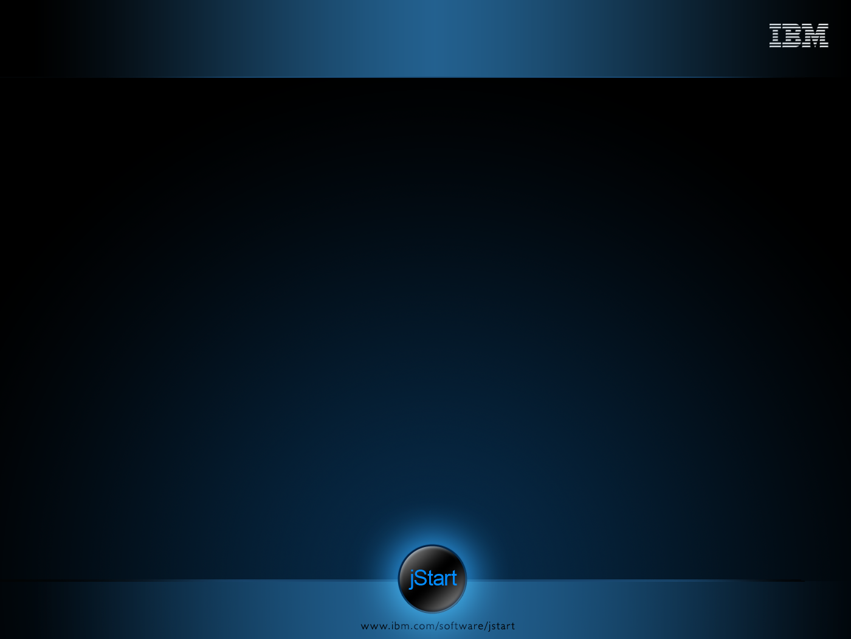
Agenda
Widget Overview
  Introduction to iWidgets
  iWidget Definition
  Widget Life Cycle
  Interaction with Other Widgets and data sources
Widget Development
  Sample iWidget
  Creating Vote iWidget
  Assembling a simple Mashup

Slide 4
Introduction to iWidgets
A widget is a small, portable application or a piece of dynamic content that can easily be placed into a Web page or an embedded browser within a rich client.
IBM iWidget Specification defines iWidget structure and semantics.
Technically iWidget consists of
  XML definition file
  JS file(s) with a widget class and executable code.
iWidgets are usually packages inside WAR files

Slide 5
iWidget Definition
The namespace in the first line indicates that this is a widget based on the IBM iWidget specification.
<iw:iwidget id="stock" xmlns:iw="http://www.ibm.com/xmlns/prod/iWidget" iScope="stock" supportedModes="view" mode="view edit" lang="en">
The itemSet tag sets a default attribute values for the widget. The id property with attributes value in the itemSet tag indicates that items defined within this tag are widget attributes.
<iw:itemSet id="attributes" private="true" onItemSetChanged="changeItemSet">
<iw:item id="company" value="IBM" />
<iw:item id="stock" value="105"/>
</iw:itemSet>
The event tag declares an event, which the widget can receive or send. Events are used to send data between widgets. Widgets should be wired together to send/receive data.
<iw:event id="location" description="locationDesc" published="true"/>
<iw:eventDescription id="locationDesc" payloadType=“string" description="" lang="en" />
<iw:event id="getData" eventDescName="gDesc" handled="true" onEvent="onGetData" />
<iw:eventDescription id="gDesc" payloadType=“string" description="Gets data.” lang="en" />

Slide 6
iWidget Definition
The resource tag specifies a shared resource (CSS, JS). In this example, the resource is a JavaSript (JS) file. This file may be shared across different widgets.
<iw:resource uri="stock.js" />
The content tag declares fragment with the HTML content needed for the widget presentation. The fragment marked as “view” is used for displaying the widget loaded for the first time. The fragment “edit” provides widget configuration dialog UI content.
<iw:content mode="view">
<![CDATA[
<div><span id="company" class="companyLabel">loading...</span> Stock Quote: <span id="stock">loading...</span></div>
]]>
</iw:content>
<iw:content mode="edit">
<![CDATA[ No Configure ]]>
</iw:content>

Slide 7
iWidget Definition
JS file is a place where widget behavior and lifecycle are implemented
dojo.declare("com.ibm.mm.eventpublisher.publisher",[com.ibm.mm.builder.widget.baseWidget, com.ibm.mm.builder.widgetAttributes],{
iWID: null,
onLoad: function() {
this.iWID = "_" + this.iContext.widgetId + "_";
},
sendData: function() {
console.warn("sendData");
var textArea = dojo.byId(this.iWID + "DataId");
console.debug("[" + textArea.value + "]");
this.iContext.iEvents.publishEvent("sendData", textArea.value);
}
});

Slide 8
Widget Life Cycle
onLoad
The onLoad event is invoked by the framework when the widget is fully loaded. The event can be used for the widget initialization.
onUnLoad
The onUnLoad event is distributed by the framework when a widget is unloaded from the page. The event can be used to release any resources that are managed by the widget.
onedit
The onedit event is fired when a widget configuration dialog is about to be displayed. The event can be used for the updating configuration dialog.
onview
The onview event is fired when the widget configuration dialog box is closed and as well as when the widget is placed on a page for the first time. This event can be used for updating widget content and/or applying new settings.

Slide 9
Interaction
Interaction with other iWidgets
  Widgets assembled in a mashup can send and receive events between each other. To interact, widgets should be wired.
Interaction with Data sources
  Widgets can receive/send data from/to external data sources such as web services, servlets and ATOM/RSS Feeds.

Slide 10
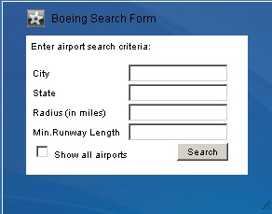
Sample iWidget
Let's use Boeing Search Form as a sample and see how it was implemented.
The Boeing Search Form iWidget can perform the following actions:
User can fill all required fields in the search criteria
Sends requests to an external data source for the data
Receives the data from the data source and forward it to other widgets

Slide 11
BoeingSearchForm.xml
<iw:iwidget name="BoeingSearchForm" xmlns:iw="http://www.ibm.com/xmlns/prod/iWidget" iScope="BoeingSearchForm“ allowInstanceContent="true" supportedModes="view edit" mode="view" lang="en">
<iw:resource uri="BoeingSearchForm.js" />
<iw:itemSet id="attributes" private="true"> <iw:item id="useLocalWeatherImg" value="true"/> </iw:itemSet>
<iw:event id="location" description="lDesc" published="true"/> <iw:eventDescription id="lDesc" payloadType="lInfo" description="" lang="en" />
<iw:event id="showAll" description="sDesc" published="true"/> <iw:eventDescription id="sDesc" payloadType="string" description="" lang="en" />
<iw:event id="runway" description="rDesc" published="true"/> <iw:eventDescription id="rDesc" payloadType="string" description="" lang="en" />
<iw:payloadDef name="lInfo">
<iw:payloadDef name="city" type="string" defaultValue="" description=""/>
<iw:payloadDef name="state" type="string" defaultValue="" description=""/>
<iw:payloadDef name="area" type="string" defaultValue="" description=""/>
</iw:payloadDef>

Slide 12
BoeingSearchForm.xml
<iw:content mode="view"> <![CDATA[
<div id="_IWID_boeingSearchForm"> <span>Enter airport search criteria:</span>
<table cellpadding="0" cellspacing="2" border="0">
<tbody><tr><td> <span>City</span> </td>
<td> <span><input type="text" id="_IWID_cityField"/><span> </td></tr>
…
</div>]]>
</iw:content>
<iw:content mode="edit"> <![CDATA[
<div id="_IWID_settingsDialog">
  <table><tr><td> <span>Use local weather images: </span></td>
  <td><span title="Local weather images enabled/disabled"><input type="checkbox" id="_IWID_useLocalWeatherImg"/></span></td>
  </tr><tr>
  <td colspan="2" align="right"><input type="button" onclick="iContext.iScope().save();" value="Save" /></td>
  </tr>
  </table></div>
]]>
</iw:content>
</iw:iwidget>

Slide 13
BoeingSearchForm.js
dojo.declare("BoeingSearchForm", null, {
defaultRadiusValue: 200,
geocodeUrl: "http://ws.geonames.org/search?maxRows=1&featureClass=P&q=",
  onLoad: function() {
    this.id = "_" + this.iContext.widgetId + "_";
    var logoImage = dojo.byId(this.id + 'logoImage');
    logoImage.src = ibmConfig.contextRoot + '/com.ibm.cit.was.boeing/images/neoIcon.png';
  },
  onedit: function(){
  var attributesSet = this.iContext.getiWidgetAttributes();
  var useLocalWeatherImg = attributesSet.getItemValue("useLocalWeatherImg");
  var useLocalWeatherImgCheckbox = dojo.byId(this.id + 'useLocalWeatherImg');
  useLocalWeatherImgCheckbox.checked = true;
  },
  onview: function() { },
  onUnLoad: function() { },
  save: function() {
  var attributes = this.iContext.getiWidgetAttributes();
  attributes.setItemValue("useLocalWeatherImg",useLocalWeatherImg.checked);
  attributes.save();
  },

Slide 14
BoeingSearchForm.js
  searchAirports: function() {
  var city = dojo.string.trim(dojo.byId(this.id + "cityField").value);
  var radius = dojo.string.trim(dojo.byId(this.id + "radiusField").value);
  var state = dojo.string.trim(dojo.byId(this.id + "stateField").value);
  this.getGeocode(city + " " + state);
  },
  getGeocode: function(address) {
  var lat,lon, urlValue = this.geocodeUrl + escape(address);
  var bindArgs = {
  url: urlValue, load: dojo.hitch(this,"geocodeCallBack"),
  error: function(error,ioArgs){alert('Error ' + error.message);}
  }
  dojo.xhrGet(bindArgs);
  },
  geocodeCallBack: function(data, ioArg) {
  var lon = data.substring(lonStart, lonEnd), lat = data.substring(latStart,latEnd);
  var lonlat = {"longitude" : lon, "latitude": lat};
  this.createOverlay(lonlat);
  },
  …
});

Slide 15
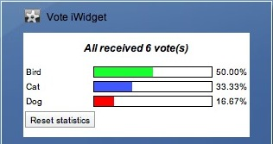
Creating Vote iWidget
Let’s create a Vote widget that will:
Collect votes
Display vote results

Slide 16
Summary
IBM iWidget Specification defines iWidget structure and semantics;
iWidget implementation normally consists of an XML definition file and a JavaScript file with classes and functions that define the widget behavior;
iWidgets use events to interact with each other. iWidgets can also talk to external data sources;
Wiring iWidgets into Mashups can further increase iWidget usefulness and reveal new usages of these iWidgets;
Eclipse IDE can be used to develop new iWidgets.

Slide 17
Thank You.
Visit Us Today At:
www.ibm.com/software/jstart

