Slide 1
Web Services and
Service-Oriented Architecture
Dickson K.W. Chiu
PhD, SMIEEE
Thanks to Prof. SC Cheung (HKUST)
Dr. Patrick C.K. Hung (UOIT)
Reference: Erl 2006, Service-Oriented Architecture: Concepts, Technology, and Design, Prentice Hall.

Slide 2
Learning Objectives
To understand the basics of Web services and SOA
To understand potential applications of Web services and SOA in e-business and enterprise computing, in particular, for business process integration
To know the some technological details of SOA: UDDI, WSDL, and SOAP

Slide 3
3.1 What is Web Service and SOA?

Slide 4
New Age of Distributed Computing
Convergence of two technologies
The Web:
  Universal communication
  HTTP, XML
Service-oriented computing:
  Exposing data and business logic through a programmable interface
  EJB, RPC, RMI, CORBA, DCOM

Slide 5
What is SOA?
Contemporary Service-Oriented Architectures (SOA) represents an architecture that promotes service-orientation through the use of Web services.
All functions, or services, are defined using a description language and have invokable interface that are called to perform business processes.

Slide 6
What is a Web Service?
W3C: “The World Wide Web is more and more used for application to application communication. The programmatic interfaces made available are referred to as Web services”
  http://www.w3.org/2002/ws/
A Web service is a software system designed to support interoperable machine-to-machine interaction over a network.
It has an interface described in a machine-processable format (specifically WSDL).
Other systems interact with the Web service in a manner prescribed by its description using SOAP messages, typically conveyed using HTTP with an XML serialization in conjunction with other Web-related standards.”
http://www.w3.org/TR/ws-arch/

Slide 7
Key features of Web Services
A modular, well-defined, encapsulated function
Used for loosely coupled integration between applications or systems
Based on XML, transported in two forms:
  Synchronous (RPC)
  Asynchronous (messaging)
  Both over Simple Object Access Protocol (SOAP)
Specified in Web Services Description Language (WSDL)
Sometimes advertised and discovered in a service registry – Universal Description, Discovery and Integration (UDDI)
Over Intranet and Internet

Slide 8
Use of SOA and Web Services
Facilitates:
  Marketing efforts
  E-Commerce
  Personalization
  Direct services to end users
Strategies:
  Focus now on partnerships
  Integration
  Direct communication
  Automating processes across organizational boundaries
Notes:
The Web services market is expected to grow to USD$28 billion in sales in the coming three years.
Ref: HOLLAND, P. 2002. Building Web Services From Existing Application. eAI Journal, September 2002, 45-47.
Early adopters of Web services may include several industries that involve a set of diverse trading partners working closely together in a highly competitive market:
Insurance Services
Financial Services
High-tech Services
Ref: RATNASINGAM, P. 2002. The Importance of Technology Trust in Web Services Security. Information Management & Computer Security, vol. 10, no. 5, 255-260.

Slide 9
3.2 Potentials of SOA for e-Business

Slide 10
Expected Potentials of SOA
The Web services market is expected to grow to USD$28 billion in sales in the coming three years.
  HOLLAND, P. 2002. Building Web Services From Existing Application. eAI Journal, September 2002, 45-47
Early adopters of Web services may include several industries that involve a set of diverse trading partners working closely together in a highly competitive market:
  Insurance Services
  Financial Services
  High-tech Services
  Ref: RATNASINGAM, P. 2002. The Importance of Technology Trust in Web Services Security. Information Management & Computer Security, vol. 10, no. 5, 255-260.
Enterprise internal integration

Slide 11

For Sharing Data in e-Business
Sharing Data with Partners
  FTP processes
  Emails
  Post & Retrieve Processes
Issues
  Usually Manual
  Multiple transfers not transactional
Here is a purchase
order for you to process…
XML
  Open Standard
  unanimous support from vendors
  Easy to work with
  Many tools available
Retailer
Supplier
Here is an invoice for the goods supplied
XML document exchange

Slide 12
Problems for Sharing Applications
Issues
  Complex, Custom, One-off Solutions
  Proprietary end points
  Not scalable
Sharing processes
EAI - Enterprise Application Integration
Not just integration, but interaction
What’s the product lead time?
Retailer
Supplier
3 Days
(for just the answer!!!)

Slide 13
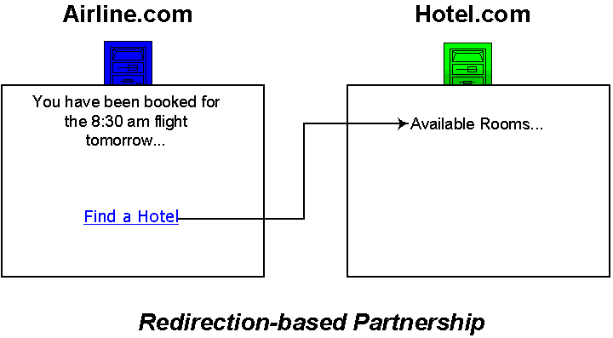
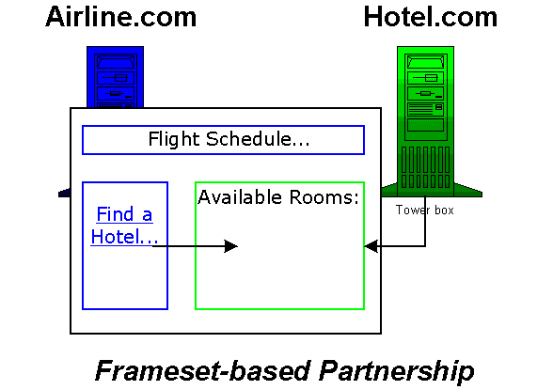
Sharing Applications
Common Approaches via the Web
  Hyper-links
  Frames

Slide 14
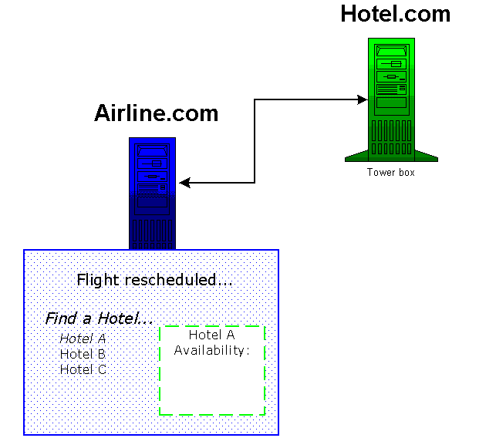

Web Service Based Integration
Applications consuming processes on external systems
Presenting one view to users

Slide 15
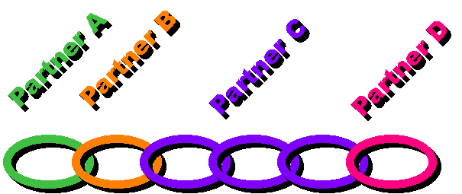
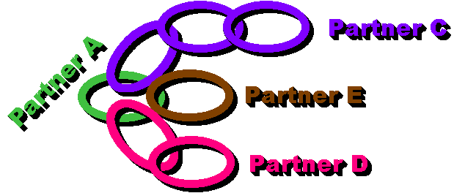
Web Service Aggregation
Partners working together
Service Aggregation / Composition
Can work together in different ways
Support workflow/business processes

Slide 16
Major Benefit of Web Services for e-Business
A major drawback of traditional business-to-business (B2B) applications is that setting up an additional connection with another trading partner is costly and time consuming.
The benefits of adopting SOA:
  Faster time to production
  Convergence of disparate business functionalities
  A significant reduction in total cost of development
  Easy to deploy business applications for trading partners
Ref: RATNASINGAM, P. 2002. The Importance of Technology Trust in Web Services Security. Information Management & Computer Security, vol. 10, no. 5, 255-260.

Slide 17
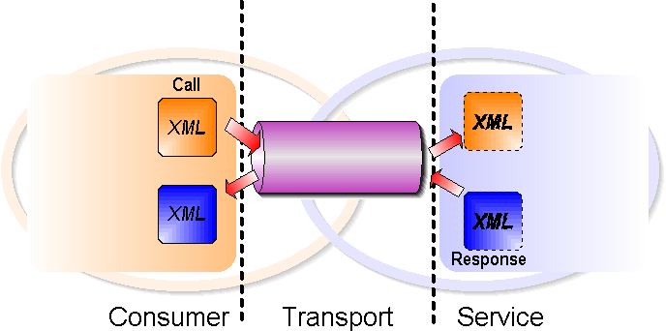
SOA Communication Overview
Communication via existing Internet Protocols and XML
Simple Object Access Protocol (SOAP)
SOAP

Slide 18
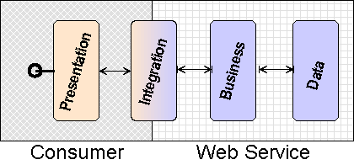
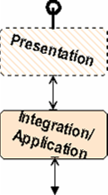
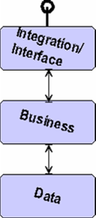
SOA Application – 2 Partners
Two Partners Scenario
  Application (Consumer)
  Web Service (Provider)
Web Service Side
  Interface
  Business Logic
  Data
Consumer Side
  Presentation
  Application

Slide 19
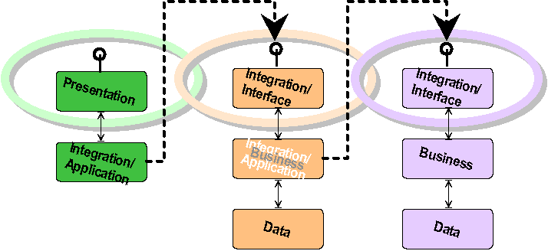
SOA Application – 3 Partners
Three partners scenario
One client application
Two Web services, one references the other

Slide 20

Order Placement
Discount
Calculation
Order
Placement
Tax
Calculation
Shipping
Calculation
Supporting services may reside
somewhere else,
provided by someone else

Slide 21

Information Integration
This is a scenario similar to your assignment…
Financial
Instrument
Mortgage
Quote
Financial
Instrument
Financial
Instrument
New services offering
different features can
be added as needed

Slide 22
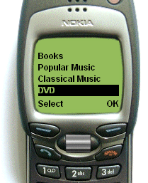
Wireless Consumer Service
PIM
Wireless
Web
Service
CRM
ERP
PIM – Personal Information Management
CRM – Customer Relationships Management
ERP – Enterprise Resources Planning
Notes:
PIM – Personal Information Management

Slide 23
3.2 SOA Technology Overview

Slide 24
SOA Technologies
UDDI
Registry
WSDL
Points to description
Points to service
Describes
Service
Finds
Service
Service
Consumer
Web
Service
SOAP
Communicates with
XML Messages

Slide 25
The Web Services Trinity
A Contract Definition Language
  Web Service Description Language (WSDL).
  De Facto standard.
Standardized Look-up
  Universal Description Discovery and Integration (UDDI)
Interoperability standards
  Simple Object Access Protocol (SOAP).
Publish/Find/Bind - Web Services are published and located via the UDDI, they are described using WSDL and are invoked using SOAP over HTTP
Demo: http://www.soapclient.com/

Slide 26
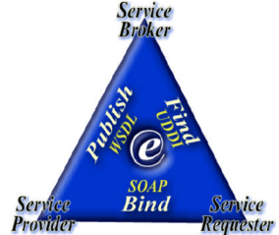
Publish/Find/Bind Model
  The service provider publishes its service(s) to a service registry such as UDDI in the form of a WSDL document.
  The service requestor finds services for consumption via service registries and this process is also called “service discovery.”
  Once the service requestor has acquired the service information, it can attempt to bind to the service and use it.
Adapted from Mohen, C. (2002). “Tutorial: Application Servers and Associated Technologies,”
ACM SIGMOD International Conference on Management of Data (SIGMOD'02), Madison, USA, June 2002.

Slide 27




Use of SOA
Publishing of business functions by means of API
Web pages for humans (B2C)
Web services for program to program (B2B)
Bank
Get Quote
E-Retailer
Logistics Company
Reservation
Internet
Supplier
A programmable application component accessible via standard Web protocols
Purchase
Order
Buyer

Slide 28
More SOA Scenario
Logistic
Company
Bank
Web Service
Shipping Order
J2EE
COM
Web Service
Credit Card Check
Internet
SOAP
SOAP
SOAP
Shop
Application
RPC
Web Service
Order Fulfillment
Web Service
E-Retailer
Supplier
Notes:
These applications at a bank, a logistic company and a supplier all use different protocols for communication between application components.
The shop application at the E-Tailer needs functions from all these applications. With traditional middleware the shop application would have to talk CORBA IIOP to the bank application, DCOM to the logistics application, and a propiretary RPC protocol to the supplier's application. Making the required applications' functions available as web services allows the E-Tailer's shop application to access these various services via the Internet using standard protocols like HTTP and SOAP (Simple Object Access Protocol). The web service handlers within the individual organizations are responsible for transforming the SOAP request into the according protocol that the application function that implements the service understands.

Slide 29
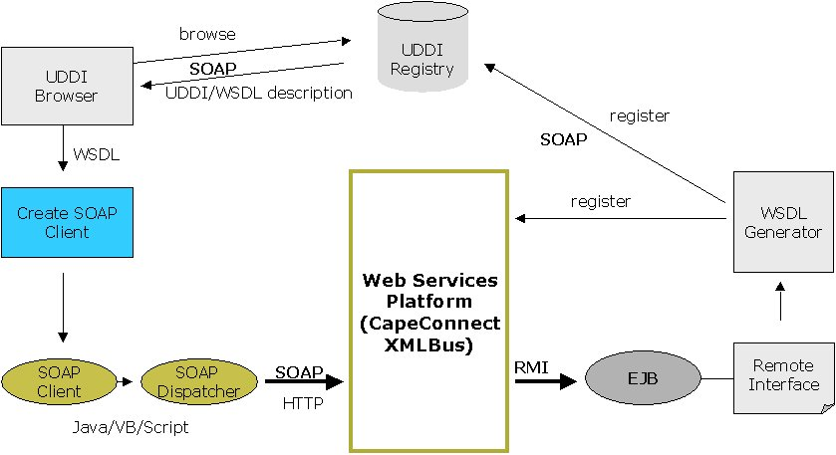
SOA Communication Infrastructure
Reproduced with the kind permission of John McGuire Cape Clear Software
Web Service Broker
Discover Service
Publish Service Description
Web
Service
Requester
Get Service Description
Use Service based on
Service Description
Web Service Provider
Notes:
See also: WSA from W3C: Figure 1-1 http://www.w3.org/TR/2004/NOTE-ws-arch-20040211/

Slide 30
Traditional RPC vs Web Services
Traditional RPC
Within enterprise
Tied to a set of programming languages
Procedural
Usually bound to a particular transport
Tightly-coupled
Firewall-unfriendly
Efficient processing
Web Services
Between enterprises
Program language independent
Message-driven
Easily bound to different transports
Loosely-coupled
Firewall-friendly
Relatively not efficient processing

Slide 31
Web Applications vs Web Services
Web Application
User-to-program interaction
Static integration of components
Monolithic service
Ad hoc or proprietary protocol
Web Services
Program-to-program interaction
Dynamic integration of components
Service aggregation
Interoperability

Slide 32
SOA Favorable Properties
Loosely-coupled: Web services can run independently of each other on entirely different implementation platforms and run-time environments.
Encapsulated: The only visible part of a Web service is the public interface, e.g., WSDL and SOAP.
Standard Protocols and Data Formats: The interfaces are based on a set of standards, e.g., XML, WSDL, SOAP, UDDI and etc.
Invoked Over Intranet or Internet: Web services can be executed within or outside the firewall.
Components: The composition of Web services can enable business-to-business transactions or connect the internal systems of separate companies, such as workflow. Workflow is a computer supported business process.
Business Oriented: Web services are not end-user software!

Slide 33
Why SOA? - Summary
SOA allows us to share processes over the Internet
  independent of platform, tools, or technology
  Anyone, anywhere, any device, anytime
It is a better integration solution for process sharing
  Applications become services
  Services are accessible
  Services enable integration
    EAI
    B2B
It will create new business models that we have yet to conceive
Services can be assembled and reused
  Based on open standards: XML and SOAP
  “Plug and Play” applications
  Delivering on the age-old promise of reusability
Notes:
Add these points:
Properties of Web Services:
Loosely-coupled: Web services can run independently of each other on entirely different implementation platforms and run-time environments.
Encapsulated: The only visible part of a Web service is the public interface, e.g., WSDL and SOAP.
Standard Protocols and Data Formats: The interfaces are based on a set of standards, e.g., XML, WSDL, SOAP, UDDI and etc.
Invoked Over Intranet or Internet: Web services can be executed within or outside the firewall.
Components: The composition of Web services can enable business-to-business transactions or connect the internal systems of separate companies, such as workflow. Workflow is a computer supported business process.
Business Oriented: Web services are not end-user software!

Slide 34
3.3 WSDL

Slide 35
WSDL - Web Services Description Language
In the format of XML document
Describes a Web Service
  What it does
  How to communicate with it
  Where to find it
Invented by Ariba, IBM, Microsoft
  Version 1.1 to W3C, March 2001
  The intent was to create something that worked
  Extensible - not something complete
  Creating a formal Web Services “data model” was not a priority
W3C standardization (to version 2.0) in progress
  http://www.w3.org/2002/ws/
Example tool support: XMLspy
Tutorial: http://www.w3schools.com/wsdl/default.asp

Slide 36
Elements in WSDL Definitions
Types
  Based on XML Schema type system
Message formats
  Parts represent method parameters
Port Types
  Set of operations
  Parameter order
  Input and output messages
Bindings
  Map a Port Type to a specific protocol, using a specific data encoding style
Services
  Set of ports that implement port types
  Access point for each port

Slide 37
WSDL – An Example
<definitions>
<types> <!-- XML Schema --> </types>
<message name=“getQuoteRequest” />
<message name=“getQuoteResponse” />
<portType name=“StockQuoteServiceInterface”>
<operation name=“getQuote”>
<input message=“getQuoteRequest” />
<output message=“getQuoteResponse” />
</operation>
</portType>
<binding name=“StockQuoteServiceBinding” type=“StockQuoteServiceInterface”>
<soap:binding transport=“http://schemas.xmlsoap.org/soap/http” />
…
</binding>
<service name=“StockQuoteService”>
<port name=“StockQuoteServicePort” binding=“StockQuoteServiceBinding”>
<soap:address location=“http://www.acme.com/services/stockquote” />
</port>
</service>
</definitions>
Definition of data types
Definition of messages
Definition of port type
Definition of the bindings
Definition of the service

Slide 38
3.4 UDDI

Slide 39
UDDI
Universal Description, Discovery and Integration
Registry for Web services
Similar to CORBA’s Naming Service or Java’s JNDI
Has a Web Services API for publishing and discovering the existence of Web services
A registry where you find a Web service and its description (WSDL)
  Search by business
  Search by service type
A coalition of organizations working together to manage UDDI registries and to further develop the Web Services API for accessing those registries.
  Joint Initiative –uddi.org
  By Ariba Inc., IBM Corp. and Microsoft Corp.
  An open uddi community to support the development of uddi
  UDDI Business Registries: Microsoft, IBM, SAP, NTT-Com
  Test UBR nodes: Microsoft, IBM, SAP

Slide 40
UDDI Advantages
Making it possible to discover the right business from the millions currently online
Defining how to enable commerce once the preferred business is discovered
Reaching new customers and increasing access to current customers
Expanding offerings and extending market reach
Solving customer-driven need to remove barriers to allow for rapid participation in the global Internet economy
Describing services and business processes programmatically in a single, open, and secure environment

Slide 41




How UDDI Works
4.
1.
SW companies, standards bodies, and programmers populate the registry with
descriptions of different types of services
Marketplaces, search engines, and business apps query the registry to discover services at other companies
2.
UDDI Business Registry
Business
Registrations
5.
Businesses populate
the registry with
descriptions of the services they support
3.
Assigns a unique identifier to each business registration
Business uses this data to facilitate easier integration with each other over the Web

Slide 42

UDDI Implementation
Manufacturers
UDDI Business Registry
Programmatic descriptions of
web services
Programmatic descriptions of businesses and the services they support
Programming model, schema,
and platform agnostic
Uses XML, HTTP, and SOAP
Flower Shops
Marketplaces

Slide 43

UDDI Business Registration
Businesses register public information about themselves
“White pages”
  including address, contact and known identifiers
“Yellow pages”
  including industry categories, based on standard taxonomies
“Green pages”
  technical information about the services exposed by the business
White
Pages
Yellow
Pages
Green
Pages

Slide 44
White Pages
Business Name
Text Description
  list of multi-language text strings
Contact info
  names, phone numbers, fax numbers, web sites…
Known Identifiers
  list of identifiers by which a business may be known, such as PCCW, DHL, IBM, HP, other

Slide 45
Yellow Pages
Business categories
3 standard taxonomies in V1
  Industry: NAICS (Industry codes - US Govt.)
  Product/Services: UN/SPSC (ECMA)
  Location: Geographical taxonomy
Implemented as name-value pairs to allow any valid taxonomy identifier to be attached to the business white page

Slide 46
Green Pages - Background
Emerging B2B applications increase the need for sharing and coordinating the use of Web services for different business processes in a loosely coupled execution environment.
A business process contains a set of activities which represent both business tasks and interactions between Web services.
In the past few years, business process or workflow proposals relevant to Web services are proposed and discussed in the business and academic world.
  Ref: www.w3c.org
All of the proposed XML languages are based on WSDL service descriptions with extension elements:
  Web Services Flow Language (WSFL) and Web Services Endpoint Language (WSEL)
  XLANG
  Business Process Execution Language for Web Services (BPEL4WS)
  ebXML…

Slide 47
Green Pages
A set of detailed technical information that describes how to “do e-commerce” with each company
Nested model
  Business processes (BPEL4WS)
  Service descriptions (WSDL)
  Binding information
Programming/platform/implementation agnostic
Services can also be categorized

Slide 48
Business Registration
Contact
XML document
Created by end-user company (or on their behalf)
Can have multiple service listings
Can have multiple taxonomy listings
Contact
businessEntity
Phone
Address
Email
Phone
Address
Email
businessKey
name
URL
description
contacts
businessServices
identifierBag
categoryBag
businessService
businessService
serviceKey
tModelKey
Name
Description
BindingTemplates
Key
Name
Description
BindingTemplates
keyedReference
keyedReference
tModelKey
keyName
keyValue
keyedReference
tModelKey
keyName
keyValue
keyedReference
tModelKey
keyName
keyValue
tModelKey
keyName
keyValue

Slide 49
Example of a Registration
Peter Smythe
businessEntity
872-6891
4281 King’s Blvd, Sydney, NSW
Peter@harbourmetals.co.au
TB993…
Harbour Metals
www.harbourmetals.co.au
“Serving Inner Sydney Harbour for …
contacts
businessServices
identifierBag
categoryBag
businessService
businessService
23T701e54683nf…
Online catalog
“Website where you can …
BindingTemplates
Key
Name
Description
BindingTemplates
BindingTemplate
keyedReference
5E2D412E5-44EE-…
http://www.sydneynet/harbour…
tModelInstanceDetails
EE123…
NAICS
02417
keyedReference
DFE-2B…
DUNS
45231
tModelInstanceInfo
4453D6FC-223C-3ED0…
http://www.rosetta.net/catalogPIP
tModelKeys

Slide 50
Business Service XML
<businessService businessKey="..." serviceKey="...">
<name>StockQuoteService</name>
<description> (...) </description>
<bindingTemplates>
(...)
<bindingTemplate>
(...)
<accessPoint urlType="http">
http://example.com/stockquote
</accessPoint>
<tModelnstanceDetails>
<tModelnstanceInfo tModelKey="..."> </tModelnstanceInfo>
<tModelnstanceDetails>
</bindingTemplate>
</bindingTemplates>
</businessService>

Slide 51
tModel XML
<tModel authorizedName="..." operator="..." tModelKey="...">
<name>StockQuote Service</name>
<description xml:lang="en">
WSDL description of a standard stock quote service interface
</description>
<overviewDoc>
<description xml:lang="en"> WSDL source document.</description>
<overviewURL> http://stockquote-definitions/stq.wsdl</overviewURL>
</overviewDoc>
<categoryBag>
<keyedReference tModelKey="UUID:...“ keyName="uddi-org:types"
keyValue="wsdlSpec"/>
</categoryBag>
</tModel>

Slide 52
Registry Operation
Peer nodes (websites)
Companies register
with any node
Registrations replicated
on a daily basis
Complete set of
“registered” records
available at all nodes
Common set of
SOAP APIs supported
by all nodes
Compliance enforced by
business contract
queries
IBM
Ariba
other
UDDI.org
other
Microsoft

Slide 53
3.5 SOAP

Slide 54

SOAP
Simple Object Access Protocol
  Standard object invocation protocol
  Peer-to-peer interaction in a distributed environment
  Built on HTTP and XML standards
  Unprecedented support
  platform and language independent
  Simple and extensible
  Allows you to get around firewalls
Tutorial: http://www.w3schools.com/soap/default.asp
SOAP 1.2
  http://www.w3.org/2000/xp/Group/

Slide 55
Why SOAP?
It is important for application development to allow Internet communication between programs.
Today's applications communicate using Remote Procedure Calls (RPC) between objects like DCOM and CORBA, but HTTP was not designed for this. RPC represents a compatibility and security problem; firewalls and proxy servers will normally block this kind of traffic.
A better way to communicate between applications is over HTTP, because HTTP is supported by all Internet browsers and servers. SOAP was created to accomplish this.
HTTP is a common binding transport protocol for SOAP nowadays
SOAP provides a way to communicate between applications running on different operating systems, with different technologies and programming languages.

Slide 56
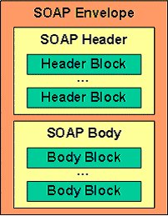
SOAP Message Structure
Soap Message Structure
  Envelope - defines an overall framework for expressing what is in a message; who should deal with it, and whether it is optional or mandatory
  Header (optional)
  Body - contains call and response information
  Fault element in body - provides information about errors that occurred while processing the message
Mechanism to send XML messages
  Consistent envelope - Header and body
  Consistent data encoding - Based on XML Schema type system
  Protocol binding framework
SOAP encoding rules - defines a serialization mechanism that can be used to exchange instances of application-defined objects
Provides the interface to a Web Service
  Document style
  RPC style

Slide 57
SOAP Skeleton in XML
<?xml version="1.0"?>
<soap:Envelope xmlns:soap="http://www.w3.org/2001/12/soap-envelope"
soap:encodingStyle="http://www.w3.org/2001/12/soap-encoding">
<soap:Header>
...
</soap:Header>
…
<soap:Body>
...
<soap:Fault>
...
</soap:Fault>
</soap:Body>
</soap:Envelope>

Slide 58
SOAP HTTP Binding – Request Example
POST /InStock HTTP/1.1
Host: www.stock.org
Content-Type: text/xml; charset="utf-8"
Content-Length: nnn
SOAPAction: "Some-URI"
<?xml version="1.0"?>
<soap:Envelope xmlns:soap="http://www.w3.org/2001/12/soap-envelope"
soap:encodingStyle="http://www.w3.org/2001/12/soap-encoding">
<soap:Body xmlns:m="http://www.stock.org/stock">
<m:GetStockPrice>
<m:StockName>IBM</m:StockName>
</m:GetStockPrice>
</soap:Body>
</soap:Envelope>
Note: blank line

Slide 59
SOAP HTTP Binding – Response Example
HTTP/1.1 200 OK
Content-Type: text/xml; charset="utf-8"
Content-Length: nnn
<?xml version="1.0"?>
<soap:Envelope xmlns:soap="http://www.w3.org/2001/12/soap-envelope"
soap:encodingStyle="http://www.w3.org/2001/12/soap-encoding">
<soap:Body xmlns:m="http://www.stock.org/stock">
<m:GetStockPriceResponse>
<m:Price>34.5</m:Price>
</m:GetStockPriceResponse>
</soap:Body>
</soap:Envelope>
Note: blank line

Slide 60
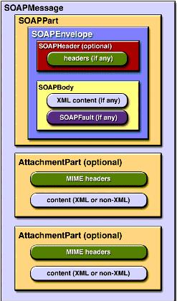
SOAP with Attachment
A SOAPMessage object may have one or more attachments.
Each AttachmentPart object has a MIME header to indicate the type of data it contains.
It may also have additional MIME headers to identify it or to give its location, which can be useful when there are multiple attachments.
When a SOAPMessage object has one or more AttachmentPart objects, its SOAPPart object may or may not contain message content.
See: http://www.w3.org/TR/2002/WD-soap12-af-20020924/

Slide 61
SOAP Communications for SOA
Internet
Partner
BearCom
Listener
Stub
Client
Proxy
Web Service
Request For WSDL (if not having that or unsure)
WSDL
SOAP Request (In)
SOAP Response (Out)

Slide 62
Positioning with Other Technologies
Compatible with/complimentary to:
  J2EE
  CORBA
  Web servers
  Application servers
  Legacy applications
  Rules engines
SOAP provides a new interface to existing systems

Slide 63
Resources
Many SOAP implementations and tools
  See www.soapware.org
www.w3.org
  Specifications (XML, XSL, DOM)
www.xml.org
msdn.microsoft.com/xml
www.alphaworks.ibm.com
www.develop.com/soap
www.uddi.org
…

Slide 64
Conferences
The lecturer has served in the program committee of these related conferences:
IEEE International Conference on Web Services (ICWS)
IEEE International Conference on Services Computing (SCC)
IEEE International EDOC Conference
IEEE International Conference on E-commerce Technology (CEC)
IEEE International Conference on e-Technology, e-Commerce and e-Service (EEE)

Slide 65
3.6 Summary and Outlook

Slide 66
Status of SOA and Web Services
Technology/Standards are still evolving
  SOAP, WSDL, UDDI are not enough
Business Web services is the next big thing, but more works are needed in
  Quality of Service, management
  Security, transaction, state, and user context
  Workflow, Identity management, Provisioning, Accounting
Will be adopted in phases
  1st phase (current state) - Concerted deployment internally within an organization, mainly for interoperability
  2nd phase - Selective and non-aggregate deployment with trusted outside business partners (Private registry deployment)
  3rd phase - Wider, more dynamic and aggregate deployment with outside business partners (Public registry deployment)

Slide 67
What’s Next?
Vendor Strategies
  Must work together
  Only efficient if everyone agrees how to do this
Grid Computing
  application layer semantics and standards
  See: http://www-1.ibm.com/grid/
Autonomous Computing (Is this IBM’s dream???)
  Flexible. The system will be able to sift data via a platform- and device-agnostic approach.
  Accessible. The nature of the autonomic system is that it is always on.
  Transparent. The system will perform its tasks and adapt to a user's needs without dragging the user into the intricacies of its workings.
  See: http://www.research.ibm.com/autonomic/
Hot research area
Small gap between research and practice

