Slide 1


CitiusTech
CLINICAL NOTE TRIAGE PRIORITY — TF-IDF
NLP-Based Urgency Classification for Urgent Care Intake Notes
Gen AI Academy | CitiusTech
Team
Omkar Satardekar | Riya Davis
Saurabh Singh | Shubham Sahu

Slide 2

CitiusTech
01
Problem Statement & Solution
Why first-come, first-served triage falls short, and our NLP approach
02
Dataset
2,100 synthetic intake notes with realistic text variations
03
ML Pipeline & Preprocessing
Agenda
Three models and the 8-step cleaning pipeline
04
Audit Trail & TF-IDF Features
From the triage problem to a deployed priority classifier.
Cleaned data, preprocessing audit and TF-IDF vectorizer
05
Model Development
TF-IDF + Logistic Regression, Naive Bayes, and TF-IDF + Vitals
06
Evaluation & Results
Held-out test performance and High-class recall
07
Inference & Deployment
Inference pipeline, FastAPI backend and Streamlit UI
08
Conclusion
Key takeaways

Slide 3

PROBLEM STATEMENT
  The existing triage queue follows a first-come, first-served approach, which may not always prioritize patients based on the urgency of their condition.
  Urgent care centers receive a large volume of free-text nurse intake notes with abbreviations, voice-to-text errors, repeated words, and other variations, making it difficult to quickly identify patients who need immediate attention.
OUR SOLUTION
  We built an NLP-based system that reads the nurse intake note and classifies it into three priority levels: High, Medium, or Low.
  The system uses TF-IDF along with patient vitals to help identify urgent cases and move them higher in the queue, while the final decision remains with the healthcare professional.
CitiusTech
| 3

Slide 4
Dataset
(Synthetic Clinical Note Dataset)
  The dataset intentionally includes real-world text variations that the preprocessing pipeline must handle:
Dataset Size
    Clinical abbreviations — c/o, hx, w/o, SOB, N/V, yo
    Voice-to-text fillers — um, uh
    Repeated/stuttered words
    Clinical spelling errors — e.g. anaphylaxsis
    Fixed EHR boilerplate
    Prior triage/leakage phrases
    Numeric vital signs — BP, HR, Temperature, SpO₂
    Typed and voice-to-text capture styles
    Notes of different lengths and writing styles
Priority Class | Records
🔴 High | 700
🟠 Medium | 700
🟢 Low | 700
Class distribution: Balanced — 33.3% each
label: Sample Raw Clinical Intake Notes
CitiusTech
| 4

Slide 5
Clinical Note Triage — ML Pipeline
Raw Dataset
Model 1 — TF-IDF + Logistic Regression
Cleaned Text
↓
TF-IDF Features
↓
Logistic Regression
↓
High / Medium / Low + Class Probabilities
Model 2 — TF-IDF + Multinomial Naive Bayes
Data Cleaning
Cleaned Text
↓
TF-IDF Features
↓
Multinomial Naive Bayes
↓
High / Medium / Low + Class Probabilities
Model 3 — TF-IDF + Vitals + Logistic Regression
8-Stage Preprocessing
Cleaned Note
↓
  TF-IDF Features
  Extracted Vitals (Imputation + Scaling)
↓
Logistic Regression
↓
High / Medium / Low
Cleaned data
TF-IDF Vectorization
Model Development
1. TF-IDF → Logistic Regression
2. TF-IDF → Multinomial Naive Bayes
3. TF-IDF + Vitals → Logistic Regression
Model Evaluation
Save Trained models
Inference
( .pkl )
CitiusTech
| 5

Slide 6
Preprocessing
(Cleaning the Clinical Note)
Raw data
Step 1: Boilerplate Removal
Patient presents to urgent care with the following complaint: pt c/o SOB. Vitals: BP 84/42, HR 136, SpO2 86%.
Removes the fixed EHR sentence from the beginning of the note using an anchored regex.
Step 2: Abbreviation Expansion
pt c/o SOB. Vitals: BP 84/42, HR 136, SpO2 86%.
Converts clinical shorthand such as c/o, hx, SOB, N/V into standard terms before vectorization.
patient complains of shortness of breath. Vitals: BP 84/42, HR 136, SpO2 86%.
Step 3: Vital Extraction
Extracts BP, HR, Temperature and SpO₂ into structured fields and removes the raw numeric values from the text.
patient complains of shortness of breath.
BP: 84/42
HR: 136
SpO₂: 86%
Step 4: Leakage Removal
Removes previous triage or priority statements so the model does not learn the answer directly from the note.
VITAL_COLUMNS = [ "systolic_bp", "diastolic_bp", "heart_rate", "temperature", "oxygen_saturation"]
CitiusTech
| 6

Slide 7
Preprocessing
(Cleaning the Clinical Note)
Raw data
Step 5: Disfluency Removal
um um pt states headach and vomitting... the the patient feels dizzy.
Removes voice-to-text fillers such as um, uh and repeated/stuttered words.
Step 6: Clinical Spelling Correction
patient states headach and vomitting patient feels dizzy
Corrects known medical spelling errors using a custom clinical dictionary.
patient states headache and vomiting patient feels dizzy
Step 7. Text Normalization
Converts text to lowercase and removes unnecessary punctuation and spacing variations.
  Stopword removal is handled by TfidfVectorizer(stop_words="english"), after these preprocessing steps.
CLINICAL_SPELLING_CORRECTIONS = [ "shortness", "breath", "tachycardia", "anaphylaxis", "abdominal", "diarrhea", "diarrhea", "dizziness", "nausea", "vomiting", "headache", "difficulty", "swelling", "palpitations", "palpitations", "pressure", "allergic", "allergies", "hypertension", "hypertensive","feverish" ]
Step 8:Length Capping
Limits unusually long notes to a maximum of 500 words to avoid excessive or irrelevant text.
CitiusTech
| 7

Slide 8
Preprocessed Data & Audit Trail
cleaned_notes.csv
preprocessing_audit.csv
Final cleaned clinical text + extracted vital signs + original note information
Purpose
Purpose
Detailed record of what preprocessing changed for each note
Further used
Model training, TF-IDF feature generation and model development
Further used
Validation, traceability, debugging and preprocessing transparency
cleaned_notes.csv
preprocessing_audit.csv
CitiusTech
| 8

Slide 9
TF-IDF Feature Extraction
(Converting Clinical Text into ML Features)
  After preprocessing, the cleaned clinical notes are converted into numerical features using TF-IDF.
Train–Test Split
Why stratified?
Training → 1,680 notes
Testing → 420 notes
80% Training / 20% Testing
    test_size = 0.20
    stratify = priority
    random_state = 42
To maintain the High / Medium / Low class distribution in both sets.
TF-IDF Configuration
TfidfVectorizer(
min_df=2,
ngram_range=(1, 2),
sublinear_tf=True,
max_features=None,
stop_words="english"
)
Why unigrams + bigrams?
This helps the model capture clinically useful word combinations rather than treating every word independently.
"pain" → unigram
"chest pain" → bigram
Saved Model
models/
└── tfidf_vectorizer.pkl
  The TF-IDF vectorizer is fitted only on the training data.
  The test set is only transformed using the already learned vocabulary and IDF values.
Current trained vocabulary: 1,086 features
CitiusTech
| 9

Slide 10
Model Development: Text-Based Models
  Both models receive the same TF-IDF feature matrix.
  The difference is the classification algorithm used after feature extraction.
Output
Saved Model
TF-IDF + Logistic Regression
models/
└── logistic_regression.pkl
LogisticRegression( max_iter=2000, class_weight=None, random_state=42 )
Predicted priority
  predict_proba() class probabilities
  Confidence score
MultinomialNB()
Saved Model
TF-IDF + Multinomial Naive Bayes
Output
models/
└── naive_bayes.pkl
  alpha = 1.0
  fit_prior = True
Uses the class distribution learned from training data
  Predicted priority
  Class probabilities
  Confidence score
CitiusTech
| 10

Slide 11
Model Development
TF-IDF + Structured Vitals + Logistic Regression
Saved Model
models/
└── logistic_regression_vitals.pkl
├── imputer.pkl
└── scaler.pkl
  The third model adds structured vital signs to the TF-IDF features.
Clinical urgency is not always expressed through words alone.
Why add vitals?
For example: "patient feels weak" and "patient feels weak, HR 136, SpO₂ 86%"
Vital Features Used
Step 1 — Missing Value Imputation
Step 2 — Standard Scaling
Step 3 — Combine Features
SimpleImputer(strategy="median")
If a note does not contain a particular vital, we don't pass NaN to the model.
Instead ,
Training-set median
↓
Numeric value
The five vital features have different numerical ranges:
Heart Rate → around 60–150
Temperature → around 97–104
Oxygen Saturation → around 80–100
Blood Pressure → different scale
Scaling puts them on a comparable numerical scale before combining them with TF-IDF features.
hstack([ tfidf_features, scaled_vitals ])
• Systolic BP
• Diastolic BP
• Heart Rate
• Temperature
• Oxygen Saturation
So the final model receives:
TF-IDF features + 5 structured vital features
CitiusTech
| 11

Slide 12
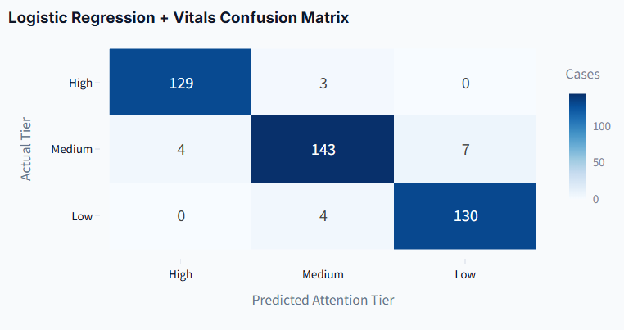
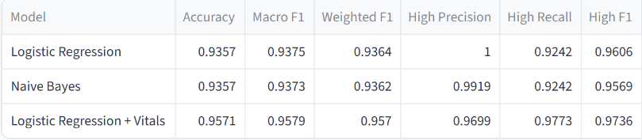
Model Evaluation & Results
  Evaluation on Held-Out Test Data
The dataset was split into:
2,100 Total Notes
↓
1,680 Training Notes
420 Held-Out Test Notes
The models were evaluated using:
  Accuracy — overall correct predictions
  Precision — correctness of predicted classes
  Recall — how many actual cases were identified
  F1 Score — balance between precision and recall
  Confusion Matrix — detailed class-wise prediction errors
  High-Class Recall — specifically monitored because missing a High-priority case is important
The TF-IDF + Vitals Logistic Regression model achieved 95.71% accuracy and 97.73% High-class recall on the held-out synthetic test set.
High → Low errors: 0 in this test set
CitiusTech
| 12

Slide 13
Inference Pipeline
New Clinical Intake Note
What happens during inference?
1. Same preprocessing as training
The new note goes through the same 8 preprocessing stages used during model development.
2. TF-IDF transformation
  vectorizer.transform([cleaned_note])
  The saved vectorizer is only used to transform the new note.
  It is never fitted again during inference.
3 Prediction
model.predict()
model.predict_proba()
FastAPI API
8-Stage Preprocessing
Cleaned data
Vital Signs
TF-IDF Vectorization
Imputation + Scaling
Model Inference
1. TF-IDF → Logistic Regression
2. TF-IDF → Multinomial Naive Bayes
3. TF-IDF + Vitals → Logistic Regression
The system returns:
  Priority: High / Medium / Low
  Confidence
  Probability for each class
  Extracted vital signs
  Cleaned note
  Preprocessing audit
  Model name & version
High / Medium / Low
Priority + Confidence
CitiusTech
| 13

Slide 14
Application Architecture & Deployment Flow
STREAMLIT UI
ui/api_client.py
Main FastAPI Routes
  POST /api/predict Analyze a clinical note and return priority, confidence, probabilities, vitals and preprocessing details
  GET /api/queue Retrieve the intake queue with priority/arrival ordering and filtering
  POST /api/queue Analyze a new note and add it to the active queue
  GET /api/model-info Return model version, TF-IDF configuration and evaluation information
  GET /api/health Check API, vectorizer and model loading status
  GET /docs FastAPI interactive API documentation
HTTP Request
FASTAPI BACKEND
/api/predict
/api/queue
/api/model-info
INFERENCE PIPELINE
Preprocessing + ML Models
Prediction Result
STREAMLIT UI
CitiusTech
| 14

Slide 15
CitiusTech
✓
Smarter triage queue
Conclusion
High / Medium / Low priority with confidence and class probabilities.
The system reads a nurse intake note and classifies it as High, Medium or Low priority, helping urgent cases move up the queue while the final decision remains with the healthcare professional.
✓
Built for messy notes
8-step preprocessing handles abbreviations, fillers, typos and boilerplate.
✓
Transparent by design
Preprocessing audit trail and saved models support traceability.
The TF-IDF + Vitals Logistic Regression model achieved 95.71% accuracy and 97.73% High-class recall on the held-out synthetic test set.
✓
Deployable architecture
FastAPI backend with a Streamlit UI for the intake queue.

Slide 16
CitiusTech
THANK YOU

