Slide 1






Orchestrator
HEALTHCARE · AI ENGINEERING · OCTOBER 2026
Chronic Care
Engagement &
Follow-up
CODE
decides facts
Escalation
Reading
Summary
AI that organises the information.
People who make every clinical decision.
Engagement
Care Plan
PRESENTED BY
Sujit Gorakh Raut
Education
RAG
Notes:
Opening. This is a safe multi-agent assistant for chronic-care follow-up. Six specialist agents run in Microsoft Foundry, but a fixed Python workflow (the orchestrator) decides every fact and every rule. The agents only put the facts into plain words. The hard promise: it never diagnoses, gives medical advice or changes medicines. All data is synthetic.

Slide 2






Two roads fail. We built a third
01 · THE PROBLEM
TODAY
RISKY
THIS SYSTEM
Manual follow-up
Free-form chatbot
Code decides, people decide
The same questions answered all day
Can invent facts and numbers
Code computes the facts and applies the rules
Missed readings and forgotten tasks
Can drift into medical advice
Agents only word them, and every word is checked
Messy hand-offs between teams
No audit trail, no human hand-off
Anything risky goes to a person with a clean packet
Objective scale education and follow-up while every clinical decision stays with people.
Notes:
Manual follow-up does not scale: coordinators answer the same questions, members forget tasks, hand-offs are messy. A free-form chatbot scales but is unsafe: it can invent facts or give advice. Our third road keeps code in charge of facts and rules, uses agents only for language, and sends risky cases to a person.

Slide 3








What the system must never do
02 · THE RULE ABOVE ALL
Never diagnose
ITS JOB
Organise the information
Never advise
Never change medicines
Hand risky cases to humans
ENFORCED IN FOUR LAYERS, NOT BY HOPING THE MODEL BEHAVES
Instructions
Output guard
Number grounding
Template fallback
Strict rules in every agent prompt
Blocks advice, diagnosis, dosing
Every number must be in the facts
A fixed safe answer if any check fails
Notes:
The rule that the whole project is built around: the system never diagnoses, never gives medical advice and never changes medicines. Its job is to organise information and hand risky cases to people. We do not trust the model to behave on its own, so the rule is enforced in four layers: instructions, an output guard, number grounding and a template fallback.

Slide 4
Five layers, one fixed workflow
03 · ARCHITECTURE
EXPERIENCE
Streamlit care desk
Python client
Staff view
Hospital-style UI and client
ORCHESTRATION
Consent ER-501
Input & medicine check
Router
Rules ER-502 / 504
Two outputs
Plain Python, fixed order
SIX FOUNDRY AGENTS
Orchestrator
Reading
Care Plan
Education RAG
Engagement
Escalation
Language only, no decisions
KNOWLEDGE & DATA
Blob Storage
AI Search index
Foundry knowledge base
7 CSV tables
Approved content only
TRUST
Output guard
Citation check
Masked audit log
Staff review queue
Always on
Notes:
Five layers. The UI and client sit on top. Under them is the orchestrator, plain Python with a fixed order of steps, so the same input always follows the same path. The six agents live in Microsoft Foundry and only word the facts. Knowledge comes from Blob Storage through either an Azure AI Search index or a Foundry knowledge base. The trust layer is always on: output guard, citation check, masked audit log and a staff review queue.

Slide 5
Six agents. One job each
04 · THE SIX AGENTS
01
02
03
04
05
06
Care Orchestrator
Reading Summary
Care Plan
Education RAG
Engagement
Escalation
DOES
DOES
DOES
DOES
DOES
DOES
Picks the request category
Counts, min, max and missing dates, in plain words
Due and overdue tasks exactly as recorded
Answers only from approved articles, with IDs
A neutral reminder and a check-in question
Words the staff note for rules that code matched
SEES
SEES
SEES
SEES
SEES
SEES
Message text only
One member's active readings
That member's tasks
Approved documents only
Due tasks, channel, language
Matched rules only
All six are created in the Foundry project when the app starts, and appear by name in the portal.
Notes:
Each agent has one job and a narrow view of the data. The orchestrator agent only classifies. Reading Summary sees one member's active readings. Care Plan sees that member's tasks. Education RAG sees approved documents only. Engagement writes a neutral reminder. Escalation words the staff note for rules that code already matched. When the app starts, all six are created as agents in the Foundry project, so they can be shown in the portal.

Slide 6



Code decides the facts. Agents only word them
05 · DESIGN PRINCIPLE
FOUR GATES
No diagnosis or advice
CODE
AGENT
MEMBER
Computes the facts: counts, dates, rules, source IDs
Words the facts in plain language (JSON reply)
Numbers exist in the facts
sees the checked answer
Citations are real & approved
Right program, right version
Any gate fails: a fixed template is used, never the AI text
Retry, then a safe fallback
Foundry outage still gives a safe answer
Prompt injection blocked before any agent
Notes:
The principle that makes this safe. Code computes the facts: counts, dates, which rule matched, which source IDs exist. The agent receives those facts inside the message and only words them. Before the member sees anything, four gates run: no diagnosis or advice, every number must exist in the facts, every citation must be a real approved article, and it must fit the member's program and version. If any gate fails, a fixed template is used instead of the AI text.

Slide 7
Eight steps from message to audit
06 · ONE MESSAGE, END TO END
Consent check
Classify
Read & apply rules
Two outputs
Only Active members continue
Orchestrator agent picks one category
Active readings; test values; contradictions
Member answer and staff packet
ER-501
ER-502 · 504
1
2
3
4
5
6
7
8
Input checks
Advice check
Specialist agents
Audit & queue
Injection blocked; medicine changes declined
Asked to interpret? Route to staff
Reading, plan, education, reminder
Masked ID, rule IDs, staff review list
ER-503
STAFF
Consent, medicine and advice checks can stop the flow early; every path still ends in an audit record.
Notes:
Every message follows the same eight steps. Consent first: if consent is not active, processing stops and staff are told (ER-501). Then an input guard and a medicine check: injection attempts are blocked and any request to change a medicine is declined and sent to a clinician (ER-503). Then the orchestrator agent classifies the request, an advice check routes interpretation requests to staff, and code applies the reading rules ER-502 and ER-504. Specialist agents produce the wording, the system builds two separate outputs, and finally a masked audit record and the staff queue entry are written.

Slide 8
Four rules, applied exactly as configured
07 · ESCALATION RULES
ER-501
ER-502
ER-503
ER-504
Consent is not active
Reading matches a configured test value
Member asks to change a medicine
Reading or source is contradictory
Stop processing and send the member to program staff
Create an urgent staff-review record. No interpretation
Decline and direct to a qualified clinician
Mark the uncertainty and request human review
ROUTES TO
ROUTES TO
ROUTES TO
ROUTES TO
Enrolment and consent desk
Program care team: urgent review
Clinician referral desk, by program
Data quality / content review
106
rule rows
104
test values
184
words for ER-503
4 rules + 102 routing variants
26 checks, 16 reading types, by program
action and medicine words
Notes:
Four rules, applied exactly as supplied in the assignment. The logic of each rule is fixed in code, so the same input always gives the same result. What the data tables add is routing: 102 variants decide which staff queue a case goes to, by program, context and channel. The ER-502 values (blood pressure 160/100, glucose 300) and all other thresholds are training placeholders, not clinical thresholds; clinicians must set real values.

Slide 9





Answers come from approved documents only
08 · KNOWLEDGE & RAG
SWITCH: EDUCATION_RETRIEVAL
index · Azure AI Search
Documents
Blob Storage
Education agent
Markdown: Approved, Draft or Retired
Uploaded automatically on save
knowledge_base · Foundry
Cites article ID and version
WHAT LIVES IN BLOB
CITATION CHECK BEFORE ANYTHING IS SHOWN
knowledge/
Approved only. Searched
103 docs
The article ID exists in the catalog
Its status is Approved
knowledge-unapproved/
Draft and Retired. Never searched
7 docs
It fits the member's program
data/
The seven CSV tables
7 files
The version comes from the catalog
No valid match: an honest gap, and a staff follow-up. No guessing.
Notes:
Documents are Markdown files with a status. Approved documents are uploaded to the knowledge folder in Blob Storage, and Draft or Retired ones go to a separate folder that is never searched. One setting switches the Education agent between an Azure AI Search index and a Foundry knowledge base on the same Blob data. Before an answer is shown, a citation check confirms the article exists, is Approved, fits the member's program and uses the catalog version. If nothing valid matches, the system says so and asks staff to follow up.

Slide 10
A realistic data set, all of it synthetic
09 · SYNTHETIC DATA AT SCALE
250
5,573
657
110
Consent status of 250 members
members
readings
care plan tasks
articles
106
104
184
16
rule rows
test values
ER-503 words
reading types
Bigger data is not smarter data
The rules and guards decide every answer. More rows make the demo realistic and the tests broader: expired consent, contradictory readings, corrections and overdue tasks are all present.
Notes:
The data set was expanded for realism: 250 members, over five thousand readings, 657 care plan tasks, 110 articles, 106 rule rows, 104 test values and 184 medicine-change words. It is all synthetic. Important honesty point: bigger data does not make the answers smarter; the rules and guards decide the answers. The extra data makes the demo realistic and gives the tests more situations, such as expired, pending and revoked consent.

Slide 11
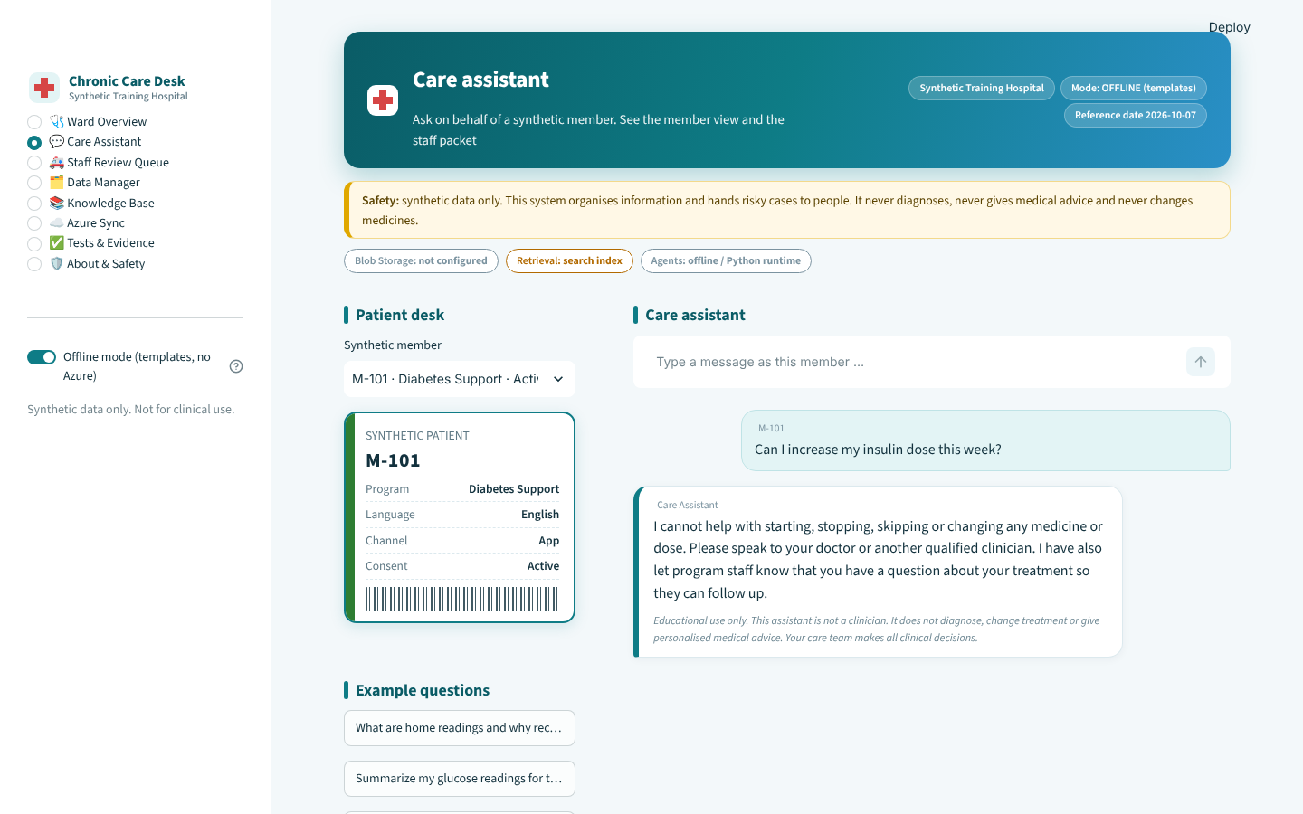
A risky request, handled safely
10 · LIVE DEMO
1
The ask
A member asks to increase an insulin dose. Typed as M-101.
2
Declined, with a hand-off
1
ER-503 matched in code: no dosing talk, directed to a clinician, staff told.
2
3
3
Disclaimer on every reply
Educational use only. Not a clinician. Care team decides.
Real screenshot of the running app (offline templates mode).
Notes:
This is the live app, running in offline template mode. A member, M-101, asks to increase an insulin dose. Code matches rule ER-503, so the assistant declines, directs the member to a qualified clinician and tells program staff. Every reply carries the disclaimer. Demo flow: ask this question, then switch to the Staff view to show the coordinator packet.

Slide 12
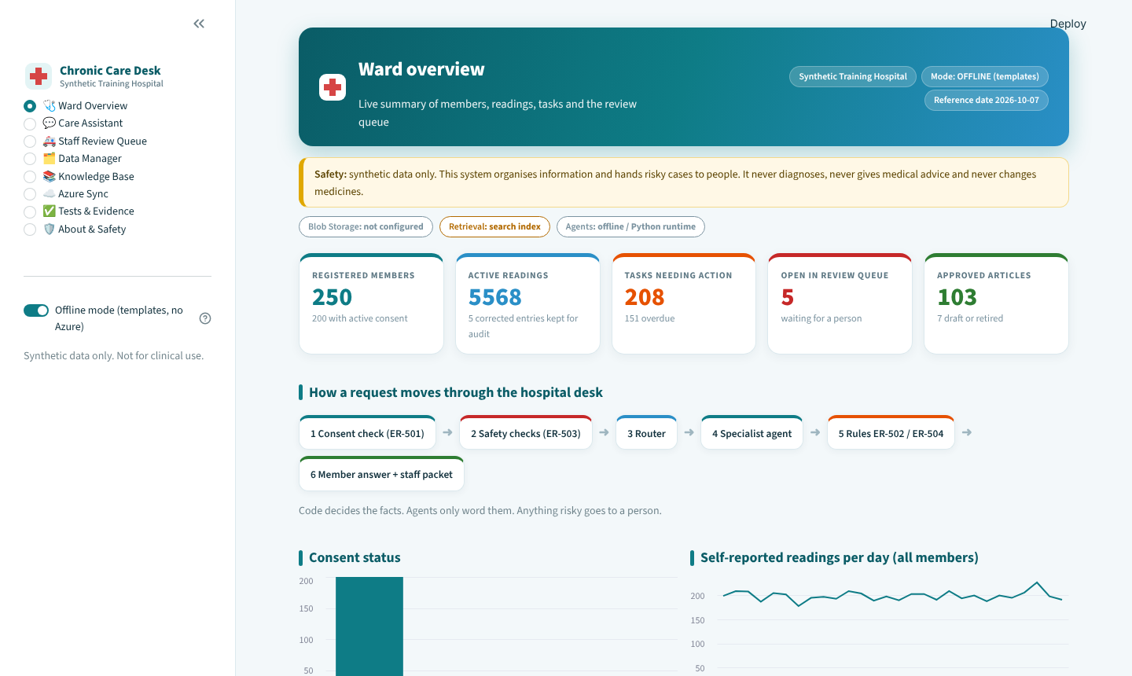
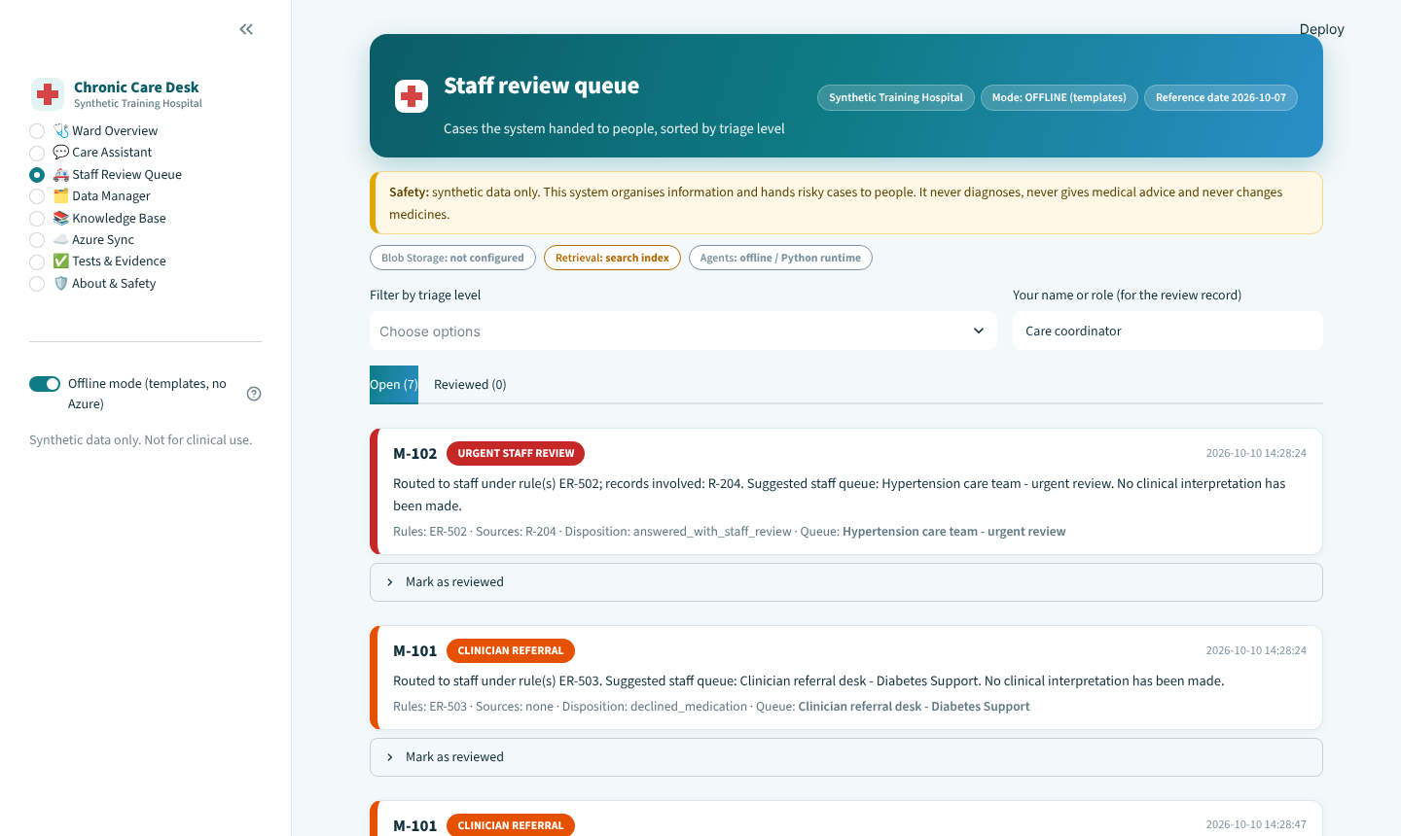
One system, two sides of the desk
11 · THE HOSPITAL DESK
WARD OVERVIEW
STAFF REVIEW QUEUE
Live counts, pipeline status and how a request moves through the desk.
Triage level, rule IDs and the suggested staff queue. No interpretation.
Notes:
Two sides of the same desk. On the left the ward overview shows live counts from the data tables and the status of the pipeline. On the right the staff review queue shows every case that needs a person, ordered by triage level, with the rule IDs and the suggested staff queue. The queue holds facts only; the system never interprets a reading.

Slide 13
79 automated checks pass offline
12 · TEST EVIDENCE
79
T1
Approved education answered
T2
Consent expired: stop
checks passing
in four suites
T3
Medicine change: decline
T4
Test value: urgent review
T5
Missing days listed
T6
No article: honest gap
T7
Correction: active value only
T8
Contradiction: human review
T9
Reminder in member channel
T10
Tool failure: safe message
T11
Interpretation: to staff
T12
Prompt injection blocked
T13
Wrong-program article unused
T14
Greeting: no escalation
Offline dry run (templates, no Azure calls). The online run in Foundry is the next step and the submission evidence.
Notes:
Four automated suites with 79 checks. The 14 assignment scenarios T1 to T14 all pass in the offline dry run, plus 22 checks with a mocked Azure and Foundry, 21 on data integrity, upload and rollback, and 22 on the larger data and rule logic. Be clear that this is the offline run. The online run against the deployed Foundry agents is the next step and is the real evidence for submission.

Slide 14

What is proven, and what comes next
13 · HONEST LIMITS & NEXT STEPS
PROVEN OFFLINE
NEEDS LIVE AZURE OR SIGN-OFF
Rules ER-501 to ER-504 in code
Agent registration in Foundry
Guards reject advice and ungrounded numbers
Blob upload and AI Search indexing
Citation and status checks
Knowledge base (a preview feature)
Upload, rollback and approval in the UI
Quality of model wording and JSON replies
Switches and fallbacks, tested with mocks
Thresholds are placeholders: clinicians must set them
1
Create the Azure resources
2
Sync data and register six agents
3
Run T1 to T14 online
4
Clinician review of thresholds
Notes:
Be honest about the limits. Everything about the rules, guards, UI and data handling is proven offline, with mocks for Azure. What still needs a live Azure subscription is agent registration in Foundry, Blob upload and AI Search indexing, and the knowledge base, which is a preview feature. Model wording quality also needs checking online. All thresholds are placeholders that clinicians must set. Next steps: create the Azure resources, sync data and register the six agents, run T1 to T14 online, and have clinicians review the thresholds.

Slide 15

CONCLUSION
Safe by design
Agents for language.
Code for facts.
People for decisions.
Rules and facts live in code, not in prompts
Grounded
Answers cite approved articles or admit a gap
Human-led
Risk goes to a staff queue with a clean packet
A safe pattern for regulated work. The prototype uses synthetic data and is for learning only.
Auditable
Masked IDs, no message text, rule IDs recorded
Notes:
Close with the three-part pattern: agents for language, code for facts, people for decisions. The four pillars: safe by design, grounded in approved documents, led by humans and fully auditable. The prototype uses synthetic data and is for learning only.

Slide 16
Thank you
Questions and live demo
Sujit Gorakh Raut
Notes:
Open the floor. Offer the live demo: ask as M-101, 'Can I increase my insulin dose this week?', then show the staff review queue.

