Slide 1

CHRONIC CARE ENGAGEMENT
& FOLLOW-UP
MEMBER ASKS
Can I increase my insulin dose this week?
A safe multi-agent assistant that explains, reminds and escalates, and never gives medical advice
SYSTEM DOES
DECLINED
ER-503
TO CLINICIAN
Staff are alerted. No advice, no interpretation.
PRESENTED BY
Sujit Gorakh Raut
Healthcare · October 2026
Notes:
Welcome. This is a multi-agent assistant for a synthetic chronic-care program. Members ask general questions, get readings summarised, and get reminders. The card shows the core idea in one picture: when a member asks to change a medicine dose, the system declines, points to a clinician and alerts staff. It never diagnoses or advises.

Slide 2
01
Use case
Why safe follow-up does not scale today
02
Solution & design principle
Six agents; code decides facts, AI words them
03
Architecture & RAG
Agenda
One message, end to end; grounded answers
04
Live demo & rules
From the use case to a safe, working, testable multi-agent system. Click any item to jump to it.
Normal, exception and safety paths
05
Results
Scenario coverage and evidence
06
Limits & next steps
What is open and what comes next
07
Conclusion & Q&A
Key takeaways
Notes:
Seven parts. The titles are links, so we can jump to any section from here and use the Agenda link in each slide's footer to come back.

Slide 3





Chronic-care teams cannot scale follow-up safely
01 · USE CASE
The problem
OBJECTIVE
Repeated questions
Scale education and follow-up, while every clinical decision stays with people.
Coordinators answer the same general questions all day
Forgotten tasks
Members miss readings and modules; follow-up is manual
THE SYSTEM MUST NEVER
Messy hand-offs
Diagnose or interpret a reading
Coordinators dig through raw messages before every call
Predict deterioration
Unsafe chatbots
Recommend or change medication
A free-form bot can invent facts or give medical advice
Present itself as a clinician
← Agenda
Notes:
Care teams are stretched. Coordinators repeat the same answers, members forget tasks, and hand-offs are messy. A normal chatbot is not safe here because it can hallucinate or advise. Our objective is to scale routine education and follow-up while leaving every clinical decision to people. The red box is the safety boundary from the assignment.

Slide 4




Six agents, one job each
02 · SOLUTION
Care Orchestrator
Reading Summary
Care Plan
A fixed Python workflow: consent, safety checks, routing, outputs.
Counts, minimum, maximum and missing dates in neutral words.
Due and overdue tasks, each with its source ID.
Sees: the whole case (it is code)
Sees: one member's readings
Sees: that member's tasks
Education RAG
Engagement
Escalation
Answers only from approved articles and cites them.
A neutral reminder in the member's channel and language.
Writes the staff reason for rules that code already matched.
Sees: approved articles only
Sees: due tasks and channel
Sees: matched rules only
← Agenda
Notes:
The six agents from the assignment. The orchestrator is plain Python plus one routing agent, so the order of steps and every safety decision are the same every time. Each of the others sees only the data it needs: that is least privilege. All six are created by code, not by hand in the portal.

Slide 5



Code decides the facts. Agents only word them
02 · DESIGN PRINCIPLE
DONE BY CODE
Exact, repeatable, unit-tested
DONE BY AI
Language only, never a decision
Consent check (ER-501)
Understand what the member asked
Escalation rules ER-502 to ER-504
+
Word summaries and reminders
Counts, min / max, missing dates
Answer from retrieved approved text
Citation check: ID, status, program, version
AI WORDING IS REJECTED, AND A FIXED TEMPLATE IS USED, IF IT CONTAINS
A number that is not in the facts
A diagnosis or a judgement of a value
Medication advice or a prediction
A claim to be a clinician
← Agenda
Notes:
This is the key design idea. Anything that must be exact is done by code: consent, the four escalation rules, the statistics and the citation check. The model only understands language and writes wording. Even then, its text is checked, and if it contains an invented number, a diagnosis, medication advice or a claim to be a clinician, it is thrown away and a fixed template is used instead.

Slide 6


How one message moves through the desk
03 · ARCHITECTURE
1
2
3
4
5
6
Consent check
Safety guard
Router
Facts and rules
Specialist agent
Outputs
Active consent or stop
Injection and medication rule
Education, readings, plan or staff
Code reads data, applies ER-502 and ER-504
Words the answer from the facts
Member view, staff packet, audit
STOP → staff
ER-501
DECLINE → clinician
ER-503
→ STAFF QUEUE
ER-502, ER-504
SEPARATE VIEWS
Every case produces three separate outputs
Member view
Staff packet
Audit record
Plain-language answer, due plan items, source IDs, the disclaimer and next-step guidance.
Member ID, readings used, due actions, sources, rule IDs and the escalation reason.
Consent result, agents called, rule IDs, source versions. Masked ID, no message text.
← Agenda
Notes:
One message, six steps. Step one is the consent gate: if consent is not active, nothing else runs. Step two blocks injection and medication-change requests. The router picks the specialist. Code then reads only that member's data and applies the rules. The specialist agent words the answer. Finally we produce three separate outputs: the member view, the staff packet and a masked audit record. The coloured tags show where a human takes over.

Slide 7




RAG: grounded answers, or an honest gap
03 · KNOWLEDGE AND RAG
Blob Storage
Azure AI Search
Education RAG agent
Citation validator
Approved Markdown articles, uploaded by script
Three indexes: Education, FAQ, Care-plan guidance
Foundry agent with a search tool; answers only from retrieved text
Code checks the cited article before anyone sees the answer
THE VALIDATOR CHECKS
Valid: answer with a citation
The article ID exists
Shown as a source such as EDU-401 (v4)
Its status is Approved
It fits the member's program
No match or invalid: say so
It matches the current version
No guessing; the question goes to program staff
The Education agent never sees readings or care plans.
← Agenda
Notes:
Knowledge starts as approved Markdown articles in Blob Storage. A script builds three Azure AI Search indexes: education, FAQ and care-plan guidance. The Education agent, hosted in Foundry, can search the education and FAQ indexes only. Its answer is then validated in code: the cited article must exist, be approved, fit the member's program and be the current version. If any check fails, or nothing relevant is found, the member is told there is a gap and staff follow up. We never fill a gap with the model's own knowledge.

Slide 8
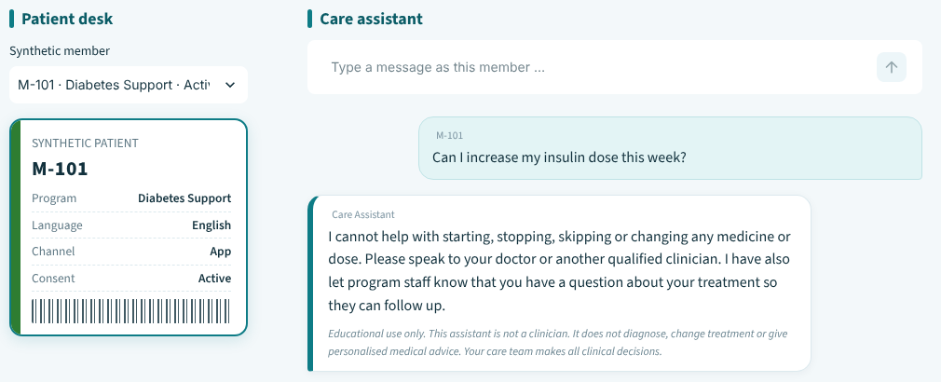

Live demo: a normal, an exception and a safety path
04 · LIVE DEMO
DEMO FLOW
1
NORMAL
M-101 asks why to record readings at home
Cited answer: EDU-401 (v4)
2
EXCEPTION
M-103 asks anything; consent has expired
Processing stops: ER-501, staff
Care Assistant: a declined medication request, with the disclaimer on the reply
3
SAFETY
WHAT TO WATCH FOR
M-101 asks to raise an insulin dose; M-102 asks for a blood pressure summary
No diagnosis
Sources shown
Disclaimer on every reply
ER-503 declined; ER-502 urgent review
← Agenda
Notes:
Three paths, about five minutes. Normal: a member asks a general question and gets a cited answer. Exception: a member whose consent has expired, so processing stops before any data is read. Safety: a medication-change request is declined, and a blood-pressure summary for M-102 triggers an urgent staff-review record without any interpretation. Point out the disclaimer and the source IDs on every reply.

Slide 9
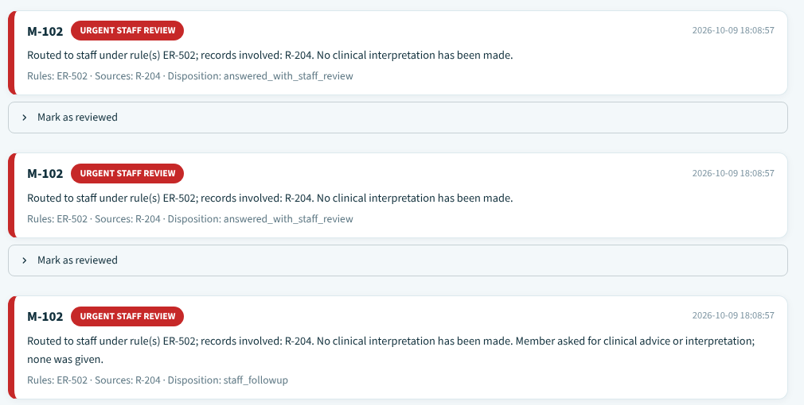

Four rules, applied exactly as supplied
04 · ESCALATION RULES
Consent is not active
ER-501
Stop processing and direct the member to program staff
Reading matches a configured test value
ER-502
Create an urgent staff-review record; do not interpret
Member asks to change medication
ER-503
Decline and direct to a qualified clinician
Staff review queue: every rule match waits for a person
ER-502 test values are placeholders
Source or reading is contradictory
Blood pressure 160/100 and glucose 300 are training values, not clinical thresholds.
ER-504
Mark the uncertainty and request human review
← Agenda
Notes:
The four rules are the ones supplied in the assignment, evaluated in code exactly as written. Each match creates a record in the staff review queue; nobody is told what a value means. The two numbers used for ER-502 are placeholders chosen so the rule can be demonstrated. Real thresholds must come from clinicians.

Slide 10

14 of 14 scenarios pass in the offline dry run
05 · RESULTS
14/14
105
Consent status of the 105 synthetic members
scenarios passed
synthetic members
2,254
24
active readings
approved articles
WHAT THE 14 SCENARIOS COVER
4
5
4
1
Expired, pending and revoked members exercise ER-501. This is an offline dry run: it proves the safety code and template wording. The online run against deployed Foundry agents is the submission evidence.
Normal paths
Safety escalations
Edge and conflict
Failure handling
← Agenda
Notes:
14 of 14 scenarios pass in the offline dry run: the six from the assignment plus eight extra, covering normal paths, safety escalations, edge cases and conflicts, and failure handling. Be clear about the scope: an offline run proves our safety code and templates, not live model wording. Re-run the suite online against the deployed Foundry agents and update this slide with that result for the submission.

Slide 11

Honest limits, and what comes next
06 · LIMITS AND NEXT STEPS
KNOWN LIMITS
NEXT STEPS
ER-502 values are placeholders
Run the online suite
160/100 blood pressure and glucose 300 are not clinical thresholds
Attach evidence from the deployed Foundry agents
Offline proof, not online proof
Clinical sign-off
Dry-run evidence covers code and templates, not live model wording
Clinician-set thresholds and reviewed article text
English keyword guards
Distress and urgent symptoms
Other languages depend on the routing agent
A dedicated route with reviewed wording and a fast staff alert
Synthetic and unreviewed
Production hardening
Data and articles are training content, not clinically reviewed
Managed identity, Key Vault, semantic search, monitoring
← Agenda
Notes:
We would rather state the limits than hide them. The ER-502 numbers are placeholders. Offline evidence is not live evidence. Keyword guards are English only. Everything is synthetic and not clinically reviewed. Next: run the online suite, get clinical sign-off, add a dedicated route for distress and urgent symptoms, and harden for production.

Slide 12

Safe by design
Rules and facts live in code, not in prompts
Conclusion
Grounded
A safe pattern for regulated work: specialist agents for language, code for facts and rules, and people for every clinical decision.
Answers cite approved versions or admit a gap
Human-led
The prototype uses synthetic data and is for learning only.
Risk goes to a staff queue with a clean packet
Auditable
Masked IDs, no message text, rule IDs recorded
Notes:
Takeaways: safe by design because rules and facts live in code; grounded because answers cite approved versions or admit a gap; human-led because risk goes to a staff queue with a clean packet; auditable because logs use masked IDs and no message text. Then open for questions.

Slide 13
Thank you
Open for questions
Sujit Gorakh Raut
Notes:
Thank you. Happy to take questions or show any of the demo paths again.

