Slide 1







HEALTHCARE · MULTI-AGENT AI
Chronic Care
Engagement
& Follow-up
A safe assistant that explains, reminds and escalates. It never gives medical advice.
Sujit Gorakh Raut · October 2026
Notes:
Welcome. This is a multi-agent assistant for a synthetic chronic-care program. The orbit on the right is the idea in one picture: six specialist agents around a protective core. They explain approved education, summarise readings, remind members of tasks, and pass anything risky to people. The system never diagnoses and never gives medical advice. Use the chapter bar at the bottom of every slide to jump around.

Slide 2

Care teams cannot scale follow-up safely
01 · THE PROBLEM
Scale education and follow-up, while every clinical decision stays with people.
THE SYSTEM MUST NEVER
Diagnose or interpret a reading
Predict deterioration
01
02
Repeated questions
Forgotten tasks
Coordinators answer the same questions all day
Members miss readings and modules
Recommend or change medication
03
04
Messy hand-offs
Unsafe chatbots
Present itself as a clinician
Raw messages before every call
A free-form bot can invent facts or advise
Problem
Solution
Principle
Flow
RAG
Demo
Rules
Results
Next
Notes:
Care teams are stretched: the same questions repeat, members forget tasks, and hand-offs are messy. A free-form chatbot is not the answer because it can invent facts or give advice. Our goal is to scale routine education and follow-up while every clinical decision stays with people. The red tiles are the hard boundary from the assignment.

Slide 3





One orchestrator, five specialists
02 · THE SOLUTION
Reading Summary
Sees: one member's readings
Escalation
Care Plan
Sees: matched rules only
Care
Orchestrator
Sees: that member's tasks
plain Python
Engagement
Education RAG
Sees: due tasks and channel
Sees: approved articles only
Problem
Solution
Principle
Flow
RAG
Demo
Rules
Results
Next
Notes:
The orchestrator is plain Python, so the order of steps and every safety decision are identical every time. Around it are the five specialists from the assignment. Each one only sees the slice of data it needs; that is least privilege. All agents are created by code, not clicked together in the portal.

Slide 4



Code decides the facts. Agents only word them
02 · DESIGN PRINCIPLE
CODE
AI
exact, repeatable, unit-tested
language only, never a decision
Consent check (ER-501)
+
Understand what the member asked
Rules ER-502 to ER-504
Word summaries and reminders
Counts, min / max, missing dates
Answer from retrieved approved text
Citation check: ID, status, program, version
AI TEXT IS REJECTED, AND A
FIXED TEMPLATE IS USED, IF IT HAS
A number not in the facts
A diagnosis or judgement
Medication advice or prediction
A claim to be a clinician
Problem
Solution
Principle
Flow
RAG
Demo
Rules
Results
Next
Notes:
The core design idea. Everything that must be exact is code: consent, the four rules, the statistics and the citation check. The model only understands language and writes wording, and even that text is checked. If it contains an invented number, a diagnosis, medication advice or a claim to be a clinician, it is thrown away and a fixed template is used.

Slide 5
How one message moves through the desk
03 · ARCHITECTURE
Consent check
Router
Specialist agent
Active consent or stop
Education, readings, plan or staff
Words the answer from the facts
DECLINE · ER-503
STAFF QUEUE · ER-502/504
SEPARATE VIEWS
1
2
3
4
5
6
STOP → staff · ER-501
Safety guard
Facts and rules
Outputs
Injection and medication rule
Code reads data, applies ER-502 and ER-504
Member view, staff packet, audit
Member view
Staff packet
Audit record
answer, plan items, sources
readings, due actions, reasons
masked ID, no message text
Problem
Solution
Principle
Flow
RAG
Demo
Rules
Results
Next
Notes:
Six steps. One: the consent gate. If consent is not active, nothing else runs. Two: block injection and medication-change requests. Three: the router picks the specialist. Four: code reads only that member's data and applies the rules. Five: the specialist words the answer. Six: three separate outputs. The coloured tags are the points where a human takes over.

Slide 6





RAG: grounded answers, or an honest gap
03 · KNOWLEDGE AND RAG
1
Blob Storage
2
Approved Markdown articles
Azure AI Search
3
Education, FAQ, Care-plan indexes
Education RAG agent
4
Answers only from retrieved text
THE VALIDATOR CHECKS
Citation validator
The article ID exists
Code checks before anyone sees it
Its status is Approved
Valid
No match
It fits the member's program
It matches the current version
Answer with a citation, e.g. EDU-401 (v4)
Say so, never guess; staff follow up
Problem
Solution
Principle
Flow
RAG
Demo
Rules
Results
Next
Notes:
Approved Markdown articles sit in Blob Storage. A script builds three Azure AI Search indexes. The Education agent, hosted in Foundry, answers only from retrieved text. Its answer then goes through a validator in code: the cited article must exist, be approved, fit the member's program and be the current version. If any check fails, or nothing relevant is found, the member is told there is a gap and staff follow up. A gap is never filled with the model's own knowledge.

Slide 7
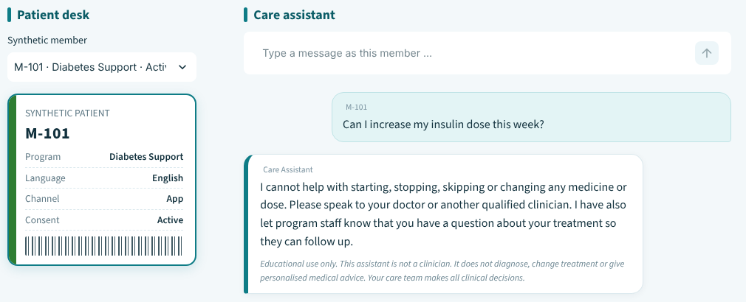
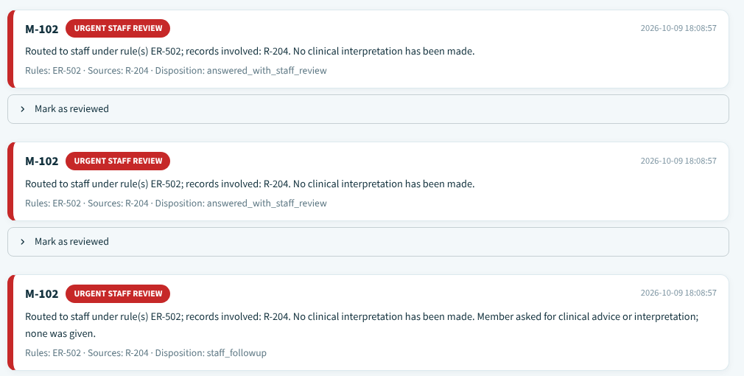
Live demo: a normal, an exception and a safety path
04 · LIVE DEMO
1
NORMAL
M-101 asks why to record readings at home
Cited answer: EDU-401 (v4)
2
EXCEPTION
M-103: consent has expired
Processing stops: ER-501
WHAT TO WATCH FOR
3
SAFETY
No diagnosis
M-101 asks to raise an insulin dose; M-102 asks for a blood pressure summary
Sources shown
ER-503 declined · ER-502 urgent review
Disclaimer on every reply
Problem
Solution
Principle
Flow
RAG
Demo
Rules
Results
Next
Notes:
Three paths in about five minutes. Normal: a general question gets a cited answer. Exception: consent has expired, so processing stops before any data is read. Safety: a medication-change request is declined, and a blood-pressure summary for M-102 creates an urgent staff-review record with no interpretation. The front screenshot is the member's chat; the one behind it is the staff review queue.

Slide 8

Four rules, applied exactly as supplied
04 · ESCALATION RULES
ER-501
ER-502
Consent is not active
Reading matches a configured test value
Stop processing and direct the member to program staff
Create an urgent staff-review record; do not interpret
ER-503
ER-504
Member asks to change medication
Source or reading is contradictory
Decline and direct to a qualified clinician
Mark the uncertainty and request human review
ER-502 values (blood pressure 160/100, glucose 300) are training placeholders, not clinical thresholds.
Problem
Solution
Principle
Flow
RAG
Demo
Rules
Results
Next
Notes:
These are the four rules from the assignment, evaluated in code exactly as written. Every match goes to the staff review queue and nobody is told what a value means. The two numbers behind ER-502 are placeholders chosen so the rule can be demonstrated. Real thresholds must come from clinicians.

Slide 9

14 of 14 scenarios pass in the offline dry run
05 · RESULTS
WHAT THE 14 SCENARIOS COVER
105
synthetic members
14/14
2,254
pass
active readings
24
Offline dry run: safety code and templates
approved articles
The online run against the deployed Foundry agents is the submission evidence; this slide shows the offline dry run.
Problem
Solution
Principle
Flow
RAG
Demo
Rules
Results
Next
Notes:
14 of 14 scenarios pass in the offline dry run: the six from the assignment plus eight extra, grouped as four normal paths, five safety escalations, four edge and conflict cases and one failure case. Be clear about scope: this proves the safety code and templates, not live model wording. After the online run against deployed Foundry agents, replace the headline and gauge with that result.

Slide 10


Every limit has a next step
06 · LIMITS AND NEXT STEPS
TODAY
NEXT
ER-502 values are placeholders
Clinician-set thresholds and sign-off
Offline proof, not online proof
Run the online suite on deployed agents
English keyword guards
Test other languages; add a distress route
Synthetic, unreviewed content
Clinically reviewed articles; production hardening
Problem
Solution
Principle
Flow
RAG
Demo
Rules
Results
Next
Notes:
Each limitation has a concrete next step. Placeholders become clinician-set thresholds. Offline evidence becomes online evidence. English-only guards become tested multilingual routing plus a dedicated route for distress. Synthetic content becomes clinically reviewed content on a hardened platform.

Slide 11




CONCLUSION
Facts in code.
Words from AI.
Decisions by people.
Safe by design
Grounded answers
Human-led escalation
Auditable
A prototype on synthetic data, for learning only.
Notes:
The whole project in three lines: facts in code, words from AI, decisions by people. That gives us safe-by-design behaviour, grounded answers, human-led escalation, and an audit trail with masked identifiers.

Slide 12
Thank you
Open for questions
Sujit Gorakh Raut
Notes:
Thank you. Happy to take questions or replay any of the three demo paths.

