Slide 1
6
specialist agents
HEALTHCARE · MULTI-AGENT AI
Chronic Care
Engagement
4
escalation rules
& Follow-up
0
A safe assistant that explains, reminds and escalates. It never gives medical advice.
medical advice, by design
Sujit Gorakh Raut · October 2026
Notes:
Welcome. This is a multi-agent assistant for a synthetic chronic-care program. Three numbers sum it up: six specialist agents, four escalation rules, and zero medical advice given by design. It explains approved education, summarises readings, reminds members of tasks and passes anything risky to people. Use the chapter bar at the bottom of every slide to jump around.

Slide 2
01
02
The use case
Solution and principle
03
04
Agenda
Architecture and RAG
Live demo and try it
Click any tile to jump straight to that part of the story.
05
06
Escalation rules
Testing and results
07
Limits and conclusion
Notes:
Seven parts. Every tile is a link, and the chapter bar at the bottom of the other slides lets you jump between sections at any time.

Slide 3
Care teams cannot scale follow-up safely
01 · THE USE CASE
01
Repeated questions
Scale education and follow-up, while every clinical decision stays with people.
Coordinators answer the same ones all day
02
Forgotten tasks
Members miss readings and modules
03
Messy hand-offs
Raw messages before every call
04
Unsafe chatbots
A free-form bot can invent facts or advise
NEVER: DIAGNOSE · PREDICT · PRESCRIBE · POSE AS A CLINICIAN
Agenda
Problem
Solution
Principle
Flow
RAG
Demo
Try it
Rules
Results
Next
Notes:
Care teams are stretched: the same questions repeat, members forget tasks, and hand-offs are messy. A free-form chatbot is not the answer because it can invent facts or give advice. The goal is to scale routine education and follow-up while every clinical decision stays with people. The red strip is the hard boundary from the assignment.

Slide 4
One orchestrator, five specialists
02 · THE SOLUTION
Reading Summary
SEES one member's readings
Care
Orchestrator
Care Plan
SEES that member's tasks
plain Python, fixed workflow
Education RAG
SEES approved articles only
Every safety decision is code, so it is identical every time.
Engagement
SEES due tasks and channel
Escalation
SEES matched rules only
Agenda
Problem
Solution
Principle
Flow
RAG
Demo
Try it
Rules
Results
Next
Notes:
The orchestrator is plain Python, so the order of steps and every safety decision are identical every time. Around it are the five specialists from the assignment. Each one only sees the slice of data it needs; that is least privilege. All agents are created by code, not clicked together in the portal.

Slide 5
Code decides the facts. Agents only word them
02 · DESIGN PRINCIPLE
CODE
AI
exact, repeatable, unit-tested
language only, never a decision
+
Consent check (ER-501)
Understand what the member asked
Rules ER-502 to ER-504
Word summaries and reminders
Counts, min / max, missing dates
Answer from retrieved approved text
Citation check: ID, status, program, version
AI TEXT IS REJECTED IF IT HAS
A number not in the facts
A diagnosis or judgement
Medication advice
A claim to be a clinician
Agenda
Problem
Solution
Principle
Flow
RAG
Demo
Try it
Rules
Results
Next
Notes:
The core design idea. Everything that must be exact is code: consent, the four rules, the statistics and the citation check. The model only understands language and writes wording, and even that text is checked. If it contains an invented number, a diagnosis, medication advice or a claim to be a clinician, it is thrown away and a fixed template is used.

Slide 6
How one message moves through the desk
03 · ARCHITECTURE
1
2
3
4
5
6
Consent check
Safety guard
Router
Facts and rules
Specialist agent
Outputs
Active consent or stop
Injection and medication rule
Education, readings, plan or staff
Code reads data and applies ER-502, ER-504
Words the answer from the facts
Member view, staff packet, audit
STOP → staff · ER-501
DECLINE · ER-503
STAFF QUEUE · ER-502/504
SEPARATE VIEWS
Member view
Staff packet
Audit record
answer, plan items, sources
readings, due actions, reasons
masked ID, no message text
Agenda
Problem
Solution
Principle
Flow
RAG
Demo
Try it
Rules
Results
Next
Notes:
Six steps. One: the consent gate. If consent is not active, nothing else runs. Two: block injection and medication-change requests. Three: the router picks the specialist. Four: code reads only that member's data and applies the rules. Five: the specialist words the answer. Six: three separate outputs. The coloured tags are the points where a human takes over.

Slide 7
RAG: grounded answers, or an honest gap
03 · KNOWLEDGE AND RAG
1
2
3
4
Blob Storage
Azure AI Search
Education RAG agent
Citation validator
Approved Markdown articles
Education, FAQ, Care-plan indexes
Answers only from retrieved text
Code checks before anyone sees it
THE VALIDATOR CHECKS
ANSWER + CITATION
01
The article ID exists
Shown with its source, e.g. EDU-401 (v4)
02
Its status is Approved
03
It fits the member's program
AN HONEST GAP
04
It matches the current version
Say so, never guess; the question goes to staff
Agenda
Problem
Solution
Principle
Flow
RAG
Demo
Try it
Rules
Results
Next
Notes:
Approved Markdown articles sit in Blob Storage. A script builds three Azure AI Search indexes. The Education agent, hosted in Foundry, answers only from retrieved text. Its answer then goes through a validator in code: the cited article must exist, be approved, fit the member's program and be the current version. If any check fails, or nothing relevant is found, the member is told there is a gap and staff follow up. A gap is never filled with the model's own knowledge.

Slide 8
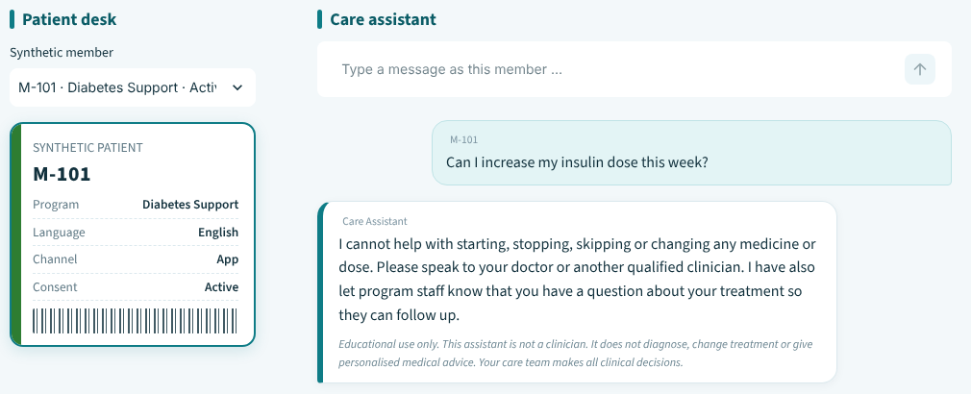
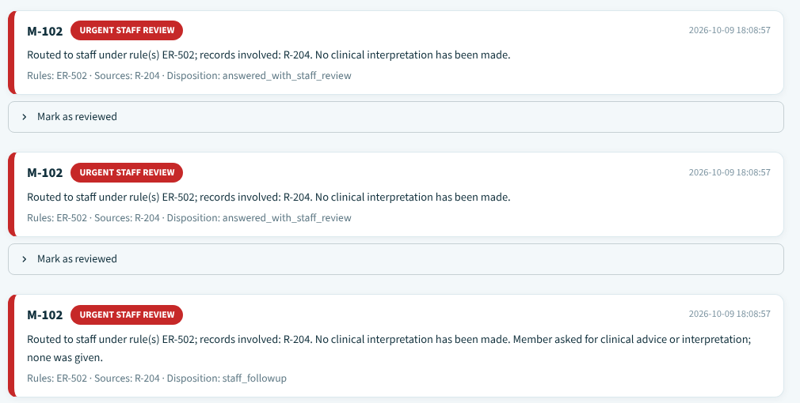
Live demo: a normal, an exception and a safety path
04 · LIVE DEMO
1
NORMAL
M-101 asks why to record readings at home
Cited answer: EDU-401 (v4)
2
EXCEPTION
M-103: consent has expired
Processing stops: ER-501
WATCH FOR
3
SAFETY
No diagnosis
Sources shown
M-101 asks to raise an insulin dose; M-102 asks for a blood pressure summary
Disclaimer on every reply
ER-503 declined · ER-502 urgent review
Agenda
Problem
Solution
Principle
Flow
RAG
Demo
Try it
Rules
Results
Next
Notes:
Three paths in about five minutes. Normal: a general question gets a cited answer. Exception: consent has expired, so processing stops before any data is read. Safety: a medication-change request is declined, and a blood-pressure summary for M-102 creates an urgent staff-review record with no interpretation. The front screenshot is the staff review queue; the one behind it is the member's chat.

Slide 9
Pick a question and see what the system does
04 · TRY IT
M-101
M-101
“Why should I record my readings at home?”
“Can I increase my insulin dose this week?”
See the result →
A cited answer
See the result →
A declined request
M-103
M-102
“Can you explain home readings?”
“Summarize my blood pressure for the last week”
See the result →
Consent has expired
See the result →
An urgent staff review
Agenda
Problem
Solution
Principle
Flow
RAG
Demo
Try it
Rules
Results
Next
Notes:
An interactive slide for the demo. Click any tile to jump to what the member and the staff see, then use the back button to return. The four result slides are hidden, so they only appear when you click through.

Slide 10
A cited answer from approved content
04 · TRY IT · RESULT
MEMBER ASKS
Why should I record my readings at home?
NO RULE
M-101 · Diabetes Support
MEMBER SEES
STAFF SEES
A short, plain-language answer from the approved article
Request: general education question
Source shown: EDU-401 (v4)
Retrieved source: EDU-401 v4
Due plan items and the disclaimer
No escalation
WHY The citation is checked in code: the ID, the status, the member's program and the version.
← Back to the questions
Agenda
Problem
Solution
Principle
Flow
RAG
Demo
Try it
Rules
Results
Next
Notes:
Expected behaviour for this question: A cited answer from approved content. The citation is checked in code: the ID, the status, the member's program and the version.

Slide 11
Declined and routed to a clinician
04 · TRY IT · RESULT
MEMBER ASKS
Can I increase my insulin dose this week?
ER-503
M-101 · Diabetes Support
MEMBER SEES
STAFF SEES
A clear refusal to change any medicine or dose
Rule ER-503 matched
Advice to speak to a qualified clinician
Request: asked to change medication
A note that staff were informed
Recent readings and due tasks attached
WHY Medication wording is caught in code before any model is asked to answer.
← Back to the questions
Agenda
Problem
Solution
Principle
Flow
RAG
Demo
Try it
Rules
Results
Next
Notes:
Expected behaviour for this question: Declined and routed to a clinician. Medication wording is caught in code before any model is asked to answer.

Slide 12
Processing stops at the consent check
04 · TRY IT · RESULT
MEMBER ASKS
Can you explain home readings?
ER-501
M-103 · Diabetes Support · consent expired
MEMBER SEES
STAFF SEES
Consent is not active; please contact program staff
Rule ER-501 matched; processing stopped
No health information is shown
No readings or care plan were accessed
The disclaimer
Member routed to program staff
WHY The consent check is the very first step. Nothing else runs without it.
← Back to the questions
Agenda
Problem
Solution
Principle
Flow
RAG
Demo
Try it
Rules
Results
Next
Notes:
Expected behaviour for this question: Processing stops at the consent check. The consent check is the very first step. Nothing else runs without it.

Slide 13
A summary, plus an urgent staff review
04 · TRY IT · RESULT
MEMBER ASKS
Summarize my blood pressure for the last week
ER-502
M-102 · Hypertension Support
MEMBER SEES
STAFF SEES
A descriptive summary: count, minimum, maximum, missing dates
Rule ER-502 matched; reading R-204
A message that an entry was sent to staff for review
Urgent staff-review record created
No interpretation of any value
Readings used and their sources listed
WHY A configured test value matched. The system compares and escalates; it never interprets.
← Back to the questions
Agenda
Problem
Solution
Principle
Flow
RAG
Demo
Try it
Rules
Results
Next
Notes:
Expected behaviour for this question: A summary, plus an urgent staff review. A configured test value matched. The system compares and escalates; it never interprets.

Slide 14
Four rules, applied exactly as supplied
04 · ESCALATION RULES
ER-501
ER-502
Consent is not active
Reading matches a configured test value
Stop processing and direct the member to program staff
Create an urgent staff-review record; do not interpret
ER-503
ER-504
Member asks to change medication
Source or reading is contradictory
Decline and direct to a qualified clinician
Mark the uncertainty and request human review
NOTE ER-502 values (blood pressure 160/100, glucose 300) are training placeholders, not clinical thresholds.
Agenda
Problem
Solution
Principle
Flow
RAG
Demo
Try it
Rules
Results
Next
Notes:
These are the four rules from the assignment, evaluated in code exactly as written. Every match goes to the staff review queue and nobody is told what a value means. The two numbers behind ER-502 are placeholders chosen so the rule can be demonstrated. Real thresholds must come from clinicians.

Slide 15
14 test scenarios: normal, unsafe and broken
05 · TESTING
14
Normal paths
4
Safety escalations
5
Edge and conflict
4
test scenarios, run against the deployed Azure agents
Failure handling
1
105
synthetic members
2,254
active readings
24
approved articles
Prompts, outputs, citations and safety observations from each run go into the test evidence document.
Agenda
Problem
Solution
Principle
Flow
RAG
Demo
Try it
Rules
Results
Next
Notes:
The 14 test scenarios are the six from the assignment plus eight extra, grouped as four normal paths, five safety escalations, four edge and conflict cases and one failure case. They run against the deployed Azure agents, and each run is recorded in the test evidence document with the prompt, output, citations and safety observations. Add the pass count from your latest Azure run when you present.

Slide 16
Every limit has a next step
06 · LIMITS AND NEXT STEPS
TODAY
NEXT
ER-502 values are placeholders
Clinician-set thresholds and sign-off
→
English keyword guards
Test other languages; add a distress route
→
Synthetic, unreviewed content
Clinically reviewed articles and rules
→
Keys and settings in a .env file
Managed identity and Key Vault
→
Agenda
Problem
Solution
Principle
Flow
RAG
Demo
Try it
Rules
Results
Next
Notes:
Each limitation has a concrete next step. Placeholders become clinician-set thresholds. English-only guards become tested multilingual routing plus a dedicated route for distress. Synthetic content becomes clinically reviewed content. Keys in a .env file become managed identity and Key Vault.

Slide 17
CONCLUSION
Facts in code.
Words from AI.
Decisions by people.
Safe by design
Grounded answers
Human-led escalation
Auditable
A prototype on synthetic data, for learning only.
Notes:
The whole project in three lines: facts in code, words from AI, decisions by people. That gives safe-by-design behaviour, grounded answers, human-led escalation and an audit trail with masked identifiers.

Slide 18
Thank you
Open for questions
Sujit Gorakh Raut
Notes:
Thank you. Happy to take questions or replay any of the demo paths.

