Slide 1
Large-scale Differential Gene Expression Analysis in scRNA-seq Data
Sujit Debnath
Farzam Taghipour
FAU Erlangen-Nuremberg
WS 2023/24

Slide 2
Agenda
Project Goal
Data Collection
Automatic Cell-types Annotation
Differential Gene Expression
Results & Summary
Visualization & Web Application

Slide 3
Project Goal

Slide 4
Goals
Retrieve scRNA-seq data from case-control studies for one fixed disease.
Create and Run pipelines
Clustering and cell type annotation → Sujit
DEGs, comparing cells from the same cell type between case and control → Farzam
Make a web-app to interactively visualize the results
Extend to > 1 diseases

Slide 5
Data Collection

Slide 6



Data Sources
Humancellatlas
10x Genomics
Gene Expression Omnibus

Slide 7
PBMC
Peripheral Blood Mononuclear Cells
White Blood Cell (WBC)
Include various immune cell types such as
lymphocytes (T cells, B cells, and NK cells)
Monocytes
Dendritic cells
They play crucial roles in the immune response

Slide 8
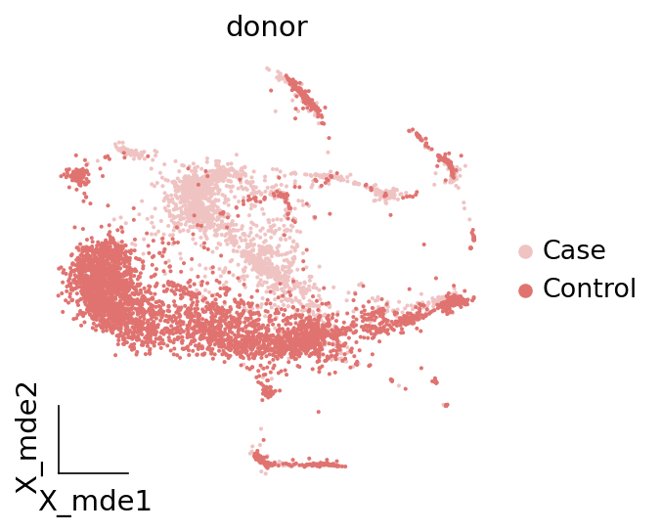
Batch Effect Problem
Arises due to
Differences in experimental conditions
Technical factors
such as sample processing
Sequencing runs
Batch-specific artifacts
Cell isolation techniques
Library preparation protocols
Sequencing platforms
Experimental conditions

Slide 9
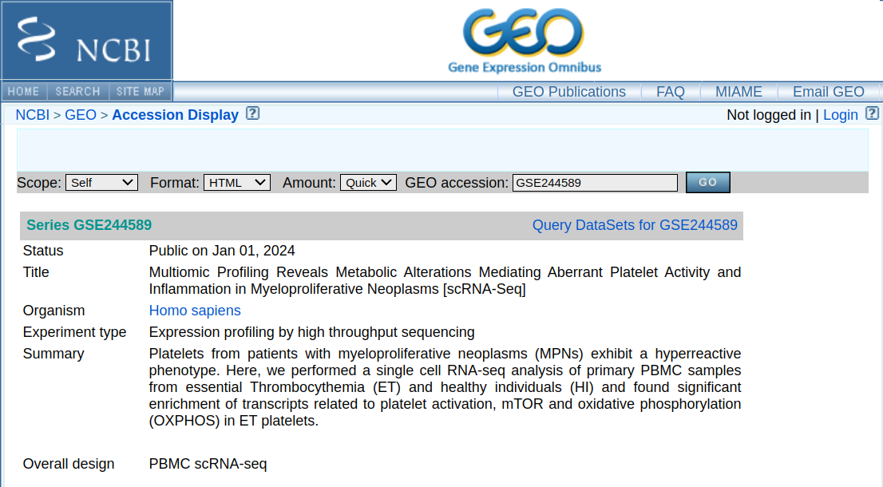
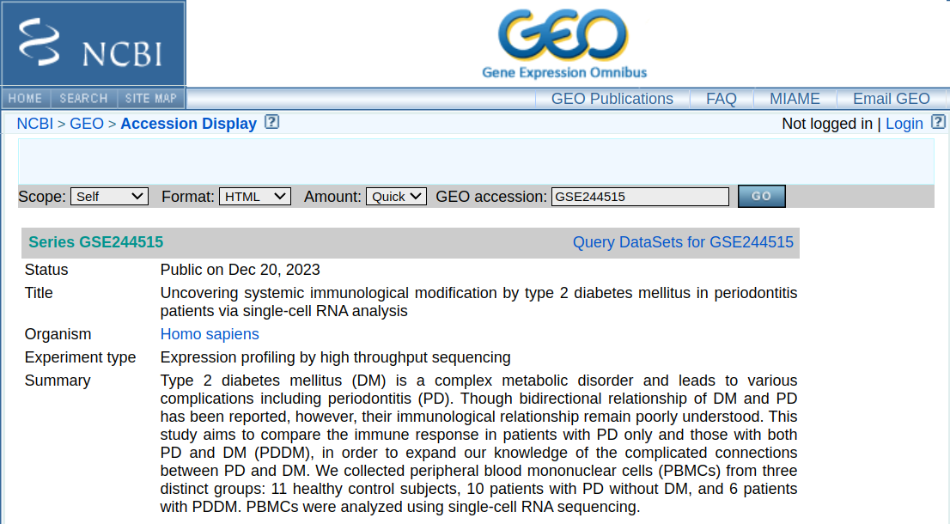
Final Data Sources
Multiomic Profiling Reveals Metabolic Alterations Mediating Aberrant Platelet Activity and Inflammation in Myeloproliferative Neoplasms [scRNA-Seq]
Uncovering systemic immunological modification by type 2 diabetes mellitus in periodontitis patients via single-cell RNA analysis

Slide 10
Preprocessing Data at a glance
Quantity control
Normalize and high variable genes (HVGs) calculated
Dimensionality Reduction (PCA)
Fixed to 50
Neighbourhood graph construction
With fixed parameters as our colleagues works on it 😉
Clusters
Leiden

Slide 11
Automatic Cell-types Annotation

Slide 12
SCSA
Based on a score annotation model
Integrates DEGs and confidence levels of cell markers
Used two databases
cellmarker
panglaodb
Able to assign cells to correct types with high precision
Original paper: https://www.frontiersin.org/journals/genetics/articles/10.3389/fgene.2020.00490/full

Slide 13
MetaTiME
Leverages pre-trained MeC models and functional annotations
Cells are projected into MeC space for annotation based on MeC scores
Provides two types of cell annotation
Major: provides broad cell-type annotation
Minor: offers detailed cell state information
Original paper: https://www.nature.com/articles/s41467-023-38333-8

Slide 14
Differential Gene Expression

Slide 15
Differential Gene Expression
Refers to
Differences in the expression levels of genes between different conditions, treatments, or cell types.
DGE analysis identifies
Genes that are significantly upregulated or downregulated between conditions, providing insights into the molecular mechanisms underlying biological processes, diseases, or experimental treatments.

Slide 16
Methods
Machine learning Methods
Support Vector Machines (SVM)
Random forests
Neural networks
Statistical Methods
T-Test
Anova
Wilcoxon

Slide 17
Results & Summary

Slide 18
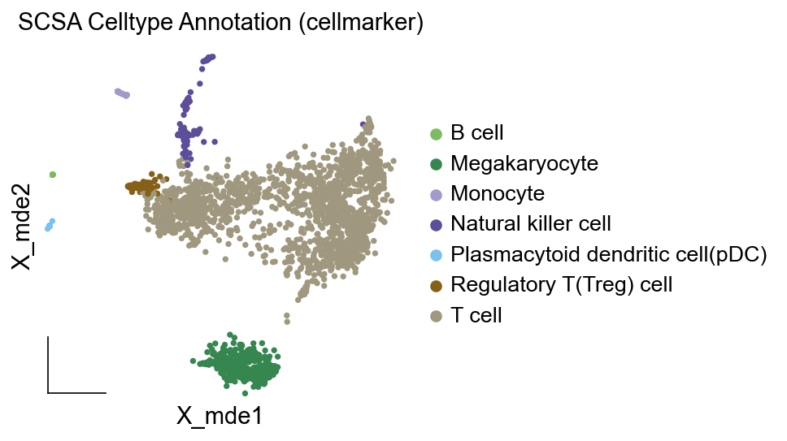
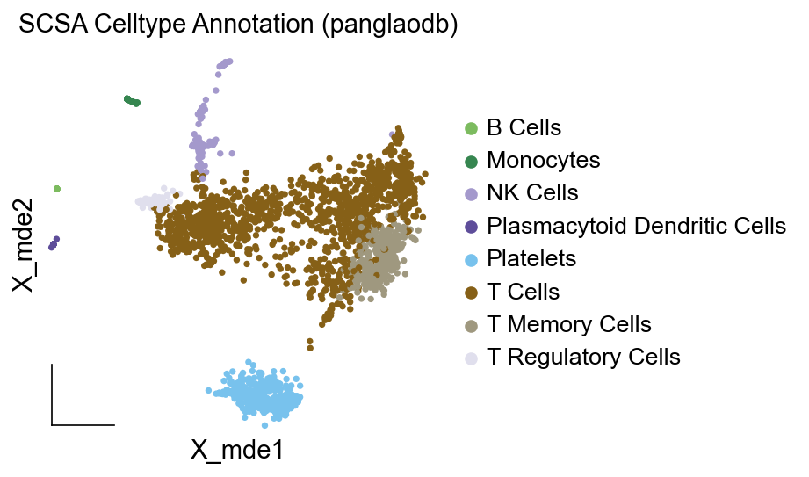
SCSA
e.g. SCSA annotation results of MPN Disease and Dataset1

Slide 19
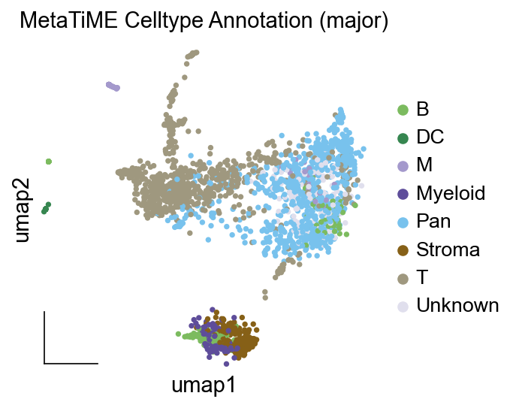
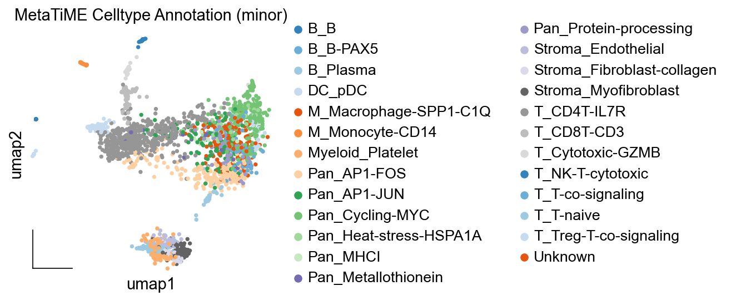
MetaTiME
e.g. MetaTiME annotation results of MPN Disease and Dataset1

Slide 20
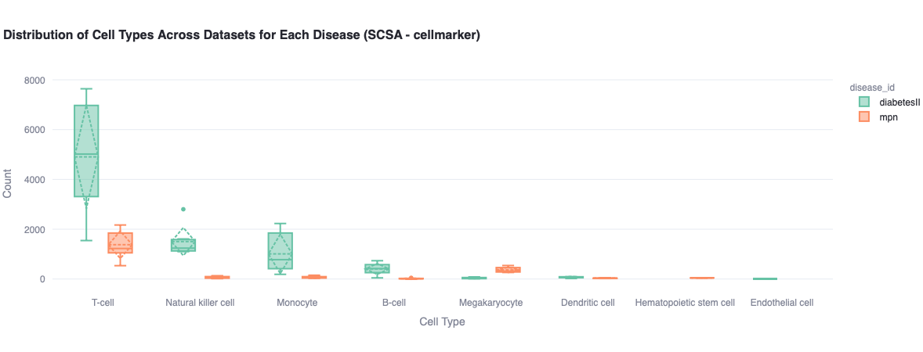
Distribution of Cell Types (SCSA - cellmarker)

Slide 21
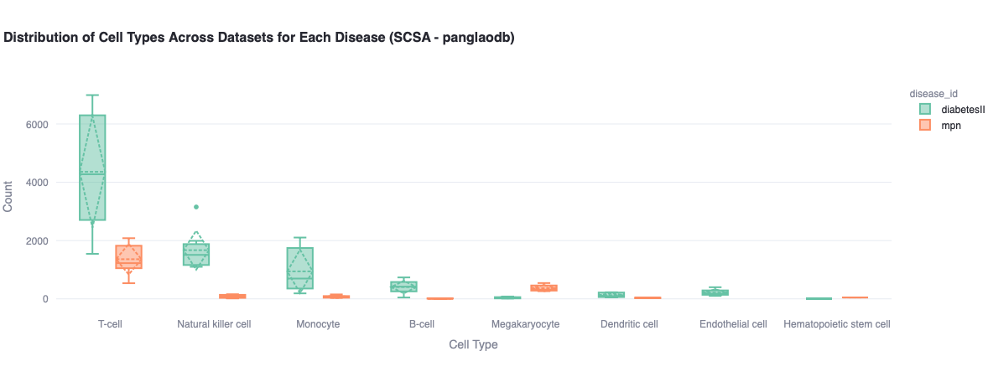
Distribution of Cell Types (SCSA - panglaodb)

Slide 22
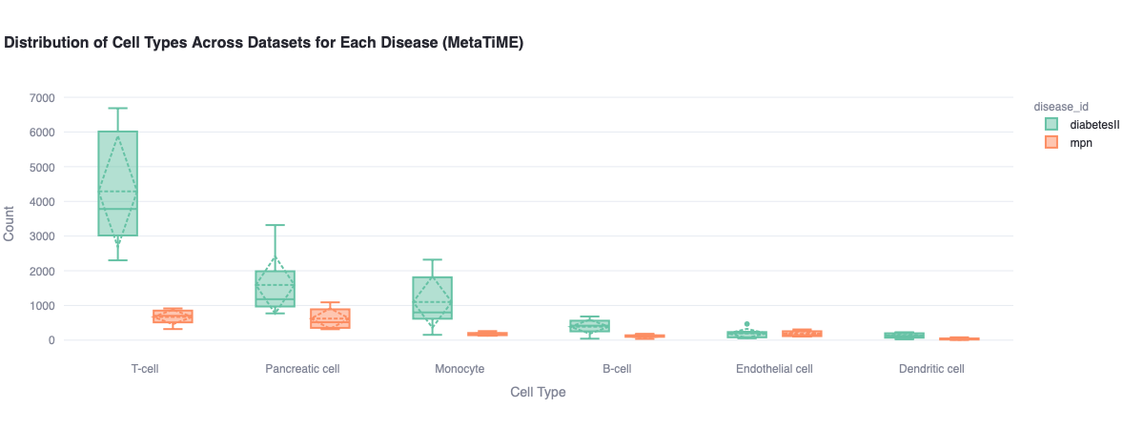
Distribution of Cell Types (MetaTiME)

Slide 23
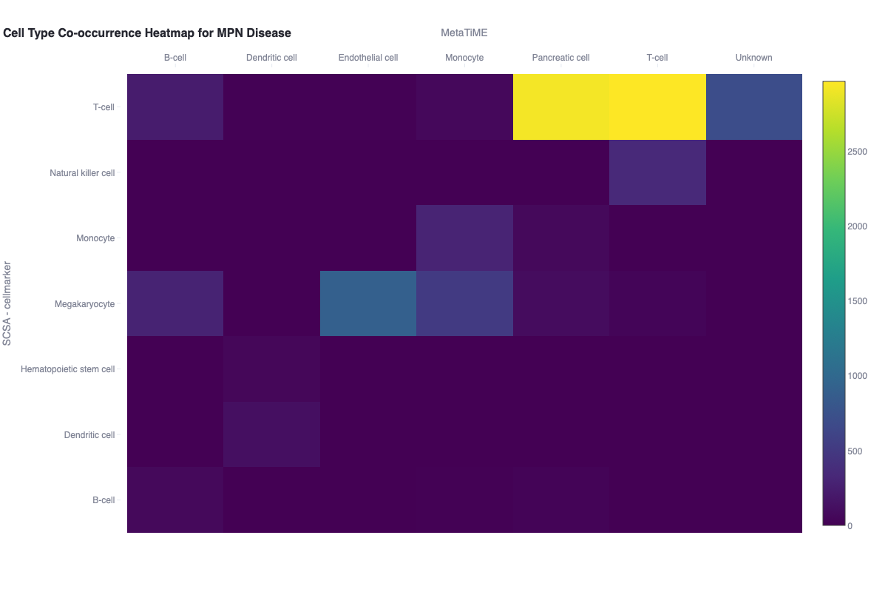
Heatmap of Cell Type Co-occurrence (one e.g.)

Slide 24
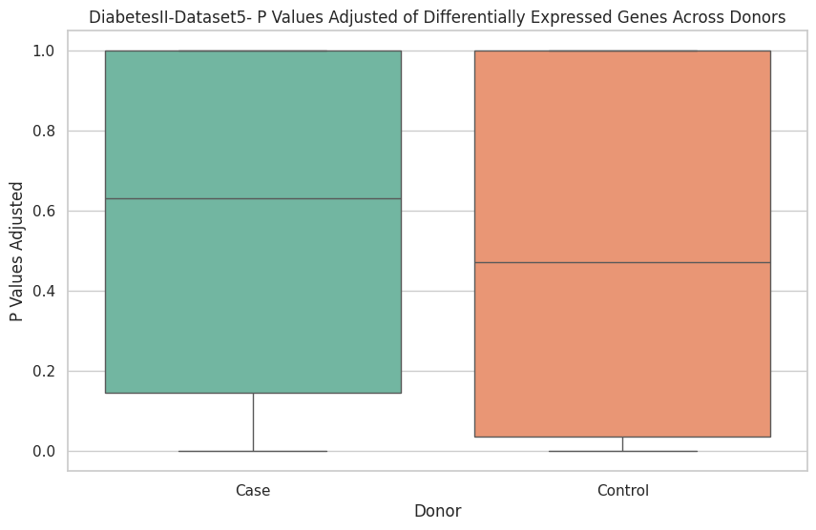
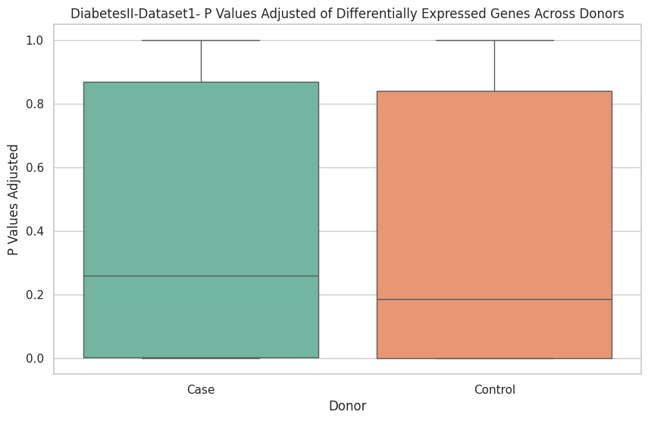
Statistical Results

Slide 25
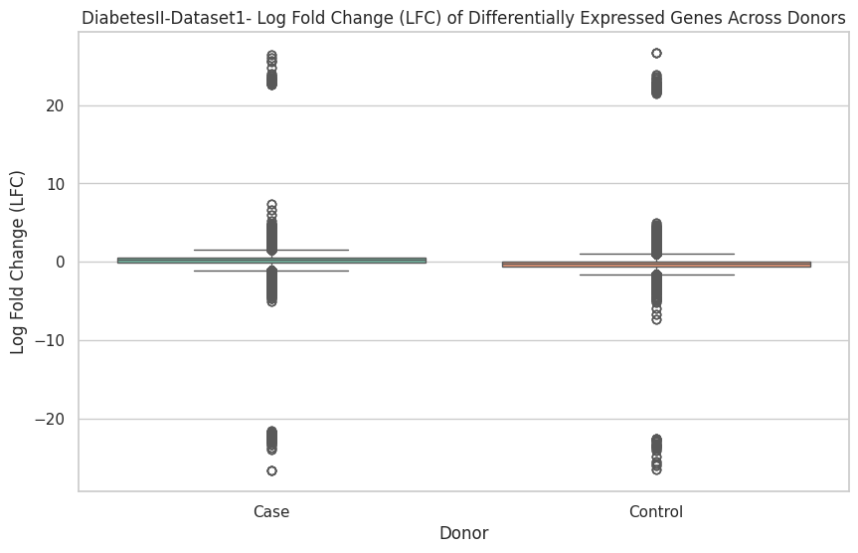
Statistical Results

Slide 26
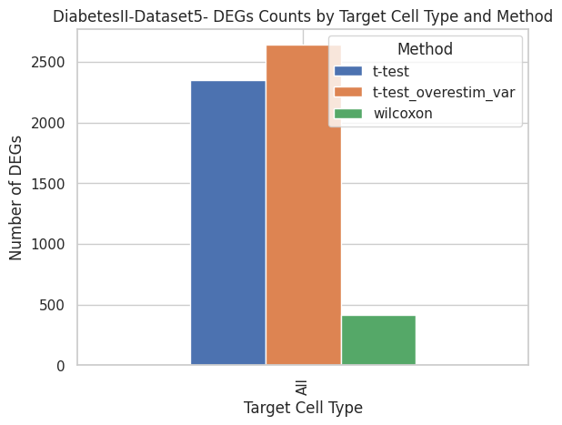
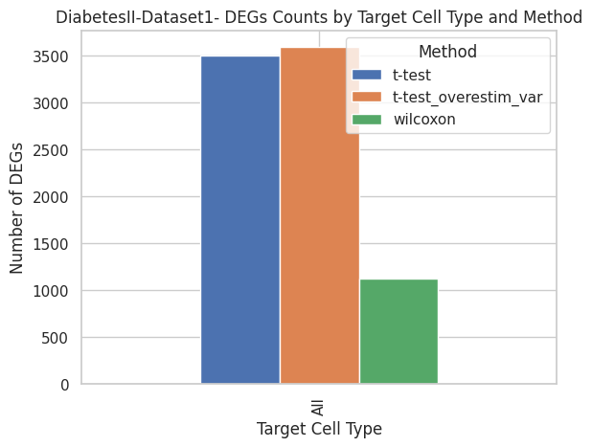
Statistical Results

Slide 27
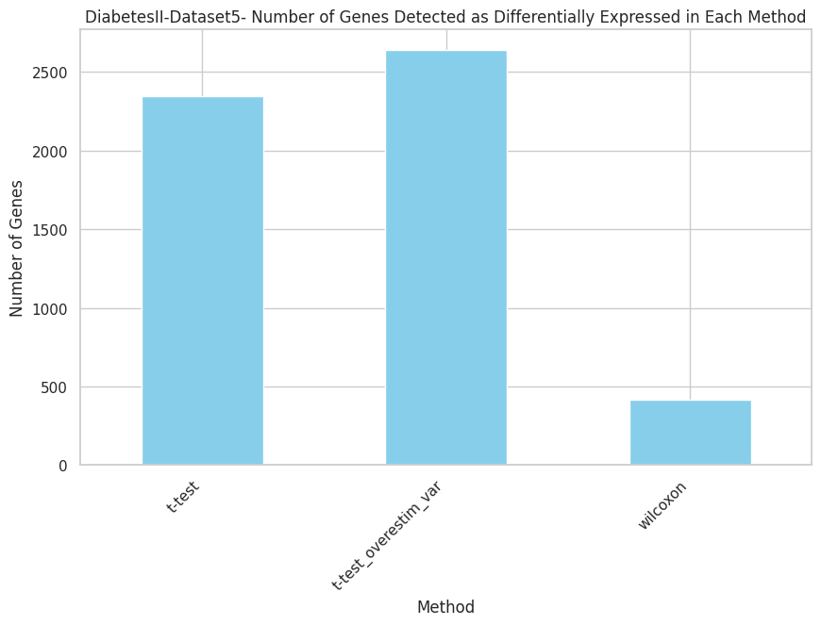
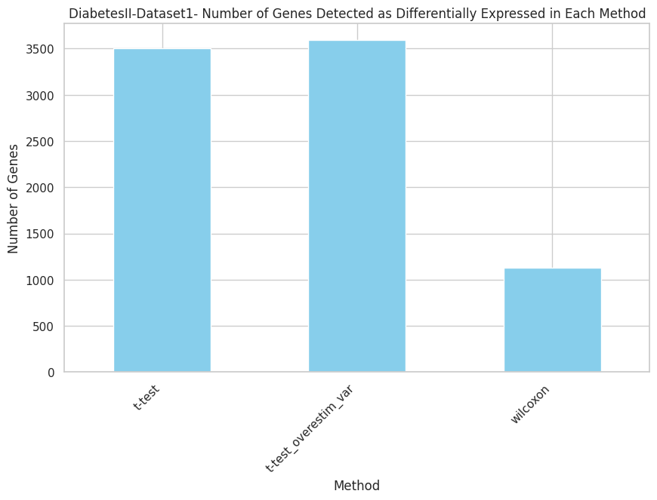
Statistical Results

Slide 28
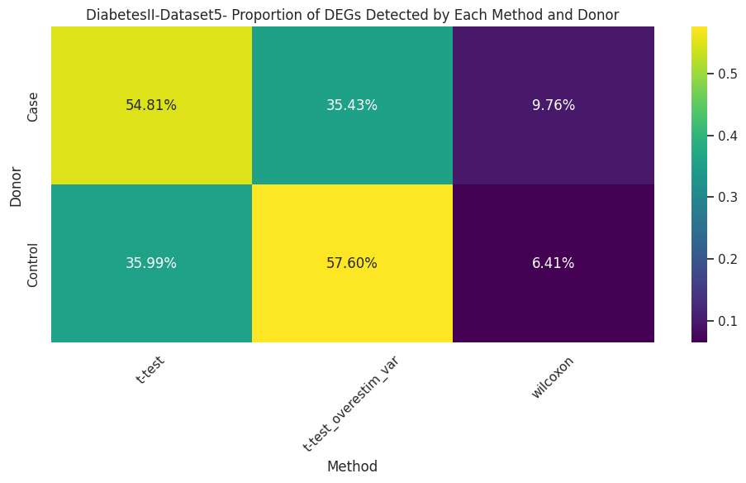
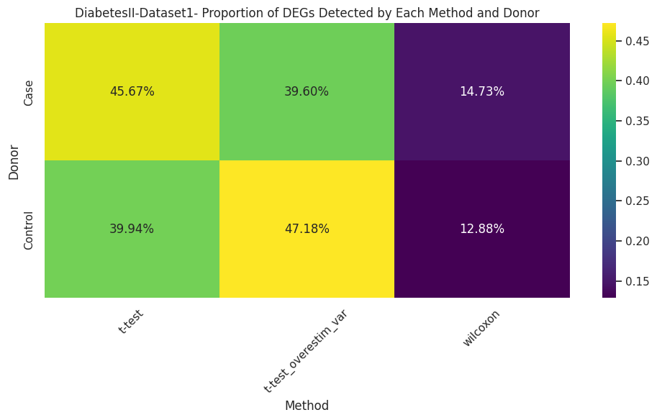
Statistical Results

Slide 29
Visualization &
Web Application

Slide 30
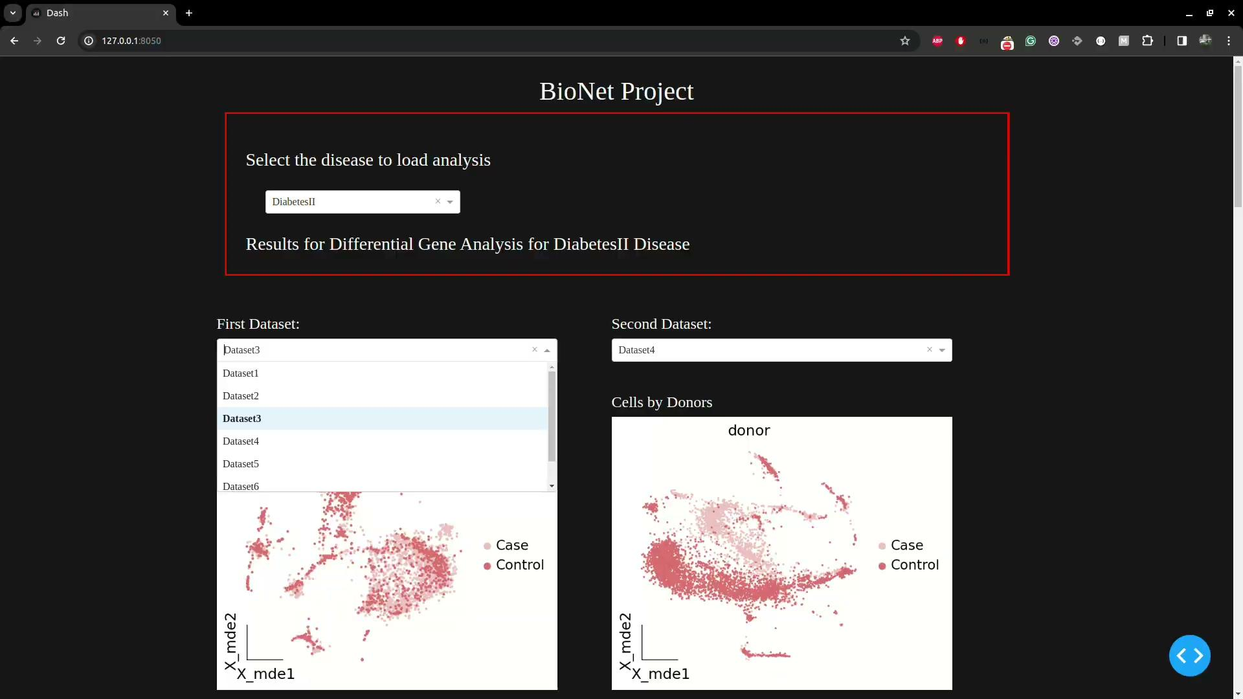

Slide 31
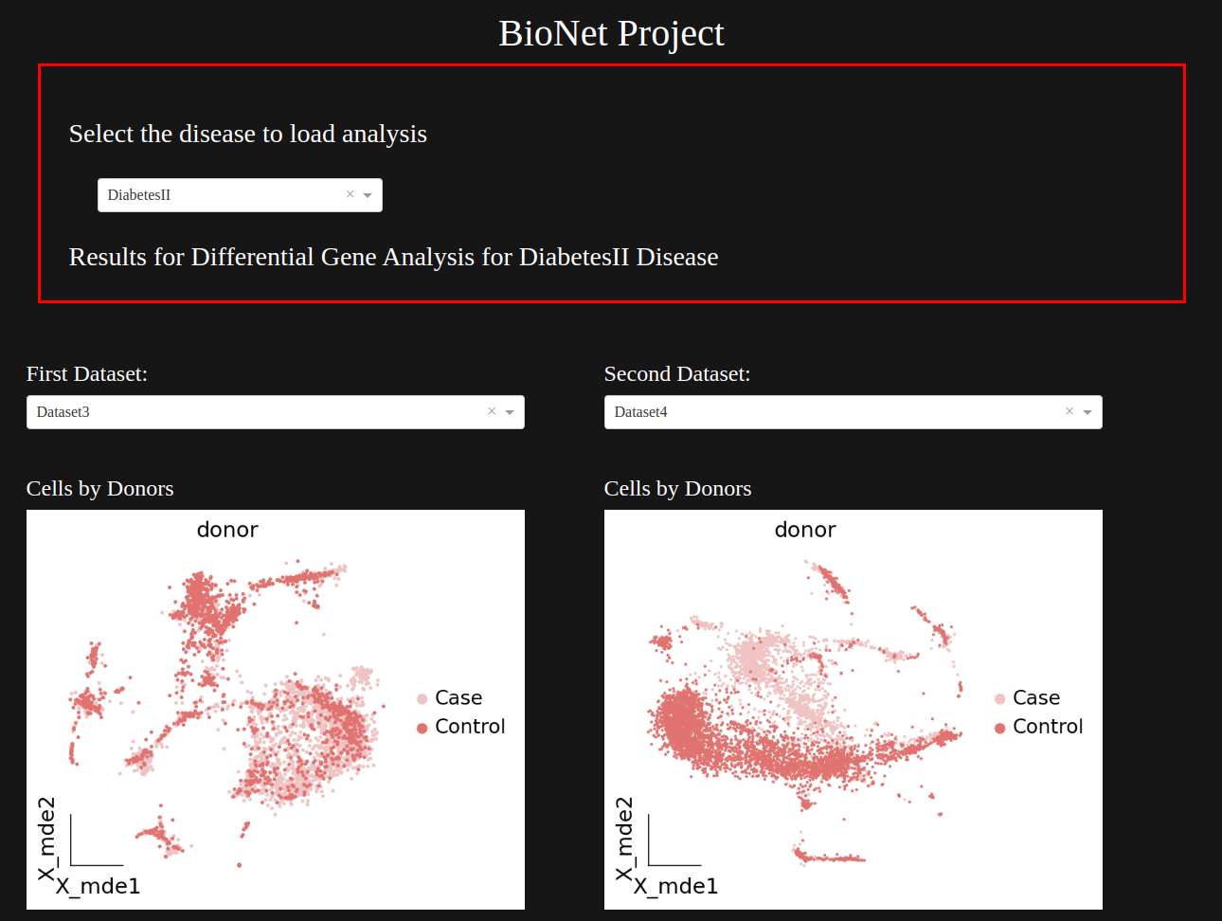
First Approach (Shiny)
Python-based Shiny
Multi-disease selection
Comparing plots functionality

Slide 32
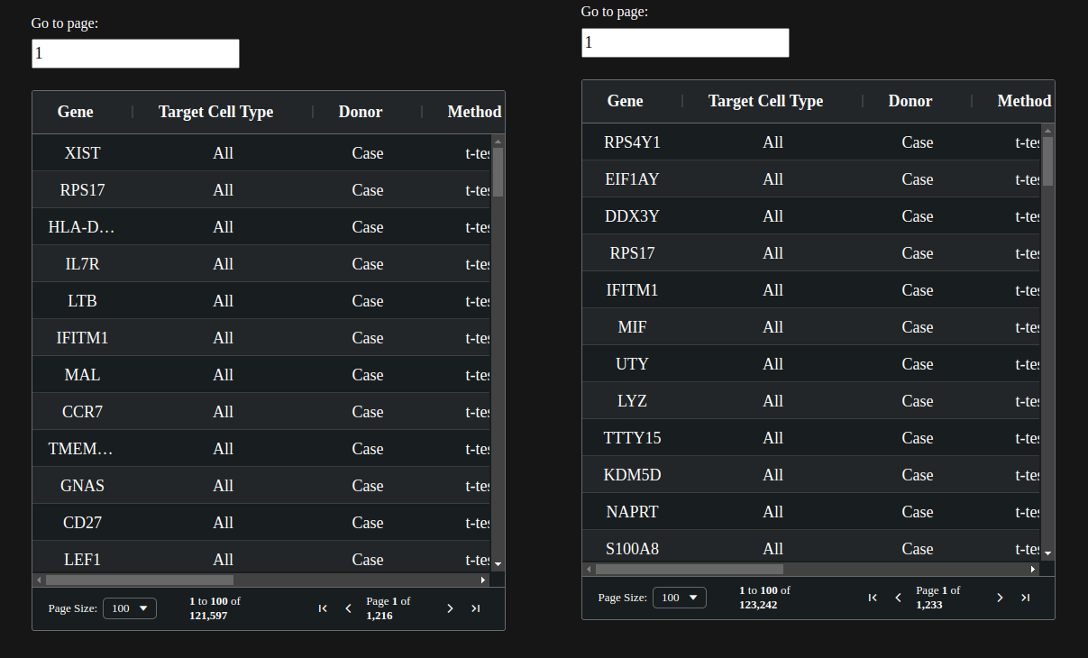
First Approach (Shiny)
Comparing plots functionality
Table filtering and comparison
Was hosted on Heroku

Slide 33
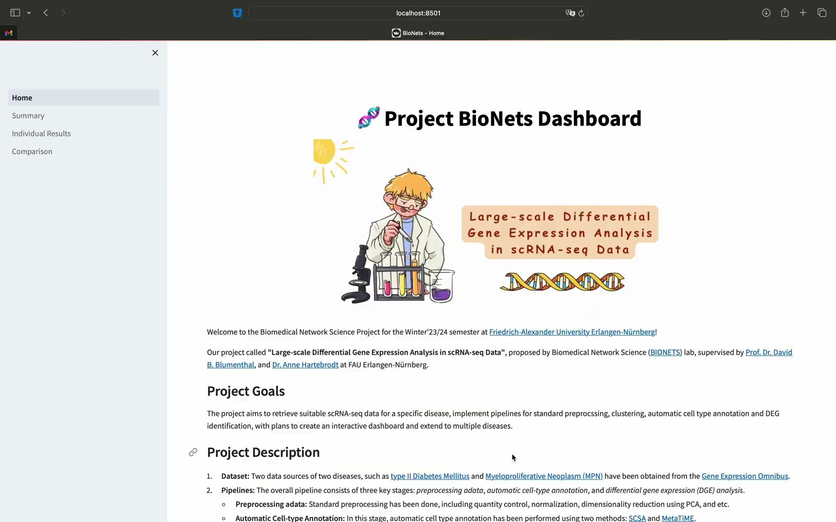

Slide 34
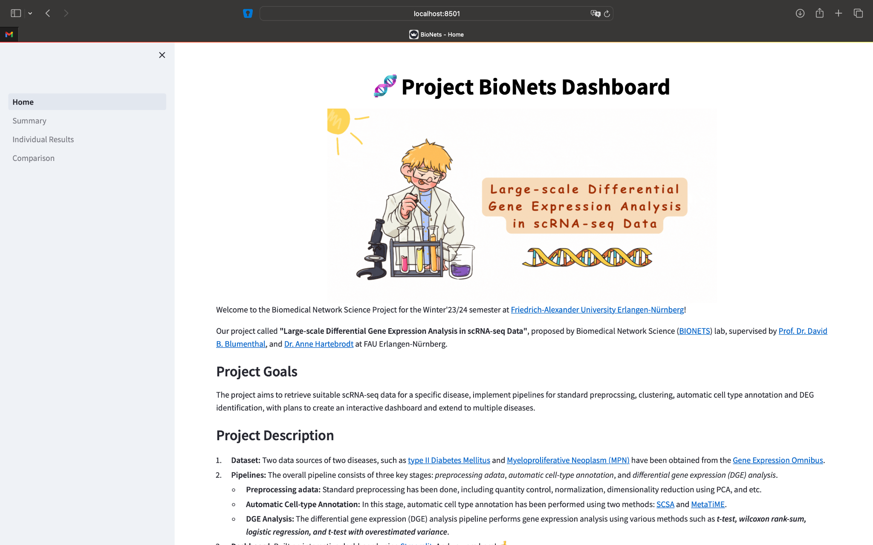
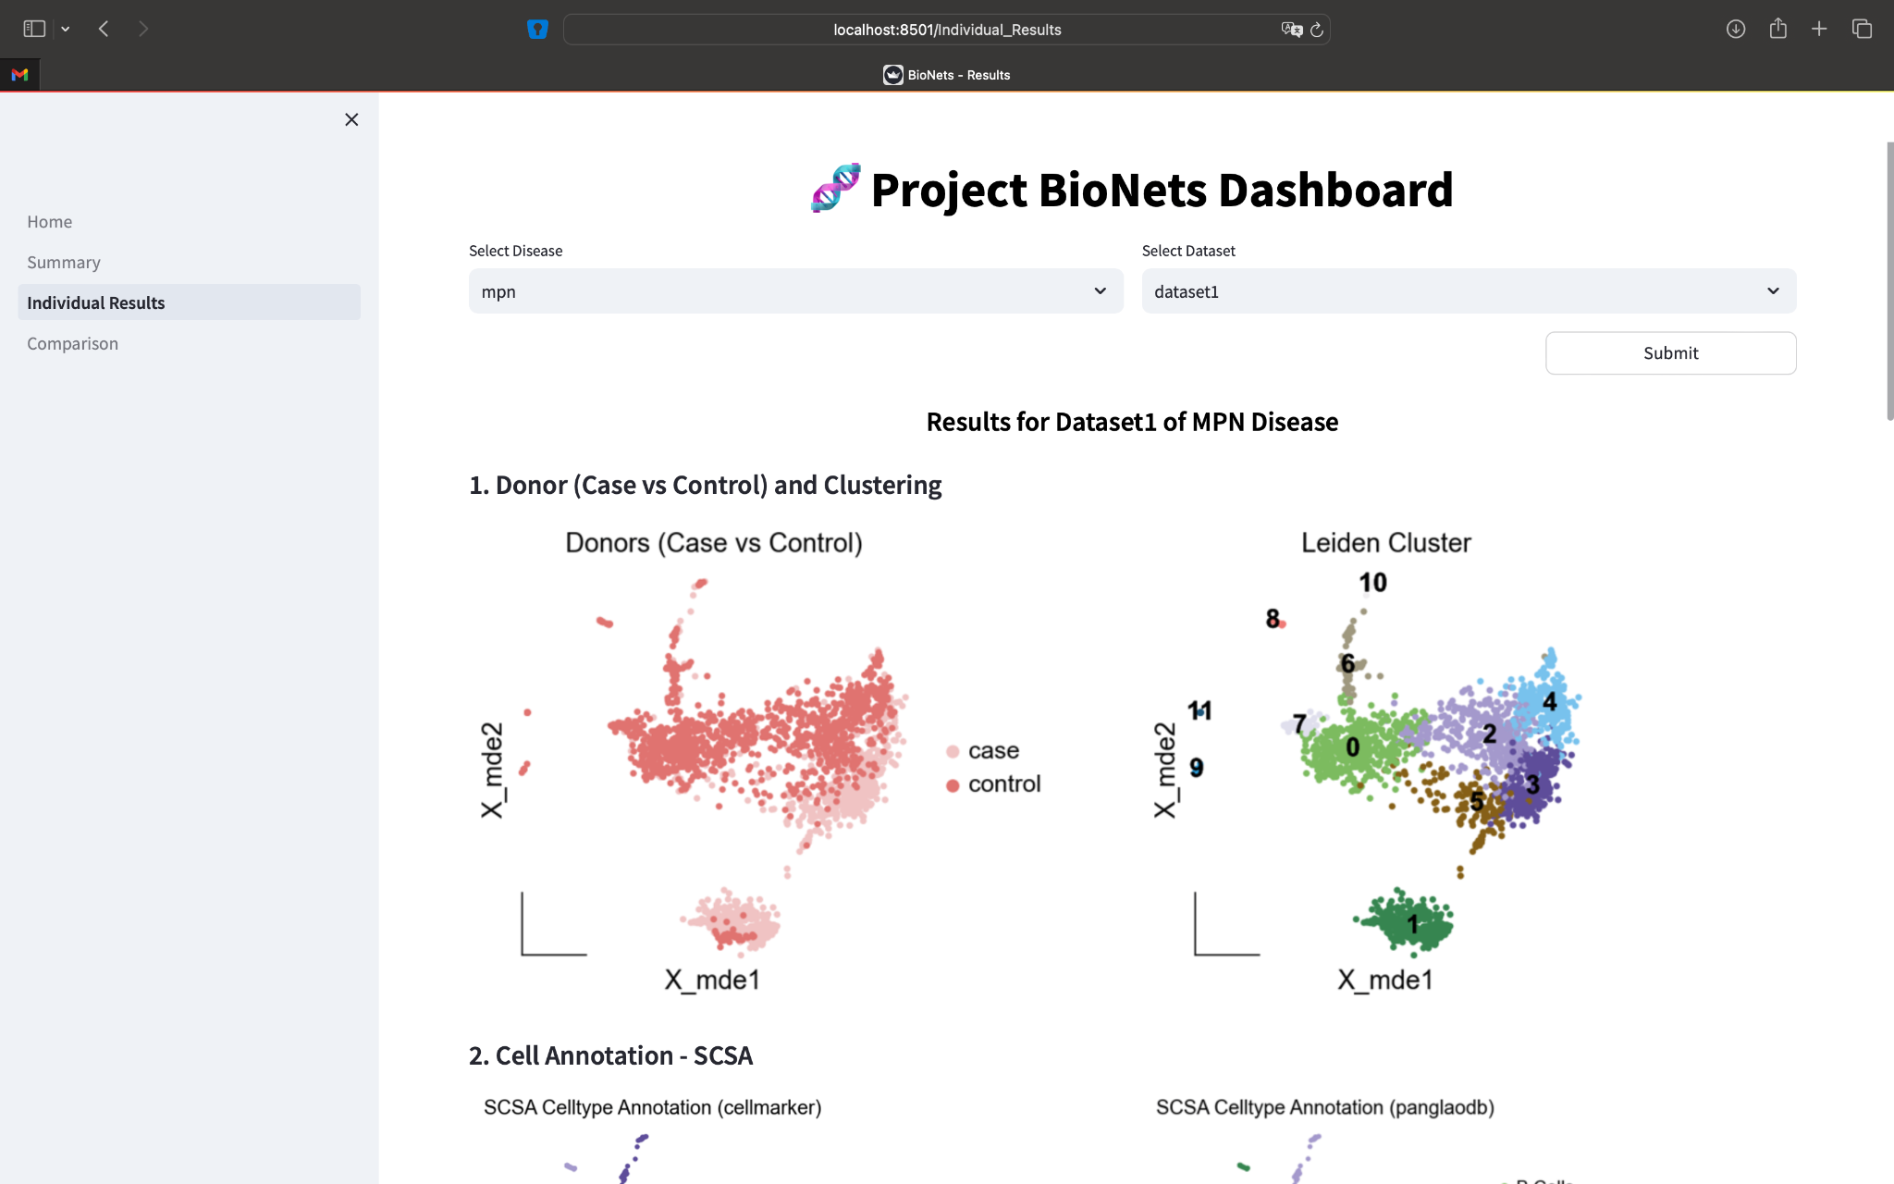
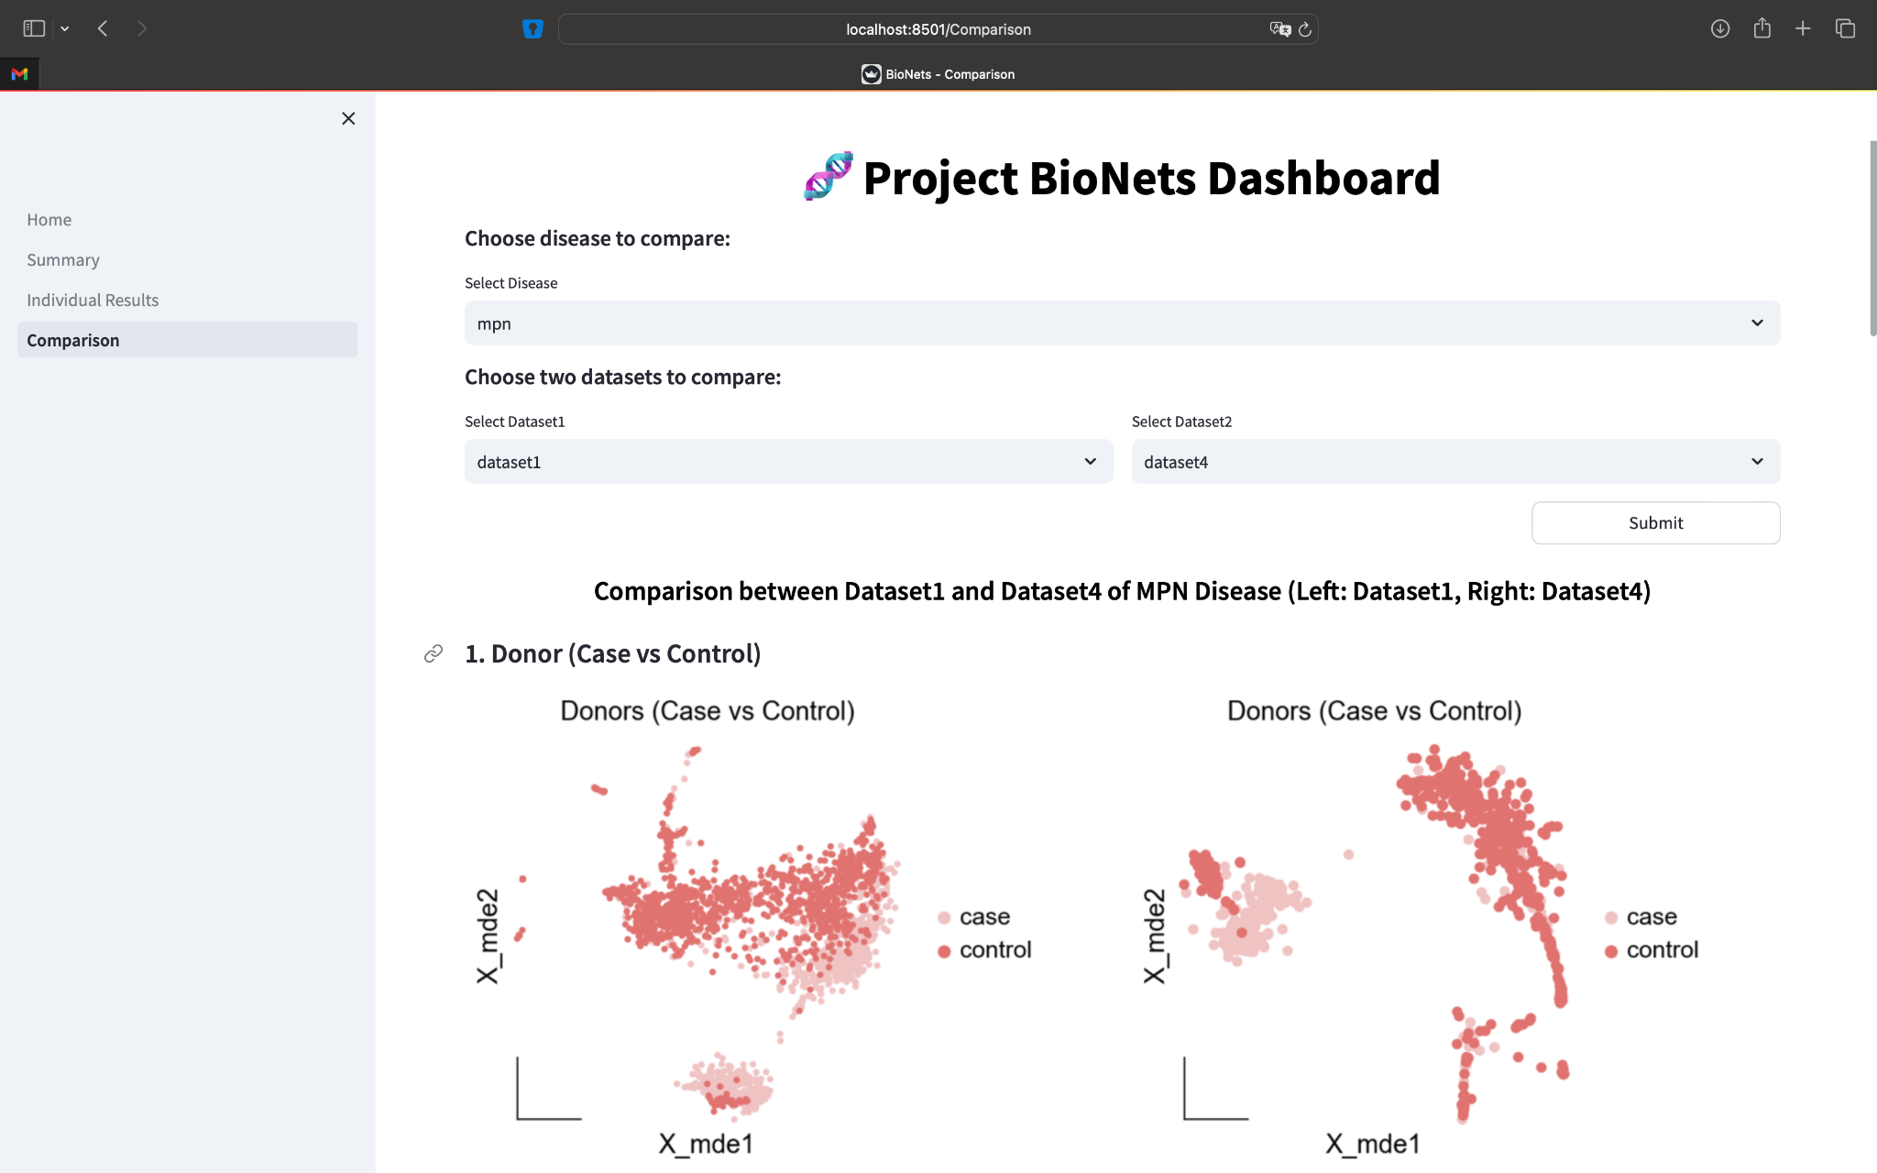
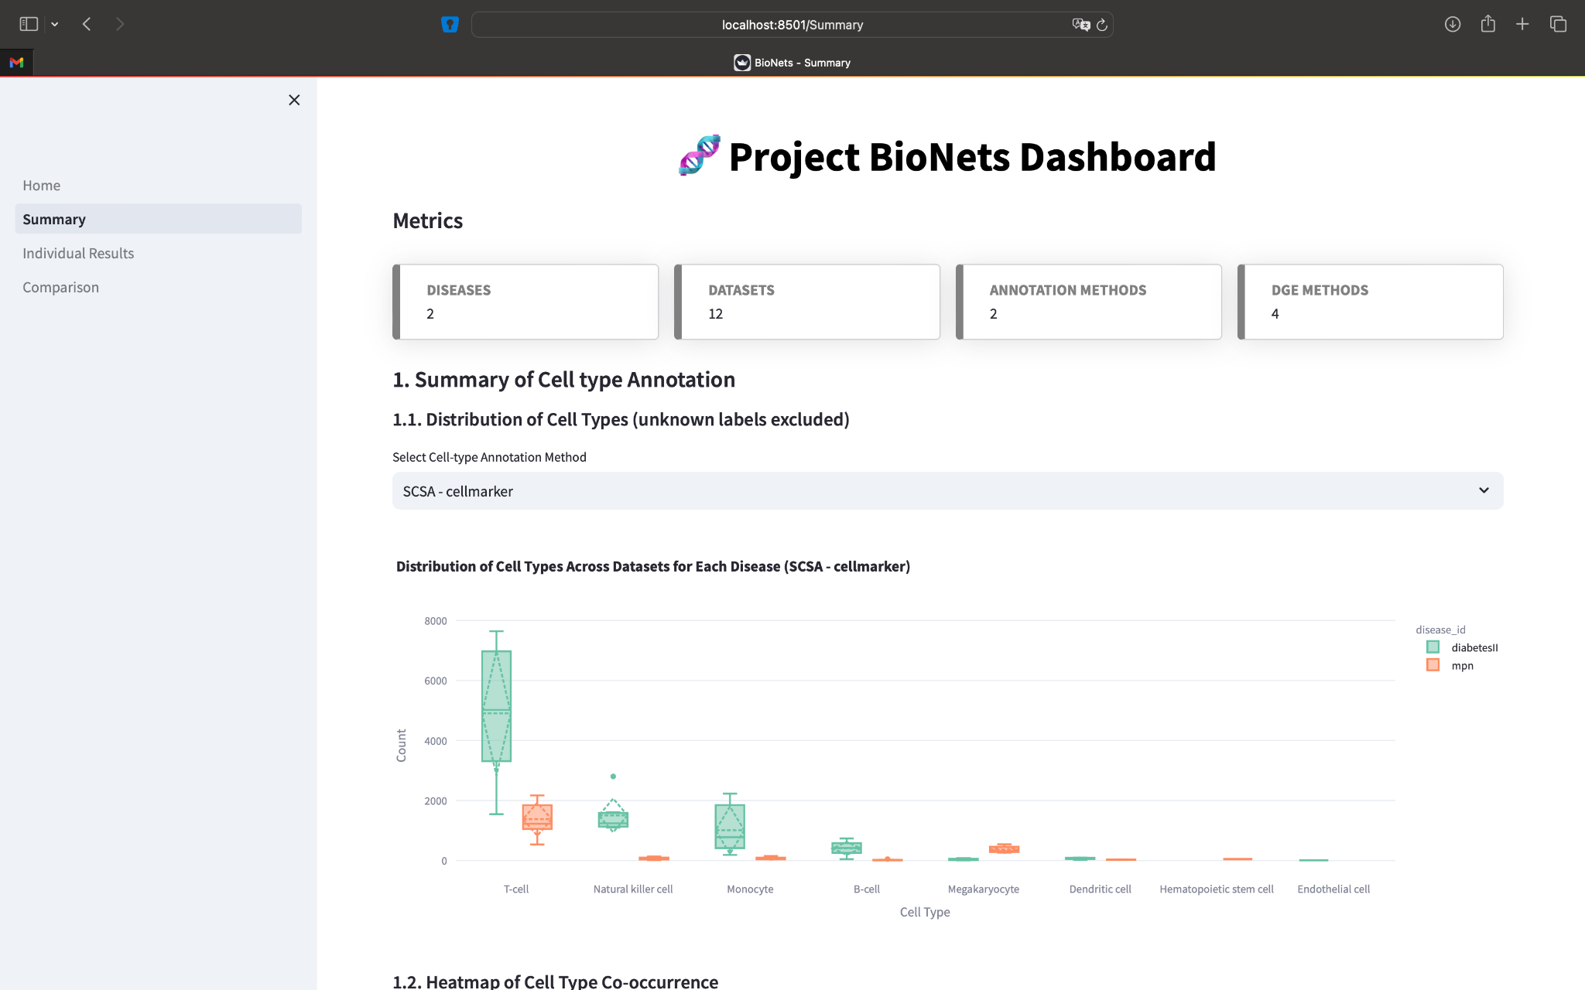
Final Approach (Streamlit)
Python-based Streamlit
Home page
Individual results showcase
Comparison functionality
Interactive summary results

Slide 35

Scan it for Git repo
If you like our project,
give us a ⭐

Slide 36
Thank You for Listening!
Any Questions?

