Slide 1
Chapter 5
Understanding Requirements
Slide Set to accompany
Software Engineering: A Practitioner’s Approach, 7/e
by Roger S. Pressman
Slides copyright © 1996, 2001, 2005, 2009 by Roger S. Pressman
These slides are designed to accompany Software Engineering: A Practitioner’s Approach, 7/e (McGraw-Hill, 2009). Slides copyright 2009 by Roger Pressman.

Slide 2
Requirements Engineering-I
Inception—ask a set of questions that establish …
  basic understanding of the problem
  the people who want a solution
  the nature of the solution that is desired, and
  the effectiveness of preliminary communication and collaboration between the customer and the developer
Elicitation—elicit requirements from all stakeholders
Elaboration—create an analysis model that identifies data, function and behavioral requirements
Negotiation—agree on a deliverable system that is realistic for developers and customers
These slides are designed to accompany Software Engineering: A Practitioner’s Approach, 7/e (McGraw-Hill, 2009). Slides copyright 2009 by Roger Pressman.

Slide 3
Requirements Engineering-II
Specification—can be any one (or more) of the following:
  A written document
  A set of models
  A formal mathematical
  A collection of user scenarios (use-cases)
  A prototype
Validation—a review mechanism that looks for
  errors in content or interpretation
  areas where clarification may be required
  missing information
  inconsistencies (a major problem when large products or systems are engineered)
  conflicting or unrealistic (unachievable) requirements.
Requirements management
These slides are designed to accompany Software Engineering: A Practitioner’s Approach, 7/e (McGraw-Hill, 2009). Slides copyright 2009 by Roger Pressman.

Slide 4
Inception
Identify stakeholders
  “who else do you think I should talk to?”
Recognize multiple points of view
Work toward collaboration
The first questions
  Who is behind the request for this work?
  Who will use the solution?
  What will be the economic benefit of a successful solution
  Is there another source for the solution that you need?
These slides are designed to accompany Software Engineering: A Practitioner’s Approach, 7/e (McGraw-Hill, 2009). Slides copyright 2009 by Roger Pressman.

Slide 5
Eliciting Requirements
meetings are conducted and attended by both software engineers and customers
an agenda is suggested
a "facilitator" (can be a customer, a developer, or an outsider) controls the meeting
a "definition mechanism" (can be work sheets, flip charts, or wall stickers or an electronic bulletin board, chat room or virtual forum) is used
the goal is
  to identify the problem
  propose elements of the solution
  negotiate different approaches, and
  specify a preliminary set of solution requirements
These slides are designed to accompany Software Engineering: A Practitioner’s Approach, 7/e (McGraw-Hill, 2009). Slides copyright 2009 by Roger Pressman.

Slide 6
Quality Function Deployment
Information deployment identifies data objects and events
Function deployment determines the “value” (as perceived by the customer) of each function required of the system
Task deployment examines the behavior of the system
Value analysis determines the relative priority of requirements

Slide 7
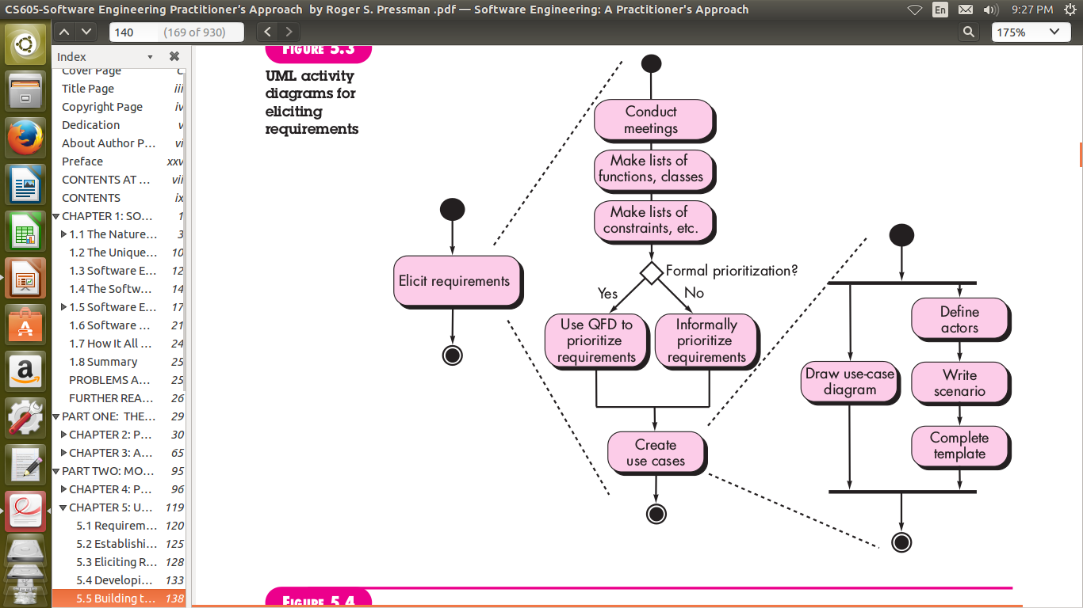
Eliciting Requirements

Slide 8
Elicitation Work Products
a statement of need and feasibility.
a bounded statement of scope for the system or product.
a list of customers, users, and other stakeholders who participated in requirements elicitation
a description of the system’s technical environment.
a list of requirements (preferably organized by function) and the domain constraints that apply to each.
a set of usage scenarios that provide insight into the use of the system or product under different operating conditions.
These slides are designed to accompany Software Engineering: A Practitioner’s Approach, 7/e (McGraw-Hill, 2009). Slides copyright 2009 by Roger Pressman.

Slide 9
Negotiating Requirements
Identify the key stakeholders
  These are the people who will be involved in the negotiation
Determine each of the stakeholders “win conditions”
  Win conditions are not always obvious
Negotiate
  Work toward a set of requirements that lead to “win-win”
These slides are designed to accompany Software Engineering: A Practitioner’s Approach, 7/e (McGraw-Hill, 2009). Slides copyright 2009 by Roger Pressman.

Slide 10
Validating Requirements - I
Is each requirement consistent with the overall objective for the system/product?
Is the requirement really necessary or does it represent an add-on feature that may not be essential to the objective of the system?
Is each requirement bounded and unambiguous?
Does each requirement have attribution? That is, is a source (generally, a specific individual) noted for each requirement?
Do any requirements conflict with other requirements?
These slides are designed to accompany Software Engineering: A Practitioner’s Approach, 7/e (McGraw-Hill, 2009). Slides copyright 2009 by Roger Pressman.

Slide 11
Validating Requirements - II
Is each requirement achievable in the technical environment that will house the system or product?
Is each requirement testable, once implemented?
Does the requirements model properly reflect the information, function and behavior of the system to be built.
Has the requirements model been “partitioned” in a way that exposes progressively more detailed information about the system.
Have requirements patterns been used to simplify the requirements model. Have all patterns been properly validated? Are all patterns consistent with customer requirements?
These slides are designed to accompany Software Engineering: A Practitioner’s Approach, 7/e (McGraw-Hill, 2009). Slides copyright 2009 by Roger Pressman.

Slide 12
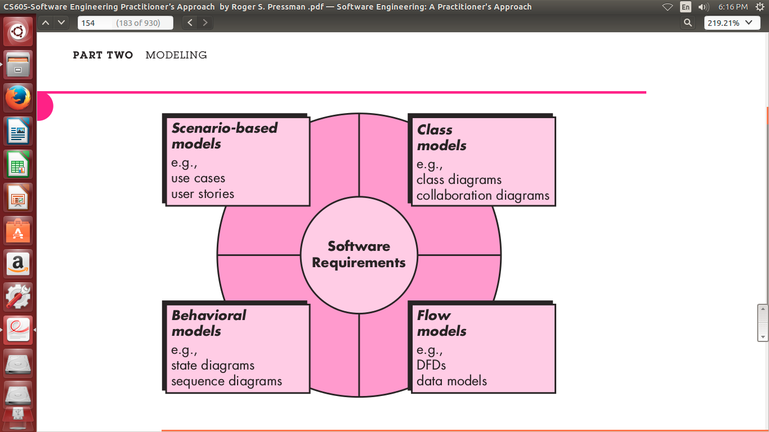
Building the Analysis Model

Slide 13
Building the Analysis Model
Elements of the analysis model
  Scenario-based elements
    Functional—processing narratives for software functions
    Use-case—descriptions of the interaction between an “actor” and the system
  Class-based elements
    Implied by scenarios
  Behavioral elements
    State diagram
  Flow-oriented elements
    Data flow diagram
These slides are designed to accompany Software Engineering: A Practitioner’s Approach, 7/e (McGraw-Hill, 2009). Slides copyright 2009 by Roger Pressman.

Slide 14
Use-Cases
A collection of user scenarios that describe the thread of usage of a system
Each scenario is described from the point-of-view of an “actor”—a person or device that interacts with the software in some way
Each scenario answers the following questions:
  Who is the primary actor, the secondary actor (s)?
  What are the actor’s goals?
  What preconditions should exist before the story begins?
  What main tasks or functions are performed by the actor?
  What extensions might be considered as the story is described?
  What variations in the actor’s interaction are possible?
  What system information will the actor acquire, produce, or change?
  Will the actor have to inform the system about changes in the external environment?
  What information does the actor desire from the system?
  Does the actor wish to be informed about unexpected changes?
These slides are designed to accompany Software Engineering: A Practitioner’s Approach, 7/e (McGraw-Hill, 2009). Slides copyright 2009 by Roger Pressman.

Slide 15
Use-Case Diagram
These slides are designed to accompany Software Engineering: A Practitioner’s Approach, 7/e (McGraw-Hill, 2009). Slides copyright 2009 by Roger Pressman.

Slide 16
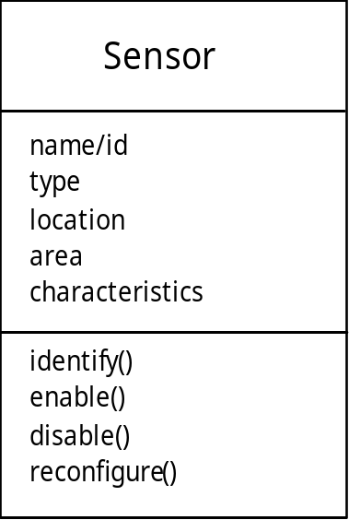
Class Diagram
From the SafeHome system …
These slides are designed to accompany Software Engineering: A Practitioner’s Approach, 7/e (McGraw-Hill, 2009). Slides copyright 2009 by Roger Pressman.

Slide 17
State Diagram
Reading
Commands
State name
System status = “ready”
Display msg = “enter cmd”
Display status = steady
State variables
Entry/subsystems ready
Do: poll user input panel
Do: read user input
Do: interpret user input
State activities
These slides are designed to accompany Software Engineering: A Practitioner’s Approach, 7/e (McGraw-Hill, 2009). Slides copyright 2009 by Roger Pressman.

