Slide 1
Hostel Management
System
DBMS Project
K Sujith Bhatt – 181MT018
Chirag K – 181ME119
Srihari M – 181CV145
1/29

Slide 2
INTRODUCTION
Hostel Management system is a web application which aims at computerization of current procedure of allocating hostel rooms.
Currently the process involves students filling up the forms and submitting them in respective hostel offices which involves a lot of paperwork, hence less efficient !
2/29

Slide 3



TYPES OF USERS
Student
Admin
3/29

Slide 4
Student
4/29

Slide 5
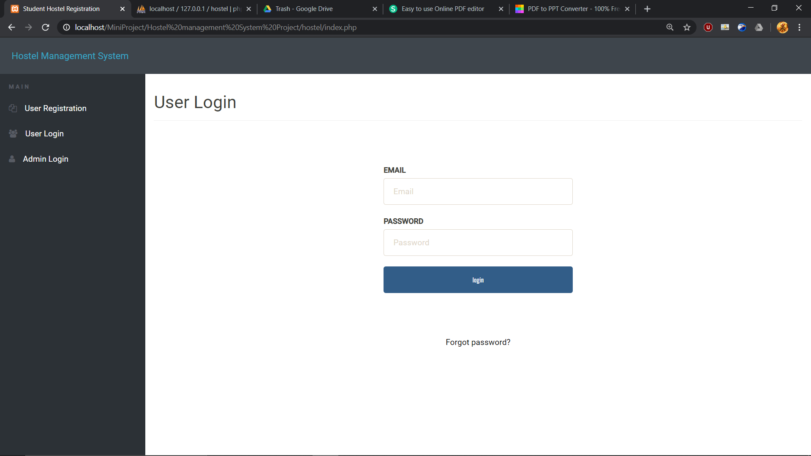
LOGIN PAGE
If and only if the user exists in DB and password entered is correct, he/she will be able to login, otherwise appropriate error message is displayed.
5/29

Slide 6
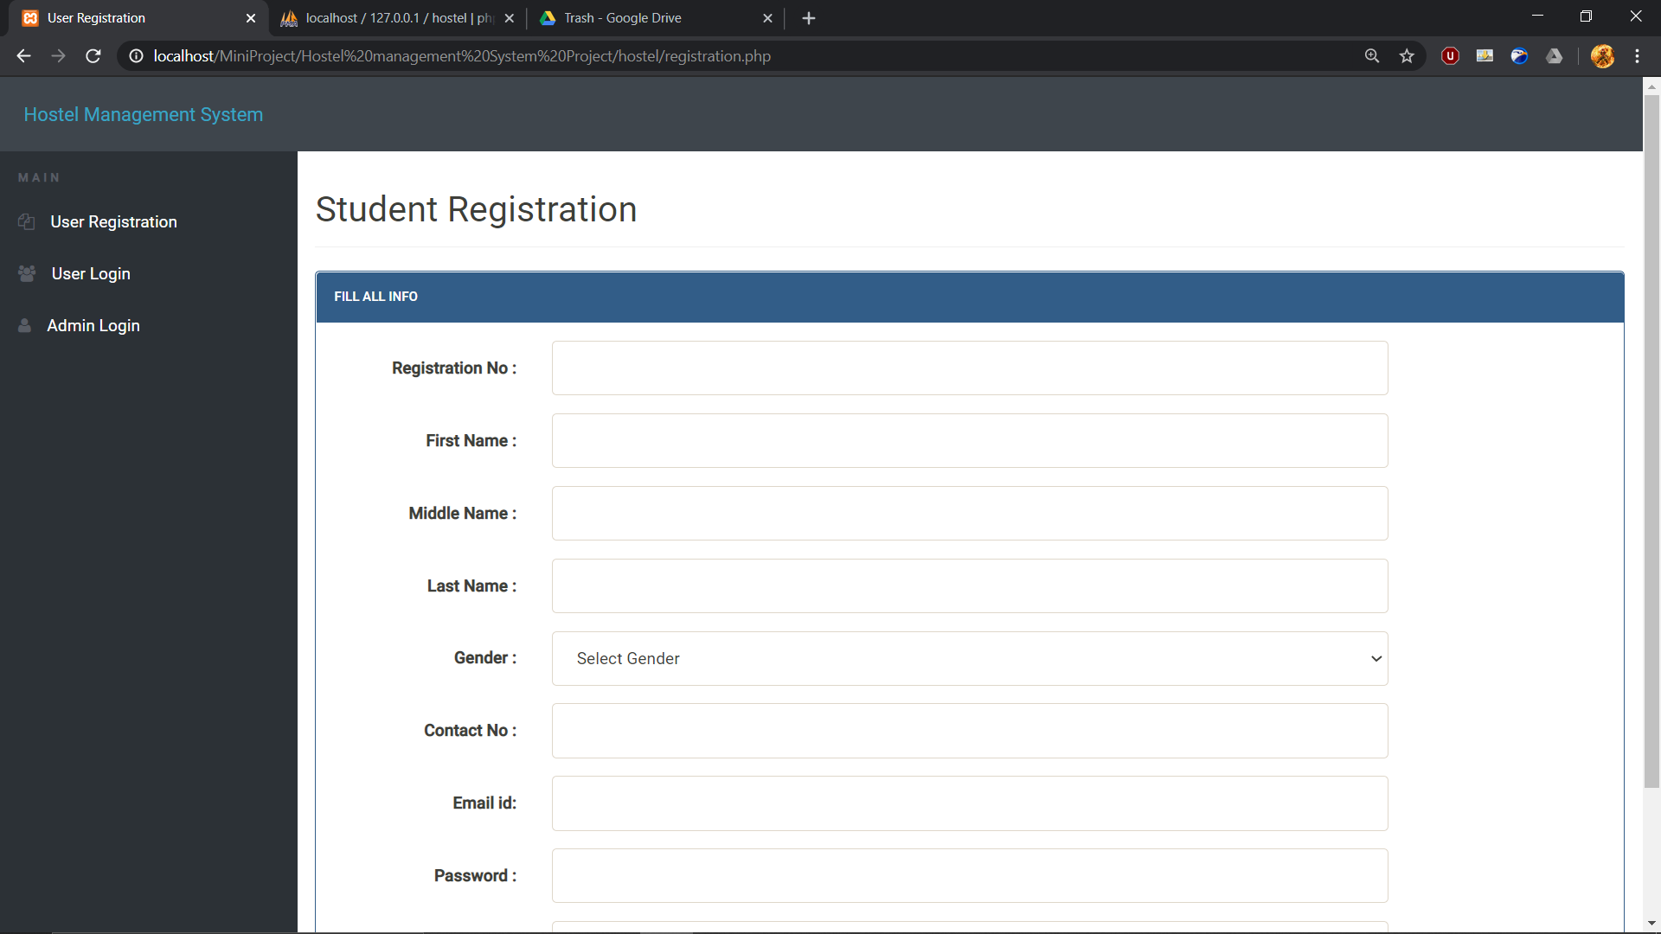
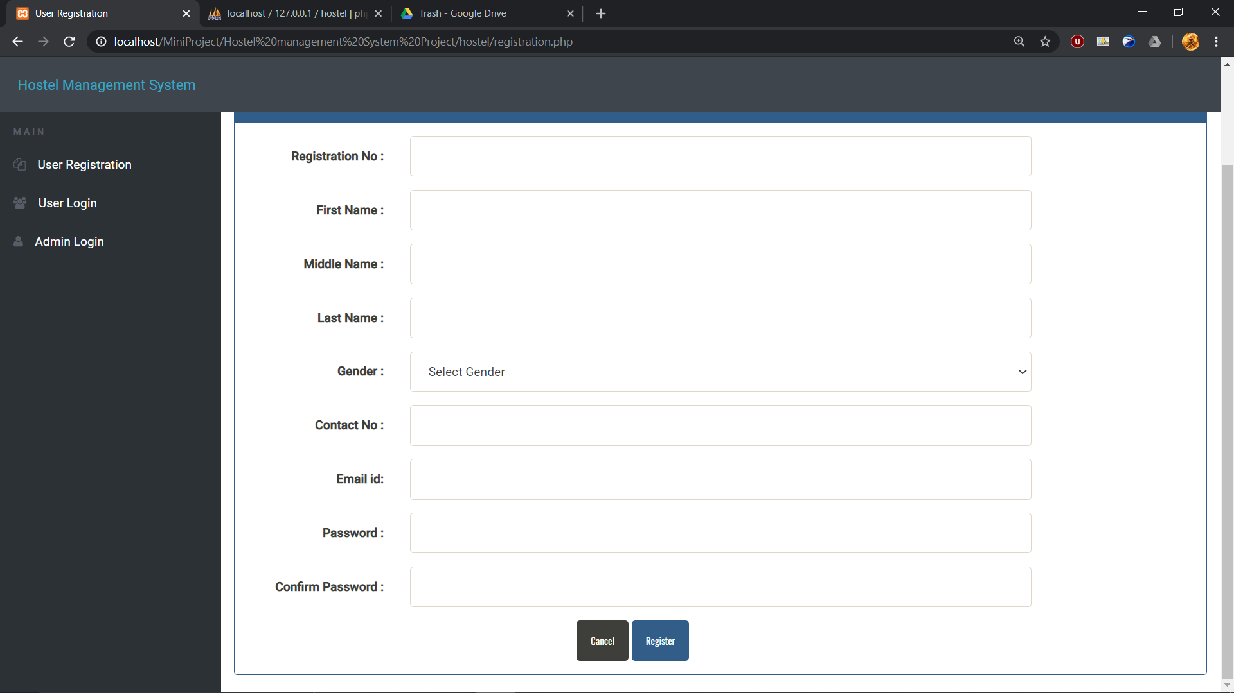
REGISTRATION PAGE
Students who are not a part of the portal can register themselves here.
Administrators can not sign up (will be added in the next version). There is only one admin unless added manually.
All the necessary error conditions are checked.(like if a user with the entered roll number already exists).

Slide 7
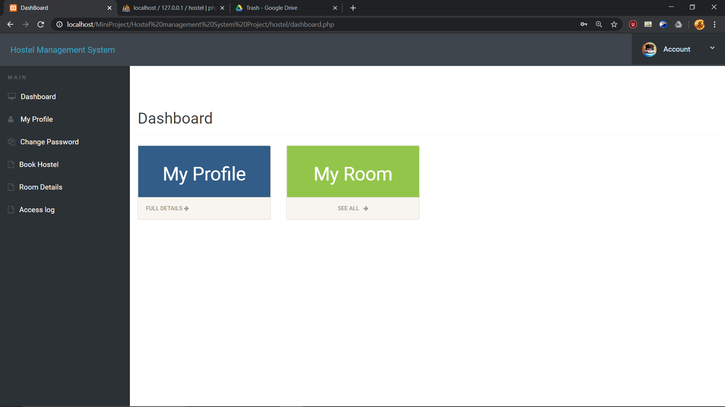
DASHBOARD

Slide 8
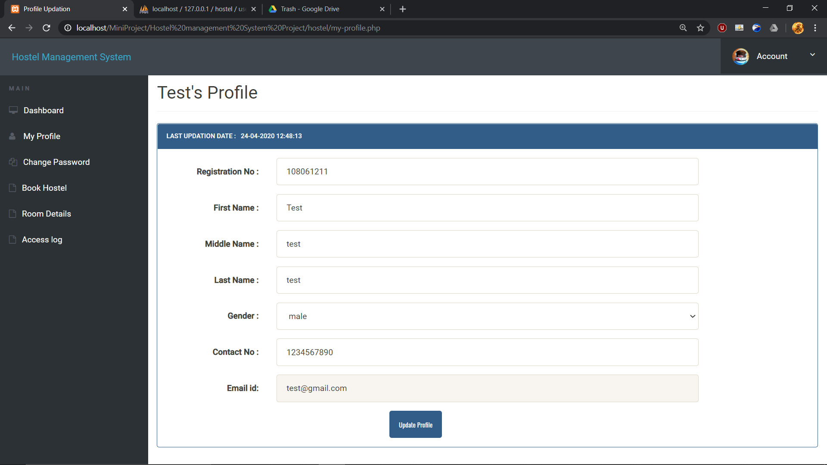
MY PROFILE

Slide 9
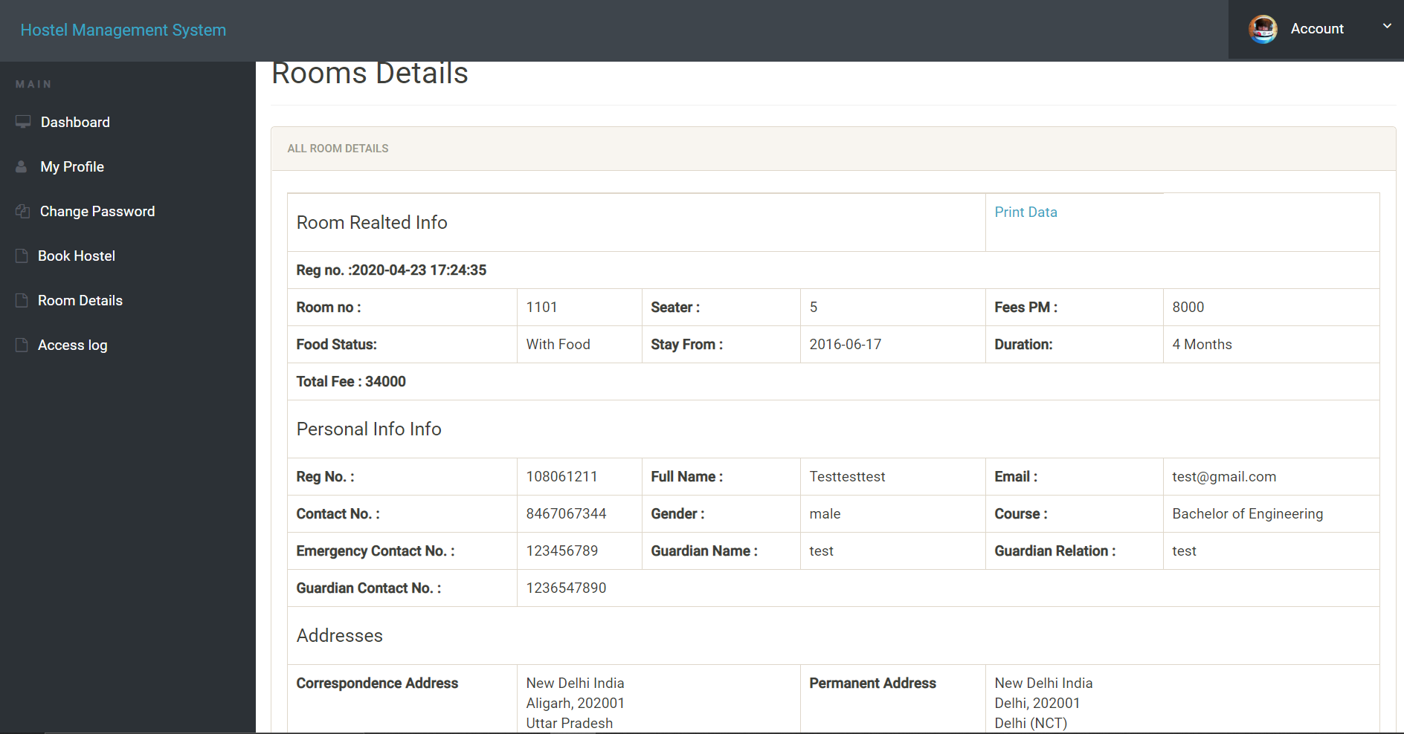
ROOM DETAILS

Slide 10
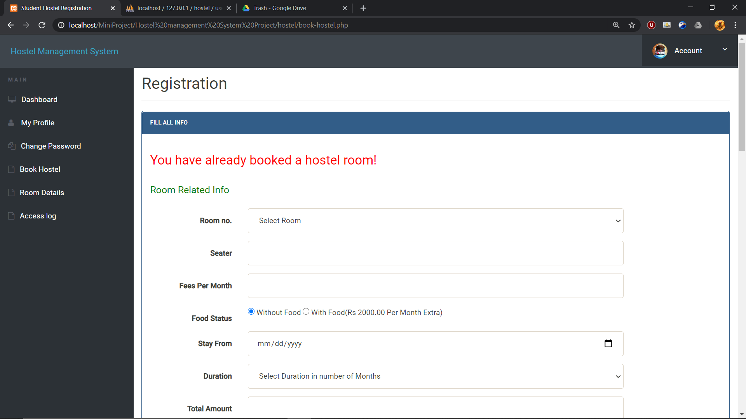
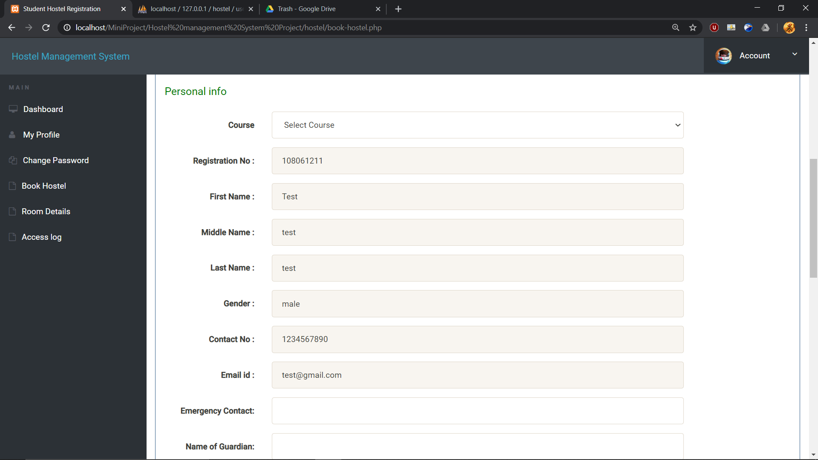
BOOK HOSTEL

Slide 11
Admin
11/29

Slide 12
The admin can register new students (all checks and validation present).
Can update his/her email id and password.
Can add and manage the courses offered.
Can add and manage the rooms available.
Can manage the students registered for hostel rooms.
Has to manually remove the students after the completion of duration of stay of students.

Slide 13
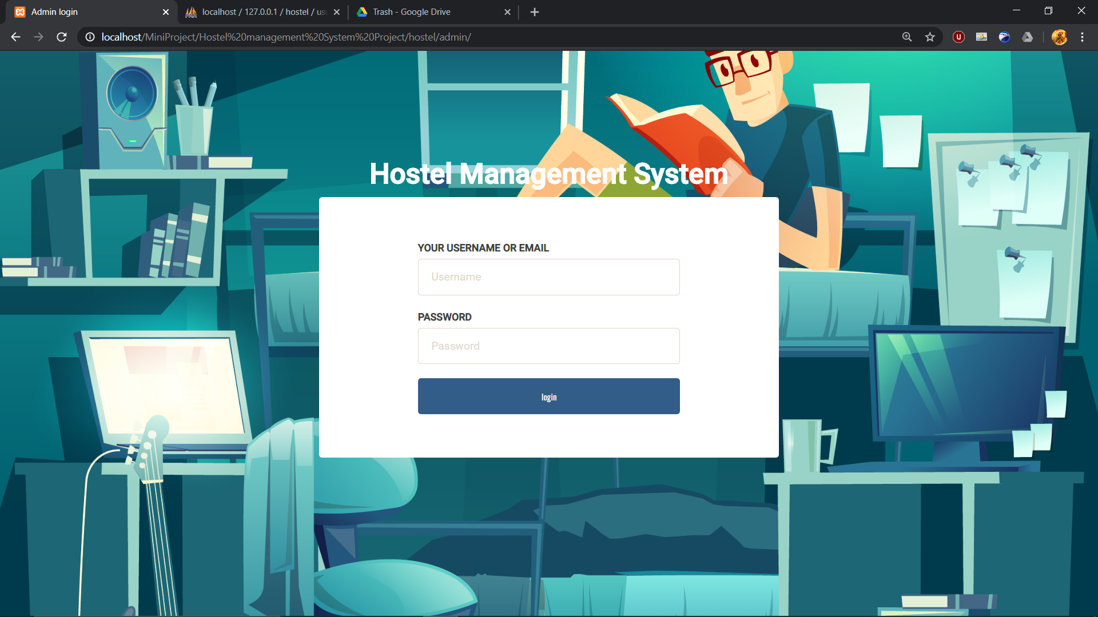
ADMIN LOGIN

Slide 14
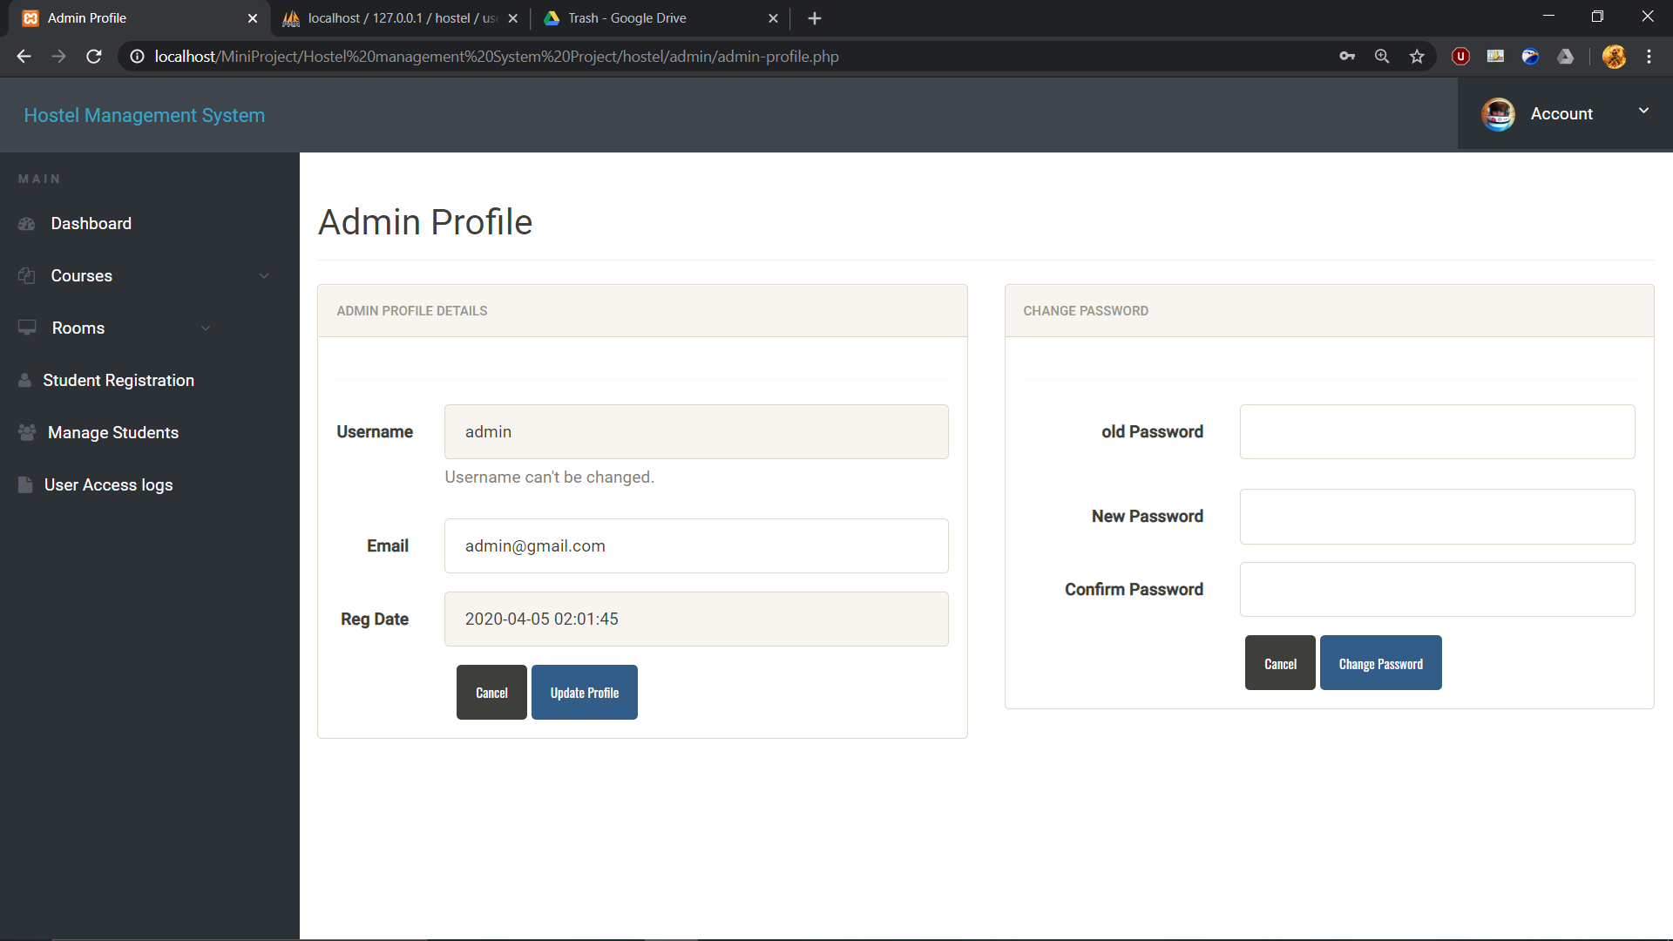
DASHBOARD

Slide 15
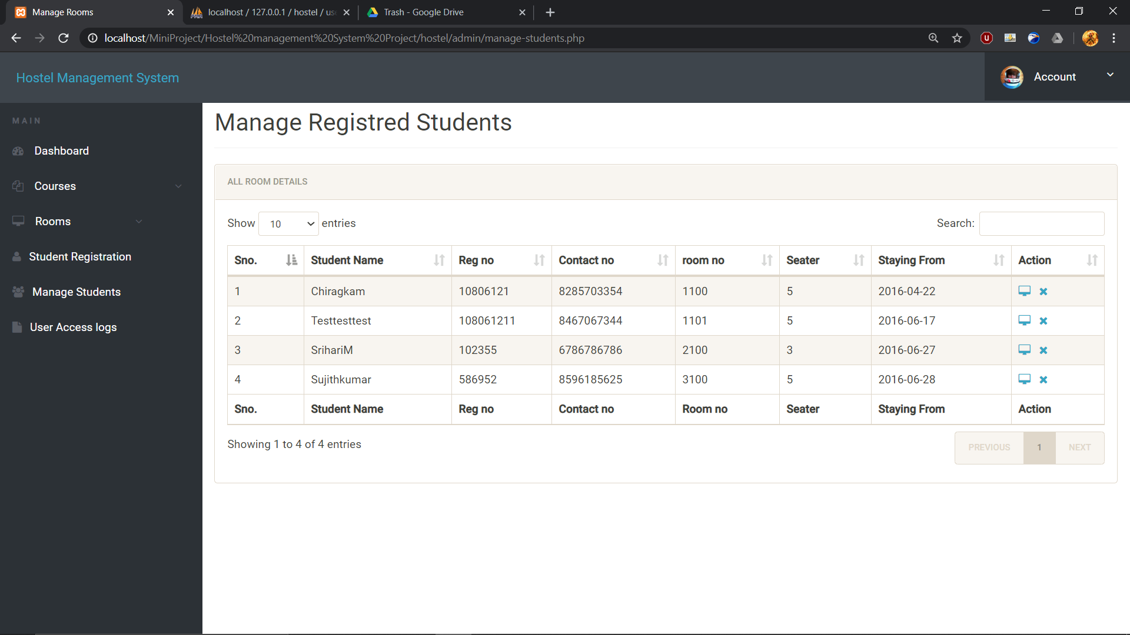
MANAGE STUDENTS

Slide 16
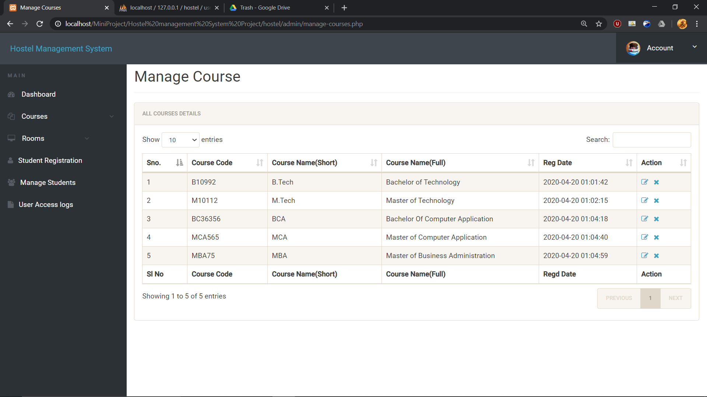
MANAGE COURSES

Slide 17
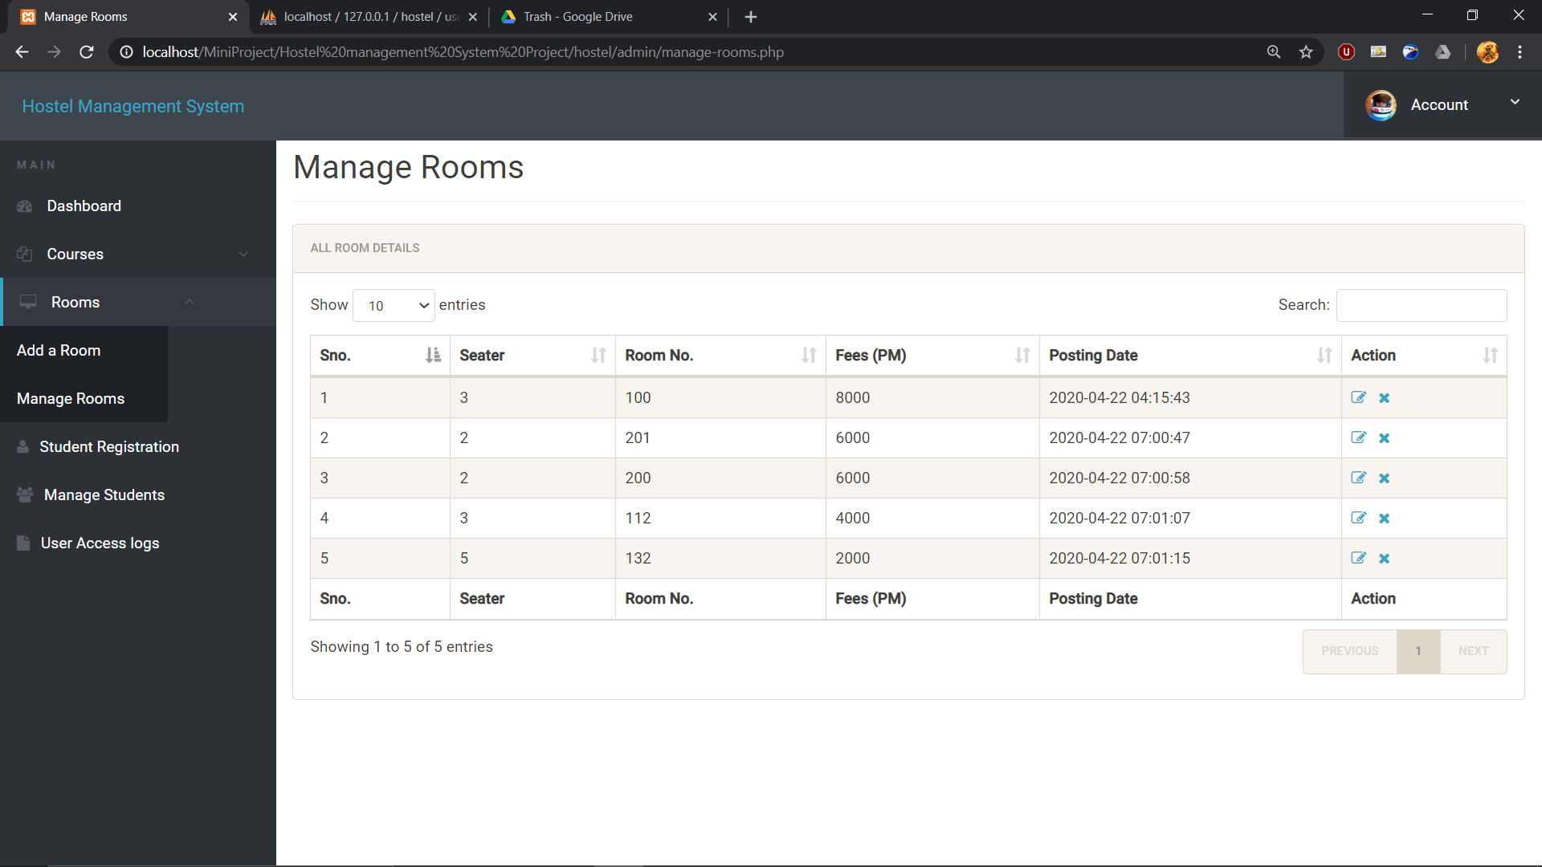
MANAGE ROOMS

Slide 18
Thank You !

