Slide 1

Jawaharlal Nehru Technological University, Hyderabad A Mini Project Seminar on
Comprehensive Analysis of Performance Metrics in NOMA Systems
Under the guidance of
Dr. M. Madhavi Latha
Senior Professor, ECE
Presenting by
G. Sujith
23011D4503
M. Tech ECE SSP

Slide 2

Contents
Introduction
Abstract
System model
Implementation
Capacity and outage probability
Bit Error Rate
Results
Conclusion
Applications
References

Slide 3
Introduction of NOMA
The capacity of Non orthogonal multiple access(NOMA) to serve numerous users at once utilizing the same time and frequency resources is the main driver for its adoption in 5G.
It is key principle for radio access in 5G networks. NOMA is based on the fundamental idea that more than one user can served in each orthogonal resource block, e.g., Time Slot, Subcarrier, Spreading code etc.
There exist two main NOMA techniques
Power domain (multiplexing in power domain)
Code domain (multiplexing in code domain)
NOMA exploits superposition coding at transmitter and successive interference cancellation (SIC) at receiver.
From the past we are seeing Orthogonal Multiple Access techniques are used where the number of users is limited due to exclusivity of orthogonal resources.
Spectral efficiency, power allocation, capacity, bit error rate and outrage probability are some parameters to analyze the NOMA performances

Slide 4
Introduction (Continuation)
The mobile generations which uses multiple access techniques are listed as
1G – Frequency Division Multiple Access
2G – Time Division Multiple Access
3G – Code Division Multiple Access
4G – Orthogonal Frequency Division Multiple Access
5G – Non Orthogonal Multiple Access
 | Orthogonal Multiple Access | Non Orthogonal Multiple Access
Advantages | Simpler receiver detection | Low latency, Higher spectral efficiency, Higher connection density, Enhanced user fairness, Supporting diverse Qos
Disadvantages | Lower spectral efficiency, limited no of users, unfairness for users | Increase complexity of receivers
Table 1: Comparison of OMA and NOMA

Slide 5
Abstract
Non Orthogonal Multiple Access (NOMA) scheme there exists two techniques i.e., Power domain and code domain. NOMA utilize superposition coding at transmitter and successive interface cancellation (SIC) at receiver. This simulation investigates the performance of NOMA in a Rayleigh fading channel environment through comprehensive simulation of key metrics: Bit Error Rate (BER), capacity and outage probability. Through systematic simulation, this evaluates NOMA performs under Rayleigh fading channel, considering factors such as modulation schemes, power allocation strategies, and the impact of fading on BER and outage probability. Perception gained from these simulations provide valuable understandings of NOMA’s potential advantages over traditional Orthogonal Multiple Access (OMA) in realistic wireless scenarios, foreground its capacity to enhance spectral efficiency and mitigate outage occurrences.

Slide 6
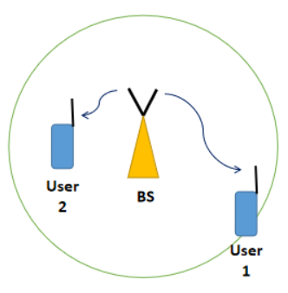

System model
System model, downlink transmission is considered i.e., from base station (BS) to the two users
User 1 is far/weak as he is far away from transmitting BS. User 2 is the near/strong user.
Base station has two distinct messages x₁ to user 1 and x₂ to user2.
α₁ and α₂ are power allocation factors for far and near users
The superposition coded NOMA signal transmitted by BS is,
$$x=\sqrt{P}\left(\sqrt{α_{1}}x1+\sqrt{α_{2}}x_{2}\right)$$
P :Transmit power
X received at far user after propagating through channel h₁ is
$$y_{1}=h_{1}x+w_{1}$$
X received at near user after propagating through channel h₂ is
$$y_{2}=h_{2}x+w_{2}$$
The Shannon capacity formula is given by
$$c=\log_{2}\left(1+γ\right)$$
γ : Signal to Interference Noise Ratio

Slide 7

Implementation of capacity and outage probability
First, declare the values of some parameters. Say the distances are, d₁= 1000 meters and d₂=500 meters and the power allocation factors considered as α₁= 0.75 and α₂ = 0.25.
Plot the capacity and outage probability as a function of transmit power. So initialize a range of transmit power from 0 dBm to 40 dBm.
Set bandwidth as B = 1MHz and calculate the thermal noise power as N₀ = kTB, where k = 1.38 x 10⁻²³ J/K, T=300K
Next, generate the Rayleigh fading coefficients h₁ and h₂ to simulate the channel between two users.
h_{i}=$\sqrt{d_{i}^{−η}}$ (randn(1,N) + 1i * randn(1,N))/$\sqrt{2}$
Here, $η$ is called the pathloss exponent. Typically $η$ = 4
d_{i} ​: Represents the distance between the transmitter and the receiver

Slide 8

Implementation (Continuation)
To plot capacity, calculate the achievable data rate
R₁=log₂(1+$\frac{{\left|h_{1}\right|}^{2}Pα_{1}}{{\left|h_{1}\right|}^{2}Pα_{2}+σ^{2}}$),
R_{1,2}=log₂(1+ $\frac{{\left|h_{2}\right|}^{2}Pα_{1}}{{\left|h_{2}\right|}^{2}Pα_{2}+σ^{2}}$), and
R₂=log₂(1+ $\frac{{\left|h_{2}\right|}^{2}Pα_{2}}{σ^{2}}$)
σ is the noise power.
Find the average value of each of the above quantities for every transmit power
Calculating the above quantities for different power levels (for eg., from 0 to 40 dBm) and the plot the achievable capacity as a function of transmit power.
To plot the outage probabilities, set target rate for each user.
P_{out,i} = Pr(R_{i} < R_{th,i})
Where R_{th,i} is the threshold rate for user i
Count the number of times the values calculated in step 5 fall below the target rates and take the average. Plot the outage probabilities as a function of transmit power.

Slide 9

Implementation of Bit Error Rate
For BER, follow same steps of capacity and outage simulation up to step 4.
Next generate noise samples for both users. The formula is,
$w_{i}=\sqrt{noⅈsⅇPoωⅇr}$ (randn(1,N) + 1i * randn(1, N))/ $\sqrt{2}$
randn(1,N) :Generates N samples of real-valued Gaussian random variables with zero mean and unit variance.
1i * randn(1,N) :Generates N samples of imaginary-valued Gaussian random variables with zero mean and unit variance.
1/ $\sqrt{2}$ :Normalizes the Gaussian random variables to have unit variance for the real and imaginary parts.
Generate random binary data for both users. Modulate the data using any digital modulation scheme. In here BPSK is used for both users.
Calculate the superposition coded signal x. calculate y₁ and y₂ dividing by h₁ and h₂ respectively.
From the equalized version of y₁ perform direct BPSK demodulation to get ${\overline{x}}_{1}$.

Slide 10

Implementation (Continuation)
Compare ${\overline{x}}_{1}$ with the user 1’s original data and estimate BER using the biterr function.
Directly decode the equalized version of y₂ to estimate x₁
Remodulate x₁ and subtract the remodulated x₁ component after multiplying it with $\sqrt{α_{1}}$ from the equalized version of y₂. Decode this signal to get ${\overline{x}}_{2}.$
Compare ${\overline{x}}_{2}$ with user 2’s original data and estimate BER using the biterr function.
Plot the BER’s as a function of transmit power.

Slide 11
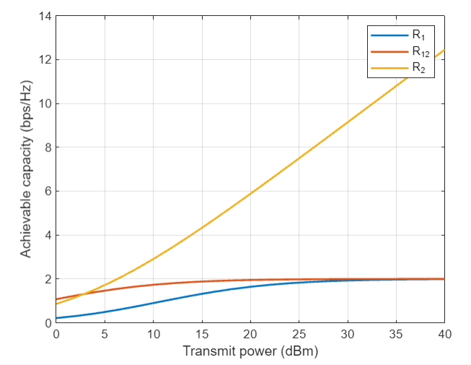
Results
Capacity Vs Transmit power
Table: Analysis of capacity
 | P_{t} | R₁ | R_{1,2} | R₂
1 | 0 | 0.2132 | 1.0748 | 0.8624
2 | 2 | 0.3046 | 1.2429 | 1.1606
3 | 4 | 0.4213 | 1.3963 | 1.5183
4 | 6 | 0.5625 | 1.5300 | 1.9326
5 | 8 | 0.7236 | 1.6420 | 2.3985
6 | 10 | 0.8967 | 1.7325 | 2.9091
7 | 12 | 1.0724 | 1.8036 | 3.4568
8 | 14 | 1.2411 | 1.8580 | 4.0344
9 | 16 | 1.3950 | 1.8988 | 4.6353

Slide 12
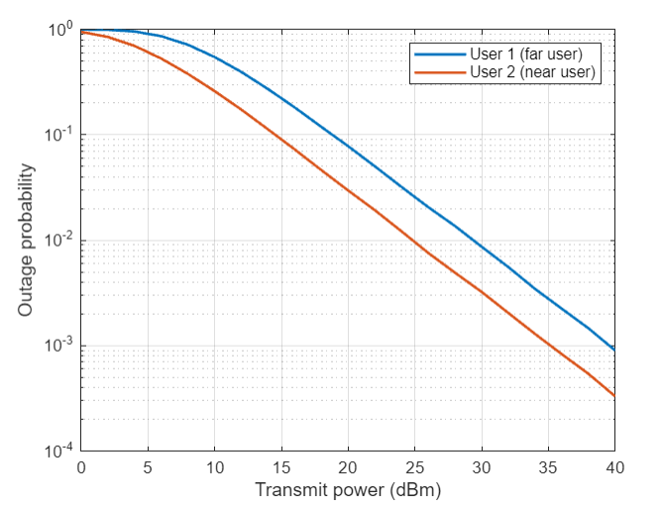
Results (Continuation)
Outrage Probability vs Transmit Power
Table: Analysis of Outrage probability
 | Pt | User1 | User2
1 | 0 | 0.9996 | 0.9491
2 | 2 | 0.9931 | 0.8494
3 | 4 | 0.9583 | 0.6980
4 | 6 | 0.8647 | 0.5270
5 | 8 | 0.7187 | 0.3752
6 | 10 | 0.5503 | 0.2584
7 | 12 | 0.3966 | 0.1721
8 | 14 | 0.2737 | 0.1129
9 | 16 | 0.1831 | 0.0729

Slide 13
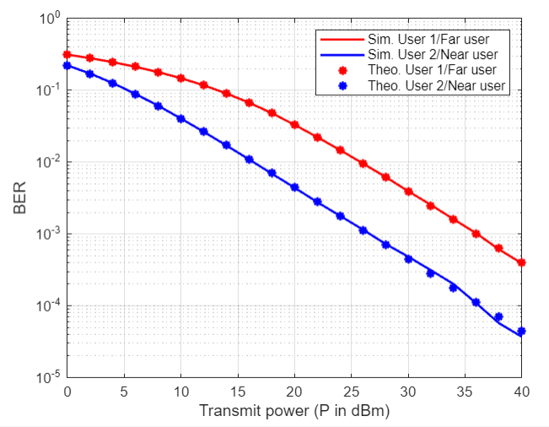
Results (Continuation)
BER vs Transmit Power
Table: Analysis of BER
Pt | User1(sim.) | User2(Sim.) | User1(Theo.) | User2(Thero.)
0 | 0.3141 | 0.2201 | 0.3136 | 0.2207
2 | 0.2810 | 0.1701 | 0.2805 | 0.1705
4 | 0.2466 | 0.1253 | 0.2463 | 0.1256
6 | 0.2127 | 0.0887 | 0.2123 | 0.0888
8 | 0.1794 | 0.0607 | 0.1792 | 0.0608
10 | 0.1477 | 0.0405 | 0.1476 | 0.0405
12 | 0.1181 | 0.0265 | 0.1178 | 0.0265
14 | 0.0910 | 0.0169 | 0.0908 | 0.0172
16 | 0.0675 | 0.0108 | 0.0672 | 0.0110

Slide 14
Applications
Wireless Network Design and Optimization
Quality of Service (QoS) Analysis
Standardization and Protocol Development
Academic Research and Development
Performance Evaluation in Emerging Technologies
Real-Time Systems and Applications
Simulation for Training and Education

Slide 15
Conclusion
Summary of Findings:
NOMA (Non-Orthogonal Multiple Access) demonstrates a significant improvement in spectral efficiency compared to traditional OMA (Orthogonal Multiple Access) techniques.
The simulation results indicate that NOMA can support a higher number of users with better capacity and lower outage probability in Rayleigh fading channels.
Power allocation strategies and modulation schemes significantly impact the performance of NOMA in terms of BER (Bit Error Rate) and capacity.
Key Insights:
Effective utilization of superposition coding at the transmitter and successive interference cancellation (SIC) at the receiver enhances overall system performance.
The trade-offs between power allocation and BER must be carefully managed to optimize system performance.
NOMA's potential to improve 5G network’s efficiency highlights its importance in future wireless communication systems.

Slide 16
References
[1] Prasheel N. Thakre, Sanjay B. Pokle., “A survey on Power Allocation in PD-NOMA for 5G Wireless Communication Systems”, 2022, DOI: 10.1109/ICETET-SIP-2254415.2022.9791576
[2] Himeur Hanane1, Meriah Sidi Mohammed1, Derraz Fouad1, “Achievable capacity analysis for power domain non orthogonal multiple access scheme”, 2022, DOI: 10.1109/ICAEE53772.2022.9961969
[3] Veeraiyah Thangasamy, Indrasen Singh, Karishma, Yaswanth, and, Jathin Sai, “Analysis of Capacity and Outage Probability for NOMA based Cellular Communication over Rician Fading Channel”, 2022, DOI: 10.1109/ICEEICT53079.2022.9768575
[4] Pawan Kumar, Kalpana Dhaka, “Average BER Analysis of NOMA Systems under TWDP fading”, 2023, DOI: 10.1109/NCC56989.2023.10068065
[5] Kumuda D K, Sarala S M, “BER, Capacity and Outage probability of NOMA for 5G Wireless Communication”, 2024, DOI: 10.1109/ICSSES62373.2024.1056139

Slide 17
Acknowledgements
Thank You

