Slide 1

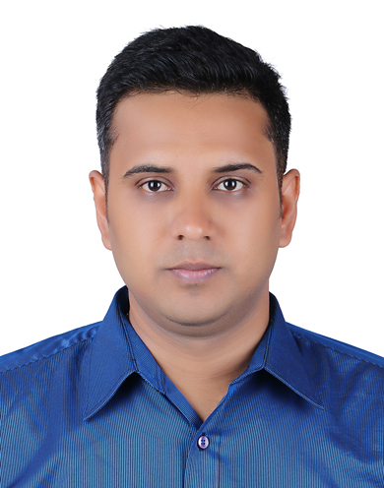


Sujith Sudhindra Rao
ROLES AND EXPERIENCE
WORKED AS | Lead Software Dev. Engineer in Siemens Sr. Software Dev. Engineer in Norton Lifelock
EXPERIENCES IN JOBS | Requirement analysis, Design, Development, maintenance of complex software application Configuration management,code and design reviews Leading a technical team by distributing, assigning work to team members Mentoring junior members of the team. Co-ordinating with all stake holders for software release
KNOWLEDGE
Programming languages : C,C++ 11,14 and 17, Python Operating system: Windows and Linux Framework/libraries: Qt 5, Win 32, STL, Boost, CORBA IDE’s: Cmake, Visual Studio Design patterns, UML Unit testing, Google Mocks & Gtest Object Oriented programming Data structures and algorithms Agile methodology Debuggers: Windbg, gdb Version control tools : Git, Clearcase, Perforce CI/CD using Jenkins
PERSONAL
AGE | 35
RESIDENCE | EINDHOVEN
MARITAL STATUS | MARRIED
LANGUAGES | ENGLISH
EDUCATION | GRADUATE in Computer Science
HOBBY’S | Playing Chess, Reading books
COMPETENCE
Coding ,designing and debugging Test case management, automation Unit testing Build automation and configuration management Software Architecture Team player Problem solver
Previous Employers
DOMAIN
Multimedia library & framework – FFmpeg, Gstreamer and image rendering Factory Automation
Products Worked on
Sinumerik CNC controller Norton 360 EVViewer & EVReader

