Slide 1
Department of CSE – Data Science
III B.Tech I Semester MiniProject-2023
Submitted by
Batch -13
STOCK PRICE PREDICTION
Names Roll no
Sujith Reddy 21R21A6751
Aman Likith 21R21A6710
Atishay Reddy 21R21A6731
K.Mahesh 21R21A6730
Supervisor:
Mrs.Rajeswari,
Assistant Professor,
Department of CSE-Data Science.

Slide 2
Contents
Abstract
Introduction
Existing System
Draw backs
Proposed System
Advantages
Requirements
Conclusion

Slide 3
Abstract
Stock price prediction involves forecasting the future values of a company’s stock based on data and various factors. The prediction model relies on comprehensive analysis of historical stock prices, trading volumes and relevant financial indicators. Various machine learning and statistical models are employed for stock price prediction. The predictive model accuracy is assessed using out of sample data that was not used during training..

Slide 4
Introduction
Stock price prediction is a crucial aspect of financial markets, aiming to forecast a company's future stock values. Utilizing historical data and advanced analytics, predictive models identify patterns, trends, and the influencing factors to guide investment decisions. This field leverages machine learning algorithms ,statistical techniques to analyze vast datasets, incorporating elements like trading volumes, technical indicators , and external factors for enhanced accuracy. Continuous refinement and adaptation of models are essential to address the ever-changing nature of market dynamics.

Slide 5
Existing System
AIRMA(Auto Regressive Integrated Moving Average)
Random Forests
Prophet by Facebook
Support Vector Machines (SVM)

Slide 6
Disadvantages
1. Market Volatility and Unpredictability:
Financial markets can be highly volatile and influenced by unpredictable events, making it challenging for models to accurately forecast stock prices.
2. Data Limitations and Quality:
Predictive models heavily rely on historical data. If the historical data is limited, incomplete, or contains errors, the model's accuracy may be compromised.
3. Overfitting and Underfitting:
Models may suffer from overfitting, where they perform well on training data but fail to generalize to new, unseen data. Underfitting may occur if the model is too simplistic.

Slide 7
Proposed System
The proposed stock price prediction system leverages a sophisticated deep learning ensemble model, amalgamating Long Short-Term Memory (LSTM) networks with traditional machine learning algorithms. This fusion aims to capitalize on the complementary strengths of deep learning in capturing temporal dependencies and the interpretability of traditional A real-time monitoring system with a feedback loop ensures the model remains responsive to emerging trends, thereby fostering adaptability and minimizing prediction lag for more informed investment decision-making.

Slide 8
LSTM
Long Short-Term Memory (LSTM) represents a specialized form of recurrent neural network (RNN), designed to address the limitations of standard RNNs in capturing long-range dependencies within sequential data. Its architecture includes memory cells capable of selectively storing or discarding information over prolonged sequences, allowing for the retention of essential context when predicting future outcomes. LSTM's unique design enables it to effectively learn intricate patterns and remember critical information, making it well-suited for tasks involving sequential data analysis, such as stock price prediction, natural language processing, and time-series forecasting. Its ability to handle vanishing and exploding gradient problems in RNNs positions LSTM as a powerful tool in various fields requiring nuanced understanding and prediction of sequential patterns.

Slide 9
Advantages
1. Informed Decision-Making:
Predictive models empower investors, traders, and financial analysts
with insights into potential future stock price movements.
2. Algorithmic Trading Strategies:
Automated trading systems can execute buy or sell orders based on
real-time predictions, leveraging the speed and efficiency of
algorithms to capitalize on market opportunities.
3. Market Sentiment Analysis:
Predictive models often incorporate sentiment analysis
from various sources, such as social media and news, to
gauge market sentiment.
4. Quantitative Analysis:
Quantitative analysis, facilitated by stock price prediction models,
allows for a systematic and datadriven approach to decision making.

Slide 10
Steps for the project
Data Collection
Data Preprocessing
Splitting Data
Model Selection
Feature Scaling
Model Architecture Design
Training the Model
Model Evaluation
Fine-tuning and Optimization
Testing and Prediction
Performance Analysis

Slide 11
Requirements
Software Requirements:
Jupyter Notebook
Python Language
Pandas,Scikit-Learn

Slide 12
Conclusion
In conclusion, stock price prediction systems play a pivotal role in modern financial strategies, offering valuable insights for informed decision-making. While these systems present advantages in risk management and portfolio optimization, it's essential to acknowledge their limitations, such as the unpredictable nature of financial markets and the need for continuous adaptation to dynamic conditions.

Slide 13
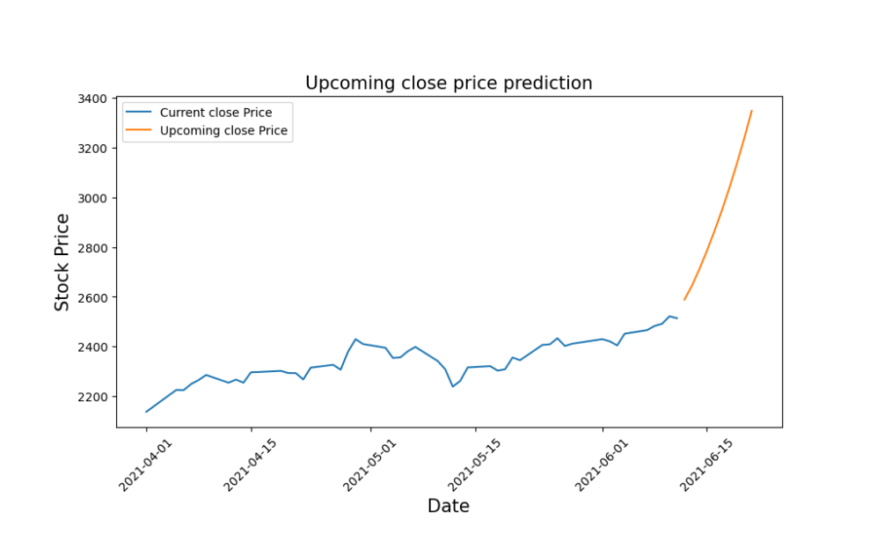
Output

Slide 14


