Slide 1
Netflix Data Analysis Using Power Bi

Slide 2
Task-1
Data Consistency Check

Slide 3
Excel
I cleared all the blank values in the data set using Excel.
And I convert date added column into proper date format.
Also Convert into csv and loaded into power Bi.

Slide 4
Task-2
Customer Demographics Analysis

Slide 5
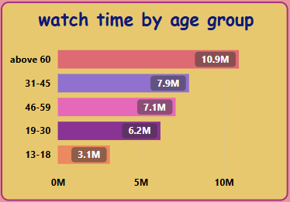
Power Bi
Here I convert a Age Column into different groups.
It helps to identify which age group watch Netflix most.

Slide 6
Task-3
Subscription Type vs Watch Time

Slide 7
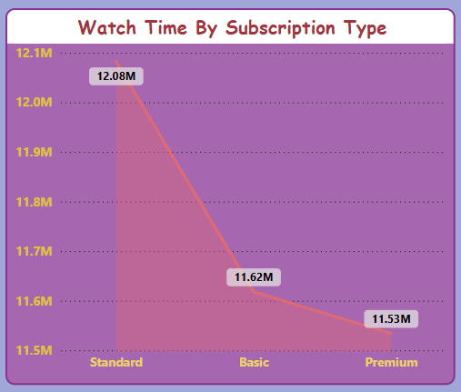
Power Bi
In the data set they provide the subscription type.
To get the total watch time I used sum to calculate.

Slide 8
Task-4
Top 10 Most Watched Shows/Movies

Slide 9
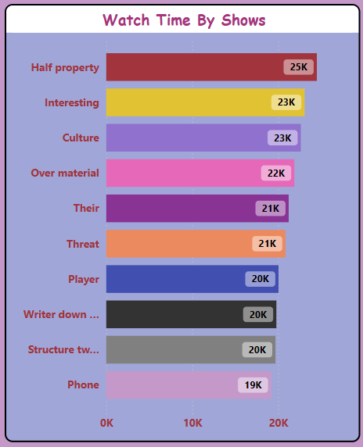
Power Bi
To identify the top 10 most watched shows for that I used top n filter to achieve that.
I used sum of watch time as a value.
So it will give the total watch time.

Slide 10
Task-5
Genre Popularity by Country

Slide 11
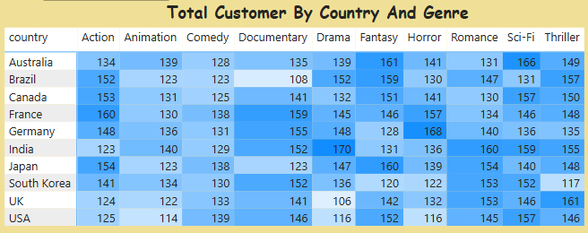
Power Bi
To find the most popular genre I used matrix table to find that.
Here I separate the viewers by their genre and their country.
From the heat map we can identify low contrast value is low viewers an high contrast is high viewers.

Slide 12
Task-6
Customer Ratings Distribution

Slide 13
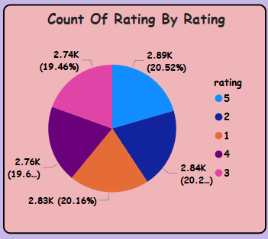
Power Bi
To identify the number of count for each rating for that I used pie chart .
So we can easily identify the % of customers ratted for the particular ratings.
Rating 5 has higher value(20.52%).
And 3 has lower value(19.46%).

Slide 14
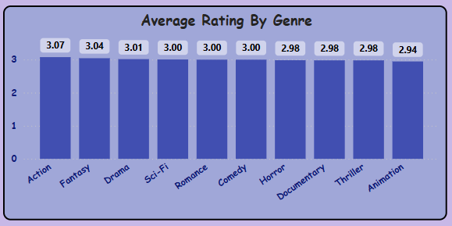
Power Bi
To identify the average rating for country and genre I created a new measure called Average rating.
From genre we have action as the higher avg rating .
And thriller, horror, documentary are sharing the lower avg rating.

Slide 15
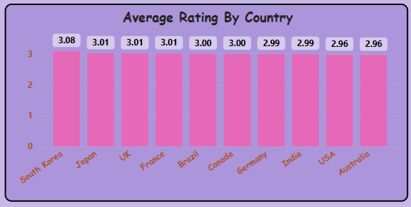
Power Bi
For Country we have south korea have highest Avg Rating.
And Usa & Australia have lowest Avg Rating.

Slide 16
Task-7
Trending Content Analysis

Slide 17
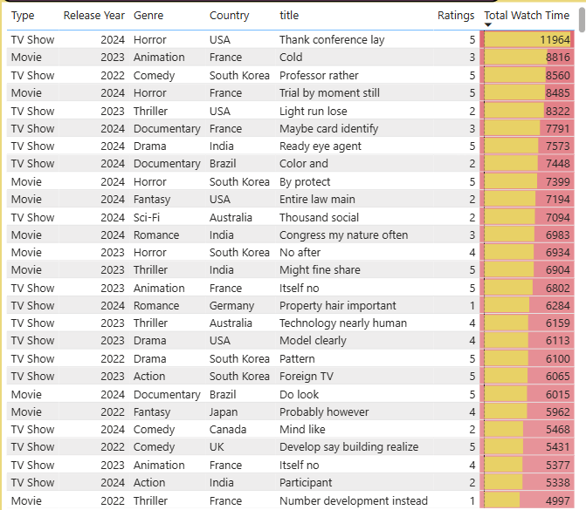
Power Bi
To find the most recent addiction I used a slicer to get the specific years.
Here the total sum of watch time will show the most recent trending shows and the details of the show.

Slide 18
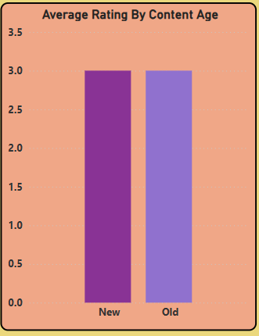
Power Bi
To separate the avg rating of newly added vs older content for that I used a conditional column based on release year.
Here above 2010 is newely added content.
And below 2010 its all older content.

Slide 19
Task-8
Subscription Market Share Analysis

Slide 20
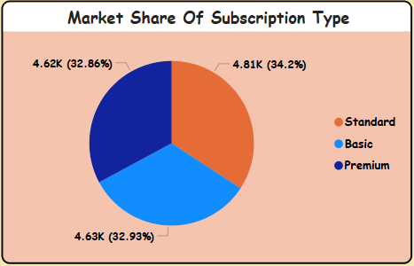
Power Bi
From the pie chart we can easily identify the market share based on total customers.
Here standard have (34.2%).
Then Basic have (32.93%).
After we have Premium (32.86%).

Slide 21
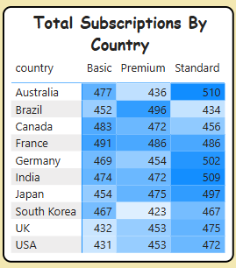
Power Bi
From this matrix table we can easily identify the customer based on different countries and the subscription type.
From this heat map the highest Basic plan customers are in France(491) and lowest customers in Usa(431).
And the Highest premium customers are in Brazil(496) and the lowest customers are in South korea(423).
In the standard type the Highest Customers are in Australia(510) and the lowest customers are in Brazil(434).

Slide 22
Task-9
Customer Insights

Slide 23
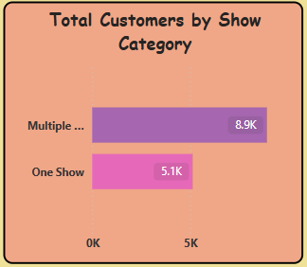
Power Bi
To get different kinds of shows, I used the GROUP BY function, on show ID and customer ID.
If count of customers =1 that mean customer watch One Show.
Otherwise customer watch Multiple Show.

Slide 24
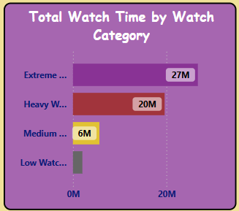
Power Bi
To identify the watch category I used conditional column for watch time.
If watch time is above 3000 then Extreme Watcher.
If watch time above 1000 mean Heavy Watcher.
And watch time above 300 mean Medium Watcher.
Other wise Low Watcher.

Slide 25
Task-10
High-Rated vs. Low-Rated Content

Slide 26
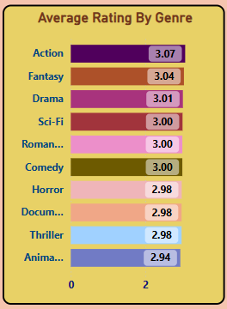
Power Bi
From this bar chart we can see that Action genre have the highest rating.
And Animation genre have the lowest rating.

Slide 27
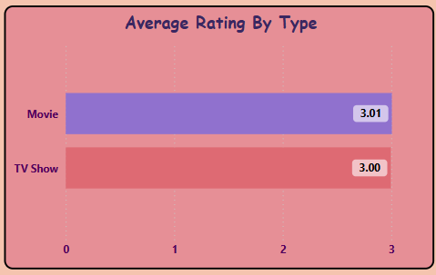
Power Bi
From the Comparision I find that Movie have the highest average rating compare to Tv shows.

Slide 28
Task-11
Director & Cast Influence on Ratings

Slide 29
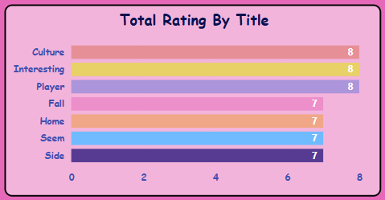
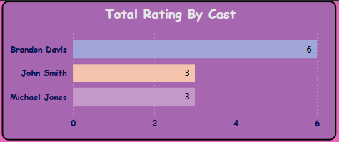
Power Bi
On the comparision of title and cast the movie with title have the highest rating compare to cast.
On the cast picture it display top 3 actors on the Netflix with high ratings.

Slide 30
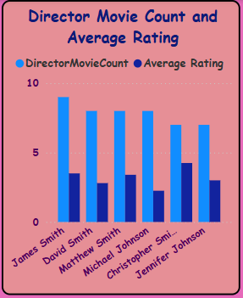
Power Bi
The column chart is displaying the movie count of director and the rating of the director.
This are the top 6 director based on movie count and average rating.

Slide 31
Task-12
Content Localization Strategy

Slide 32
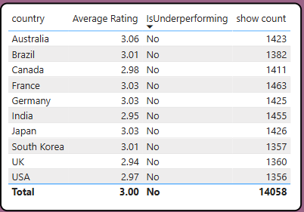
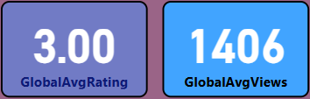
Power Bi
To identify the performance of the country I created a new measure called is under performing.
Here If the avg rating is less than global rating it display yes it mean under performing other wise it display no.
Same as if the total views less than global avg views then it consider as low performance.

Slide 33
Task-13
Best Time to Release New Content

Slide 34
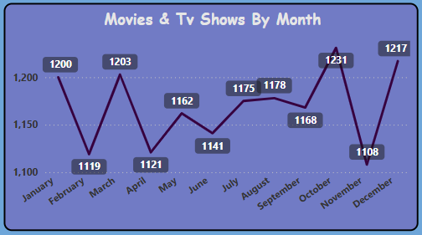
Power Bi
From here we can see the most of the movies and tv shows released on October and December.
And November is the lowest movie and tv shows are released.

Slide 35
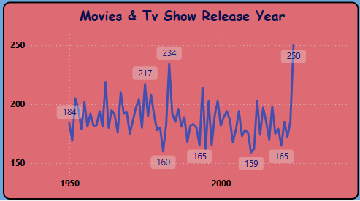
Power Bi
In the line chart we can identify highest movie released year and lowest movie released year.
In 2024 is the highest movies and tv showsare released (250).
And in 2010 is the lowest movie and tv shows are released(159).

Slide 36
Task-14
Customer Engagement Dashboard

Slide 37
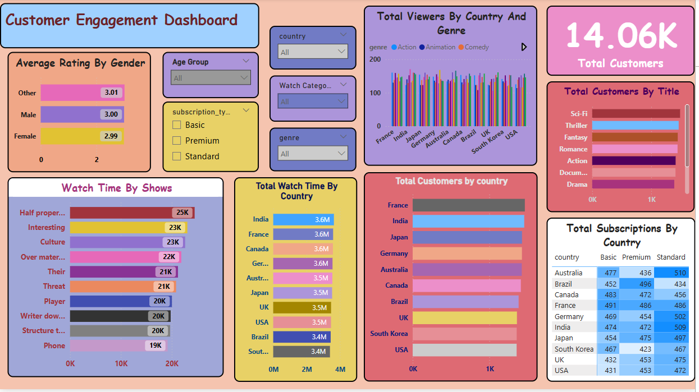

Slide 38
Task-15
Compare Netflix's content availability and ratings by country

Slide 39
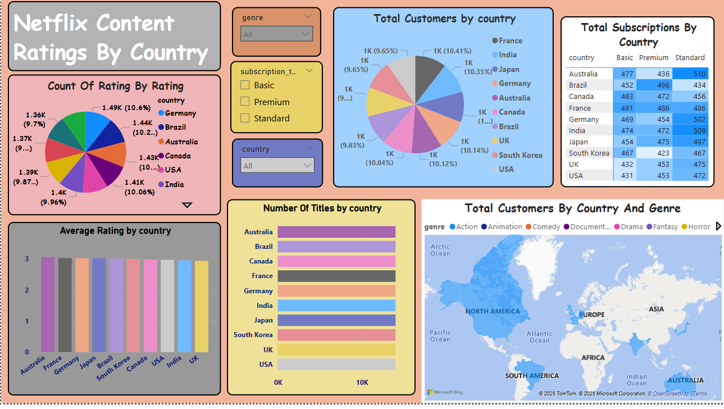

Slide 40
Conclusion

Slide 41
Age Group
In age group above 60+ are watching most of the shows and movies.
Below 18 age group have low watch time.
They mostly liked genre is Romance ,Science Fiction and Animation.
To increase the watch time we can focus on this genre to release new content.

Slide 42
Genre
The Animation and Comedy genre have the lowest watch time around 3.27 to 3.29 million.
By focusing on this genre we can increase the watch time.
Country
Some country has low customers in some genre in brazil the documentary have 108 customers and uk and usa they have low customers in drama.
And most of the countries are struggling to increase the customer on animation genre.

Slide 43
Best Month To Release Movie
From this analysis most of the movies are released in particular month(October,December,January,march).
If we launch our movies on this month it will be positive.

Slide 44
Subscription Type
STANDARD (12.08 million watch time)
Most popular and affordable.
2 user can watch at one time.
BASIC (11.62 million watch time)
Only one user can watch at one time.
And lower video quality.
PREMIUM (11,53 million watch time)
It allow 4 users at one time
It cost too much.

Slide 45
Director And Actor
By producing a movie from top performance directors like james smith ,David smith, Mathew smith,Michael johnsonit will increases the chances of gaining popularity and higher user ratings.
By combining the top director and top actors it will attracte more audience.
Additionally, offering a 30% discount to customers switching from the Basic to the Standard plan can encourage upgrades, leading to increased engagement and longer watch times.

Slide 46
Thank you

