Slide 1
Zomato Order & Restaurant Analysis Using Power BI

Slide 2
Task - 1

Slide 3
Upload Dataset into MySQL
3
I create a new schema called Zomato.
And I import a two data sets.

Slide 4
Task - 2

Slide 5
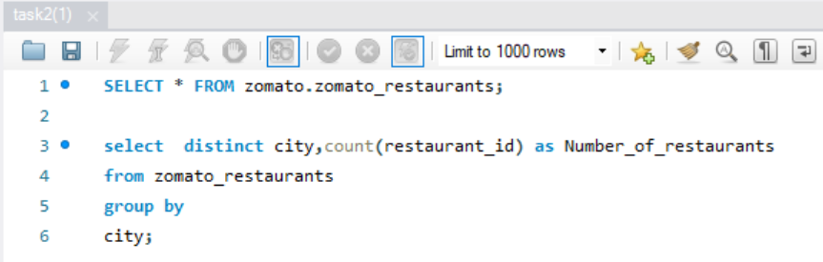
Perform Simple Data Transformations Using SQL
3
Using a count function to identify Number of restaurants in each city.

Slide 6
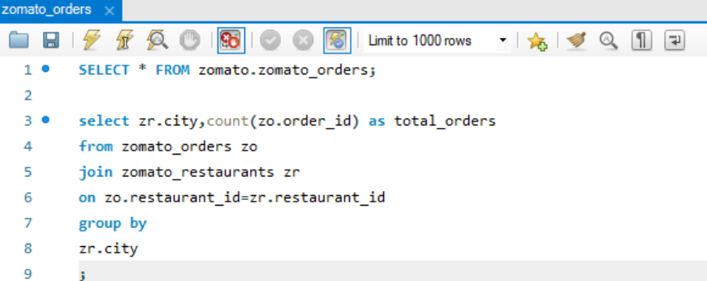
Perform Simple Data Transformations Using SQL
3
Identifying top 5 city which have highest number of orders.

Slide 7
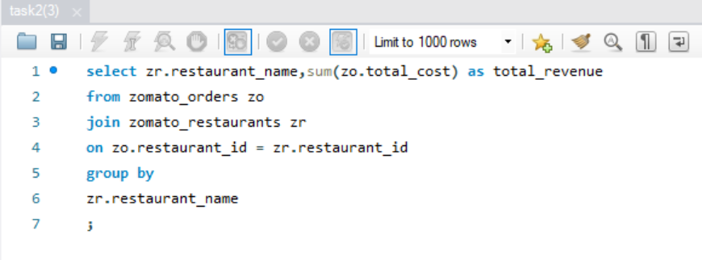
Perform Simple Data Transformations Using SQL
3
Identifying total revenue generated by each restaurant.

Slide 8
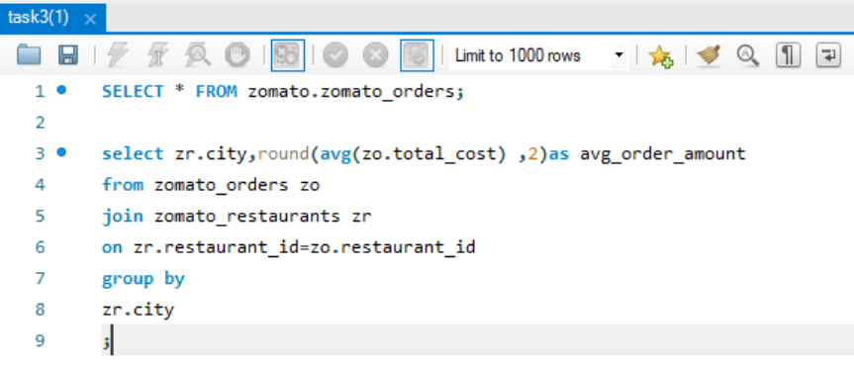
Data Aggregation
3
Finding the average order amount for each city.

Slide 9
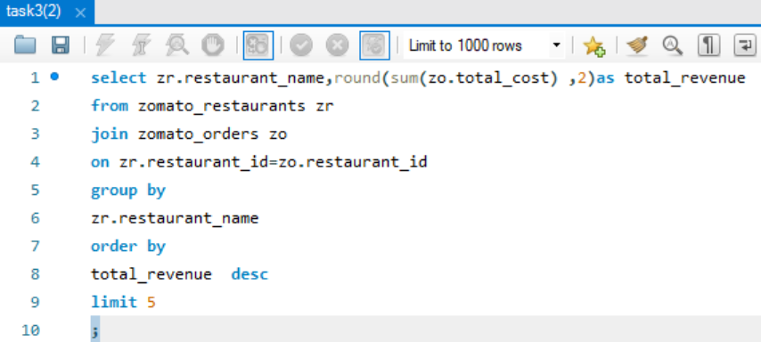
Data Aggregation
3
Identifying the top 5 restaurants with highest total sales.

Slide 10
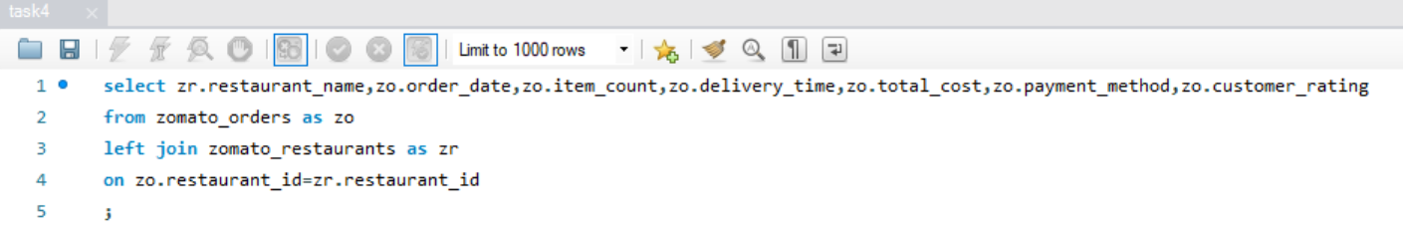
Data Joins
3
Joining the Zomato_Orders and Zomato_Restaurants table to get the restaurant details along with orders table.

Slide 11
Export the transformed dataset
3
After transforming the dataset I use a export option to save the transform data into csv or excel file.

Slide 12
Task - 3

Slide 13
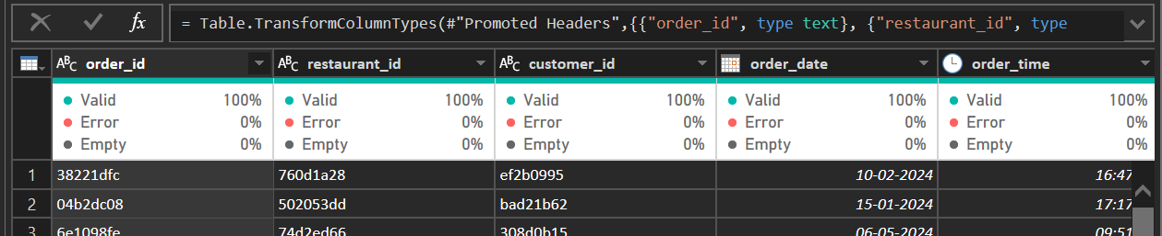
Power BI Analysis and Visualization
3
After importing a dataset I tried to find there is an any error in the dataset.
Above we can can see there is an any error or any null value by each column
The empty represent the % of null value or empty value.
The error represent the % of rows with error.
The valid represent the % of valid entries (non error,non null).

Slide 14
Power BI tasks

Slide 15
Task - 1

Slide 16
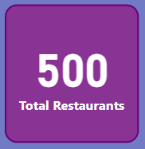
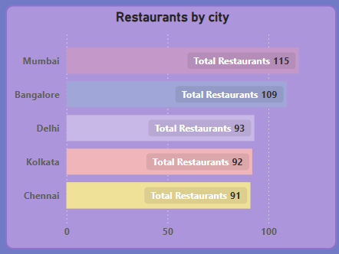
Number of Restaurants per City
3
Here I used a bar char to identify the number of restaurant for each city.

Slide 17
Task - 2

Slide 18
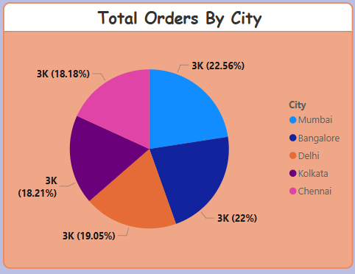
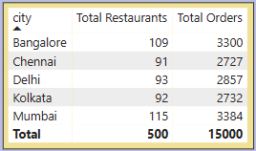
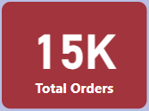
Percentage of Orders from Different Cities
3
Here I used a pie char to identify the number of orders for each city.
And I created a table to identify which city have a most orders and how much restaurant.

Slide 19
Task - 3

Slide 20
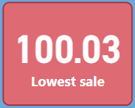
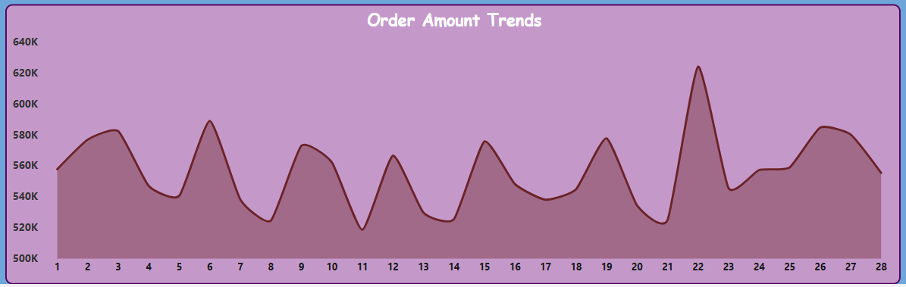
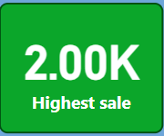
Order Amount Trends Over Time
3
Here I used a line char to identify the trend over the ordre amount.
Using a order amount and order date column to identify the trends.

Slide 21
Task - 4

Slide 22
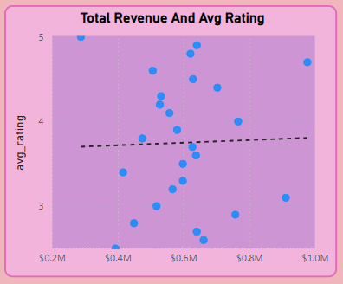
Correlation of Factors Affecting Average Rating
3
Using a scatter plot to identify the correlation
Slight positive trend
As revenue increases, average rating slightly increases.

Slide 23
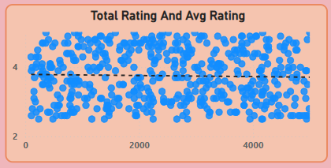
Total Rating and Avg Rating
3
No clear trend (points spread randomly).
Total number of ratings doesn’t significantly affect the average rating.

Slide 24
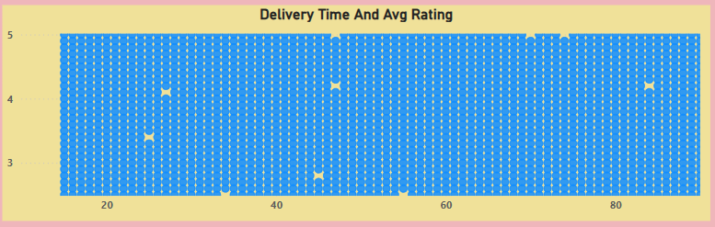
Delivery Time and Avg Rating
3
Negative trend.
Higher delivery times may slightly lower the average rating.

Slide 25
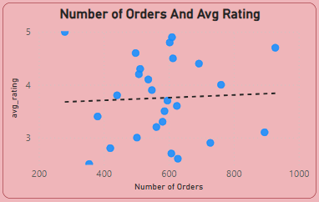
Number of Orders and Avg Rating
3
Slight positive trend
Restaurants with more orders to have higher average ratings.

Slide 26
Task - 5

Slide 27
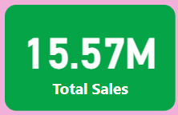
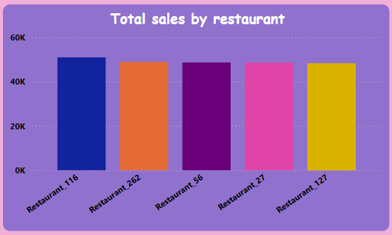
Top 5 Restaurants by Total Sales
3
In this column chart we can see the top 5 restaurant based on total sales.

Slide 28
Task - 6

Slide 29
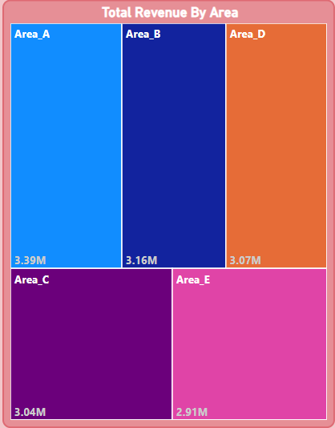
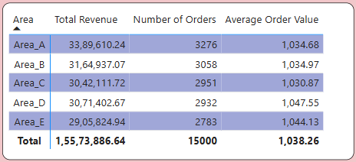
Revenue by Area Using a Tree Map
3
In this tree map we can see highest revenue to lowest revenue.
And also the table can explain the area in details.

Slide 30
Task - 7

Slide 31
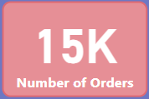
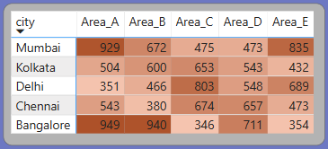
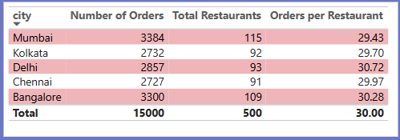
Order Density by City
3
From the Heat map we can see the order density.
The high contrast value is high and the lower one is low value.
On the table we can find the city details.

Slide 32
Task - 8

Slide 33
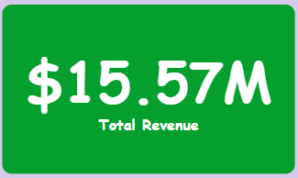
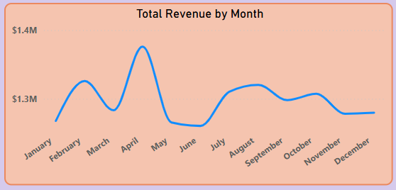
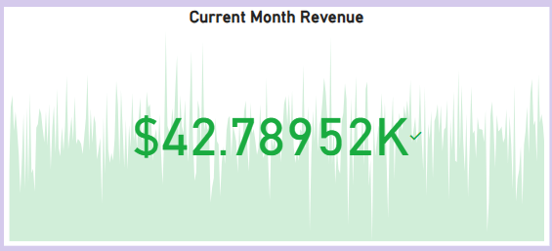
Total Revenue & Average Order Value
3
The kpi card is displaying the current month revenue.
In the line chart we can see April is the highest made revenue and in the July lowest revenue was generated.

Slide 34
Task - 9

Slide 35
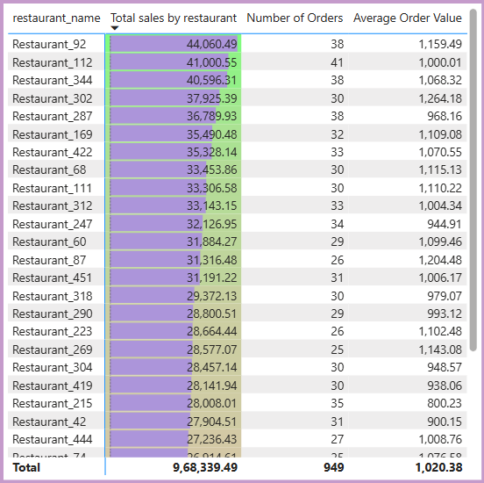
Restaurant-Wise Sales Summary in a Table
3
All the restaurant detalils are mentioned in the table.
By sorting the total sales we can find the best performing restaurant.

Slide 36
Task - 10

Slide 37
Power BI Dashboard
3
After finishing all the task and combining into one place and creating attractive dashboard.
And used a slicer to get data from specific category.

Slide 38
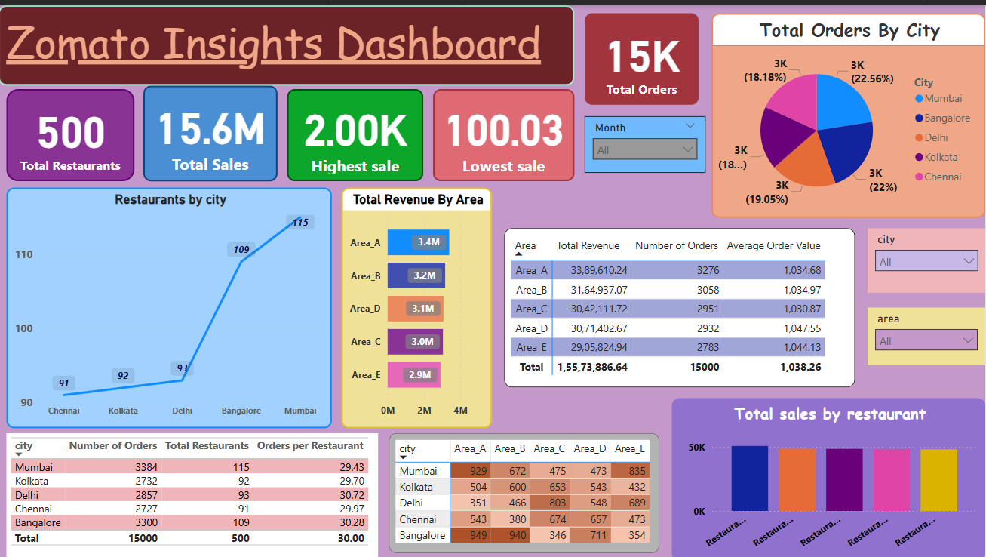

Slide 39
From the project:
3
Order Distribution by City:
Bangalore and Mumbai have the highest number of orders.
Chennai, Kolkata, and Delhi have comparatively lower order volumes.

Slide 40
From the project:
3
Restaurant Availability:
Cities with more than 100 restaurants (like Bangalore & Mumbai) have higher order volumes.
Cities with fewer than 100 restaurants (like Chennai, Delhi, Kolkata) have lower orders.
This shows a direct relationship between the number of restaurants available and the number of orders placed.

Slide 41
From the project:
3
Business Strategy Insight:
We can suggest that increasing restaurant partnerships in low-order cities (like Chennai or Kolkata) might help boost order volumes there..

Slide 42
Thank you

