Slide 1

EcoSure
Shopping Sustainably
By: Varsha Ravi, Sujitha Seenivasan, Harsheni Siddharthan, and Allison Tseng
Notes:
V

Slide 2
INSPIRATION
Fashion brands are known for not being very transparent about their sustainability. We wanted to make a chrome extension that returns the sustainability index of clothes calculated by an algorithm inspired by the Higg Index.
Notes:
varsha

Slide 3
What It Does
01
Developing a sustainability index

Slide 4
OUR SUSTAINABILITY INDEX
We assigned products a sustainability index from 1 to 10 with 10 being the most sustainable.
The index was calculated from the the percentage of each material the product was made of and the sustainability of each material. The sustainability of each material considered factors like global warming, abiotic resource depletion, eutrophication, etc.
References: Pulse of the Fashion Industry report
Notes:
A H

Slide 5
Continued…
Material | Environmental Impact
Synthetic
Polyester | made from non biodegradable petrochemicals Creates nitrous oxide (worse than CO2)
Rayon ( viscose ) | Made from pulpwood plantations which draw in large amounts of water Treated with hazardous chemicals
nylon | Made of petrochemical monomers Produce nitrous oxide and sewage water
acetate | plant based but its heavily chemically treated somewhat biodegradable based on the percentage of plant material and proper degrading procedures microplastic pollution better than virgin plastics but still bad toxic chemicals so bad in labor | better than polyester
PVC | Extracted with oils (dependent on fossil fuels) Build up chlorine toxins Created dioxins Dangerous plastic | Worse than polyester
Notes:
A H

Slide 6
Natural
Cotton | severely degrades soil quality the most pesticide intensive crop in the world uses 8.2 million tonnes of chems water contamination a kg of cotton takes 10,000 L of water to produce takes 2700 liters of water to make 1 t-shirt 233 billion cubic metres a year carbon impact is between 2 and 4 tonnes of CO2 per hectare globally 220 million tonnes of CO2 per annum
Organic cotton | 40% less global warming potential, compare to normal cotton 91% reduction in blue water consumption (freshwater lakes, rivers, and aquifers) better labor practices-> promotes gender equality, community bonds, improved soils much better than cotton
Denim | one pair of jeans uses 3781 L of water decently more water than just cotton lost of pesticides indigo dying process is very water intensive sandblasting for distressed look is not safe for workers worse cotton
Notes:
A H

Slide 7
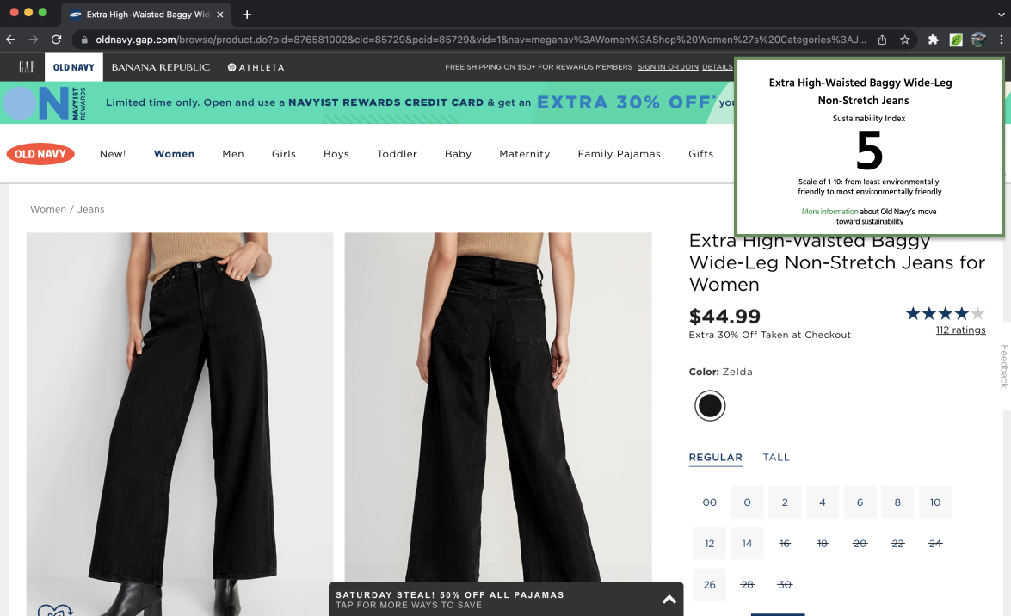
Initial Plan
(Made in Figma)
Notes:
A

Slide 8
How We Built It
02
Coding
Notes:
S

Slide 9
Built With?
HTML
CSS
JavaScript
Used to develop the front end
Used to format/ design the front end
Used to develop the backend

Slide 10
Process
Web Scraping
Backend
Frontend
Research
Sujitha worked with Node js and javascript to data scrape from websites
Varsha and Allision used Javascript for backend development
Harsheni and Sujitha used CSS and HTML for frontend development
Harsheni and Allison developed the sustainability index
Notes:
S

Slide 11
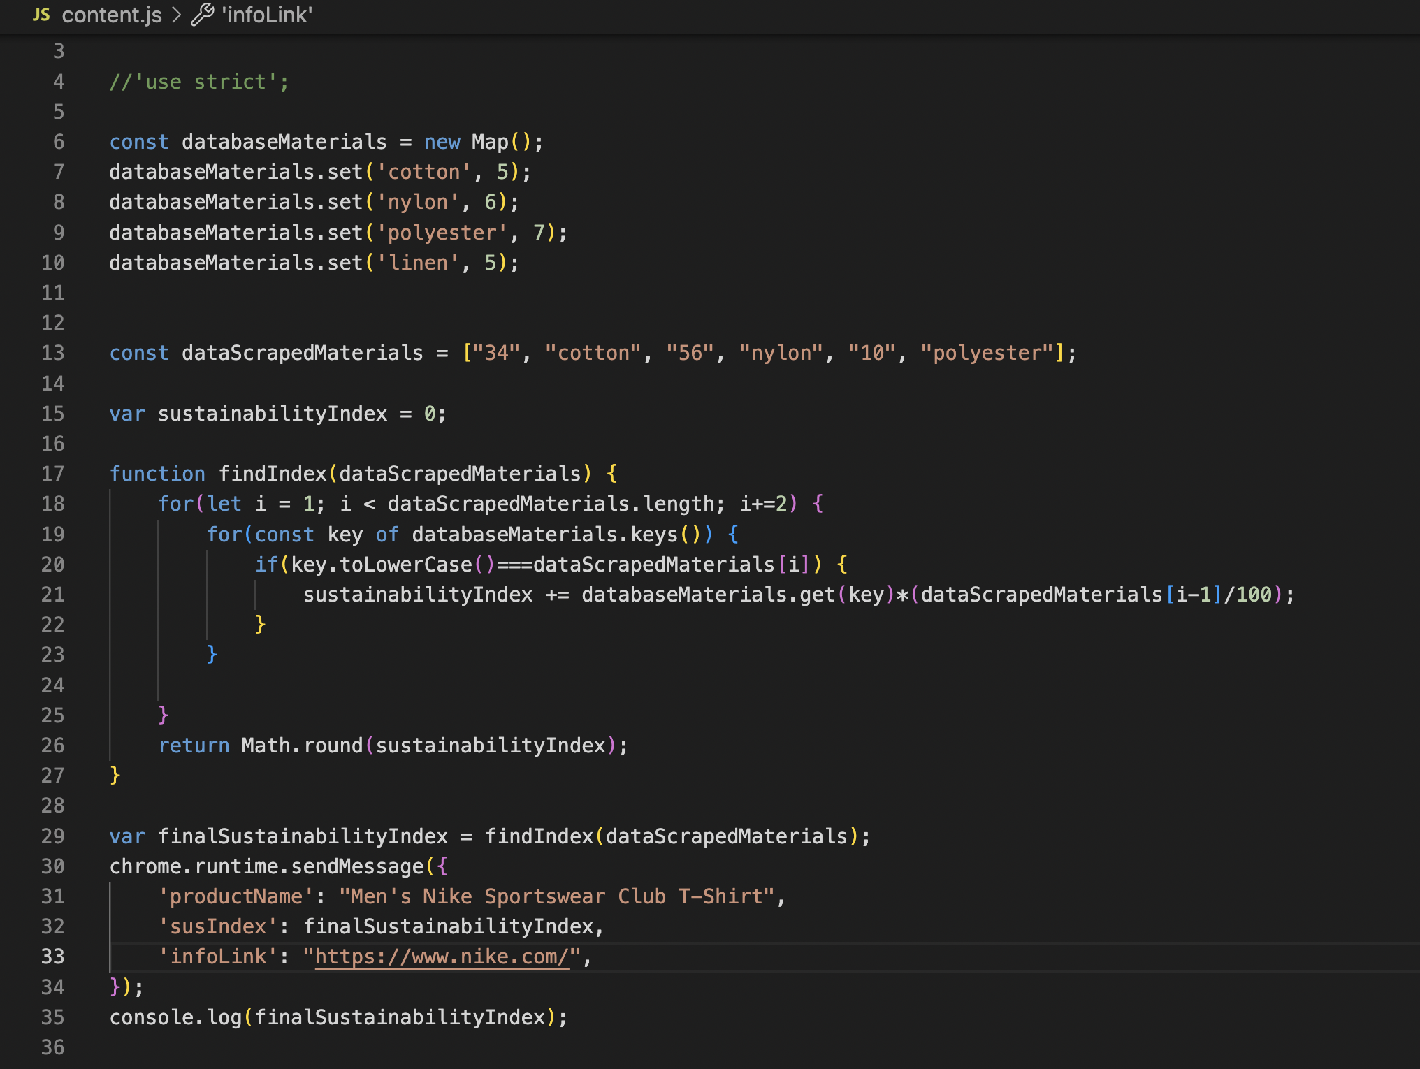
Backend
Notes:
V

Slide 12
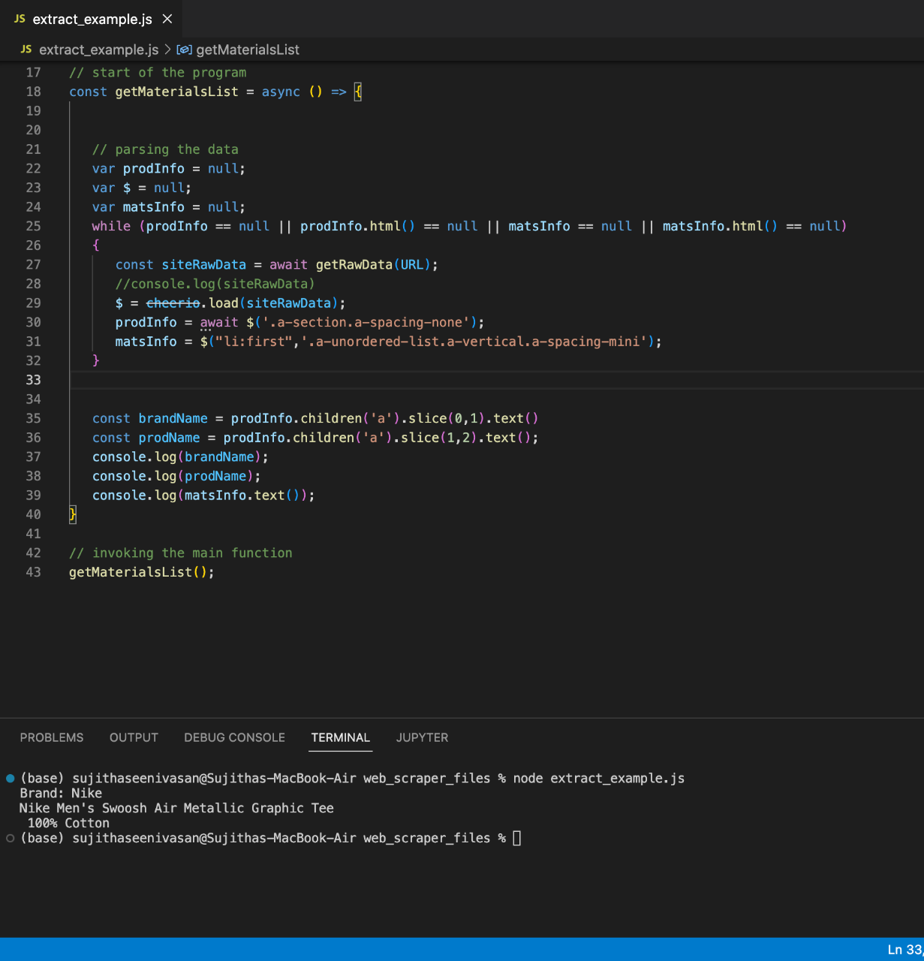
Web Scraper Output
Notes:
S

Slide 13
03
Challenges We Ran Into

Slide 14
Problems That We Faced
Connecting Frontend to Backend
Creating a Good Index
Getting the Right Data from Web Scraping
We struggled with understanding APIs in order to integrate our code
It was tough developing an arbitrary index with so many potential variables
Parsing through raw data from web scraping for specific words was really hard

Slide 15
Accomplishments that We’re Proud of

Slide 16
Integrating Frontend and Backend
Getting the Web Scraper to Work
Gaining a Good Understanding of JavaScript
We managed to connect the frontend to the backend
The web scraper managed to take the materials list from the webpage and we could calculate the index based off the webpage data
We all started with no JavaScript, CSS, or HTML experience

Slide 17
What We Learned
Teamwork
How to Learn and Navigate New Languages
We learned how to write and integrate CSS, HTML, and JavaScript code
We learned how to divide roles and work together to make a full stack program

Slide 18
What’s Next for EcoSure?
More Obscure Fabrics
Accuracy of Ranking System
A Wider Variety of Companies
The extension only allows for a limited selection of materials to be analyzed in the sustainability index but widening the range would be a good next move.
As of now, the prototype works on Amazon but we plan to grow the functionality to work on a wider scope.
Another area of improvement involves refining our algorithm for calculating the sustainability index to consider more categories.

Slide 19
THANK YOU!

Slide 20
Sources
https://pre-sustainability.com/articles/measuring-sustainability-index-basics/
https://www.worldwildlife.org/industries/cotton#:~:text=Runoff%20of%20pesticides%2C%20fertilizers%2C%20and,indirectly%20through%20long%2Dterm%20accumulation.
https://www.greenchoices.org/green-living/clothes/environmental-impacts
https://www.worldwildlife.org/videos/how-your-t-shirt-can-make-a-difference#:~:text=Did%20you%20know%20that%20the,cotton%20fields%20to%20your%20closet.
https://ejfoundation.org/news-media/clothes-and-climate-is-cotton-best#:~:text=They%20also%20mean%20that%20the,fibre%20which%20is%20notoriously%20thirsty.
https://goodonyou.eco/material-guide-ethical-denim/
https://goodonyou.eco/is-acetate-eco-friendly/
https://www.greylockglass.com/wp-content/uploads/2021/08/Pulse-of-the-Fashion-Industry_2017.pdf

