Slide 1
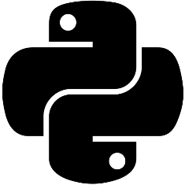
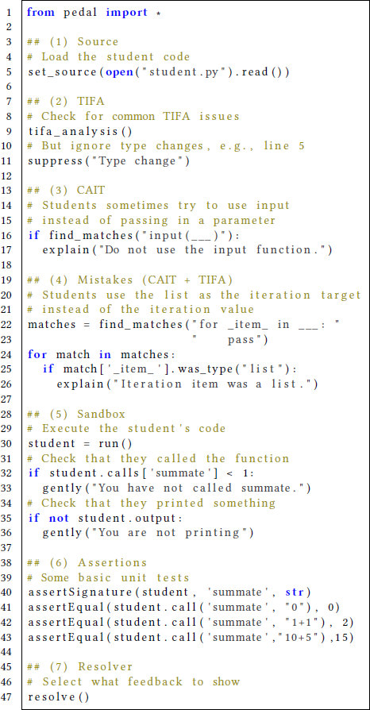
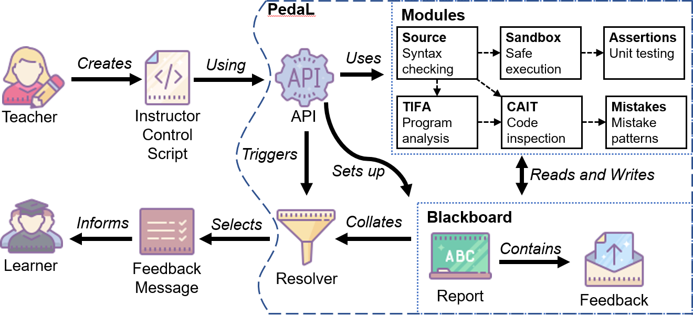
Pedal Pedagogical Feedback Libraries for Python https://pedal-edu.github.io
Structurally identify student mistakes using Python Code
Reusable collection of student misconceptions
Mistake specification using natural python code!
Feedback, Grading, and Analysis Tools
for Python
Open-source, pure Python
Integrate with any Python platform: Jupyter Notebooks, VPL, BlockPy
from pedal.quick import *
Help Us Develop Pedal!
Find us on github! https://github.com/acbart/pedal
Raise github issues
Give us feedback
Ask about using Pedal in classrooms
Contact Us:
Luke Gusukuma: lukesg08@vt.edu
Cory Bart: acbart@udel.edu

Slide 2
PedaL Pedagogical Libraries for Python https://github.com/acbart/pedal
What is it good for?
Instructor Insights
Automated Identification of Mistakes in student code
Enables easy collection of student misconceptions
What does it allow you to do?
Research
Autograding
Type checking student code
Confirm student code patterns
More sophisticated unit testing
Safer Sandboxing
Analysis of student code on the misconception level
Play a more active role in writing and delivering feedback
Provide feedback in a deterministic manner using instructor priorities
Unit Test your feedback
Integrate Feedback of other tools
And more…
See our paper!
Session 7E: Python Debugging
Saturday 11:35AM-12PM

