Slide 1
PedaL An Infrastructure for Automated Feedback Systems
Luke Gusukuma, Austin Cory Bart, Dennis Kafura
SIGCSE’20: Python Debugging Session
Saturday March 11, 2020
Notes:
I’m Luke Gusukuma
And I’m Cory Bart
And Today we’ll be presenting Pedal, short for Pedagogical Libraries, an infrastructure for automated feedback systems.

Slide 2


Typical Submission Flow
Student Code Submission
Unit Test
Suite
List of Failed Unit Tests
Notes:
So to set the context, let’s start with what the typical submission process might look like.
Typically what happens is student code is submitted,
Run against a unit test suite, and then out spits a list of failed unit tests, and optimistically perhaps some instructor written error messages describing the manner of the failure.

Slide 3
Dissecting a Unit Test
def summate(values): return sum(values)
Define a function summate that consumes a list of numbers and produces their sum.
Oops, student used the built-in sum function
from student import summate
self.assertEqual(summate([1, 3, 5]), 9)
def summate(values): for value in values: Return value + values
How many students made these mistakes?
You wrote 200 lines of unit tests; how do you know they’re correct?
Student’s code crashes on import
Traceback (most recent call last):
File "main.py", line 7, in test_summate
self.assertEqual(round(result), 6)
TypeError: type str doesn't define __round__ method
Traceback shows instructor code at fault
What do you tell a student when a test fails?
Notes:
Alright, so breaking this open further, let’s say part of an assignment requires students to create a summation.
The unit test might look something like this, pretty straight forward.
But what if we want to ban the usage of the built in sum function? How is that detected? Are we hand inspecting the code?
What if the student’s code crashes on import? Is there any credit we can give them? Is there something right about their code?
Moreover, even if the code doesn’t run quite right, how can we know more about the students and the mistakes they made? What mistakes did students make in general?
When we get to larger projects, we have large numbers of unit tests! How do you know all your unit tests are correct?
If you are using a classic unit test, then the error message will show your code as causing the error. Novice students might accuse you of having an error!

Slide 4
Beyond Unit Testing
How do we improve the internal consistency of our automated assessment of student code?
How and when is it best to give students feedback on their code to improve learning? [1]
How can we go beyond unit testing?
Notes:
These kind of issues really speak to three large questions:
How do we improve the internal consistency of our automated assessment of student code?
How do you know your unit tests are correct?
What do you tell a student when a unit test fails?
How and when is it best to give students feedback on their code to improve learning?
Can we give credit to crashing code?
How many students have made these mistakes?
How can we go beyond unit testing?
Are we hand inspecting code?
Are they using functions they shouldn’t be?

Slide 5
Pedal Vision
Feedback needs to be treated like a first class entity - engineered like software
Feedback needs to be more than unit testing
Need an extensible and flexible infrastructure to accomplish this
Notes:
Confronting these questions started giving us a vision for what we should be striving for:
First off, we think feedback needs to be treated like a first class entity. This session is about debugging, which is dependent on the evidence students have – which is the feedback students get from the environment. And this evidence is processed by our unit tests, our hint generation, etc.; they are our first line of defense in combating student misunderstandings. As such, we need to take a formal design perspective, a software engineering perspective of feedback
Second, the perspective of feedback needs to extend beyond just teachers writing unit tests, beyond assignments, because every time we can give a student feedback, it’s an instructional opportunity. And in some cases, we need more information than what unit tests can tell us.
And third, to support all of this, to support all the new feedback technology currently being produced, constraint based models, hint generation, etc. we need an extensible, flexible, easy to use infrastructure that can weave all these things together.

Slide 6
What is PedaL (Pedagogical Libraries)?
Pedal is…
Pedal is NOT…
Python library
Architecture for designed feedback and analysis
Collection of tools
Autograding platform
Meant for human-grading
Notes:
And with this vision in mind, we created pedal.
Alright, so what is Pedal? Pedal is a python library, something you can pip install
It’s an architecture for designed feedback and analysis, and a collection of tools. It is NOT another autograding platform, nor is it necessarilly meant to replace human graders (although we hope it can help replace them to some extent).

Slide 7
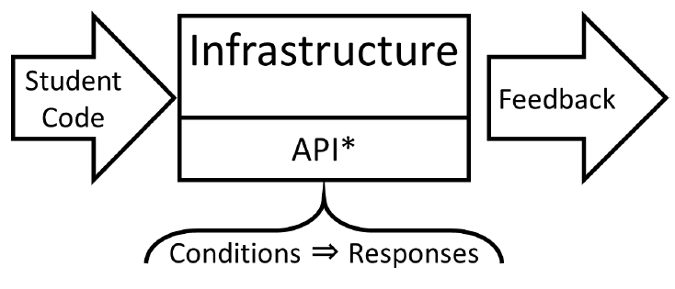
Our Model for Feedback
Notes:
So to try and address the gauntlet of different feedback systems out there, we wanted to look at a broader perspective of feedback and we came up with this model.
Student code is still the source of our evidence, and when fed into an infrastructure and API, whether that be some hint generation data mining system, a linter, a battery of unit tests, or what have you, it produces feedback. And implicitly, we’re creating code to look for various conditions that the student code fulfills, good or bad, and we produce some response to that condition, some kind of feedback.

Slide 8
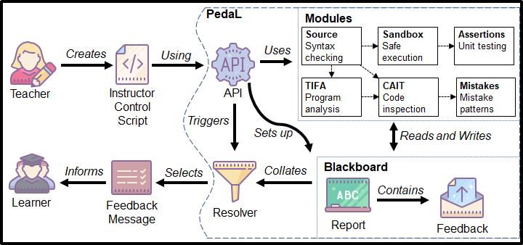
What is PedaL (Pedagogical Libraries)?
Notes:
In a more specific form, instructors write ordinary python code, which we refer to as a control script. This python code uses the PedaL API, an interface that gives you access to several modules that are available in PedaL. They give you a means to specify conditions we want to detect and respond to
These modules write to and read from a temporary data blackboard that we call the Report, collecting and organizing conditions and responses. The resolver than processes the report in order to determine the appropriate feedback. That can be as simple as selecting a single piece of feedback to deliver to a student, or grouping and merging feedback by category, or even writing out a CSV file of every triggered condition.
And if you don’t like the default resolver, write your own! If you don’t like a particular module, write your own module. If there’s a module you think there is missing, you can write your own!
(1/3rd to half way mark?) 6-7 minutes

Slide 9
Demo

Slide 10
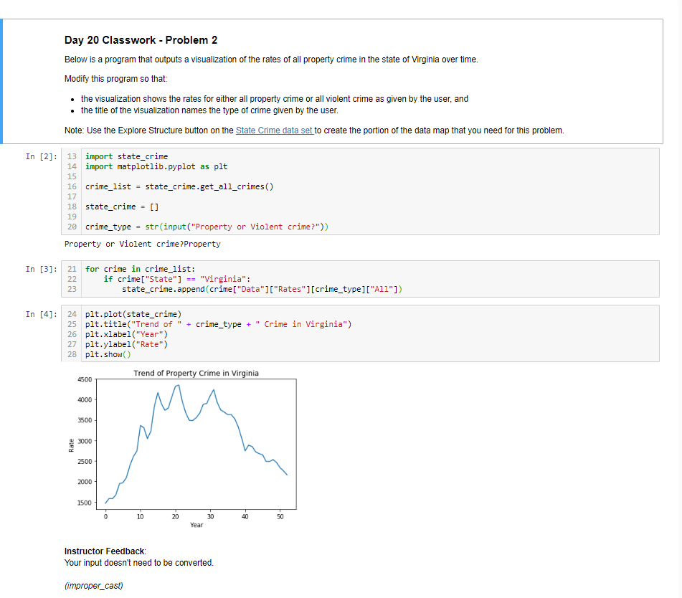

PedaL in Jupyter Notebooks

Slide 11
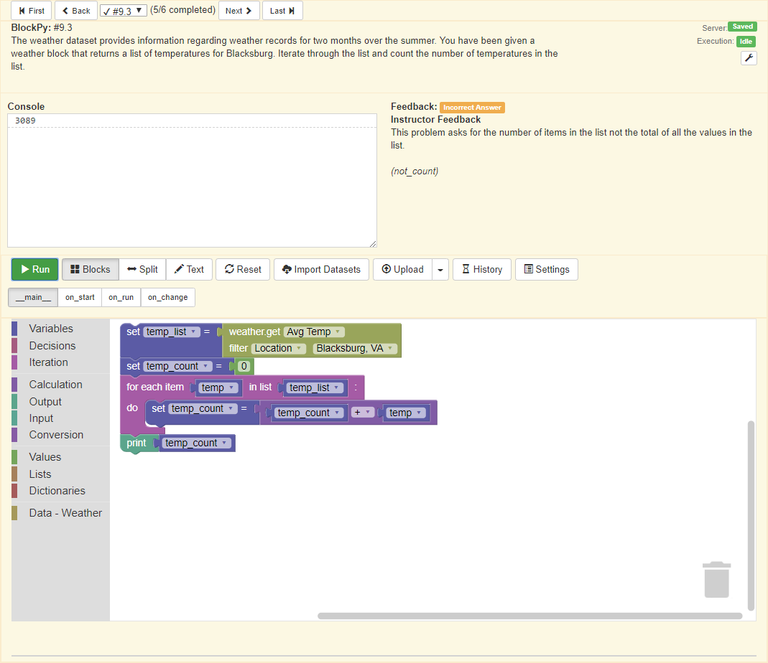
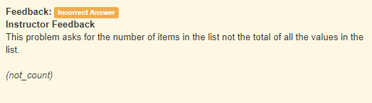
PedaL in BlockPy

Slide 12
How we fit in
Understanding - compare to GradeScope, how you can get fine-grained info. We’re not here to replace that, we’re just trying to support it with infrastructure.
Picture of student submitting file to “your favorite autograder”, where Pedal fits in
Notes:
Alright, so we’ve shown [demoed] that pedal can address the challenges we brought up earlier, but how does that fit in with your current ecology? How does it fit into your classroom?
First off, Pedal, being a python library, doesn’t replace any autograding platform. And while it may not replace human grading, through usage of it's components, we can address some things that we would normally need a human to look over their code for. But the main idea is that being a python library will make it easy to integrate into anything.
###in fact, we imported it into grade scope and had it working as is###
As a more detailed breakdown, it’s easier to look at it from the perspective of various audiences.

Slide 13
Audiences - Students
Helps students debug programs
Provide students with immediate feedback
Notes:
So first and foremost are the students. Students can be on the receiving end of feedback produced by Pedal. And by leveraging
The various features available, it can help students debug their code on a more fine-grained level, ranging from linter errors and
Bad programming patterns, to failing unit tests.

Slide 14
Audiences - Teachers
Allows instructors to provide feedback to many students
Saves classroom time
Notes:
As Teachers, in many classrooms and/or labs, instructors walk around the classroom giving feedback to students. If you’ve given one piece of feedback for one mistake several times,
An instructor can simply create a feedback function to address the issue, dealing with the future occurrences of such a mistake.

Slide 15
Audiences - Curriculum Designers/Researchers
Allows identification of mistakes
Allows evaluation of curriculum at a finer grained level
Easier ways to analyze code
Notes:
Not only that, but curriculum designers can also use pedal.
If Curriculum designers know what mistakes students are going to be making ahead of time, they can prepare feedback for such mistakes.
It also allows for formative and summative evaluation of the curriculum through free response problems! By writing conditions for either sets of mistakes
Or correct code associated with performance objectives, a designer can evaluate performance of students and how that changes with changes to the instruction
And from the researcher perspective, it makes it easier to analyze the code from a research perspective by giving ways to measure precise numbers of students who fall under certain categories of mistakes and allows researchers and curriculum designers to see What feedback is most effective.

Slide 16
Take Aways
Try PedaL!
Think about giving more formalized feedback!
Think about Testing Feedback/Unit Tests!
Notes:
Alright, so what should you take away from this presentation?
First, try PedaL, it’s pretty awesome and we’ve been using it in our classrooms
Second, think about giving more formalized feedback. Instead of just pointing out failing unit tests, try to give
More designed explanations, and with the help of pedal, you can give even more fine grained evidence to help aid those explanations.
Finally, Think about testing your feedback and unit tests! As your code bases grow larger, it becomes a project that should be managed.
After all, developing feedback and instruction are both design processes and should be treated as such. We don't actually know much as a community about what makes effective coding feedback - we need to figure that out.

Slide 17
Pedaling Towards Improved Feedback
Community-supported infrastructure
What does this look like in other languages
Notes:
And as for what lies beyond this. First, we hope that we can get community-support for Pedal. That is, we hope people can start using Pedal, letting us know what is working and what needs fixing, creating new modules and resolvers for pedal, and try to push the envelope of feedback even further.
Second, we hope the ideas behind Pedal will be pushed into other languages! Right now we have Python, or we could Call it PyPedaL, what about Java Pedal, JPedal, Javascript Pedal JSPedal, Ruby Pedal.
You get the idea. But the larger goal of Pedal is pedaling towards improved feedback as a community.

Slide 18
Wrap Up
Links
Github: https://github.com/pedal-edu/pedal
Documentation: https://pedal-edu.github.io/pedal/
Developer Contact Info
Luke Gusukuma (Virginia Tech)
lukesg08@vt.edu
Cory Bart (University of Delaware)
acbart@udel.edu

Slide 19
Yeah, but...
“I’m a busy practitioner teaching 7 classes for 100 students, how can this possibly help me if I have to now write so much more code and unit tests.”
“You’re asking people to make code bases.” - we already have codebases, let’s treat them like it.
You’re asking busy people to do more work.
Hundreds of students, every semester, don’t you get tired of the same feedback?

Slide 20
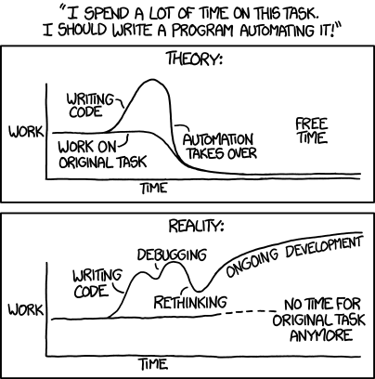
XKCD

