Slide 1
News Classifier and Trending Event Detection https://github.com/sujithcp/NewsAnalyser
SHARANYA KV
SUJITH CP

Slide 2
A Brief Introduction
Data classification and mining are trending and rapidly evolving fields of
Computer science. Data mining is the process of identifying patterns and relationships in data that often are not obvious in large and complex data sets.
News event detection and classification are very helpful in socio-economic research and such purposes. As social media and real-time information sharing gains popularity, an automated event detection system can do better in understanding the required events.
Machine Learning Technologies for Data Mining
Inductive Logic Programming
Genetic Algorithms
Neural Networks
Statistical Methods (We use Bayesian method for classification)
Decision Trees
Hidden Markov Models

Slide 3
Data Collection
RSS links collection
Feed fetching
Preprocessing and cleaning
Extract news from feed links using beautifulsoup and sumy
Transformation and reduction
Tokenizing,stopwords removal, stemming etc.
Prepare categorized datasets for training
Discard very short and irrelevant data
Training
Train the machine using naïve Bayes classifier.(Used nltk module for the same)
Dump the classifier object for easy retrieval.(Using pickle)
Testing
Test 1: Use same dataset for training and classification.
Expecting higher accuracy.
Test 2: Use mutually exclusive 50% data for training and classification.
Procedure for building news classifier

Slide 4
Data collection and cleaning
RSS url with category indication
feed parser
Link
Html parser
Main content
Feed URL
Title
Date
summary
summarization
Sqlite database
Insert into table with attributes id,date,title,link, content etc.

Slide 5
Training
Supervised learning using naïve Bayes classifier
NB classifier works on the Bayes theorem in probability mathematics
Processed data
Dump the classifier object for easy reuse (Using pickle library)
NB algorithm
Processed test data
NB classifier
Category, probability

Slide 6
Analysis
Random testing
Data set size : 5000+
Accuracy : 94.6
Best case test
No. of fault classification : 265
Data set size : 9000+
Accuracy : 97.17

Slide 7
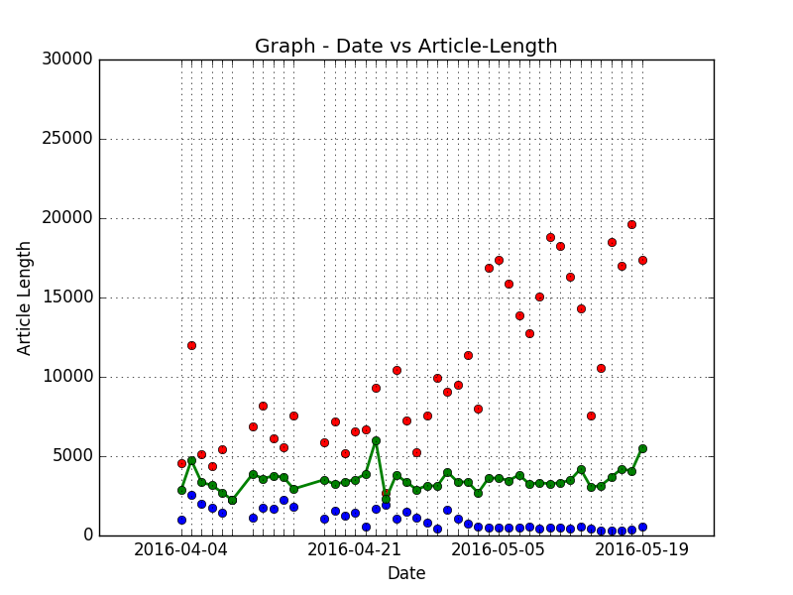
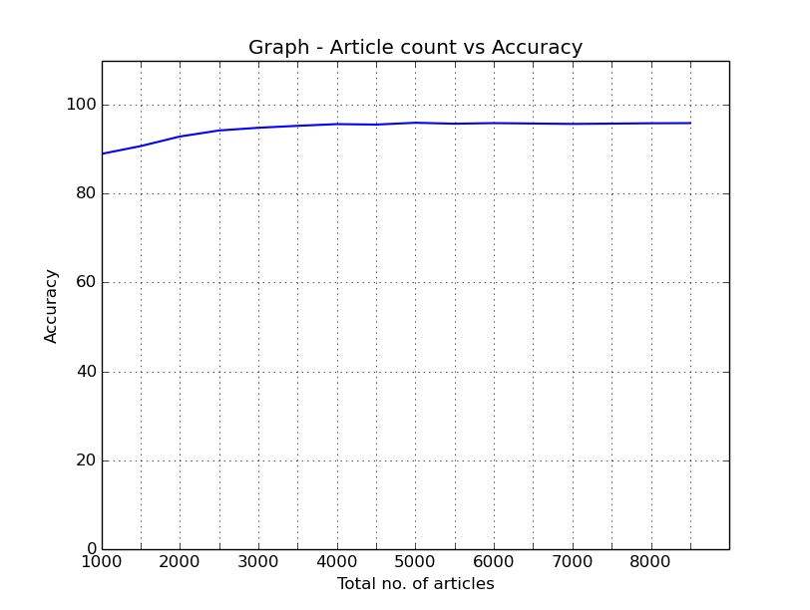
Analysis

Slide 8
Proposed Enhancements
Multi-category tagging for documents
Dynamic categorization during fetching

Slide 9
Event detection
Event detection is an unsupervised learning task.
We used retrospective event detection which identifies previously unidentified events in chronological order.
Events are those phrases which occur in a peaking frequency for a short period of time.

Slide 10
Event detection Procedure
Data selection and sampling
Fetch data from database for a period
Transformation and reduction
tokenize
N-gramize
Unsupervised learning
Compare with previous events
Compute weight for each phrases
Analysis and verification
Compare with online data manually
Compute hit and miss and false alarms of events. (Out of the program task)
visualization

Slide 11
Data transformation
The data used for learning purpose must be cleansed before the task
Main processing steps are
Tokenize the news data and remove stopwords.
“Brain cancer detected in the Assam state
{ brain, cancer, detected, assam, state }
Create unigrams, bigrams, and trigrams and add it to the phrases list (learning vocabulary)
{ {brain, cancer, . . . . }
{brain cancer, cancer detected, . . . . . }
{brain cancer detected, cancer detected assam, . . . . . }
}

Slide 12
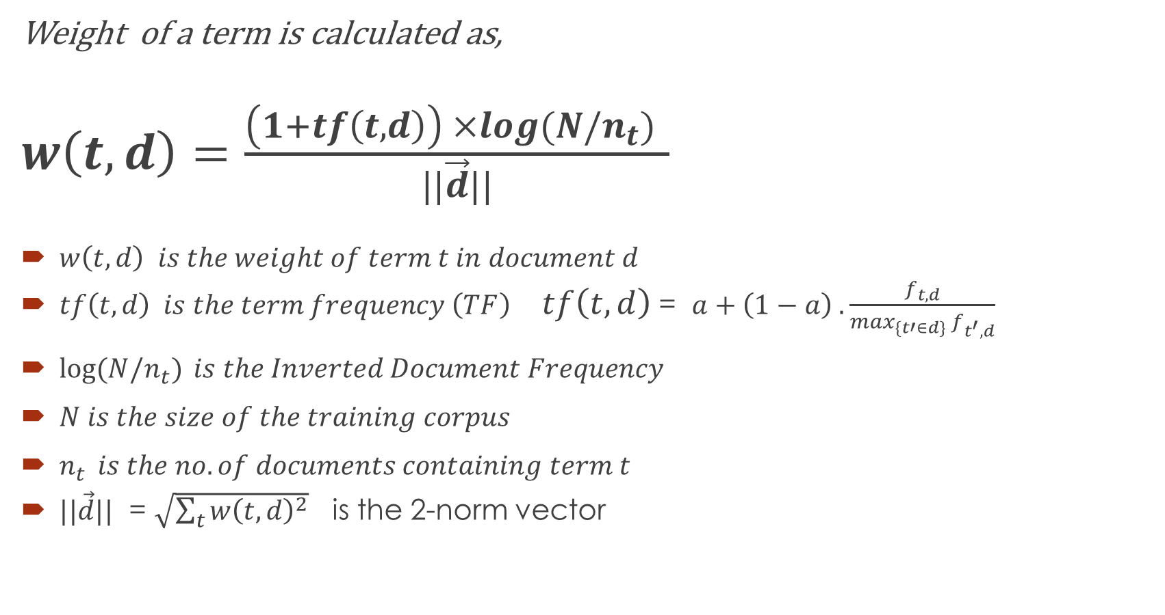
Event detection working
Weight of a term is calculated as,
$w\left(t,d\right)=$ $\frac{\left(1+tf\left(t,d\right)\right) ×log(N/n_{t}) }{||\vec{d}||}$
$w\left(t,d\right) is the weight of term t in document d$
$tf\left(t,d\right) is the term frequency \left(TF\right)$ $tf\left(t,d\right)$ = $a+\left(1−a\right) . \frac{f_{t,d}}{\max_{\{t′∈d\}} f_{t^{′},d}}$
$\log{(N/n_{t})} is the Inverted Document Frequency$
$N is the size of the training corpus$
$n_{t } is the no. of documents containing term t$
$||\vec{d}||$ = $\sqrt{\sum_{t}{{w\left(t,d\right)}^{2}}}$ is the 2-norm vector

Slide 13
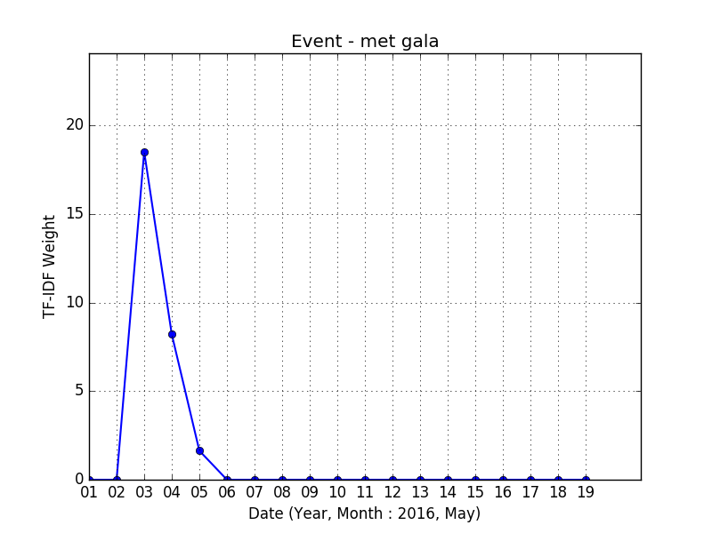
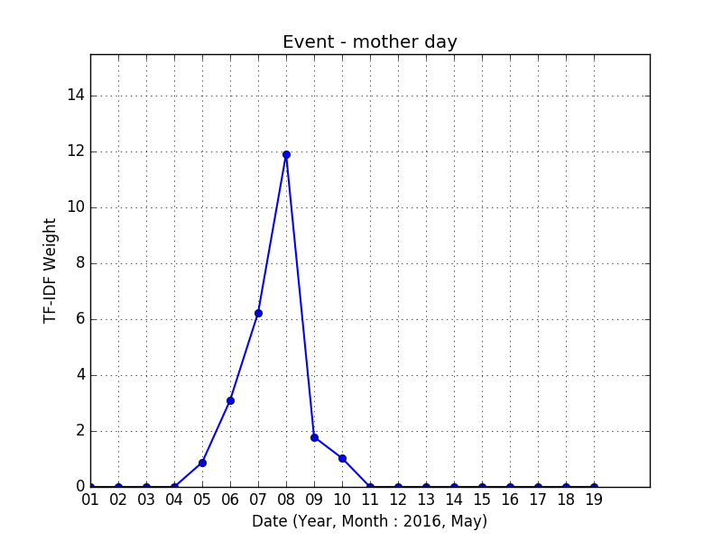
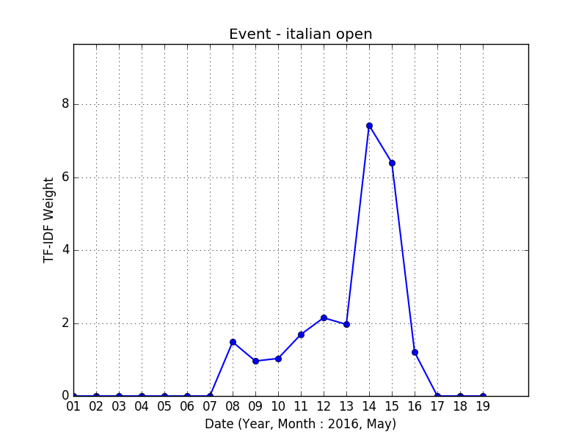
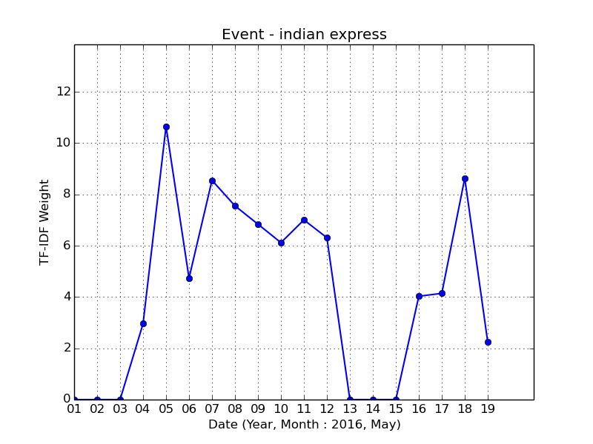
Analysis
Some correctly detected events
Met gala
ipl 2016
Mother day
Assembly polls
Cannes review
Rio Olympics
Some noises
Film review
Times India
Jessica parker
Indian express
Captain America
Net profit

Slide 14
Proposed Enhancements
Clustering and event merging.
Real-time online reference, comparison, and verification.

Slide 15
References
Learning approaches for Detecting and Tracking News Events: IEEE paper by Yiming Yang, Jaime Carbonell, Ralf Brown,Tom Pierce, Brian T. Archibald, Xin Liu
Web references:
http://stevenloria.com/how-to-build-a-text-classification-system-with-python-and-textblob/
https://en.wikipedia.org/wiki/Tf%E2%80%93idf

Slide 16
Thank you….

