Slide 1

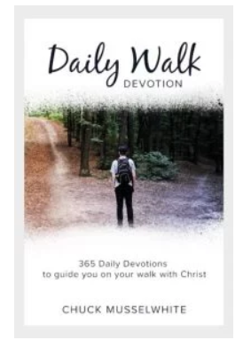
Daily Walk Devotion
POST CAMPAIGN ANALYSIS
BY
GROUP 10 :
DHAIRYA SHAH
RAMESH SUBEDI
SUJITH NAIR
UDAY KUMAR

Slide 2
Executive Summary
The Daily Walk Devotion’s mission is to help you take your next step of faith by writing devotions that challenge and inspire you to walk with Jesus
Added new campaigns based on location that led to 96% more clicks in first 14 days
Increased daily budget utilization 40% , maximizing potential reach of the website
Client experienced a 100% increase in pageviews on the website
Downtime of 9 days, due to deactivation of account based on non-compliance

Slide 3
Changes Made During the Challenge
Added 3 campaigns based on location
Daily Walk Philippines (Philippines): 25% budget
Daily Walk India (India): 12.5% budget
Daily Walk US (US): 12.5% budget
Added 1 campaign based on delivery method
Daily Walk High CTR (Accelerated delivery): 25% budget
Original Campaign: Daily Walk Devotion : 25% budget
Added keywords related to bible verse
Modified Campaign Budgets based on clicks, CTR and Cost Per Click.
Decreased Max. Cost Per Click to increase clicks while utilizing the entire budget
Regularly added/removed keywords to maximize clicks, CTR
Added/Removed lowest performing text ads as needed

Slide 4


Campaign Performance

Slide 5
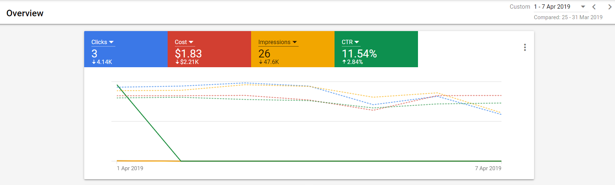

Account Deactivation(Third Week) Lost reach opportunity due to deactivation (Apr 1-8, 2019) vs (Mar 25-31, 2019)
Clicks Lost Due to Downtime: 4140
Account Deactivated because :
Unapproved single-word keywords or generic / insufficiently mission-based
Dynamic ads and responsive ads not allowed (replace them with expanded text ads)

Slide 6
Lessons Learned
Geotargeting helps in understanding the reception of various keywords, ad texts and cost per click value changes with country
Accelerated delivery combined with optimized maximum CPC is useful for campaigns that targets multiple countries as each will have its own most active time zone
Account deactivation can be avoided by periodic filing for reactivation even when the account is active. The Google specialists will check for compliance
It takes about 3-4 days for Maximize Clicks to find the optimum Cost Per Click and is a great strategy to start with

