Slide 1
MIND CONNECT GROUP 8
Aishvarya Bandivdekar
Alice Zheng
Anshu Verma
Hei (Kira) Oh
Pragadeesh Prakasam
Rohith Selvarajan
Sujith Nair

Slide 2
Our proposed platform - 'MindConnect'
The proposed platform named 'MindConnect' is an app/website that shares your thoughts/opinions/ideas on various questions with a narrowly selected dynamic group and allows you to engage further on it.
However, you do not have to scroll through 10,000+ groups to select which ones you might want to join.
The platform will be similar to Reddit, a place where users can engage on various topics with other like-mind or similarly-interested users, but with a more tailored recommendation for groups made through questions asked in the beginning for each new user
A forum where participants are able to connect with users who have responded to similar topics, and able to expand their interests in a gradual manner.

Slide 3
Our Social Aspect...
Users can view other people’s opinion and thoughts on the original topic and engage with them and express their own opinions.
Allows users freedom of engagement at their leisure & to slowly expand their interests in different topics.
Users will be able to mark “Like” to the post/ comments they like and ”Dislike” or “Skip” to the ones they don’t find relevant or good.
People will be posting on the platform based on their own experience and their own knowledge, thus making the responses/ solutions more authentic and appropriate. Because of this, Subject matter experts are not required.

Slide 4
Our Target Users...
A person looking for a social media app/website that just works, without giving tons of options.
Customers who wants to engage with people without having to spend time building a social profile and learning tactics to improve engagement.
Our ideal customer is a person who feels the concept of existing social media is too expansive, and wishes to participate in a more tailored fashion.

Slide 5
Customer Persona : Saya Mishra
Age : 25
Occupation : Student
Status : Single
Location : Mumbai, India
Quiet ; Ambitious ; Hardworking
Goals :
Go online anytime to find new people on the internet
Share and discuss interesting ideas on social media
Frustrations:
Widespread Abuse/Harassment on social media
Difficult to build online presence
Hard to find conversationalists and trustworthy people online

Slide 6
Customer Persona : Jim Andrews
Age : 32
Occupation : Data Analyst
Status : Married
Location : London, UK
Friendly ; Kind ; Nerd
Goals :
A place online to express myself without fear of judgement
Discussions on social media during free time
Frustrations:
No time to invest on understanding how to be popular on social media apps
No place for a normal conversation – it has to be funny, angry or controversial
Everything is about going viral

Slide 7
Our Customer Segment
Most social media are aimed at outgoing extroverts, which makes sense, as they categorize as “social”.
Many people enjoy the ambiguity of engaging with random strangers over topics that are of interest to both parties. There is no pressure to engage more than is comfortable for each user. While similar apps exist, there is an overwhelming number of different topics available that might dissuade new users from socializing further.

Slide 8
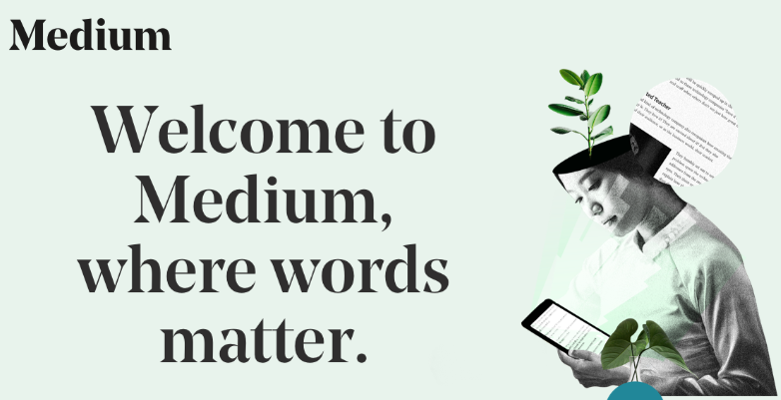



Our Competition...
Our main competitors would be sites like Reddit, Medium, Quora.
However -
The paid partner programs lead to quantity driven content generation
Plagiarism is a big issue where users are obsessed with follower-count and number of views/ likes.

Slide 9
Their Social Component...
Medium requires a paid subscription while Quora and Reddit offer free read/write access to their members. You need to sign up with an email ID or other social media sites like Facebook.
Once signed up, the websites offer you a choice of topics to follow and based on that further generates the content to show you.
The user can write an article, answer a question, comment on someone's post and follow users and topics. All three websites have BNBR (Be Nice, Be Respectful) rules.
There are Direct Messaging options available to users who want to connect 1x1

Slide 10
Competitor Statistics
Below are some statistics about Reddit as per Pew Research Centre conducted in 2016 in US that will help us understand our own potential target user group demographics and help us plan towards attracting and engaging the 'non-users'
 |  | Reddit users (%) | Reddit new users (%)
Gender | Men | 67 | 71
 | Women | 33 | 29
Age Group | 18-29 | 64 | 59
 | 30-49 | 29 | 33
 | 50-64 | 6 | 7
 | 65+ | 1 | <1
Education | College degree | 42 | 48
 | Some College | 40 | 43
 | High School or less | 18 | 9
Values | Liberal | 43 | 47
 | Moderate | 38 | 39
 | Conservative | 19 | 13
Source - https://www.journalism.org/2016/02/25/reddit-news-users-more-likely-to-be-male-young-and-digital-in-their-news-preferences/

Slide 11
Potential of ‘MindConnect'
The goal of the platform is to provide good/relevant content to the customers.
Provide a free platform where they can find like minded people, share ideas and engage with others in a non-toxic environment
Users will be given suggestions to discussions that are generated by shared interests which they can be part of.
It allows our users to feel like they 'belong' to a community.

Slide 12
Social Engagement
By subscribing to this platform, users will be able to take part in discussions and connect with other people who have similar thought process.
Each user will be able to interact with other users by:
Posting a question
Answering a question from other users
Commenting on another user's post
Discussing thoughts on a particular topic with a group of users
Posting a blog for the entire audience of the site
"Liking" the question\post
“Replying“ to the post

Slide 13
Why are they important?
Driving factor for attracting users to the platform. Users want to interact with others especially given our focus for the platform.
These components help add value to our community and encourage users to interact with others to answer questions or discuss interest topics. The more interaction, the more traffic to the platform and a stronger community.

Slide 14
KPIs of Platform
KPIs for the Website/App:
Total No. of subscribers by month
Rate of new subscribers by month
No. of posts and comments generated each day
Average Time spent by each user

Slide 15
Measuring KPIs
By use of Analytic tools available, we will measure the KPI’s mentioned in the earlier slide.
We will use tools such as RivalIQ, Brandwatch Analytics, etc. as well as user/customer persona to create a better experience for the users based on their preferences.
These will help to enhance/ modify/ add new content on the platform based on gathered data.

Slide 16
Monetizing the Platform
As this is a free platform available to customers, money cannot come from subscribers.
We will try to publish relevant ads on the website which will help us generate money which can be used to maintain the platform.
By displaying ads, ad companies will pay us for each click done by user.
We will experiment with Wikipedia style donations which will also add to authenticity and portray the true vision of the site.
As an alternative to ad-revenue, we would implement a donation system where certain premium, or reward system, can be unlocked similar to Patreon.
People will be able to fund/donate money to the creators of their favorite content to support the creators.
As per their donation amount, donators will be given rewards/ perks such as discounts on merchandize, gift cards, early access to the content etc.
MindConnect will keep 3-5% of the amount donated depending on the amount of donation.

Slide 17
Monetizing Social Component
We chose not to monetize social components for the initiation of the platform as we believe it will hinder the growth of the platform.
As we expect to create authentic content, relevant trends and gaps in various areas can be easily captured. These can be shared with retailers for a price without divulging any user information other than possibly demographics.
Creating hyperlinks to product offerings on keywords from the answer section. This will have to be monitored well to avoid abuse.

Slide 18
Customer Journey
AWARENESS
We first make our target users aware of the availability of our platform
EVALUATION
Our users start evaluating the benefits of using our platform
SIGN UP
Our users will sign up if they like the platform, find it easy to use and useful
RETENTION
Through a fair moderation policy we will ensure our users will have a safe and interesting experience
ADVOCACY
Our most engaged users will promote the platform in their network
Notes:
Source : https://medium.com/@azviss4/customer-journey-mapping-in-7-bookmarks-d116da67a0c2

Slide 19
Customer Journey - Awareness
Ways a new customer can become aware of MindConnect :
Social media referral : Chris tells Joan about this app that does not have crazy options and is so easy to use.
Following Hashtag Campaigns : #MindConnectApp ; #TrulySocialApp ; etc. being used with sponsored ads on social media
Search Network Campaigns : Keywords – simple social media apps, online discussion, online forum, discussion questions, message board ideas
Reach out to be featured on articles like “Best new social media apps in 2019” on popular online list creators like :
hootsuiteblogs.com
lifewire.com
smallbiztrends.com
Through owned website and social media account on various apps that provide information and links for the app

Slide 20
Customer Journey – Evaluation\Sign Up
Once on the app, the user experiences these features of MindConnect :
No personal information solicited
Age ; Gender ; Three interested topics to be selected
Shows random first post/group post/blog based on this information – Options to
Like / Dislike / Skip
Reply / Comment
Report
Posts tailored based on likes and replies – this information not shared/ made public
A menu option to :
Choose more interests
Create profile
Check old posts
Focus entirely on making a seamless connection with online community
No groups , No upvotes , No search for specific people

Slide 21
Customer Journey – Retention\Advocacy
After customer engages with the app for a certain time frame :
Non-obtrusive ads start showing up
Request to allow notifications
Notifications to users :
To provide feedback
To know more about us
To donate to the developers
To refer a friend

Slide 22
Results / Conclusions about the project
The platform “MindConnect” is for an audience that wants to go back to the basics of social media.
An attempt to remove the construct that what is popular is good and replace it with one-on-one human interaction
Reduce options and make it simpler to spend time on the internet
A platform that is truly focused on the customer and uses machine learning to optimize user experience rather than using personal data to sell advertisement or exert influence

Slide 23
THANK YOU

