Slide 1

Social Media Project
Improving Your Social Media Score
BY : SUJITH NAIR

Slide 2
Contents
Choose a social media platform
Why LinkedIn?
Business Strategy
Branding Strategy
Marketing Strategy
Channel Strategy
Status on 27 Jan 2019
Current Status (24 April 2019)
Status on 7 March 2019
Engagement - Lead and Lag Indicators
Lag indicators for 14 weeks
Lead indicators for 14 weeks
Informational Interview Experience
Summary

Slide 3
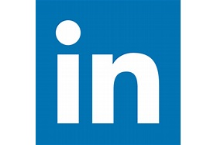
Choose a social media platform
LinkedIn
Profile :
https://www.linkedin.com/in/sujithnairdfw/

Slide 4
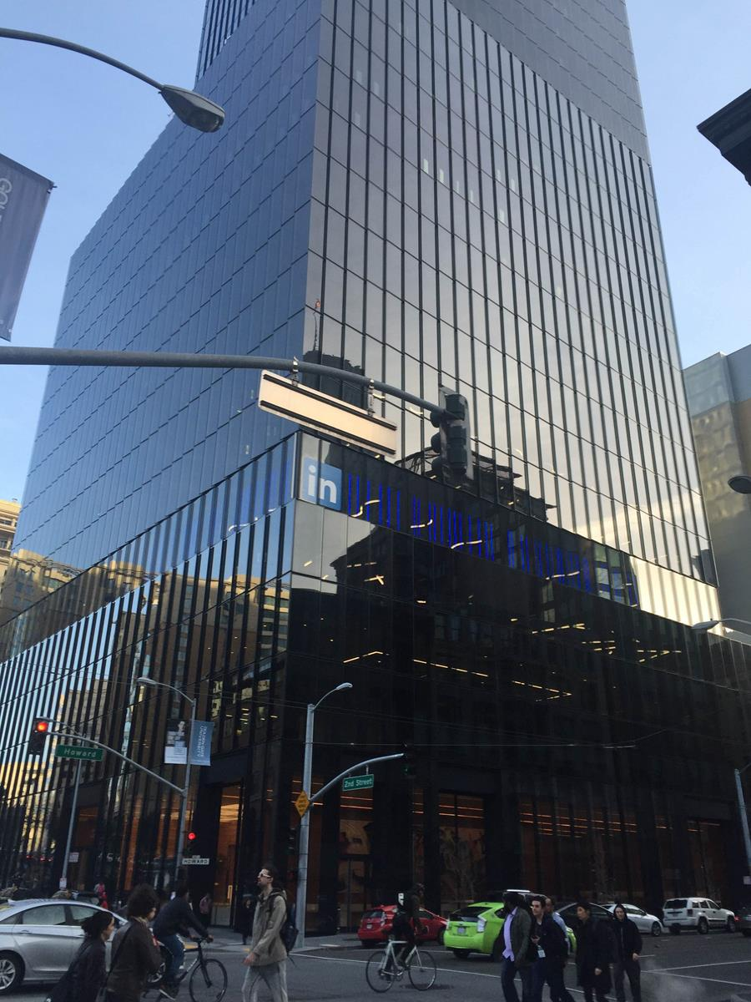
Why LinkedIn?
Motivated to invest time into a project improves my professional branding.
It is a project that could land me an internship.
An opportunity to apply new learned techniques to market myself before I learn to market any thing else.

Slide 5
Business Strategy
Receive skill recognition and job offers from recruiters and industry professionals on LinkedIn

Slide 6
Branding Strategy
Showcase leadership, excellent communication and problem solving capabilities
Ensure that the perception generated is clear on areas of specialization in ETL, predictive analytics, marketing and data science

Slide 7
Marketing Strategy
Increase connections from 707 to 1500 and profile views over last 90 days from 85 to 500.
Reach out to experts in the field on LinkedIn to conduct informational interviews
Create content – articles, posts, videos and replies to enhance engagement with peers
Improve profile quality by clearly communicating areas of expertise

Slide 8
Channel Strategy
Connect with people on LinkedIn for increased engagement
Explore other social media platforms like Twitter, Instagram etc. to bring audience to Linkedin profile and posts

Slide 9
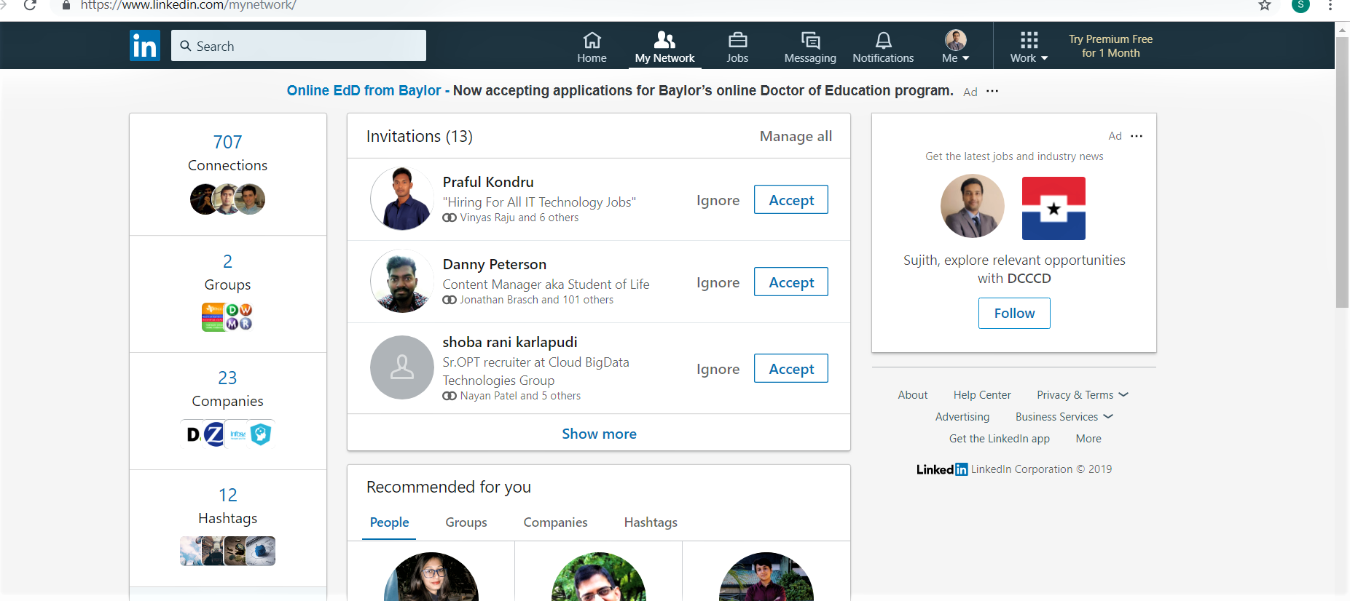
BASELINE STATUS ON JAN 27 2019

Slide 10
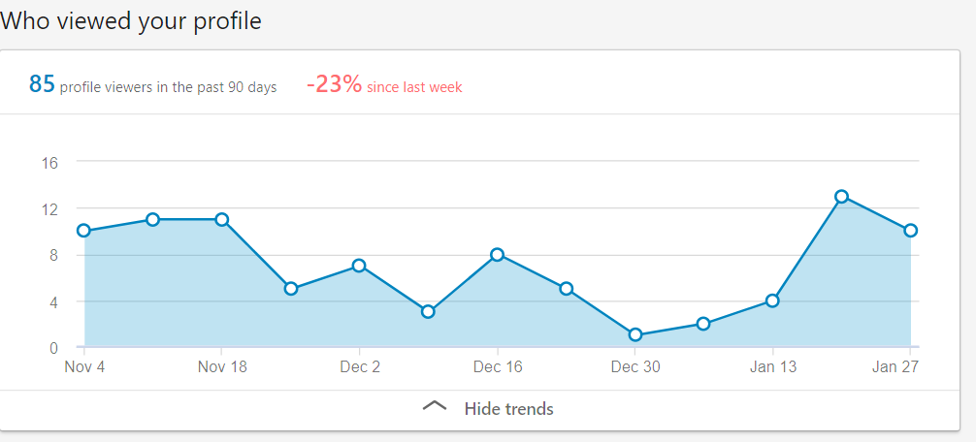
BASELINE STATUS ON JAN 27 2019

Slide 11

BASELINE STATUS as on Jan 27 2019
707 Connections
85 profile views in last 90 days
0 Articles/Posts
2 groups
Following 23 companies
12 hashtags

Slide 12
CURRENT STATUS on 24 April 2019
927 Connections
165 profile views in last 90 days
2 Articles/Posts
8 groups
Following 81 companies
19 hashtags

Slide 13
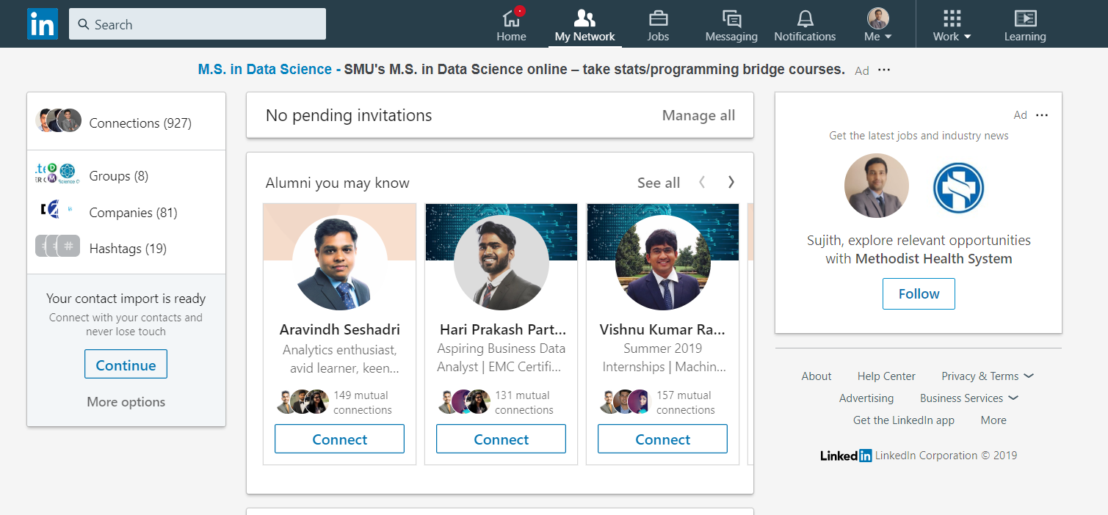
CURRENT STATUS

Slide 14
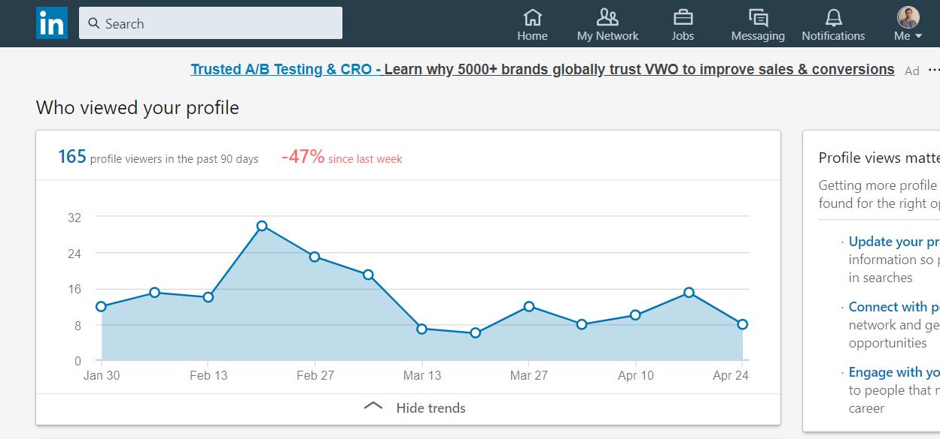
CURRENT STATUS

Slide 15
STATUS as on 7 March 2019
Did your reach grow? – Yes – 866 connections from 707
Profile views increased? – Yes – 147 in last 90 days from 85
By how many followers/friends/etc and percent(%)
22.2% increase in connections
73% increase in profile views in last 90 days
Is this what you expected? Why or why not?
Partly. Aim was to increase 50-60 connections a week to reach goal of 1500 by end of semester
Grew by 31 connections per week on average in last 5 weeks

Slide 16
STATUS as on 7 March 2019
What were the contributing factors?
1. 80% of new connections were requests sent out by me.(130 out of 157)
2. Targeted connection requests with a note got a 65% approval rate. (130 approved out of 200 sent)
3. Received approx. 5 requests a week due to improved profile and increased reach.
What were the most successful strategies you employed?
1. Searched for people with keywords like Marketing Analyst and Marketing Analytics
2. Generally found recent professionals for analyst and experienced professionals\recruiters for analytics
3. Sent connection requests to professionals with at least a year of experience
4. Looked for alumni or people working in Dallas Fort Worth area

Slide 17
STATUS as on 7 March 2019
What would you do again / or differently
1. Spend time everyday on network building.
2. Write more posts and articles
3. More informational interviews
How/ What are you going to change before Part 3 is due?
1. Continue reaching out to professionals for Informational Interview. Look to conducts 5 informational interviews a week. Currently it is on average 1 per week.
2. Spend 30 minutes on network building everyday apart from weekends. Last 5 weeks it was few hours mostly on weekends only.
3. Put out a post daily and one article each week. Until now it was 1 post a week and no articles.

Slide 18
Engagement Metrics - Lag and Lead Indicators
The goal of the project is to receive internship opportunities
The primary way that I have chosen is through requesting 15 minute calls(Informational Interviews) through LinkedIn messages to 1st degree contacts from targeted companies
This establishes primary contacts in the company, possible connection to recruiter, opportunity to get expert advice and learn about the company which can be useful in interviews
Secondary ways are to increase profile views and apply to LinkedIn opportunities

Slide 19
Lag Indicators after 14 weeks
Received internship offers/interviews through LinkedIn? No
How many relevant opportunities discussed through LinkedIn contacts : 7
6 from recruiters : Failed due to permanent position requirement
1 from professional : Urgent internship requirement in March – now filled

Slide 20
Lead Indicators after 14 weeks
Number of Informational Interviews conducted - 11
Informational Interview requests made – Approx. 85
Response Rate : 20%
Acceptance Rate : 13%
Lead to recruiters/interviews - 0

Slide 21
Informational Interview Experience
I approach a new contact with a message like below :
Hi ,
Thank you for accepting my connection request.
May I set up a phone call with you sometime this week to discuss your experience with Match.com? Your advice would be greatly appreciated.
I recognize this may be a busy time for you, so if we are unable to connect here I’ll try to reach you next week to see whether that is more convenient.
Thank you for your time,
Sujith Nair

Slide 22
Informational Interview Experience
Those who agree for a call are very supportive and generally appreciate this approach.
We talk about trends in the business of their company, their experience, their skills. I ask for advice on how to progress in marketing analytics and getting an interview.
Few of them ask about my background and interests.
Have received some great advice and tips.
Follow up with them after a week and then monthly for any recommendations they may have.

Slide 23
SUMMARY
Expectation to land a summer internship through LinkedIn was not successful
Improved reach in the Marketing Analytics community
Informational interview is a powerful approach to networking
However, response rate is low(20%)
Potential to create opportunities by conducting 5-6 interviews a week
Targeted approach in place of a generic approach can be tested to see if the response rate and interview lead rate is better

