Slide 1

An Experimental .NET framework for the browser/Sujith Quintelier
Blazor

Slide 2
Overview
What is Blazor?
How Blazor Works
Why?
Features
Roadmap
FAQ
Code Examples
Questions

Slide 3

DANGER, WILL ROBINSON!
Blazor is experimental!
0.5.0 was released on July 25, 2018!

Slide 4
What is Blazor?
Blazor is a single-page web app framework built on .NET that runs in the browser with WebAssembly.
Use C#/Razor to author
Browser + Razor = Blazor

Slide 5
How Blazor Works
C# and Razor code files are compiled into .NET assemblies
Assemblies and .NET runtime are downloaded on the browser
Blazor uses JavaScript to bootstrap the .NET runtime (Mono) loading the required assembly references
Blazor allows DOM manipulation/browser API calls from the .NET runtime via JavaScript interoperability

Slide 6
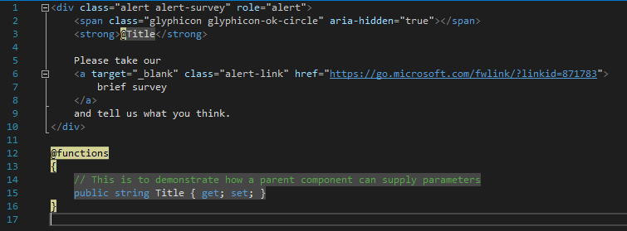
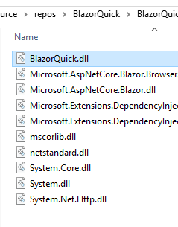
How Blazor Works
C# and Razor code files are compiled into .NET assemblies

Slide 7
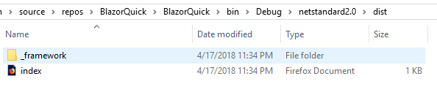
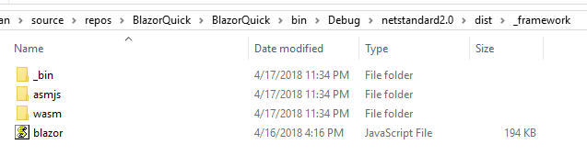
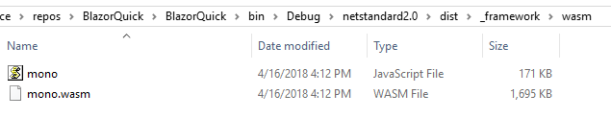
How Blazor Works
Assemblies and .NET runtime are downloaded on the browser

Slide 8
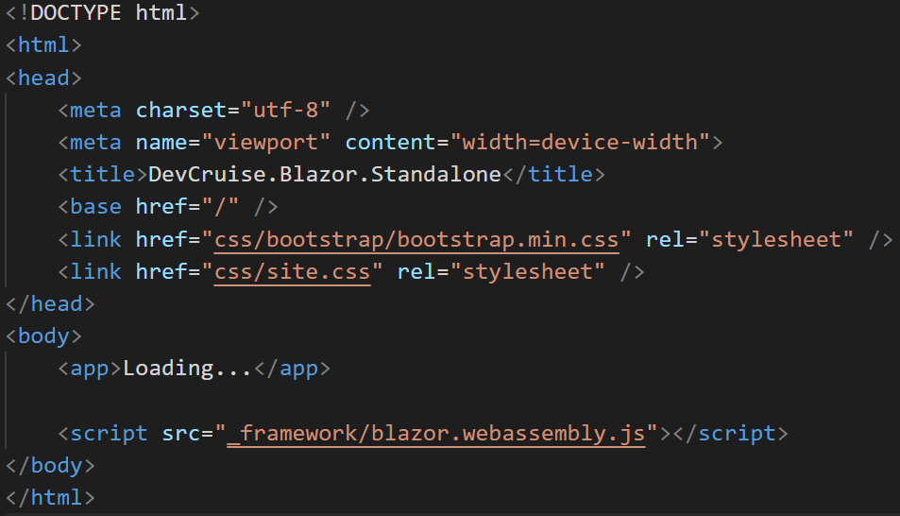
How Blazor Works
Blazor uses JavaScript to bootstrap the .NET runtime loading the required assembly references

Slide 9
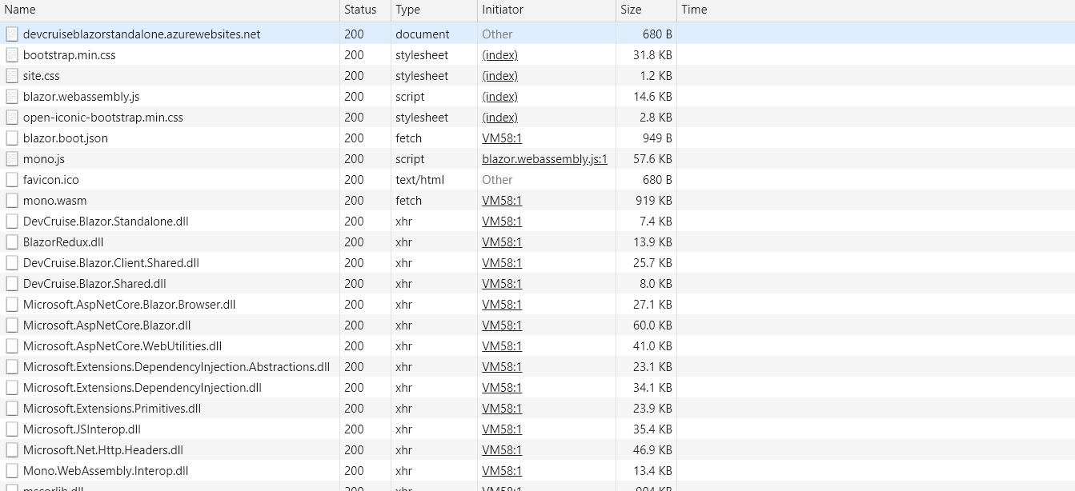
How Blazor Works
Blazor uses JavaScript to bootstrap the .NET runtime loading the required assembly references

Slide 10
How Blazor Works
Blazor allows DOM manipulation/browser API calls from the .NET runtime via JavaScript interoperability
C#
Render Tree
Blazor JavaScript
Change DOM
DOM
C#
Event Trigger
Process Event
Blazor JavaScript
Change DOM
DOM
UI Differences

Slide 11
Why?
Full Stack development using C# and .NET
.NET advantages:
High Performance
Scalability
Maintainability
Cross Platform
Visual Studio
Notes:
https://www.techempower.com/benchmarks/#section=data-r15&hw=ph&test=plaintext&l=hra0al

Slide 12
Features
Component model for building composable UI
Routing
Layouts
Forms and validation
Dependency injection
JavaScript interop
Live reloading in the browser during development
Server-side rendering

Slide 13
Features
Full .NET debugging both in browsers and in the IDE
Rich IntelliSense and tooling
Ability to run on older (non-WebAssembly) browsers via asm.js
Publishing and app size trimming

Slide 14
FAQ
Does Blazor compile my entire .NET assembly into WebAssembly?
No.
Only .NET runtime is compiled into WebAssembly.
Could be support for full static ahead-of-time compilation into WebAssembly in the future.

Slide 15
FAQ
Won’t the app size huge for the .NET runtime?
Not really.
Runs on full Mono Desktop profile right now.
Plans to reduce size by using custom profile.

Slide 16
FAQ
Can I use Blazor without .NET backend?
Yup.
Can be deployed as set of static files.

Slide 17
Setup
WebAssembly compatible browser
https://platform-status.mozilla.org/#web-assembly
.NET Core 2.1 Preview 2 SDK
At least v.2.1.300-preview2-008533
https://www.microsoft.com/net/download/dotnet-core/sdk-2.1.300-preview2
Visual Studio 2017 Preview (15.7)
https://www.visualstudio.com/vs/preview
ASP.NET Core Blazor Language Services extension
https://go.microsoft.com/fwlink/?linkid=870389

Slide 18
Setup
Visual Studio Code/command line
dotnet new -i Microsoft.AspNetCore.Blazor.Templates
dotnet new blazor

Slide 19
Code Example
New Project

Slide 20
Components
Fundamental building block of web apps
Components are self-contained UI
Includes HTML and logic to inject data or respond to events
They can be nested, reused, and shared between projects
Written using C#/Razor and HTML

Slide 21
Code Example
Components

Slide 22
Layouts
Layouts are really just components
Defined in a Razor template
Must implement the Microsoft.AspNetCore.Blazor.Layouts.ILayoutComponent component
Adds a Body property that contains the content to be rendered
Allows for nested layouts

Slide 23
Code Example
Layouts

Slide 24
Routes
Handles internal routing of pages
Router is configured in App.cshtml
Uses the @Page directive defined in the Pages
Can have multiple routes
Can contain parameters

Slide 25
Code Example
Routes

Slide 26
Data Binding
Supports one-way and two-way data binding
Binding using the bind= attribute
Support for binding data types:
Int
String
DateTime
Enums
Bool
If you need another type, you must provide a getter/setter.

Slide 27
Code Example
Data binding

Slide 28
JavaScript Interop
Supports calling JavaScript from inside Blazor
Blazor uses registered functions
Supports calling C# from JavaScript

Slide 29
Code Example
JavaScript Interop

Slide 30
Questions
?

Slide 31
Additional Information
Blazor GitHub
https://github.com/aspnet/Blazor/
Blazor.net
http://blazor.net/docs/
Steve Sanderson’s Intro to Blazor
http://blog.stevensanderson.com/2018/02/06/blazor-intro/
Steve Sanderson’s Demo Video
https://www.youtube.com/watch?v=MiLAE6HMr10

