Slide 1

An Experimental .NET framework for the browser/Sujith Quintelier
Blazor

Slide 2

Overview
What is Blazor?
How Blazor Works
Why?
Features
Roadmap
FAQ
Code Examples
Questions
Blazor
Overview

Slide 3

Experimental
Blazor is experimental!
0.5.0 was released on July 25, 2018!
Blazor
Exerimental

Slide 4
What is Blazor?
Blazor is a single-page web app framework built on .NET that runs in the browser with WebAssembly.
Use C#/Razor to author
Browser + Razor = Blazor
Blazor
What is Blazor?

Slide 5
How Blazor Works
C# and Razor code files are compiled into .NET assemblies
Assemblies and .NET runtime are downloaded on the browser
It uses JavaScript to bootstrap the .NET runtime (Mono) loading the required assembly references
It allows DOM manipulation/browser API calls from the .NET runtime via JavaScript interoperability
Blazor
How Blazor Works

Slide 6
…
Blazor
…

Slide 7
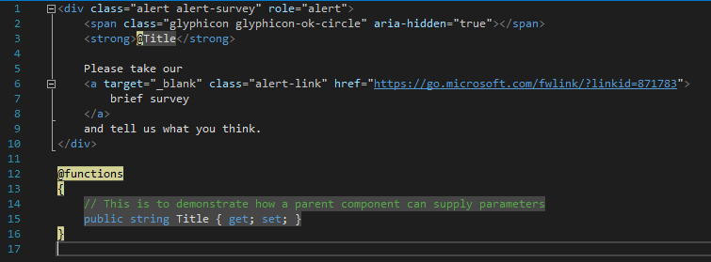
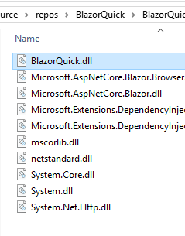
How Blazor Works
C# and Razor code files are compiled into .NET assemblies
Blazor
How Blazor Works
Assemblies

Slide 8
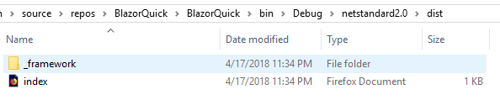
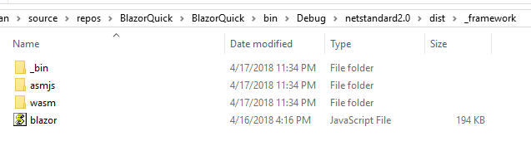
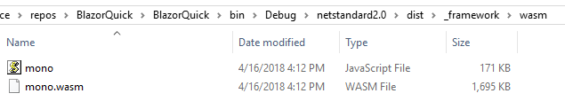
How Blazor Works
Assemblies and .NET runtime are downloaded on the browser
Blazor
How Blazor Works
Download

Slide 9
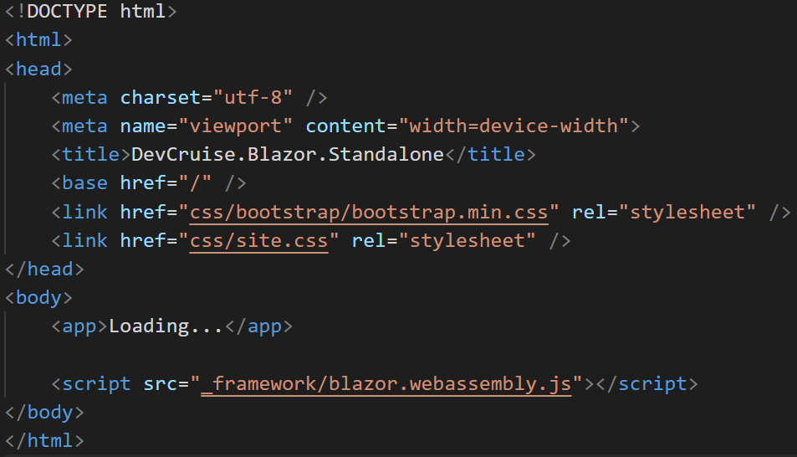
How Blazor Works
Blazor uses JavaScript to bootstrap the .NET runtime loading the required assembly references
Blazor
How Blazor Works
Bootstrap

Slide 10
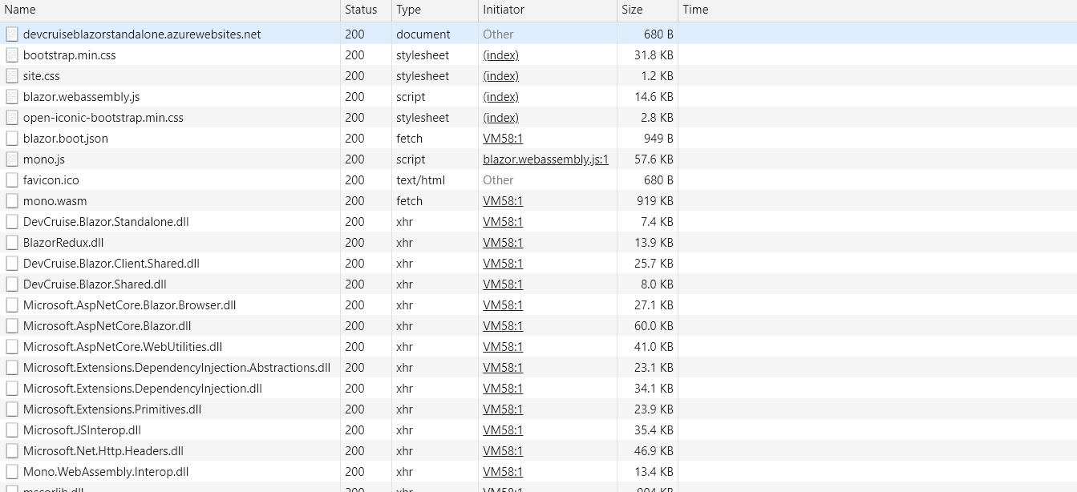
How Blazor Works
Blazor uses JavaScript to bootstrap the .NET runtime loading the required assembly references
Blazor
How Blazor Works
Bootstrap

Slide 11
How Blazor Works
Blazor allows DOM manipulation/browser API calls from the .NET runtime via JavaScript interoperability
Blazor
How Blazor Works
Bootstrap
C#
Render Tree
Blazor JavaScript
Change DOM
DOM
C#
Event Trigger
Process Event
Blazor JavaScript
Change DOM
DOM
UI Differences

Slide 12
Why
Full Stack development using C# and .NET
.NET advantages:
High Performance
Scalability
Maintainability
Cross Platform
Visual Studio (Code)
Blazor
Why

Slide 13
Features
Component model for building composable UI
Routing
Layouts
Forms and validation
Dependency injection
JavaScript interop
Live reloading in the browser during development
Server-side rendering
Blazor
Features
Part 1

Slide 14
Features
Full .NET debugging both in browsers and in the IDE
Rich IntelliSense and tooling
Ability to run on older (non-WebAssembly) browsers via asm.js
Publishing and app size trimming
Blazor
Features
Part 2

Slide 15
Setup
WebAssembly compatible browser
https://platform-status.mozilla.org/#web-assembly
.NET Core 2.1 SDK (2.1.300 or later)
https://www.microsoft.com/net/download/dotnet-core/sdk-2.1.302
Visual Studio 2017 (15.7 or later)
https://www.visualstudio.com/vs
ASP.NET Core Blazor Language Services extension
https://marketplace.visualstudio.com/items?itemName=aspnet.blazor
Blazor
Setup
Part 1

Slide 16
Setup
Blazor
Visual Studio Code/command line
dotnet new -i Microsoft.AspNetCore.Blazor.Templates
dotnet new blazor
Setup
Part 2

Slide 17
Code Example
Blazor
New Project
Code Example
New Project

Slide 18
Components
Fundamental building block of web apps
Components are self-contained UI
Includes HTML and logic to inject data or respond to events
They can be nested, reused, and shared between projects
Written using C#/Razor and HTML
Blazor
Components

Slide 19
Code Example
Blazor
Components
Code Example
Components

Slide 20
Layouts
Blazor
Layouts are really just components
Defined in a Razor template
Must implement the Microsoft.AspNetCore.Blazor.Layouts.ILayoutComponent component
Adds a Body property that contains the content to be rendered
Allows for nested layouts
Layouts

Slide 21
Code Example
Blazor
Layouts
Code Example
Layouts

Slide 22
Routes
Blazor
Handles internal routing of pages
Router is configured in App.cshtml
Uses the @Page directive defined in the Pages
Can have multiple routes
Can contain parameters
Routes

Slide 23
Code Example
Blazor
Routes
Code Example
Routes

Slide 24
Data Binding
Blazor
Supports one-way and two-way data binding
Binding using the bind= attribute
Support for binding data types:
Int, String, DateTime, Enums
Bool, Long, Decimal
If you need another type, you must provide a getter/setter.
Data Binding

Slide 25
Code Example
Blazor
Data Binding
Code Example
Data Binding

Slide 26
JavaScript Interop
Blazor
Supports calling JavaScript from inside Blazor
Supports calling C# from JavaScript
JavaScript Interop

Slide 27
Code Example
Blazor
JavaScript Interop
Code Example
JavaScript Interop

Slide 28
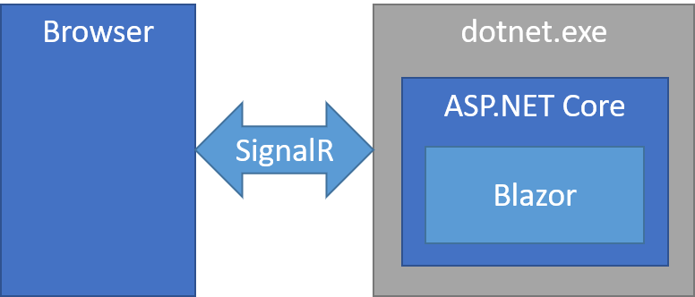
Server Side
Blazor
Blazor takes the out-of-process model for Blazor and streeeetches it over a network connection so that you can run Blazor on the server. With Blazor you can run your Blazor components server-side on .NET Core while UI updates, event handling, and JavaScript interop calls are handled over a SignalR connection.
Server Side

Slide 29
Server Side
Blazor
Entire app with .NET and C# using the Blazor component model.
Rich interactive feel and avoid unnecessary page refreshes.
Download size is significantly smaller and the initial app load time is much faster.
Blazor component logic can take full advantage of server capabilities including using any .NET Core compatible APIs.
Because you're running on .NET Core on the server existing .NET tooling, like debugging, just works.
Works with thin clients (ex browsers that don't support WebAssembly, resource constrained devices, etc.).
Server Side
Benefits

Slide 30
Server Side
Blazor
Latency: every user interaction now involves a network hop.
No offline support: if the client connection goes down the app stops working.
Scalability: the server must manage multiple client connections and handle client state.
Server Side
Downside

Slide 31
Questions
Blazor
Questions
???

Slide 32
Additional Info
Blazor
Blazor GitHub
https://github.com/aspnet/Blazor/
Blazor.net
http://blazor.net/docs/
Steve Sanderson’s Intro to Blazor
http://blog.stevensanderson.com/2018/02/06/blazor-intro/
Steve Sanderson’s Demo Video
https://www.youtube.com/watch?v=MiLAE6HMr10
Additional Info

