Slide 1
SIX-MINUTE PRODUCT DEMO
GitHub Copilot Cost Compass
Understand the rules
before the bill arrives.
A shared sandbox for engineering velocity and predictable spending.
Maya
Daniel
M
D
ENGINEERING LEAD
FINOPS LEAD
Protect productive developer flow.
Make additional spend predictable.
GITHUB COPILOT COST COMPASS · 0:00–0:35
01
Notes:
Meet Maya, an engineering lead, and Daniel, a FinOps lead. They want the same outcome: productive AI adoption. Maya worries that a guardrail will interrupt a developer in the middle of useful work. Daniel worries that usage-based consumption will turn into unpredictable additional spend. Cost Compass gives them one place to test both concerns before either reaches production.

Slide 2
Licenses are only the starting point.
Usage-based billing adds three questions that engineering and finance must answer together.
01
02
03
Consumption
Additional spend
Stop conditions
How are included AI credits pooled and attributed?
When does usage become paid overage, and whose budget moves?
Which controls only alert, and which stop usage?
The FinOps question
How do we agree on guardrails without learning through a surprise invoice—or a blocked developer?
GITHUB COPILOT COST COMPASS · 0:35–1:20
02
Notes:
With usage-based billing, buying licenses is only part of the decision. The team also needs to understand how included consumption is pooled, when additional usage becomes paid spending, and which controls merely alert versus actually stop usage. That is a FinOps problem: engineering and finance need to agree on guardrails without learning through a surprise invoice or a blocked developer.

Slide 3
Describe the situation—not every row.
Repository agents turn intent into deterministic, reviewable JSON.
ENVIRONMENT
LESSON
Default Set Generator
Scenario Generator
“Create a compact synthetic enterprise with Alice, Bob, stable IDs, AI-credit products, budgets, and no live usage history.”
“Show a cost-center pool reaching its cap, then compare paid overage with a user hard stop.”
→ synthetic-compact.json
→ cost-center-pool-to-overage.json
Stable IDs | explicit assumptions | falsifiable outcomes | deterministic replay
GITHUB COPILOT COST COMPASS · 1:20–2:05
03
Notes:
Instead of manually inventing every tenant, user, budget, and usage event, we describe the situation we want to understand. The Default Set Generator creates a synthetic topology with stable IDs, explicit assumptions, and no live billing history. The Scenario Generator then creates the lesson: ordered usage events, expected outcomes, and the exact thresholds or blocking reasons we want to observe. Both artifacts are deterministic and reviewable as JSON.

Slide 4
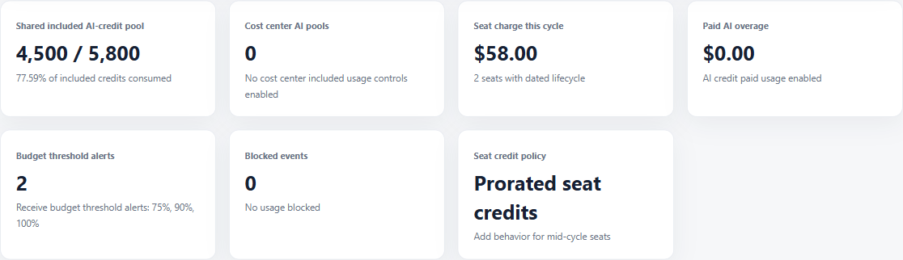
Open a synthetic sandbox—not a production tenant.
The environment is selectable, browser-local, and safe to replay.
No GitHub connection
✓
All data stays in the browser.
Two teaching scales
✓
Compact for focused lessons; enterprise for realistic topology.
One operating view
✓
Pool, seats, overage, alerts, and blocks are visible together.
Two views from the same browser-local synthetic tenant
GITHUB COPILOT COST COMPASS · 2:05–2:45
04
Notes:
Now we open Cost Compass. Nothing connects to GitHub, and all data stays in this browser. The dashboard shows the selected synthetic tenant, its included AI-credit pool, seat charges, paid overage, budget alerts, and blocked events. We can switch between a compact teaching dataset and a larger enterprise dataset without touching a real organization.

Slide 5
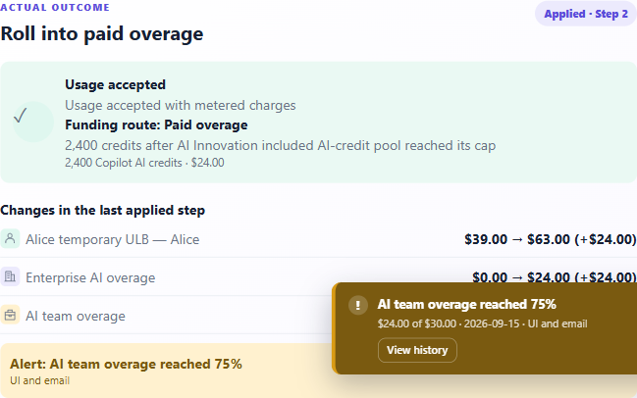
Decision one: continue after included credits?
A cost-center pool reaches its cap; the next event becomes paid overage.
3,900 / 3,900
COST-CENTER INCLUDED CREDITS
$24 → 80%
PAID OVERAGE · 75% ALERT FIRES
Developer continues
Funding route and budget movement remain explicit.
GITHUB COPILOT COST COMPASS · 2:45–4:10
05
Notes:
Our first lesson enables an included-usage control for the AI Innovation cost center. Alice uses all 3,900 credits attributed to that cost center. At the cap, the policy is configured to continue as paid overage rather than block the developer. Alice then consumes 2,400 additional credits. Cost Compass predicts and applies the result: the event is accepted, $24 is attributed to paid overage, and the $30 cost-center budget reaches 80 percent, crossing its 75-percent alert. This is the shared decision in concrete terms. Maya sees that the developer continues. Daniel sees the exact funding route, affected budgets, and alert before the policy is deployed.

Slide 6
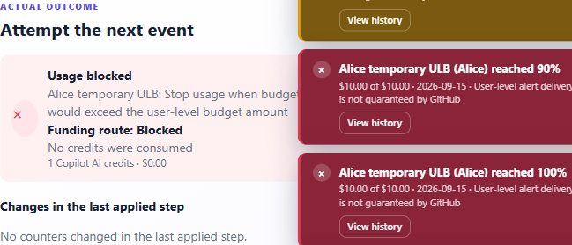
Decision two: stop at the exact boundary?
A user-level budget accepts the limit, then rejects the next event atomically.
$10.00
EXACT LIMIT · ACCEPTED
↓ one more credit
$10.01
WOULD EXCEED · BLOCKED
0 credits consumed · 0 counters changed
GITHUB COPILOT COST COMPASS · 4:10–5:20
06
Notes:
The second lesson tests a user-level hard stop. Alice consumes 1,000 credits, worth $10 for this budget, and reaches the limit exactly. That event is accepted. The next event is only one additional credit, but it would move the budget from $10.00 to $10.01. The simulator rejects the complete event, consumes no credits, and changes no counters. Now the interruption is not an abstract fear. Engineering and FinOps can see the exact boundary, the user affected, the reason shown to an operator, and the difference between an alert and a hard stop.

Slide 7
AGREE BEFORE DEPLOYMENT
Generate -> simulate -> inspect -> agree.
Turn a policy conversation into a repeatable decision workflow.
1
2
3
4
Describe
Generate
Simulate
Agree
Tenant, personas, policies, and the question to answer.
Synthetic environment and deterministic lesson.
Run boundaries and inspect every affected control.
Choose the guardrail before production adoption.
Productive adoption. Predictable spend. Guardrails tested before production.
GITHUB COPILOT COST COMPASS · 5:20–6:00
07
Notes:
Cost Compass turns a policy conversation into a repeatable workflow: describe the tenant, generate the lesson, simulate the boundary, inspect every affected control, and agree on the guardrail. The result is productive AI adoption without using a surprise invoice as the monitoring system or a blocked developer as the first test case. Understand the rules before the bill arrives.

