Slide 1

Terraform
TF
Arxus

Slide 2

Agenda
Intro
Demo

Slide 3

Manual​
Azure Portal​
Imperative – how it’s executed​
Powershell AZ Module​
Azure CLI​
Python​
..​
Declarative – Desired State – What needs to be executed​
ARM Template​
Terraform​
IaC

Slide 4
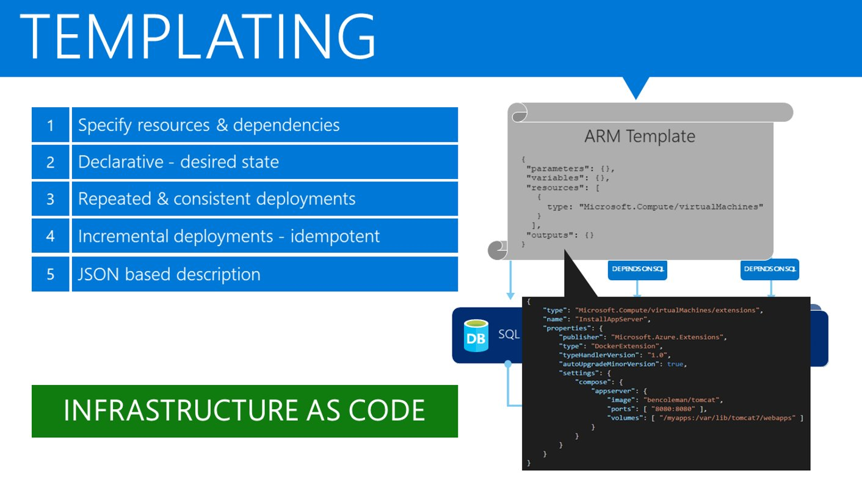
IaC

Slide 5
Azure Portal​
Wizards​
Portal Templates​
Visual Studio​
Imperative​
Declarative ​
Devops Pipelines​
ARM plugins​
Terraform plugins​
IaC

Slide 6
Resources
Providers
Input variables
Output values
Local values
Modules
Data sources
Structure

Slide 7
Configuration
Providers
Azure
Aws
…
Resources
Resource Groups
Storage Accounts
AKS
…
Initialization
Install providers
Plan
State Refresh
Compare
Apply
Provision resources
Destroy
Steps

Slide 8
Refer to previously created resources
Use location from resource group
Id
…
Known after apply
Implicit
Id
Explicit
Depends_on = […]
Non-Dependent
Parallel
Dependencies

Slide 9
Reuseable scripts
Define
variable "region" {
default = “westeurope"
}
Use
provider “azurerm" {
region = var.region
}
Assign
Command line
terraform apply -var 'region=westeurope'
File
region = "westeurope “
terraform apply -var-file="secret.tfvars“
Environment
TF_VAR_name
Input variables

Slide 10
Define
output "ip" {
value = public_ip
}
View
terraform output ip
Output variables

Slide 11
Terraform Cloud
Azure Storage Account
Remote Storage

Slide 12
Could solve some of these problems
Understanding and navigation
Updating configuration
Duplication
Share
Usage
Organize configuration
Encapsulate configuration
Re-use configuration
Provide consistency and best practices
Structure
Root
Sub directories
Modules

Slide 13
Use
https://registry.terraform.io/modules/Azure
Create
Create Modules directory
Create sub directory for each module
Add Module
Main.tf
Outputs.tf
Variables.tf
Use
module “samplemodule" {
source = "./modules/acme-rg
tags = {
Terraform = "true"
Environment = "dev"
}
}
Modules

Slide 14
Azure Subscription
Use https://shell.azure.com
TF is preinstalled
Azure CLI is preinstalled
Use terminal
(Install TF)
(Install Azure CLI)
Demo Prerequisites

Slide 15
az account list --query "[].{name:name, subscriptionId:id, tenantId:tenantId}“
az ad sp create-for-rbac --role="Contributor" --scopes="/subscriptions/${SUBSCRIPTION_ID} "
export ARM_SUBSCRIPTION_ID=your_subscription_id
export ARM_CLIENT_ID=your_appId
export ARM_CLIENT_SECRET=your_password
export ARM_TENANT_ID=your_tenant_id
export TF_VAR_client_id=your_appId
export TF_VAR_client_secret=your_password
Shell

Slide 16
See https://github.com/sujithq/mini-workshop-tf
Copy test directory
Cd test
Terraform init
Test

Slide 17
See https://github.com/sujithq/mini-workshop-tf
Copy terraform-aks-k8s
Cd terraform-aks-k8s
Set variables
RG_STATE_FILES=rg-k8s-state
DEF_LOCATION=westeurope
STORAGE_ACCOUNT_NAME=k8sstorage123
CONTAINER_NAME=tfstate
KEY=k8s.tfstate
Create Resource Group
az group create -n $RG_STATE_FILES -l $DEF_LOCATION
AKS

