Slide 1
Store Sales Prediction
Written By | Sujith Reddy Muthyala
Document Version | 1.0
Last Revised Date | 27-oct-2021

Slide 2
Objective:
“To find out what role certain properties of an item play and how they affect their sales by understanding Big Mart sales.”
In order to help Big Mart, achieve this goal, a predictive model can be built to find out the sale of every item for every store. Also, the key factors that can increase their sales and what changes could be made to the product or store’s characteristics.
Benefits:
Detection the features heavily responsible for item sales from particular outlet.
Gives better insight of customers interest for the item.
Helps in easy flow for managing resources.
Manual inspection of what action needed to hike the sale.

Slide 3
Data Description
Given is the variable name, variable type, the measurement unit, and a brief description. The concrete compressive strength is the regression problem. The order of this listing corresponds to the order of numerals along the rows of the database.
Name | Data Type | Description
Item_Identifier | String | Unique product ID
Item_Weight | Float | Weight of product
Item_Fat_Content | String | Whether the product is low fat or not
Item_Visibility | Float | The % of a total display area of all products in a store allocated to the particular product
Item_Type | String | The category to which the product belongs
Item_MRP | Float | Maximum Retail Price (list price) of the product
Outlet_Identifier | String | Unique store ID
Outlet_Establishment_Year | Integer | The year in which the store was established
Outlet_Size | String | The size of the store in terms of ground area covered
Outlet_Location_Type | String | The type of city in which the store is located
Outlet_Type | String | Whether the outlet is just a grocery store or some sort of supermarket
Item_Outlet_Sales | Float | Sales of the product in the particular store. This is the outcome variable to be predicted.

Slide 4
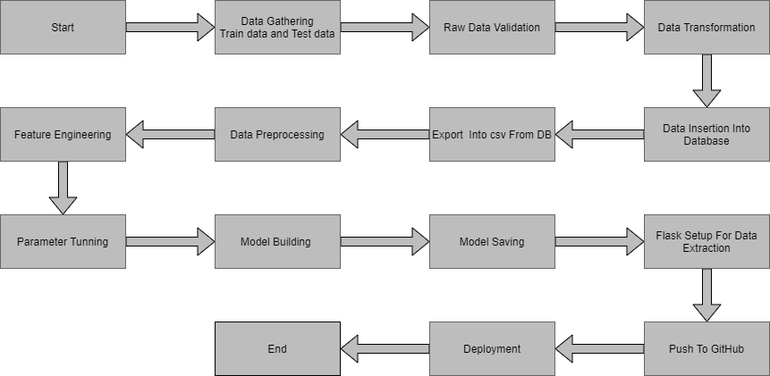
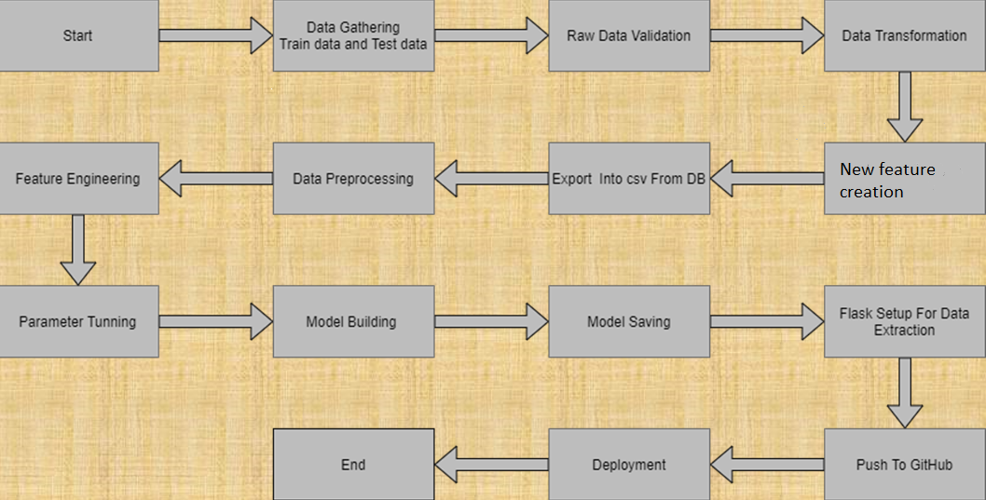

Architecture

Slide 5
Architecture Description
1. Data gathering:
Data source: https://www.kaggle.com/brijbhushannanda1979/bigmart-sales-data
Train and Test data are stored in .csv format.
2.Raw Data Validation:
After data is loaded, various types of validation is required before we proceed further for any operation. Validations like checking for zero standard deviation for all the columns, checking for complete missing values in any columns, etc. These are required because The attributes which contains these are of no use. It will not play role in contributing the sales of an item from respective outlets.
Like if any attribute is having zero standard deviation, it means that’s all the values are same, its mean is zero. Which indicate that either the sale is increase or decrease that attribute will remain the same. Similarly, if any attribute is having full missing values, then there is no use of taking that attribute into an account for operation. It’s unnecessary increasing the chances of dimensionality curse.
3. Data Transformation
Before sending the data into the database, data transformation is required so that data are converted into such form with which it can easily insert into the database. Here, ‘Item Weight’ and “Outlet Type’ attributes contain the missing values. So they are filled in both train set as well as test set with supported appropriate data types

Slide 6
4. Database Insertion
Both train and test data set are inserted into database. Here mongoDB database is used to stored the data set. Separate collections were created for both train and test set.
5. Export into csv from database
From database both the train and test data set are exported into local system and stored into csv files. Now this csv file will be proceeded for further processing.
6. Data preprocessing
In data preprocessing all the process required before sending the data for model building are performed. Like, here the ‘Item Visibility’ attributes is having some values equal to 0, which is not appropriate because if item is present in the market, then how its visibility can be 0. So, it has been replaced with the average value of the item visibility of respective ‘Item Identifier’ category. New attributes was added named ‘’Outlet years”, where given establishment year is subtracted from the current year. New “Item Type” attribute was added which just take first two character of the Item Identifier which indicates the types of the items. Then mapping of “Fat content” is done based on ‘Low’, ‘Reg’ and ‘Non-edible’.

Slide 7
7. Feature Engineering:
After preprocessing it was found that some of the attributes are not important to the item sales for the particular outlet. So those attributes are removed. Even one hot encoding is also performed to convert the categorical features into numerical features.
8. Parameter tunning:
Parameters are tunned using Randomized searchCV. Four algorithms are used in this problem, Linear Regression, Gradient boost, Random Forest and XGBoost regressor. The parameters of all these 4 algorithms are tunned and passed into the model.
9. Model building:
After doing all kinds of preprocessing operations mention above and performing scaling and hyper parameter tunning, data set is passed into all four models, Linear Regression, Gradient boost, Random Forest and XGBoost regressor. It was found that Gradient boost performs best with smallest RMSE value i.e. 587.0 and highest R2 score equals to 0.55. So ‘Gradient boost’ performed well in this problem.
10. Model saving:
Model is then saved using pickle library in. pkl format.

Slide 8
11 Flask setup for data extraction:
After saving the model, API building process started using Flask. Web application creation was created here. Whatever the data user will enter and then that data will be extraction by the model to predict the prediction of sales, this is performed in this stage.
12 Git Hub
Whole project directory will be pushed into GitHub repository.
13 Deployment:
Cloud environment was set up and project was deployed form GitHub into Heroku cloud platform.
App link- https://sujith-salesprediction.herokuapp.com/

Slide 9
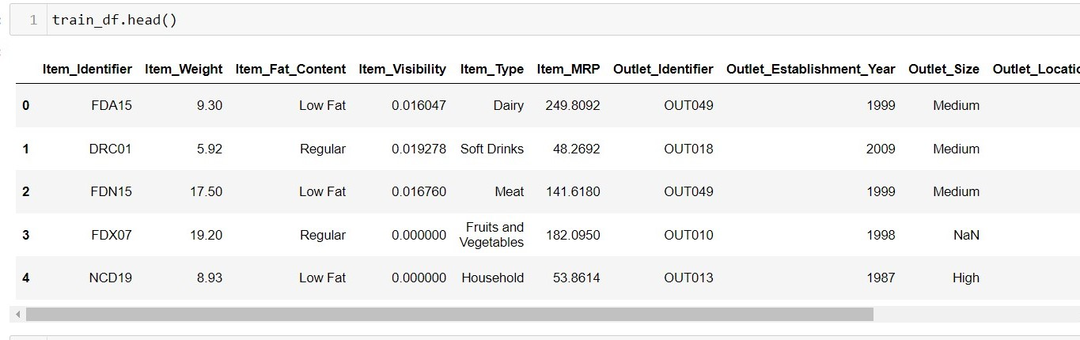
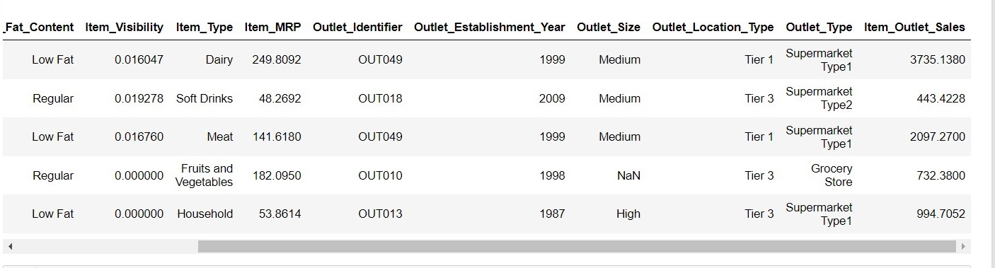
Data set description
Big Mart’s data scientists collected sales data of their 10 stores situated at different locations with each store having 1559 different products as per data collection.
Using all the observations it is inferred what role certain properties of an item play and how they affect their sales. The dataset looks like as follow:

Slide 10
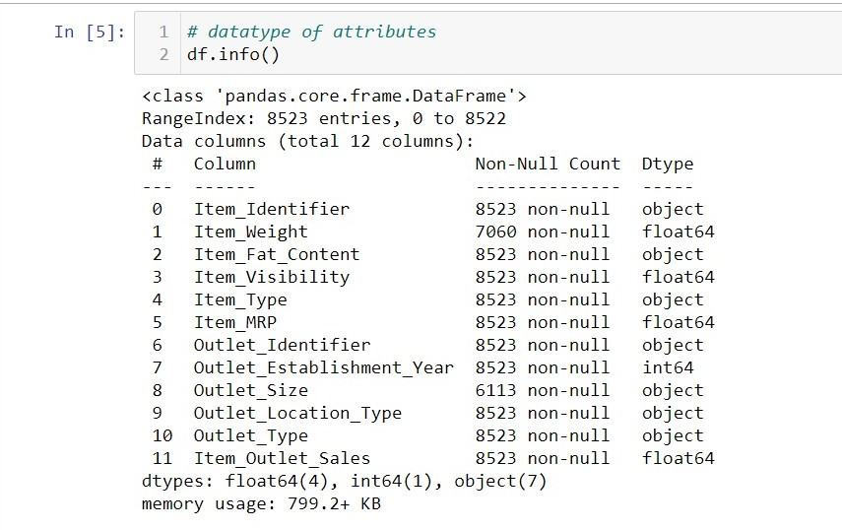
The data set consists of various data types from integer to float to object as shown in Fig.

Slide 11
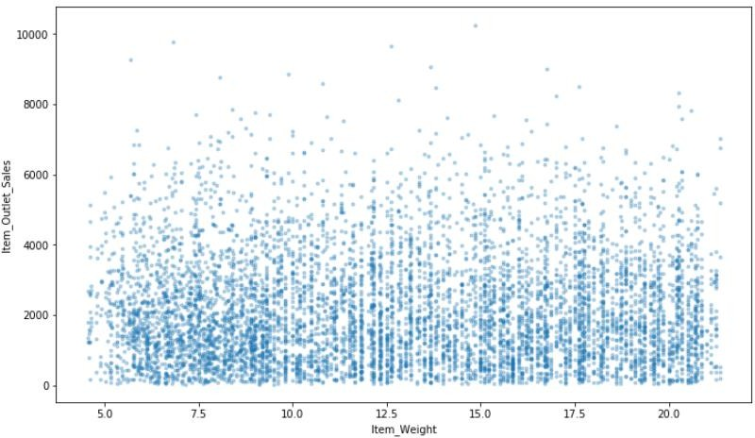
Observations
Correlation is used to understand the relation between a target variable and predictors. In this work, Item-Sales is the target variable and its correlation with other variables is observed. Considering the case of Item-Weight, the feature item weight is shown to have a low correlation with the target variable Item-Outlet-Sales in below Fig.

Slide 12
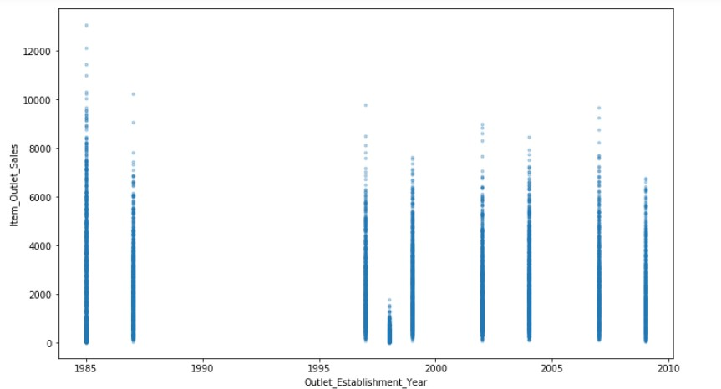
As can be seen from below Fig. there is no significant relation found between the year of store establishment and the sales for the items. Values can also be combined into variables that classify them into periods and give meaningful results.

Slide 13
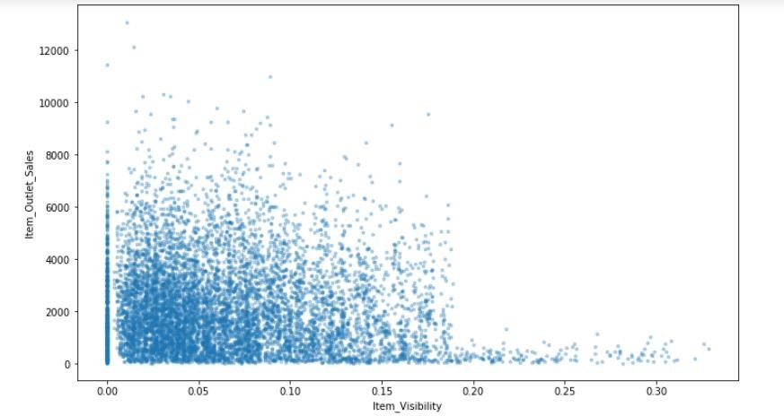
The place where an item is placed in a store, referred to as Item visibility, definitely affects the sales. However, the plot chart show that the flow is in opposite side. One of the reasons might be that daily used products don’t need high visibility. However, there is an issue that some products have zero visibility, which is quite impossible.

Slide 14
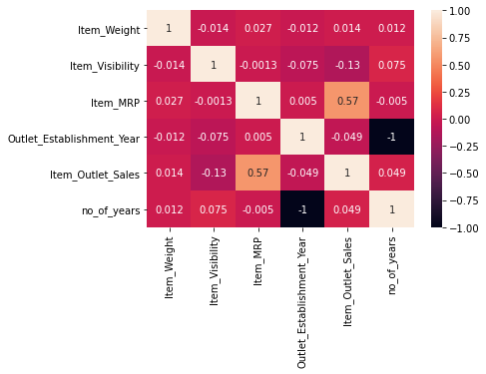
Correlation
Item visibility is having nearly zero correlation with our dependent variable Item_Outlet_Sales and grocery store outlet type. This means that the sales are not affected by visibility of item which is a contradiction to the general assumption of “more visibility thus, more sales”.
Item_MRP (maximum retail price) is positively correlated with sales at an outlet, which indicates that the price quoted by an outlet plays an important factor in sales.
Variation in MRP quoted by various outlets depends on their individual sales.

Slide 15
Metrics for Data Modelling
The coefficient of determination R² (R-squared) is a statistic that measures the goodness of a model’s fit i.e., how well the real data points are approximated by the predictions of regression. Higher values of R² suggest higher model accomplishments in terms of prediction along with accuracy, and the value 1 of R² is indicative of regression predictions perfectly fitting the real data points. For further better results, the use of adjusted R² measures works wonders. Taking logarithmic values of the target column in the dataset proves to be significant in the prediction process. So, it can be said that on taking adjustments of columns used in prediction, better results can be deduced. One way of incorporating adjustment could also have included taking square root of the column. It also provides better visualization of the dataset and target variable as the square root of target variable is inclined to be a normal distribution.
The error measurement is an important metric in the estimation period. Root mean squared error (RMSE) and Mean Absolute Error (MAE) are generally used for continuous variable’s accuracy measurement. It can be said that the average model prediction error can be expressed in units of the variable of interest by using both MAE and RMSE. MAE is the average over the test sample of the absolute differences between prediction and actual observation where all individual differences have equal weight. The square root of the average of squared differences between prediction and actual observation can be termed as RMSE. RMSE is an absolute measure of fit, whereas R² is a relative measure of fit. RMSE helps in measuring the variable’s average error and it is also a quadratic scoring rule. Low RMSE values obtained for linear or multiple regression corresponds to better model fitting.

Slide 16
With respect to the results obtained in this work, it can be said that there is no big difference between our train and test sample since the metric RMSE ratio is calculated to be equal to the ratio between train and test sample. The results related to how accurately responses are predicted by our model can be inferred from RMSE as it is a good measure along with measuring precision and other required capabilities. A considerable improvement could be made by further data exploration incorporated with outlier detection and high leverage points. Another approach, which is conceptually easier, is to combine several sub-models which are low dimensional and easily verifiable by domain experts, i.e., ensemble learning can be exploited.

Slide 17
Prediction results
The largest location did not produce the highest sales. The location that produced the highest sales was the OUT027 location, which was in turn a Supermarket Type3, having its size recorded as medium in our dataset. It can be said that this outlet’s performance was much better than any other outlet location with any size provided in the considered dataset.
The median of the target variable Item_Outlet_Sales was calculated to be 3364.95 for OUT027 location. The location with second highest median score (OUT035) had a median value of 2109.25.
Adjusted R-squared and R-squared values are higher for Gradient boost model than average. Also its RMSE value is low as compared to other model with highest CV score. Therefore, the gradient boost model fits better and exhibits accuracy

Slide 18
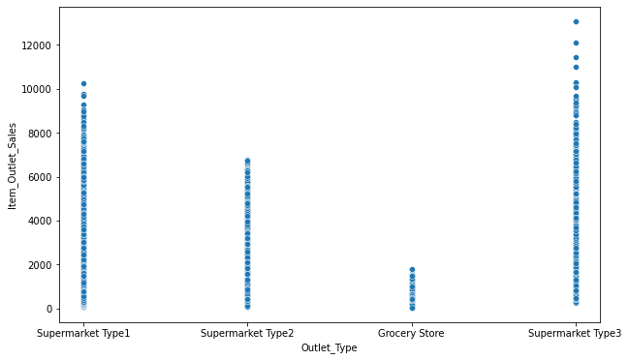
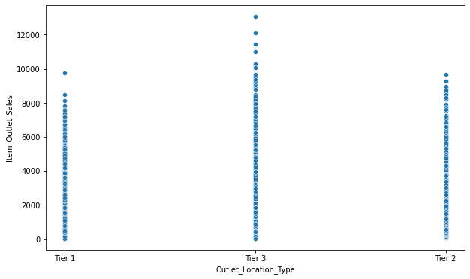
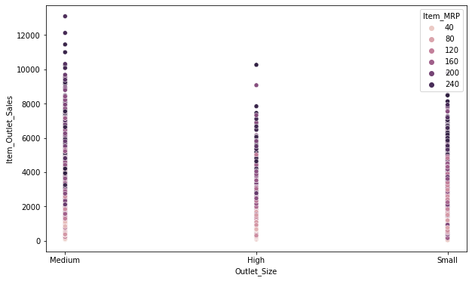
Conclusion
In this project, basics of machine learning and the associated data processing and modeling algorithms have been described, followed by their application for the task of sales prediction in Big Mart shopping centers at different locations. On implementation, the prediction results show the correlation among different attributes considered and how a particular location of medium size recorded the highest sales, suggesting that other shopping locations should follow similar patterns for improved sales.
Also it can be concluded that more locations should be switched or shifted to Tier-3 in outlet type “Supermarket Type3” to increase the sales of products at Big Mart. Any one-stop-shopping-center like Big Mart can benefit from this model by being able to predict its items’ future sales at different locations.

Slide 19
Q & A:
Q1) What’s the source of data?
Ans. The data for training is provided by the client from:
https://www.kaggle.com/brijbhushannanda1979/bigmart-sales-data
Q 2) What was the type of data?
Ans. The data was the combination of numerical and Categorical values.
Q 3) What’s the complete flow you followed in this Project?
Ans. Refer the Architecture section for this.
Q 4) After the File validation what you do with incompatible file or files which didn’t pass the validation?
Ans. Files like these are moved to the Achieve Folder and a list of these files has been shared with the client and we removed the bad data folder.
Q 5) How logs are managed?
Ans. We are using different logs as per the steps that we follow in validation and modeling like validation log, database operation log, preprocessing log, model training log, etc..

Slide 20
Q 6) What techniques were you using for data pre-processing?
Removing unwanted attributes
Visualizing relation of independent variables with each other and output variables
Removing outliers
Cleaning data and imputing if null values are present.
Converting categorical data into numeric values.
Scaling the data
Q 7) How training was done or what models were used?
Before diving the data in training and validation set we performed clustering over fit to divide the data into clusters. As per cluster the training and validation data were divided. The scaling was performed over training and validation data
Algorithms like Linear regression, Gradient boost, Random forest and XGBoost were used .
Q 8) How Prediction was done?
Ans. The testing files are shared by the client. We pass its data to the best model which we have saved in pickle format and get the prediction.
Q 9) Where the model was deployed?
Ans. When the model is ready, we deploy it in Heroku platform. This model is an web application where user can enter the data and these data gets extracted in the backend and user gets the prediction result.

