Slide 1

Referoscope

Slide 2

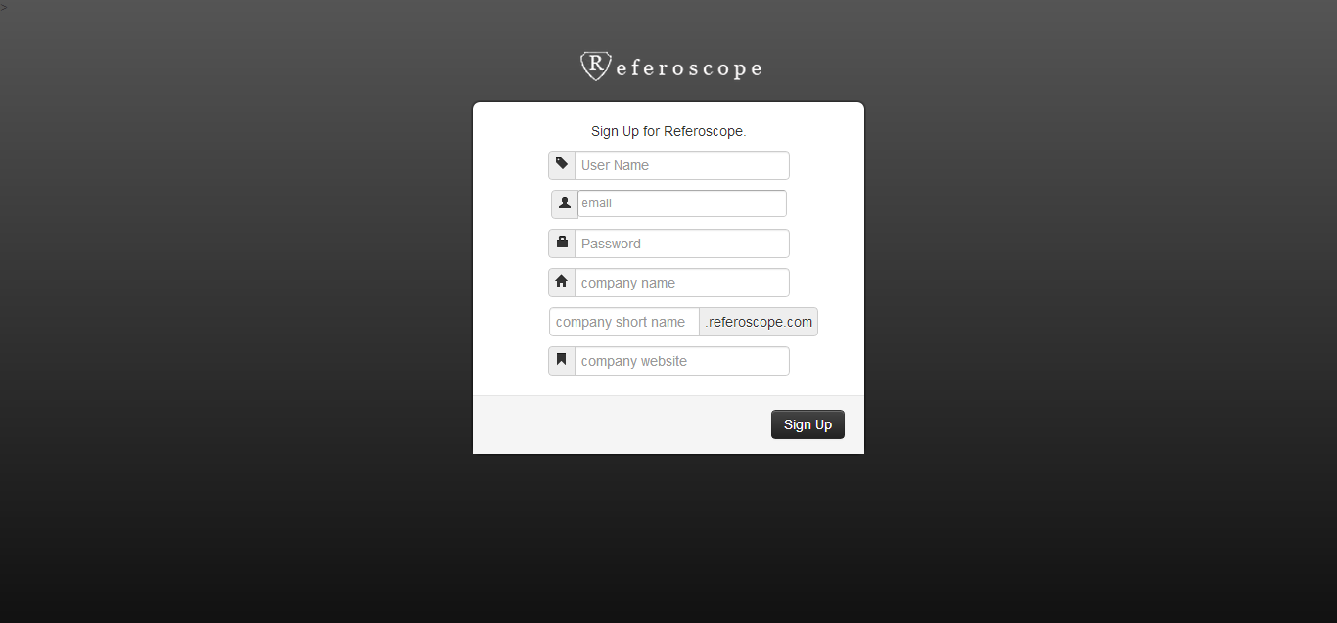
Sign Up

Slide 3
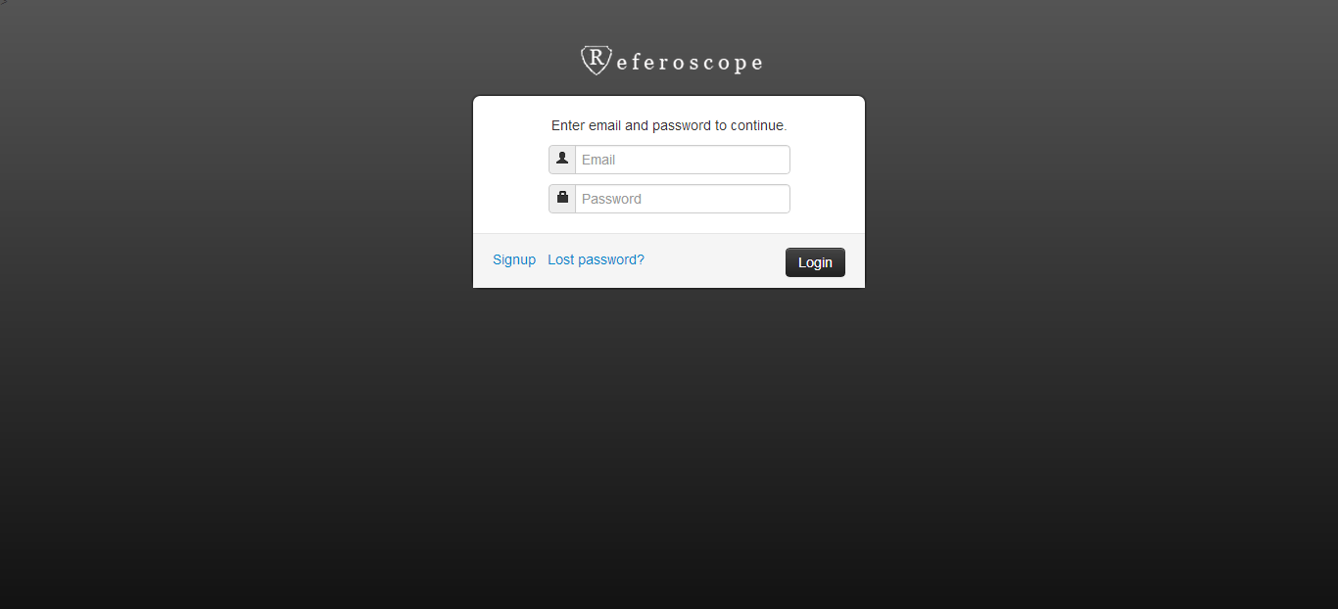
Login

Slide 4
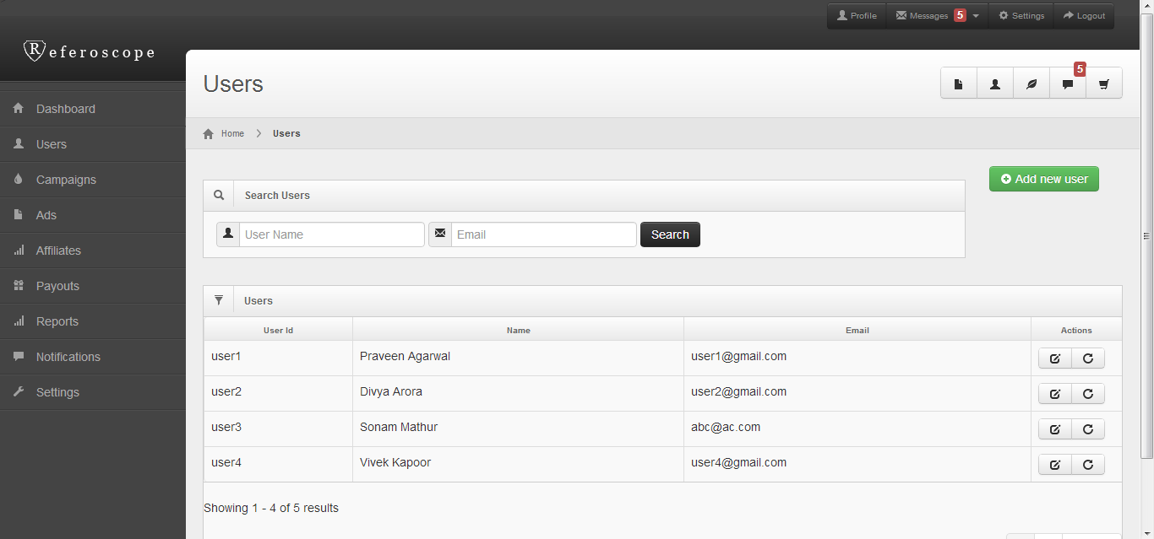
User Management

Slide 5
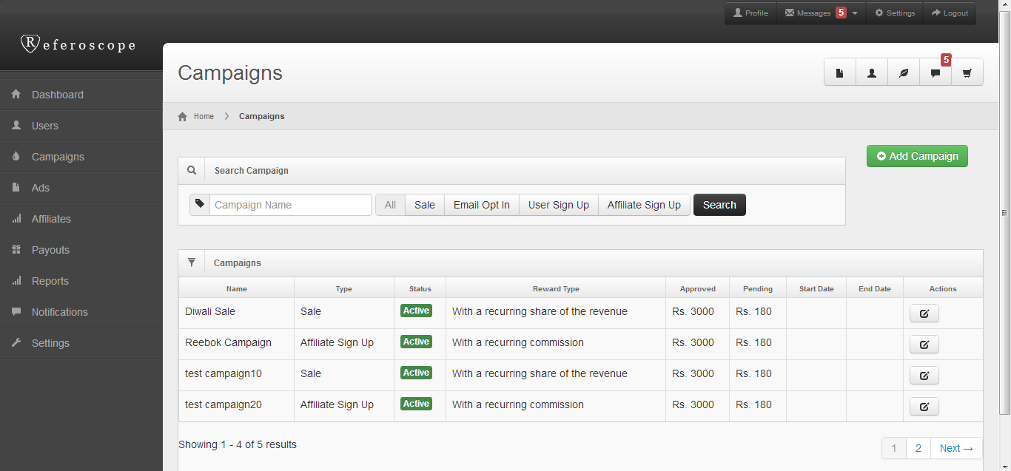
Campaigns

Slide 6
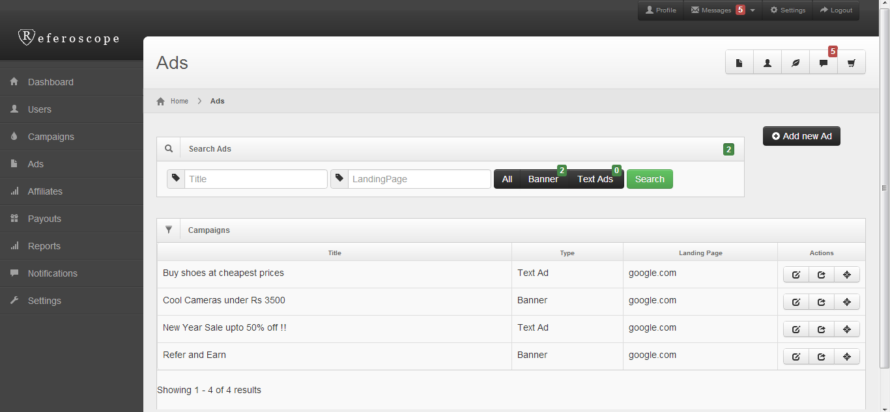
Ads

Slide 7
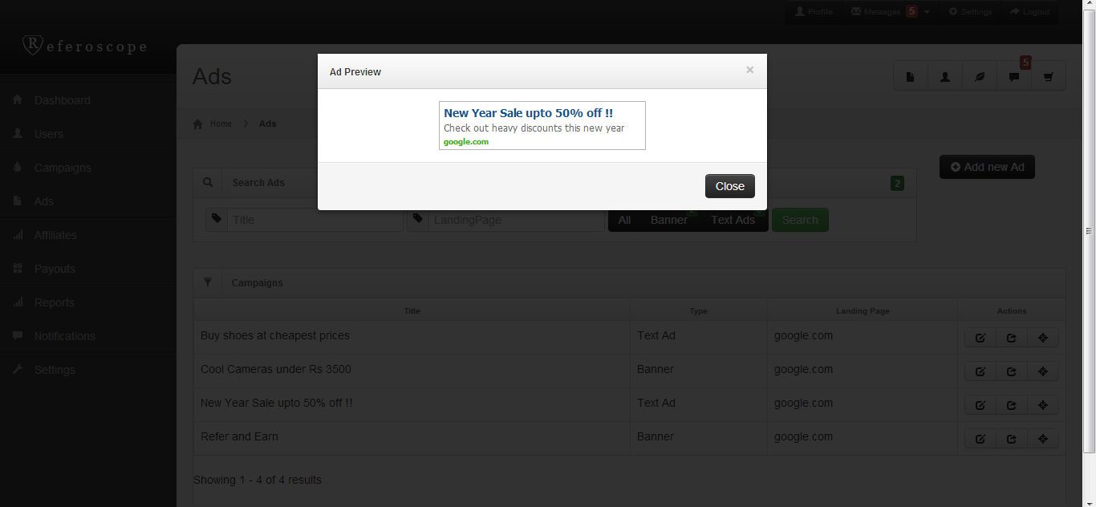
Ad Preview

Slide 8
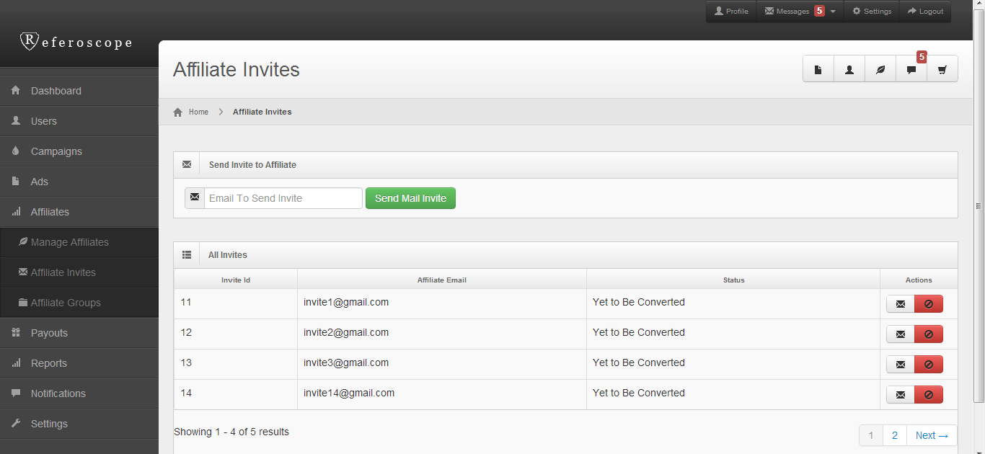
Affiliate Invites

Slide 9
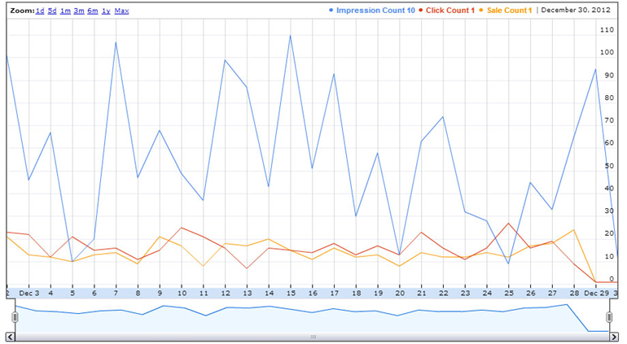
Impression vs Click vs Sale Report

Slide 10
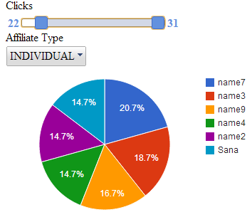
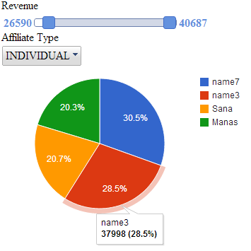
Affiliate Pie Chart

Slide 11
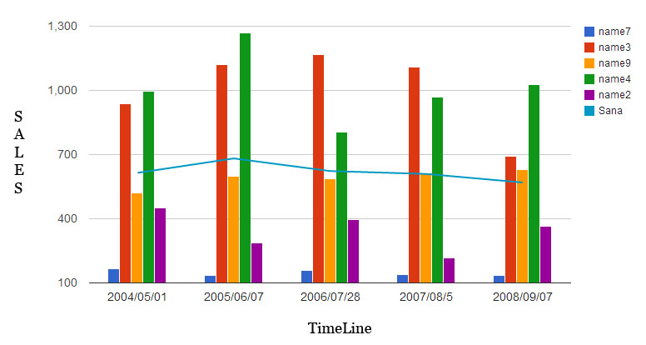
Sales Barchart

Slide 12
Referoscope
Thank You
Please visit www.referoscope.com
Or you can directly reach us at:
0124-4112528 or mail us @
sales@referoscope.com

