Slide 1
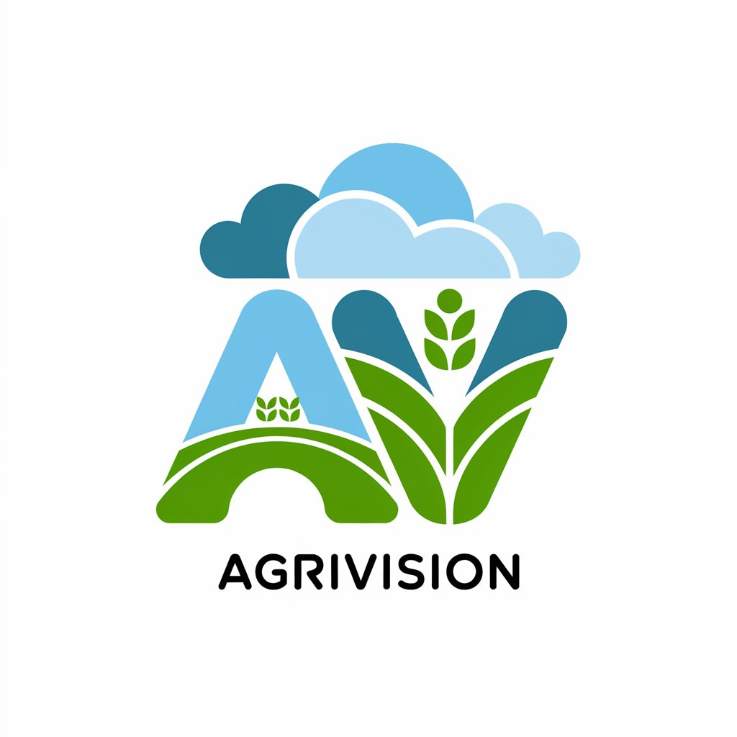
AgriVision
🌱 AgriVision is an AI-powered mobile application designed to assist farmers with smart agricultural solutions using real-time data and AI models.
Why AgriVision?
🌍 Designed for Rural Areas – Supports local languages for better accessibility. 📶 Works with or Without Internet – Online & Offline modes ensure farmers can access crucial insights anytime. 🧑‍🌾 Boosts Productivity – Helps farmers make data-driven decisions for healthier crops and higher yields.
By integrating real-time APIs, machine learning, and deep learning models, AgriVision transforms traditional farming into smart, AI-powered agriculture.
🚀 Farming Smarter, Not Harder! 🌱
1

Slide 2
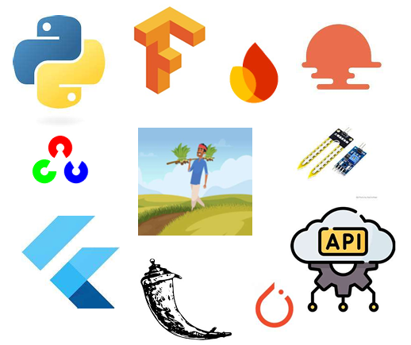
Tech Stack
CNN for Classification of crop diseases and pests :
Used MobileNetV2 for feature extraction from the images and added an output softmax layer with 55 nodes for classification. OpenCV for preprocessing. Random Forest For crop recommendation:
Collected crop recommendation dataset from Kaggle.
Analysed soil features(N, K, P, pH ) and weather conditions to recommend crops.
APIs Used:
Soilgrids(To collect soil features)
Agromonitoring and OpenWeatherMap (To access weather forecast)
Huggingface API(For LLM integration)
Cloud Services:
We have integrated google cloud services for cloud storage and used Cloud Translation API for translation services.
APP Development:
Used Flutter for App dev and Flask for Backend.

Slide 3
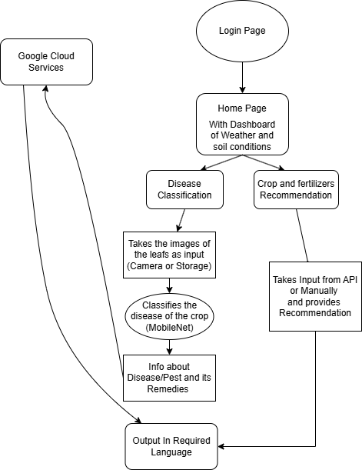
APP Flow
Login Page: User authentication.
Home Page: Dashboard with weather and soil data.
Disease Classification:
Takes leaf images (camera/storage).
Uses MobileNet for disease detection.
Provides disease info and remedies.
Outputs in the required language.
Crop & Fertilizer Recommendation:
Takes input (API/manual).
Provides recommendations.
Google Cloud Services:
Supports processing, storage and multi-language output.

Slide 4
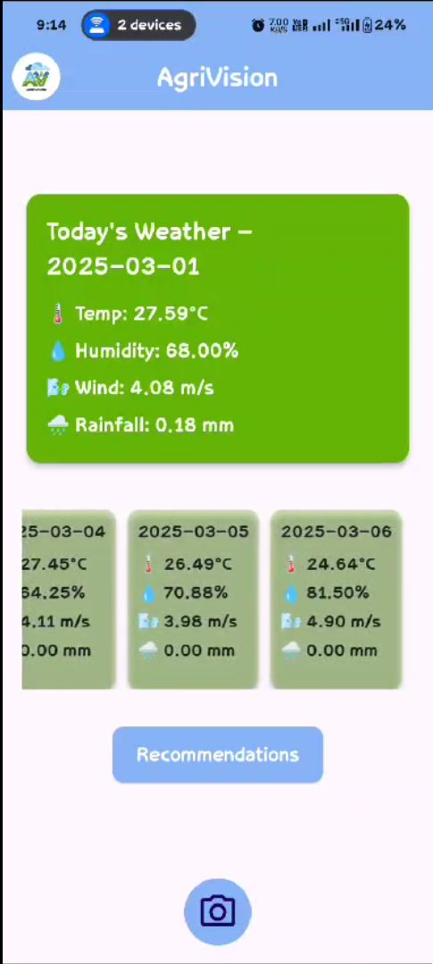
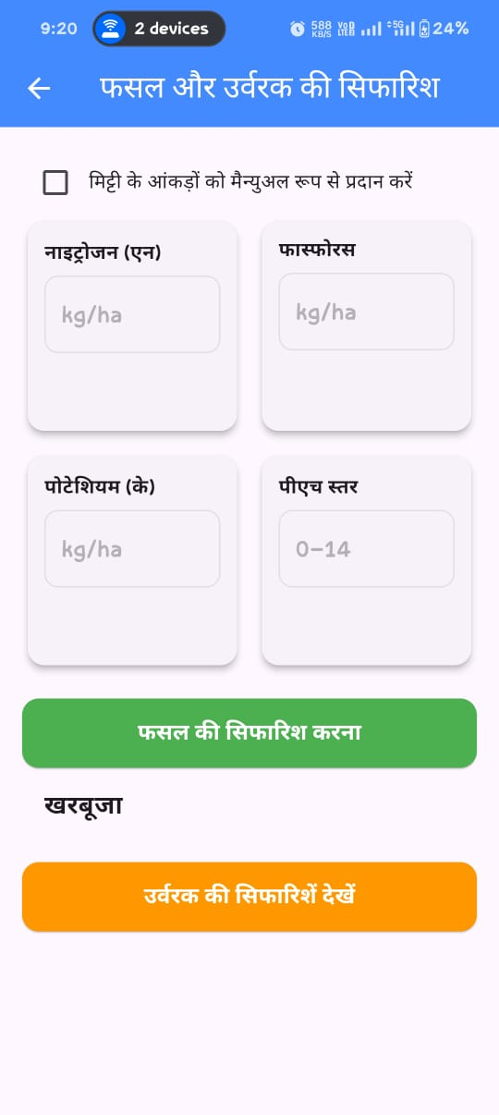
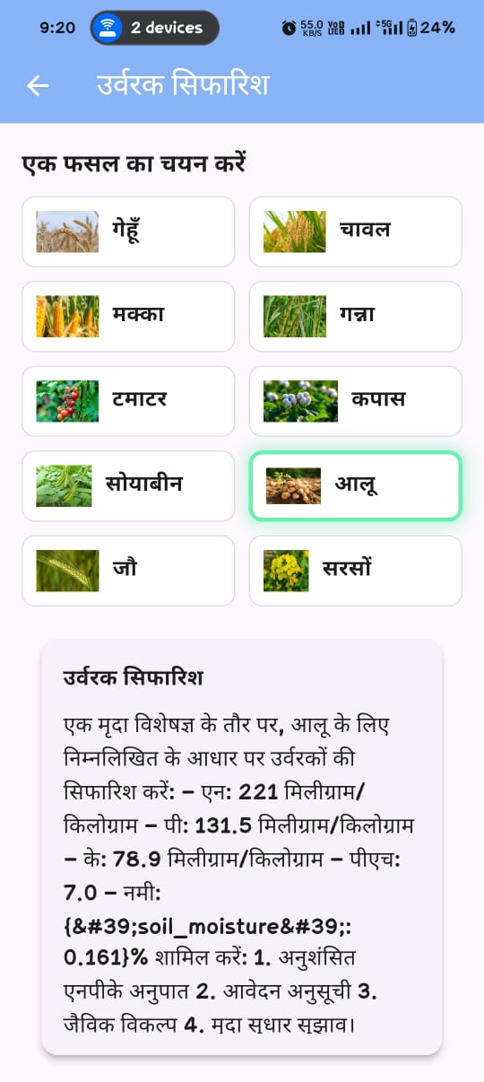
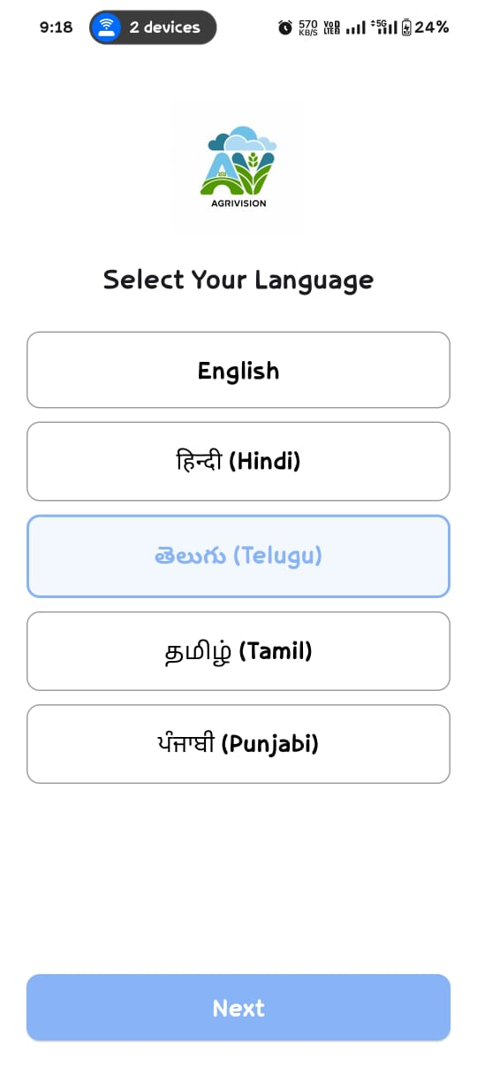
App Interface

