Slide 1
Name Pronunciation Tool
- Team Check Ops

Slide 2
Challenge Short Description:
Enterprise-wide tool for phonetic pronunciation of Names.

Slide 3
User Stories Covered:
The employee/contingent worker can listen to the standard pronunciation of their name.
The employee/contingent worker, can record the pronunciation(non-standard/custom) of their name in their voice.
The employee/contingent worker, can upload any saved pronunciation audio file from their local drive.
The employee/contingent worker, can play the custom pronunciation of their name in the selected speed.
The employee/contingent worker, can opt out of the pronunciation service. In this case, only the standard pronunciation will be available.
Any employee can listen to the pronunciations (standard/non-standard) of their co-worker names. Editing the pronunciations is restricted.
Any employee will be able to view the phonetic representation of their name.

Slide 4
Technologies Used:
React JS - UI Development
Python - API Service Development
Yugabyte - Database
Microsoft Azure Cognitive Services – Text-To-Speech and Speech-To-Text APIs
Microsoft Azure Cloud - Hosting the application
Docker – Deployment

Slide 5
Documents Attached:
Use Case Stories – High Level
Sequence Diagram
Runbook/Playbook for React Deployment
Runbook/Playbook for Python API Service Deployment
Demo – Recorded Video

Slide 6
Demo:
For the demo, please play the Recorded Video.

Slide 7
Team CheckOps:
Awanika
Aditya Mangla
Sujit Kundu
Jagannath Raju
Jayaprakash Badaru
Saikishore Kothakota
Sharon Cordeiro

Slide 8
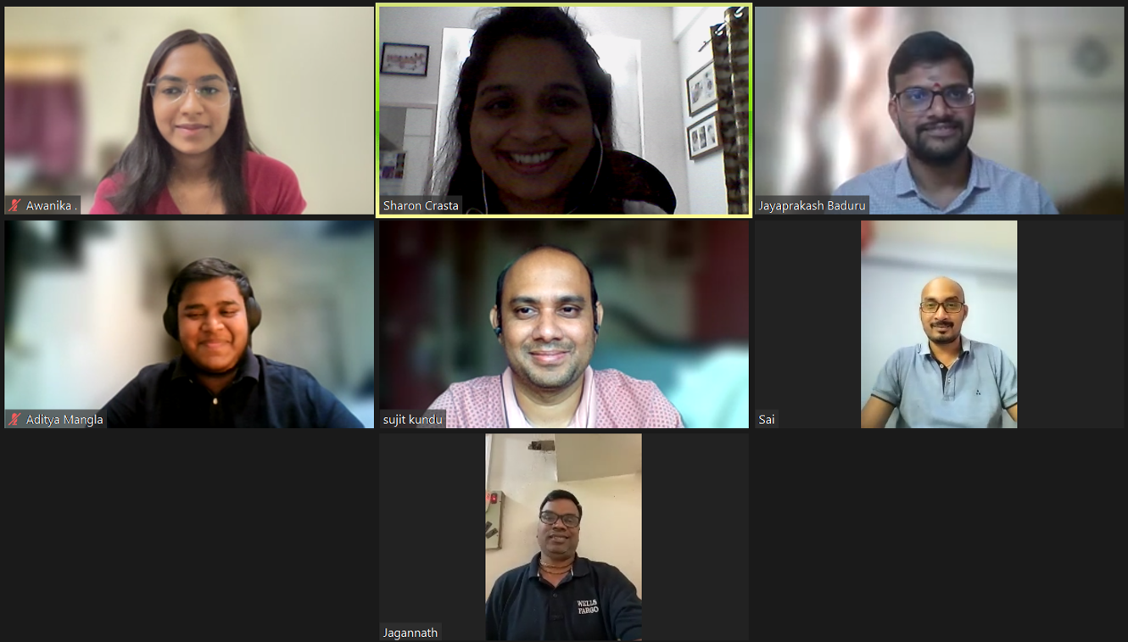

Slide 9
For any Questions, please reach out to Team Check Ops.

Slide 10
Thank you!!

