Slide 1
Presentation on PPE Kit Detection By Shreyas Kale– TY B- 223109013- 312001 Sumant Umardand– TY B- 22310540- 312016 Sujit Rohokale– TY B- 22310922- 312026 Subject : Machine Learning
Guided by
Dr. Jyoti Madake
Department of Electronics and Telecommunications
Vishwakarma Institute of Information Technology, Pune

Slide 2
Outline
Introduction
Objectives
Methodology
Dataset
Implementation
Different Phases of Implementation
Results
Conclusions

Slide 3
Introduction
The PPE (Personal Protective Equipment) Kit Detection system aims to ensure safety compliance at industrial or construction sites.
It uses computer vision and deep learning (YOLOv8) to automatically detect whether a person is wearing safety gear like a helmet, gloves, vest, and boots.
The system processes live or recorded video frames to identify PPE components and non-compliance in real time.

Slide 4
Objectives or Aim and Objectives
Aim: To develop an AI-based detection system that identifies PPE kits worn by workers in real-time using YOLOv8.
Objectives:
To train a YOLOv8m model on a PPE detection dataset.
To achieve over 90% detection accuracy for five classes (helmet, vest, gloves, boots, human).
To evaluate the system using precision, recall, and mAP metrics.
To implement real-time PPE detection through a live or recorded video stream.

Slide 5
Methodology
Steps:
Dataset Collection (Roboflow PPE dataset)
Data Reprocessing & Labelling
Model Training using YOLOv8m
Evaluation and Accuracy Optimization
Real-time Detection Implementation
Software & Hardware Used:
Language: Python
Libraries: Ultralytics, OpenCV, NumPy
Training Platform: Google Colab (GPU runtime)
Hardware Setup: Windows PC (8–16 GB RAM) with CPU/GPU support

Slide 6
Dataset used
Source: Roboflow (Project ID: ppe-detection-yfmym-o5cr7)
Classes: 5 (boots, gloves, helmet, human, vest)
Format: YOLOv8 compatible (images, labels, data.yaml)
Dataset Size: ≈ 6,000 images (train, valid, test)
Data Type: RGB images
License: CC BY 4.0

Slide 7
Different Phases of Implementation
Phase 1:
Dataset preparation and augmentation.
Phase 2:
Training YOLOv8m model using Roboflow data.
Phase 3:
Evaluation (precision–recall, confusion matrix).
Phase 4:
Integration for real-time PPE detection via webcam/video feed.

Slide 8
Results
Model Used: YOLOv8m (pretrained on COCO, fine-tuned on Roboflow PPE dataset)
Epochs Trained: 10(l-Model),50(m-Model)
Best Accuracy Achieved: ~90.4% (mAP@50)
Precision: 0.91
Recall: 0.88
mAP@50-95: 0.69

Slide 9
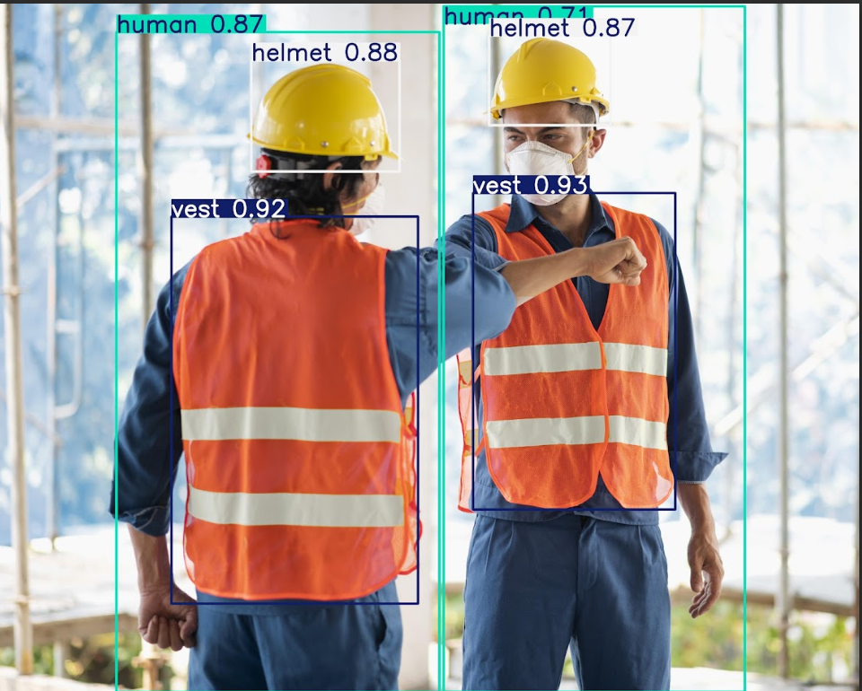
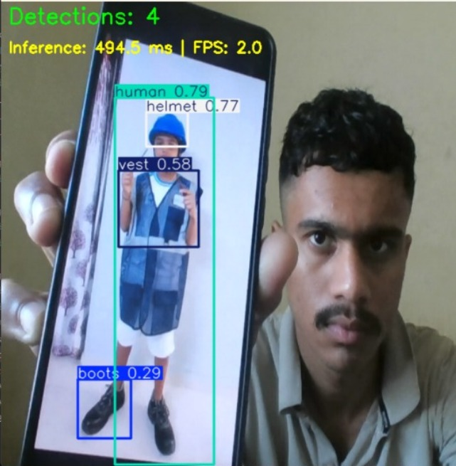
Results
IMG.1
IMG.1: Image taken from internet.(Test)
IMG.2: Testing the model on webcam.

Slide 10
Results
Object Type | Class ID | Confidence | Bounding Box Location (Approximate) | Size (W×H pixels)
Vest | 4 | 93.15% | Right-Center | 1667×2610
Vest | 4 | 91.88% | Center-Left | 2032×3192
Helmet | 2 | 87.67% | Top-Center | 1222×917
Helmet | 2 | 87.30% | Top-Right | 1000×739
Human | 3 | 86.97% | Left-Side (Large) | 2662×5444
Human | 3 | 71.43% | Right-Side (Large) | 2483×5655
Table.1: Object Detection Results Summary of IMG.1

Slide 11
Conclusion
The model we trained is YOLOv8m, fine-tuned on the PPE dataset from Roboflow.
It was trained for 50 epochs and gave an accuracy of around 90% (mAP@50).
The model can detect helmet, vest, gloves, boots, and human very clearly in both images and videos.
During testing, the detections were quite accurate, and the labels appeared correctly for all PPE items.
When connected with a webcam, it was able to detect PPE kits in real-time without much delay.

Slide 12
THANK- YOU

