Slide 1
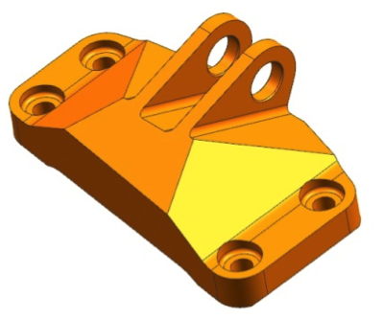
Project intent & overview
A lighter loaded part, with evidence for every geometry or material change
GE JET ENGINE BRACKET CHALLENGE
THE INTENT
Make it lighter.
Keep it structurally sound.
Reasoning loop
Demo scope
Read stress contours.
Predict one edit.
Re-run the solve.
Score the prediction.
GE-style rebuild
LC1 vertical loading
3-axis CNC checks
FreeCAD + CalculiX
Original challenge bracket / © GE / GrabCAD
3D PART OPTIMIZATION AGENT
01 / 03
Notes:
Sources: docs/intent.md; docs/requirements.md v0.5; docs/ge-jet-engine-bracket.md; docs/ge-bracket-part.md. Original bracket image: docs/assets/ge-bracket/original-bracket.png, © GE / GrabCAD, https://grabcad.com/challenges/ge-jet-engine-bracket-challenge (source captured in repository 2026-09-13). Project scope differs from the original challenge: parametric rebuild, LC1 only and 3-axis CNC rather than all four load cases and additive manufacturing. Planned verification includes mass, stress, displacement, manufacturability and prediction accuracy.

Slide 2
Status so far
Repository evidence as of 19 September 2026
FROZEN BASELINE
Toolchain demonstrated
First bracket solve
1,199 g
458 MPa
Headless cantilever solve
Off-screen stress rendering
Image delivery via gateway
CAM + G-code + simulation
6 geometry parameters
77 valid geometry states
LC1: 35.59 kN upward
Outside the support zone
602 MPa allowable at SF 1.5
0.451 mm displacement
Known limits
Next: finish the hand walkthrough
Support peaks are singular. The rigid pin
understates local lug stress. One vision
run mislocated the hotspot.
Freeze mesh settings and verify face groups.
Review the contour and real model exchange.
Complete the integration specification.
3D PART OPTIMIZATION AGENT
02 / 03
Notes:
Status sources: docs/ge-bracket-part.md (frozen 2026-09-19, six parameters, mass 1199 g, 77 checked states); docs/ge-bracket-lc1.md (LC1 35585.77 N, rigid model peak outside supports 457.8 MPa, allowable 602.1 MPa, displacement 0.4506 mm). Values are preliminary to the mesh freeze and are not an end-to-end validated optimization result. out/gate3/result.json ok=true; out/gate2a/148_ver_stress.png; out/gate2b/result.json proves transport but contour_1600 hotspot quadrant was incorrect; out/gate4/clean/result.json and out/gate4/undercut/result.json show headless CAM and residual-stock detection on smoke-test blocks, not the full bracket. M2.1/M2.2 are committed. No claim that all M1 gates or M2 are complete. Next work: docs/plan.md M2.3–M2.10.

Slide 3
Project roadmap
17 September – 3 October 2026 / planned milestone windows
17 SEP
19 SEP
22 SEP
25 SEP
28 SEP
1 OCT
3 OCT
M1 Foundations
17–19 Sep
M2 Hand walkthrough
19–22 Sep
M3 Engineering pipeline
23–25 Sep
M4 Agent loop
26–28 Sep
M5 Judgement
29 Sep–1 Oct
M6 Refusal & release
1–3 Oct
Key gates: physics validation by 25 Sep / scored agent cycle by 28 Sep / runnable package by 3 Oct
3D PART OPTIMIZATION AGENT
03 / 03
Notes:
Source: docs/plan.md v0.5, dated 2026-09-17, milestone map M1–M6 and fixed delivery date 2026-10-03. These are planned windows, not completion claims. Current local evidence on 2026-09-19 shows M2.1/M2.2 frozen and several foundations smoke tests complete. V1 = cantilever validation. V3 = SimJEB design 148 LC1 reference comparison. Agent work is gated on V1 and V3. Three tasks, three mutation types, five machinable alloys, raw records before scoring, and a reproducible macOS arm64 package form the release scope. Plan retains dated fallback triggers.

