Slide 1
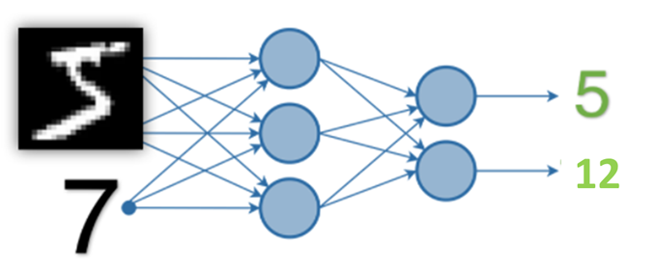
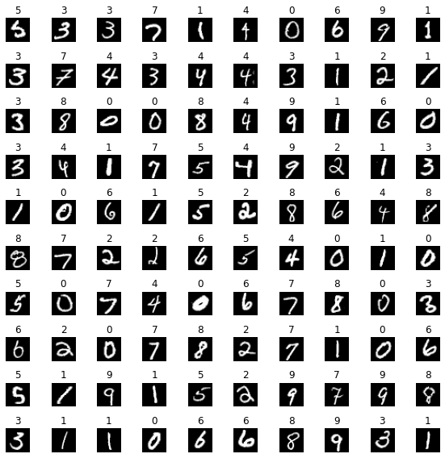
Data Representation
Single Image
Each Image representation
torch.Size([1, 28, 28]) ie
torch.Size([batch_size, height of image, width of image])
Batch of Images – batch_size = 100
Batch Image representation
torch.Size([100, 28, 28]) ie
torch.Size([batch_size, height of image, width of image])

Slide 2
Random Number
Random number representation- torch.Size[10]
[0, 0, 0, 0, 0, 0, 0, 1, 0, 0]
Single Image
Random Number
Sum Number
12
Sum number representation- torch.Size[19]
[0, 0, 0, 0, 0, 0, 0, 0, 0, 0, 0, 0, 1, 0, 0, 0, 0, 0, 0, 0]

Slide 3
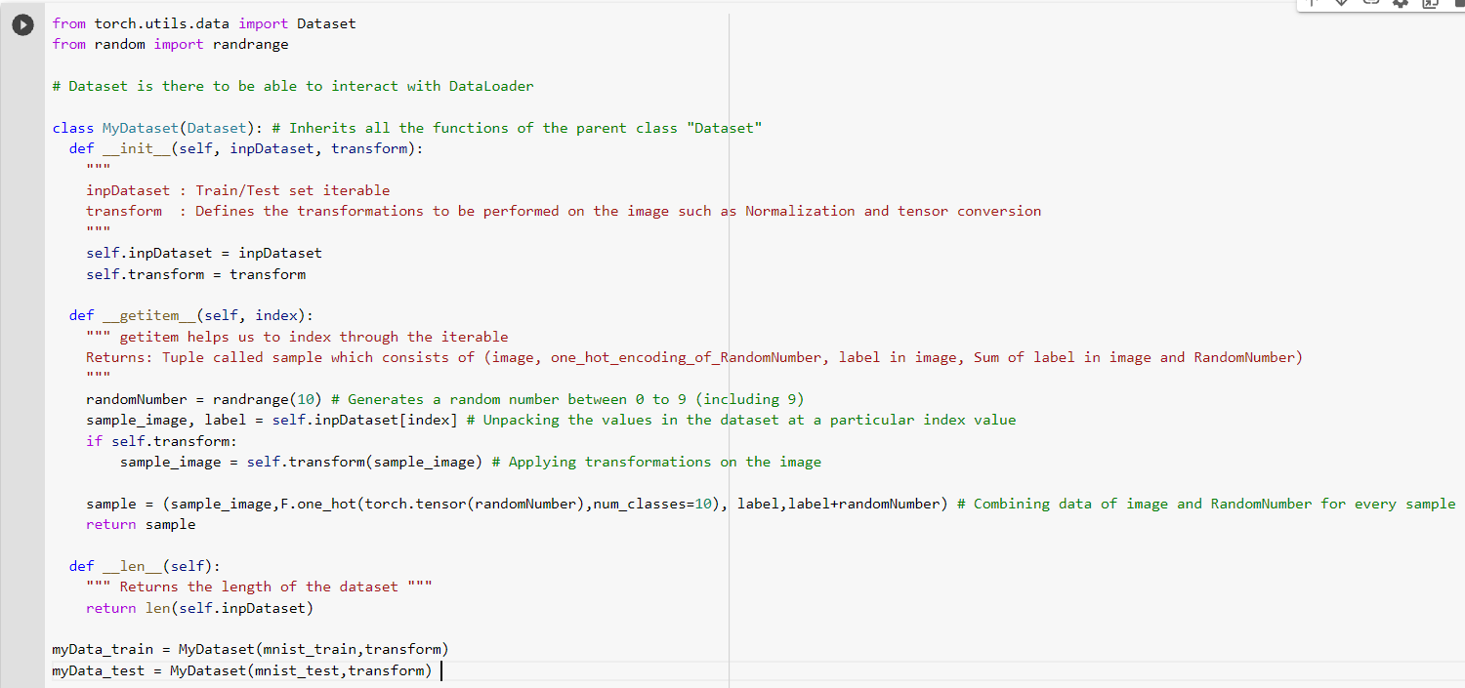
Data Generation Strategy: MyDataset → Class
This includes generation of inputs and outputs required to train the model
Inputs: Iterable for image dataset, transform function
Outputs for each indexed sample : image, one-hot encoding of RandomNumber, label of image, Sum value (MNIST Image value + RandomNumber)
Outputs for one indexed sample

Slide 4
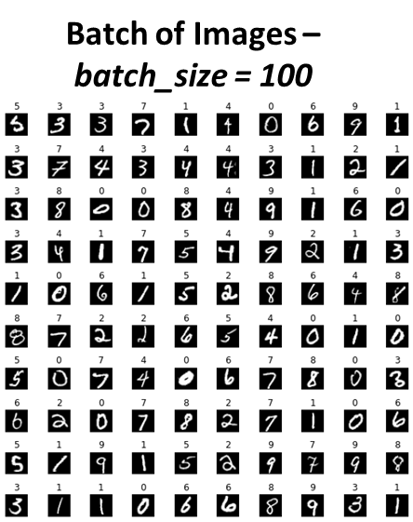
how you have combined the two inputs (basically which layer you are combining)
Method2: Only FCs
Method1: Convolution + FCs
Conv Layer1
Relu
Conv Layer2
Relu
Combining Image data & RandomNumber data
CONCATENATE
Flatten + One-hot encoding of RandomNumbers ( torch.Size(batchsize,10)
Flatten
Dropout
MaxPool2d
FC2 - Image label Output
FC1
Relu
Dropout
FC3 - Sum label Output

Slide 5
Stacking the tensors
Reshape image data
Batch of image data
Batchsize, 784
Batch of RandomNumbers
Batchsize, 10
Batchsize, 794

Slide 6
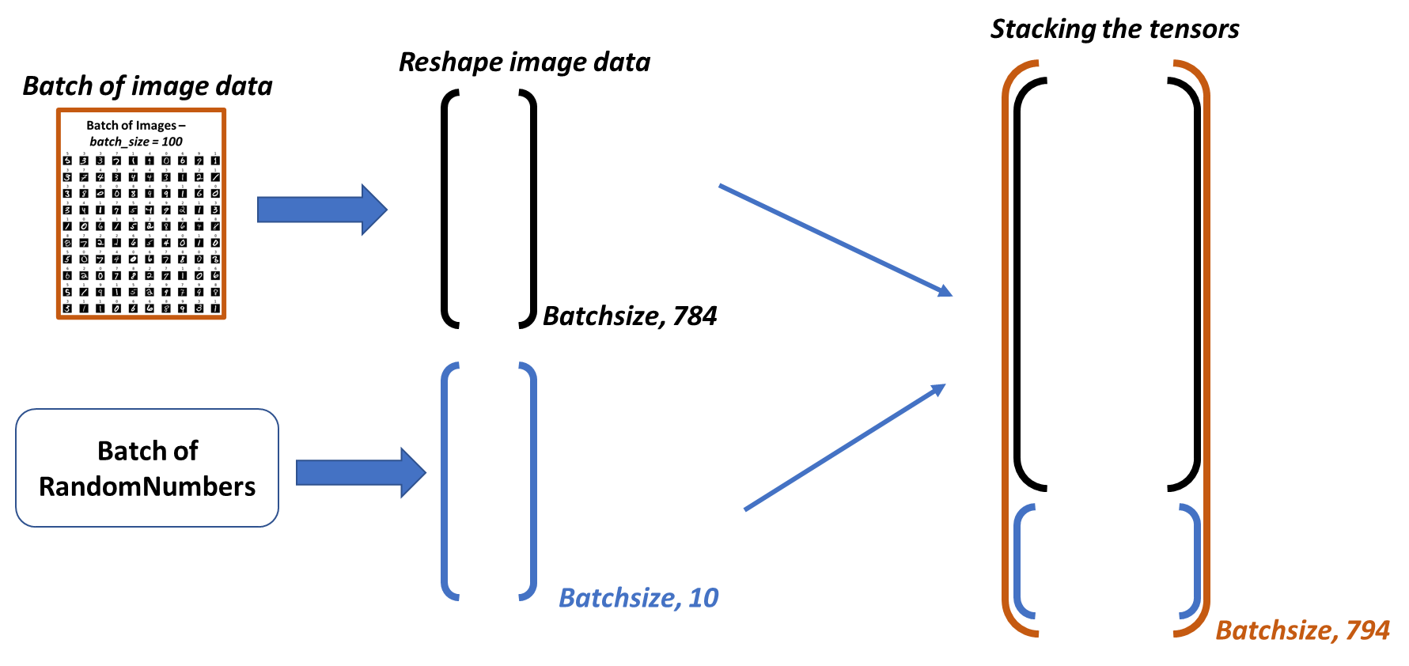
Method2: Only Fully Connected (FC) Networks
Data Preparation
Combining Image data & RandomNumber data before sending to Neural Network
FC Layer1
Relu
FC Layer2
Relu
Relu
FC Layer2
Image Label Output
Out Layer1
Dropout
Relu
Sum Label Output
Out Layer2

Slide 7
SNo | Method | Image label Prediction Accuracy | Sum label Prediction Accuracy
1 | Convolutions + FC | 99% | 96%
2 | Only FC Network | 98% | 97%

Slide 8
