Slide 1
Presentation on RC5
Presented By:- Mayank Kumar Jha
College:- Saroj Mohan Institute of Technology
Stream:- Computer Science and Engineering
Paper:- Cryptography and Network Security
Paper Code:-CS801D
Year:- 4th
Semester:- 8th
Roll:- 16800116066
Reg. No.:- 161680110031

Slide 2
What is RC5
RC5 is a block cipher notable for its simplicity. Designed by Ronald Rivest in 1994.
RC stands for "Rivest Cipher", or alternatively, "Ron's Code.
Rivest announced also RC2 and RC4 and now there is RC6 which is The Advanced Encryption Standard (AES) candidate (RC6 was based on RC5).

Slide 3
Features
Symmetric block cipher (Like Feistel Network Structure)
the same secret cryptographic key is used for encryption and decryption
Suitable for hardware and software
It uses only computational primitive operations commonly found on typical microprocessors
Fast
Cause it uses Word-Oriented operations

Slide 4
Features count.
Adaptable to processors of different word lengths
For example with 64 bit processor RC5 can exploit their longer work length
Therefore the number w of bits in a word is a parameter of RC5, different choices of this parameter results different algorithms.
Variable number of rounds
The user can explicitly manipulate the trade-off between higher speed and higher security.
So the number of rounds i is a second parameter of RC5

Slide 5
Features count.
Variable length cryptographic key
The user can choose the level of security appropriate for his application the key length b in bytes is thus a third parameter of RC5
Simple
It is simple to implement, This simplicity makes it more interesting to analyze and evaluate, so that the cryptographic strength can be more rapidly determined
Low memory requirements
So it is easily implemented on devices with restricted memory

Slide 6
Features count.
Data-dependent rotations
◉ RC5 highlight the use of data-dependent rotations and encourage the assessment of the cryptographic strength data-dependent can provide

Slide 7
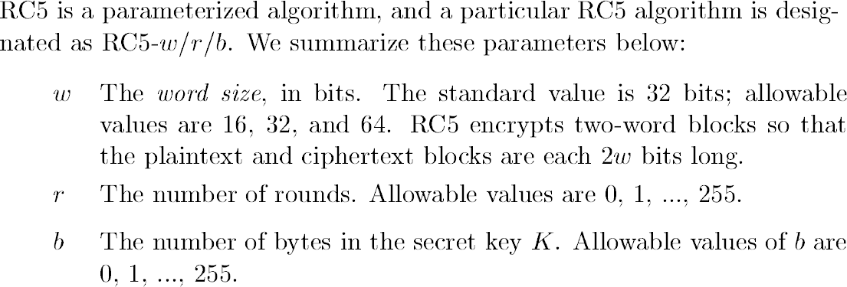
Parameterization

Slide 8
Parameterization count.
RC5 algorithm example: RC5-32/16/7
similar to DES
Two 32-bit word inputs and outputs
16 rounds
7-byte(56-bit) secret key
Choices for w and r
speed vs. security
Choosing larger number of rounds provides an increased level of security

Slide 9
Dropped parameters
RC5 Dropped parameters
The default is 32/12/ 7 for 32 bit words
The default is 64/16/7 for 64 bit words
So if any parameter is dropped use the corresponding default parameter
Examples
◉ RC5-32 | Means | 32/12/7
◉ RC5-32, 9 | Means | 32/9/ 7
◉ RC5-64 | Means | 64/16/7

Slide 10
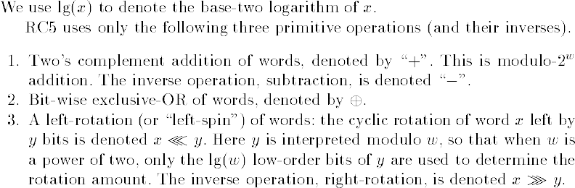
Notations and Primitive operations

Slide 11
Algorithm
The are three components of RC5
Key expansion algorithm
Encryption algorithm
Decryption algorithm
Plaintext
Encryption Algorithm
Ciphertext
Secret Key K
Key Expansion Algorithm
Expanded Key S
Decryption Algorithm
Plaintext
Ciphertext

Slide 12
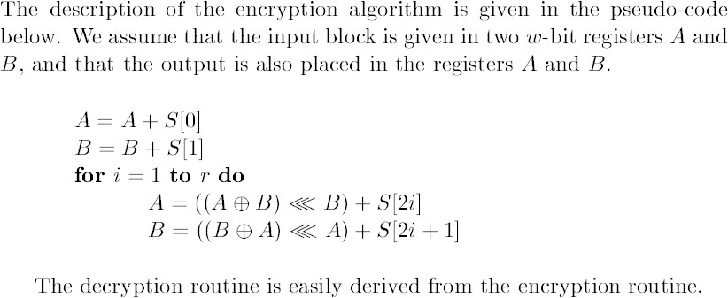
Encryption

Slide 13
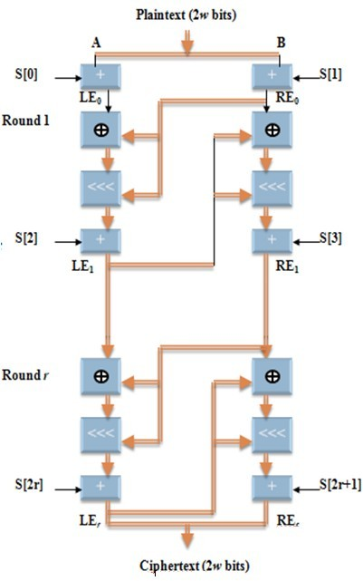

Encryption
A = | A | + | S[0];
B = | B | + | S[1];
for | i A | = = | 1 to r do ((A ⊕ B)
<<< B) + S[2*i];
B = ((B ⊕ A) <<< A) + S[2*i + 1];
A <<< B
Bits in A are rotated to left by the amount specified by lower log2(w) bits in B

Slide 14
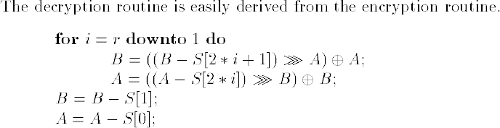
Decryption

Slide 15
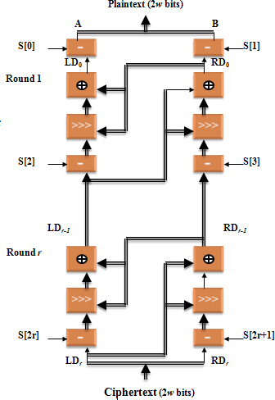
Decryption
for | i | = | r downto 1 do
 | B | = | ((B - S[2*i +1]) >>> | A) ⊕ A;
 | A | = | ((A - S[2*i]) >>> B) | ⊕ B;
B = | B | - | S[1];
A = | A | - | S[0];
A >>> B
Bits in A are rotated to right by the amount specified by lower log2(w) bits in B

Slide 16
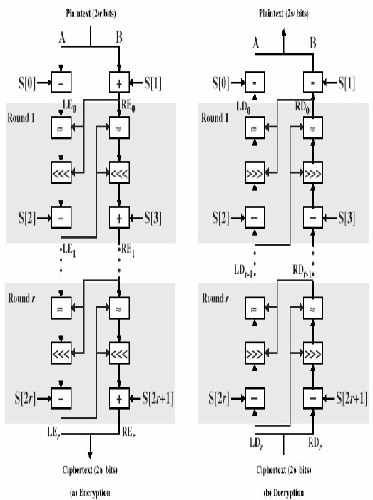
Encryption and Decryption

Slide 17
Key Expansion
RC5
RC5 performs some operations on the secret key to generate a total of t sub keys, which are stored in S array, S[0],S[1], …, S[t-1]
The key expansion algorithm consists of two constants (Magic numbers) and three simple algorithm parts
Step-1: Convert secret key bytes to words
Step-2: Initialize sub key array S (S[0], S[1], …, S[t-1])
Step-3: Mix the secret key into sub key array S

Slide 18
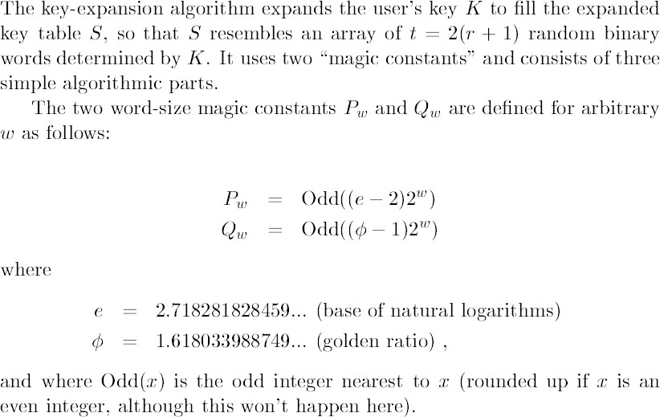
Key Expansion

Slide 19
The magic constants
In key expansion, magic constants are used
◉ Pw = Odd((e - 2)2w); e=2.718281828…. (base of natural logarithms)
◉ Qw = Odd((φ - 1)2w);φ=1.618033988…. (golden ratio = (1+sqr(5))/2)
Odd(x): odd integer nearest to x
◉ Example
w 16 | 32 | 64
P_{w} B7E1 Q_{w} 9E37 | B7E15163 9E3779B9 | B7E151628AED2A6B 9E3779B97F4A7C15

Slide 20
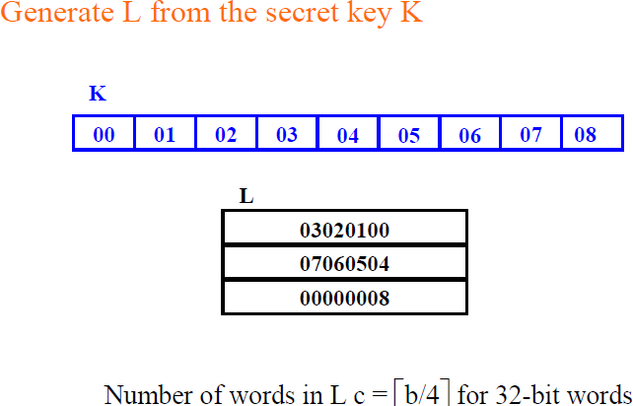
Step-1: Convert secret key bytes to words
Copy the Key into new array L of Words with size equal c Any unfilled byte positions of L are zeroed
In case b = c = 0 we reset c =1 and set L[0] = 0

Slide 21
Step-2: Initialize sub key array S
create an expanded key table, S[0...t-1]
◉
has t entries, t = 2(r + 1) w-bit words
Initialize array S
S[0] = P_{w};
for i = 1 to t - 1 do
S[i] = S[i - 1] + Q_{w};

Slide 22
Step-3: Mix the secret key into sub key array S
Mix the secret key into table, S
i = j = 0; A = B = 0;
do 3 * max(t, c) | times:
A = S[i] = | (S[i] + A | + B) <<< 3;
B = L[j] = | (L[j] + A | + B) <<< (A + | B);
i = | (i + | 1) mod(t);
j = | (j + | 1) mod(c);

Slide 23
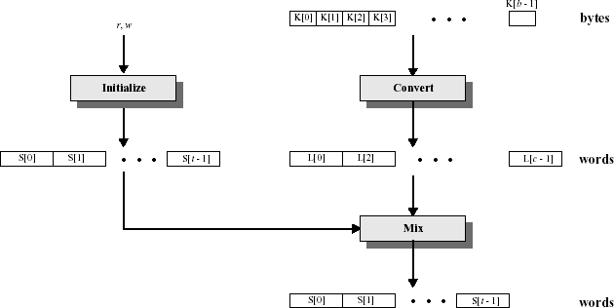
Key Expansion Algorithm

Slide 24
The security of RC5
Exhaustive Search
Differential cryptanalysis
Linear cryptanalysis
Timing Attacks

Slide 25
Exhaustive Search
RC5-32/r/b allows
a maximum of 2040 secret key bits
a maximum of 25(2r + 2) expanded key table bits
Choosing large values for r and b can prevent exhaustive attacks

Slide 26
Differential cryptanalysis
◻
It has a quite evolutionary effect on the design and analysis of block ciphers
The basic Idea
Two plaint text are chose with a certain difference P` (The difference here is measured by xor but for other cipher alternative measure may be applied)
The two plaintexts are enciphered to give two cipher texts such that their difference C`
Such a pair (P` , C`) is called a characteristic
Depending on the cipher and the analysis the behavior of this characteristics can be useful in deriving certain bit of the key
◻

Slide 27
Linear cryptanalysis
Introduced By Matsui.
The basic idea is
to find relations among certain bits of plaintext, cipher text and key
Such as relation is called linear approximation which can be used to obtain information about the key
Becomes impractical for r > 6

Slide 28
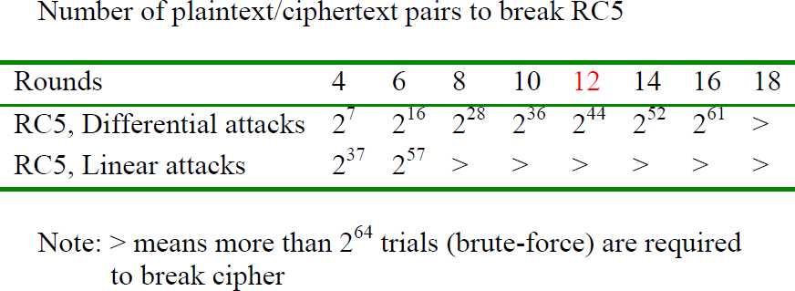
Differential and Linear attack

Slide 29
Conclusion
Provides good security against the four main attacks
Simple encryption/decryption algorithms
RC5 is relatively is still under scrutiny by other cryptanalysis attack

