Slide 1
Basic Principles related to the security of a message
Cryptography & Network security – cs801d
presented by –
Ankit kumar
Roll- 16800116093
CSE – 4th Year (8th sem)

Slide 2
Message Security
Message security is the practice of encrypting messages on your device so that they can be read only by the intended recipient.
message encryption is necessary in many situations :-
Confidentiality: Message encryption is the only way to ensure that only the indented recipients are reading your messages.
Authenticity: Message encryption is the only way to ensure the identity of the people you are communicating with.

Slide 3

SECURE COMMUNICATION
Secure communication refers to the scenarios where the message or data shared between two parties can’t be accessed by an adversary.
data confidentiality, data integrity, authentication and non-repudiation are core principles of modern day cryptography.

Slide 4
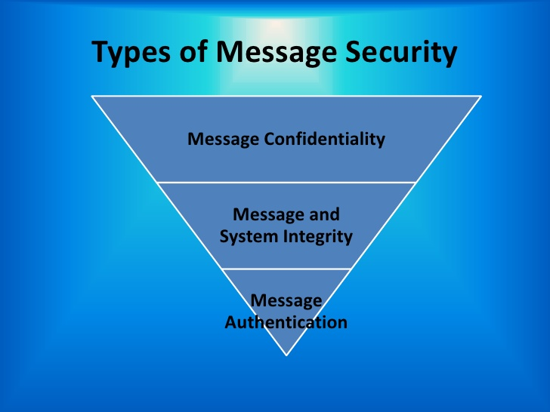
Message security

Slide 5

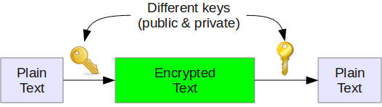
Basic principle of message cryptography
Confidentiality:- refers to certain rules and guidelines usually executed under confidentiality agreements which ensure that the information is restricted to certain people or places.
Data integrity:- refers to maintaining and making sure that the data stays accurate and consistent over its entire life cycle.
Authentication:-is the process of making sure that the piece of data being claimed by the user belongs to it.
Non-repudiation:- refers to ability to make sure that a person or a party associated with a contract or a communication cannot deny the authenticity of their signature over their document or the sending of a message.

Slide 6
LIMITATIONS OF MESSAGE SECURITY
ALTHOUGH YOU CAN HIDE THE CONTENTS OF EMAIL WITH PUBLIC-KEY ENCRYPTION, IT DOES NOT HIDE WHO YOU ARE SENDING MAIL TO AND RECEIVING MAIL FROM.
THIS MEANS THAT EVEN WITH PUBLIC KEY ENCRYPTION THERE IS LOT OF PERSONAL INFORMATION WHICH IS NOT SECURE.
THE DISADVANTAGE TO USING MESSAGE-LAYER SECURITY IS THAT IT IS RELATIVELY COMPLEX AND ADDS SOME OVERHEAD TO PROCESSING.

Slide 7
REFERENCES
https://www.tutorialspoint.com/
https://www.geeksforgeeks.org/
https://www.wikipedia.org/
https://www.google.co.in/imghp?hl=en

Slide 8


