Slide 1
Digital Signature Changes the process of Public Key Cryptography
Cryptography & Network security – cs801d
presented by –
Souvik Chatterjee
Roll- 16800116022
CSE – 4th Year (8th sem)

Slide 2
DIGITAL SIGNATURE
Digital signatures are the public-key primitives of message authentication. In the physical world, it is common to use handwritten signatures on handwritten or typed messages. They are used to bind signatory to the message.
Similarly, a digital signature is a technique that binds a person/entity to the digital data. This binding can be independently verified by receiver as well as any third party.
Digital signature is a cryptographic value that is calculated from the data and a secret key known only by the signer.

Slide 3
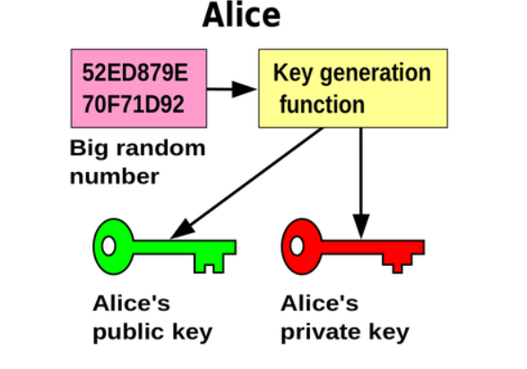
PUBLIC KEY CRYPTOGRAPHY
Public key cryptography is a cryptographic system that uses private/public keys. The advantage of this approach is in not requiring some sort of secure channel for the initial exchange of secret keys between communicators. This makes secure communication with strangers on open networks possible.

Slide 4
A public key is another hexadecimal number which can be shared publicly.
In most common encryption systems, the public and private keys are both generated at the same time. In others, the public key is generated from the private key. The public and private keys are associated with each other through a mathematical relationship. However, there is no way use the public key to figure out the private key. That is because these systems are based on math problems with no efficient solutions which can take outputs and work backwards from to get the original inputs.

Slide 5
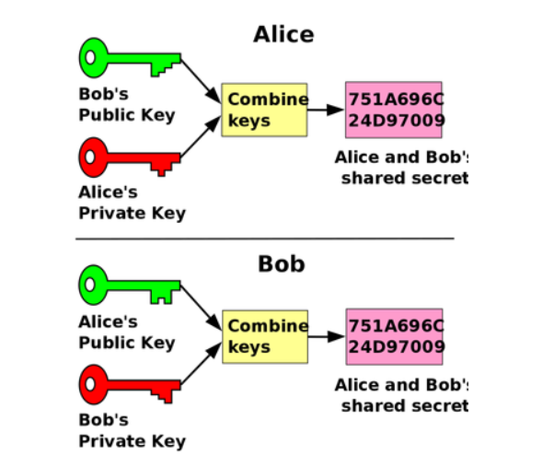
Public key cryptography with digital signatures
A digital signature with public-key cryptography securing a message is created in the following way. First, the message is digitally signed like explained above. Then, this bundle is encrypted with the sender’s private key, and again with the receiver’s public key
Looking at it like hypothetical function calls, it may look something like this:
public_key_of_recipient(private_key(message_hashing(message) + message + type of hashing algorithm))

Slide 6

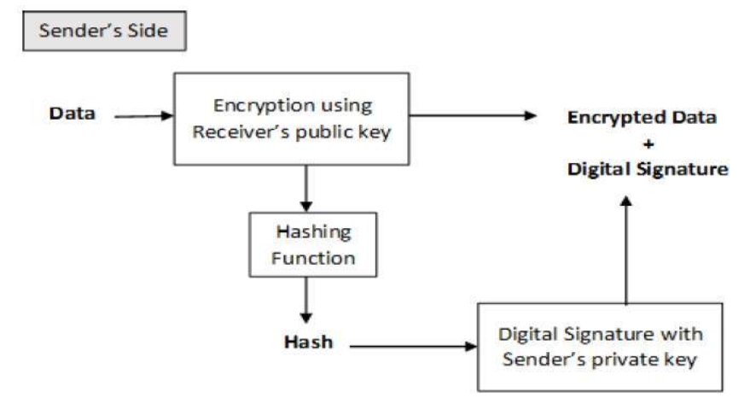
Encryption with Digital Signature
In many digital communications, it is desirable to exchange an encrypted messages than plaintext to achieve confidentiality. In public key encryption scheme, a public (encryption) key of sender is available in open domain, and hence anyone can spoof his identity and send any encrypted message to the receiver.
This makes it essential for users employing PKC for encryption to seek digital signatures along with encrypted data to be assured of message authentication and non-repudiation.
This can archived by combining digital signatures with encryption scheme. Let us briefly discuss how to achieve this requirement. There are two possibilities, sign-then-encrypt and encrypt-then-sign.
However, the crypto system based on sign-then-encrypt can be exploited by receiver to spoof identity of sender and sent that data to third party. Hence, this method is not preferred. The process of encrypt-then-sign is more reliable and widely adopted. This is depicted in the following illustration
The receiver after receiving the encrypted data and signature on it, first verifies the signature using sender’s public key. After ensuring the validity of the signature, he then retrieves the data through decryption using his private key.

Slide 7
REFERENCES
https://www.tutorialspoint.com/
https://medium.com/
https://www.wikipedia.org/
https://www.google.co.in/imghp?hl=en

Slide 8


