Slide 1


Slide 2


What is block cipher?
In cryptography, a block cipher is a deterministic algorithm operating on fixed-length groups of bits, called blocks, with an unvarying transformation that is specified by a symmetric key.
A block cipher algorithm is a basic building block for providing data security.
To apply a block cipher in a variety of applications, five “modes of operations” are defined by NIST.

Slide 3

Introduction to block cipher modes of operation
NIST : National Institute of Standards and Technology
That five modes of operations are :
Electronic code book
Cipher chaining block
Cipher feedback mode
Output feedback mode
Counter mode

Slide 4


When we use block cipher modes of operation?
Block cipher only allow to encrypt entire blocks.
What if our message is longer/shorter than the block size?
When message is longer/shorter than the block size , we use modes of operations.
Algorithms that exploit a block cipher to provide a service (e.g. confidentiality ).

Slide 5
Electronic codebook
ECB is the simplest mode of operation.
The plain text is divided into N blocks.
The block size is n bits.
If the plaintext size is not multiple of the block size , the text is padded to make the last block the same size other blocks.
Same key is used to encrypt and decrypt each block.

Slide 6

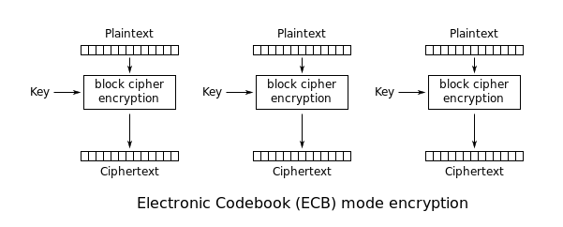
Electronic codebook encryption process
Cipher texti = encryption with key (plain texti)

Slide 7


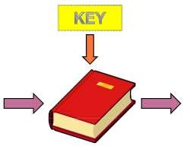

Electronic codebook encryption example

Slide 8
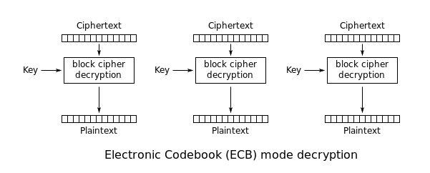
Electronic codebook Decryption process
Plain texti = Decryption with key (cipher texti)

Slide 9
Electronic codebook Decryption example

Slide 10

Electronic codebook encryption/decryption Security issues
Patterns at the block level are preserved.
For example equal blocks in the plain text become equal block in the cipher text.
If any person finds out the cipher text block 1,5 and 10 are the same ,that person knows that plaintext blocks 1, 5 and 10 are the same.
This is a leak in security.

Slide 11

What is initialization vector?
An initialization vector (IV) or starting variable is a block of bits that is used by several modes to randomize the encryption and hence to produce distinct cipher texts even if the same plain text is encrypted multiple times, without the need for a slower re-keying process.
An initialization vector has different security requirements than a key, so the IV usually does not need to be secret
However, in most cases, it is important that an initialization vector is never reused under the same key.

Slide 12
What is initialization vector? (continue…)
For CBC and CFB, reusing an IV leaks some information about the first block of plaintext, and about any common prefix shared by the two messages.
For OFB and CTR, reusing an IV completely destroys security. This can be seen because both modes effectively create a bit stream that is XORed with the plaintext, and this bit stream is dependent on the password and IV only. Reusing a bit stream destroys security.
In CBC mode, the IV must, in addition, be unpredictable at encryption time; in particular, the (previously) common practice of re-using the last cipher text block of a message as the IV for the next message is insecure.

Slide 13
Cipher block chaining mode
IBM invented the Cipher Block Chaining (CBC) mode of operation in 1976.
In CBC mode, each block of plaintext is XORed with the previous cipher text block before being encrypted.
This way, each cipher text block depends on all plaintext blocks processed up to that point. To make each message unique, an initialization vector must be used in the first block.

Slide 14
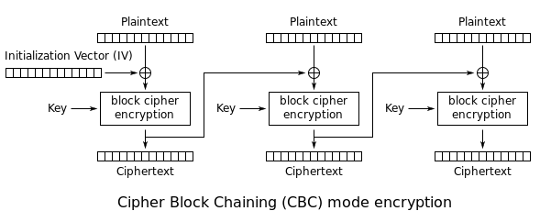
Cipher block chaining mode encryption
IV = initialization vector
Cipher texti = encryption with key (plain text XOR cipher text i-
1)

Slide 15
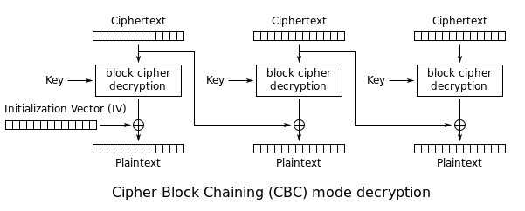
Cipher block chaining mode Decryption
IV = initialization vector
plain texti = Decryption with key (cipher text XOR cipher text i-1)

Slide 16
Cipher block chaining mode Security issues
The patterns at the block level are not preserved.
In CBC mode, equal plain text block belonging to the same message are enciphered into different cipher text block.
However ,if two message are equal ,their encipherment is the same if they use the same IV.
As a matter of fact ,if the first M blocks in two different message are equal , they are enciphered into equal blocks unless different IVs are used.
For this reason , some people recommended the use of time- stamp as an IV.
Any person can add some cipher text blocks to the end of the cipher text stream.

Slide 17
Cipher feedback mode
ECB and CBC modes encrypt and decrypt blocks of the message.
Block size n is predetermine by the underlying cipher ; for example , for DES n = 64
for AES n =128
In some situations, we need use DES or AES as secure cipher , but the plain text or cipher text block size are to be smaller.
For example , to encrypt and decrypt 8-bit characters , you would not want to use one of the traditional cipher like Caesar cipher.
The solution is to use DES or AES in cipher feedback mode

Slide 18
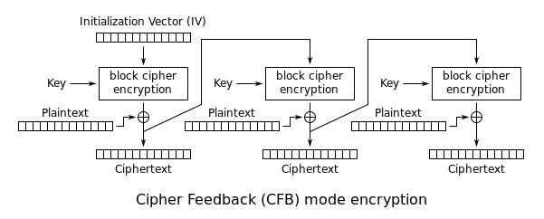
Cipher feedback mode encryption
IV = initialization vector
Cipher texti = Encryption with key (Cipher text i-1 ) XOR plain text

Slide 19
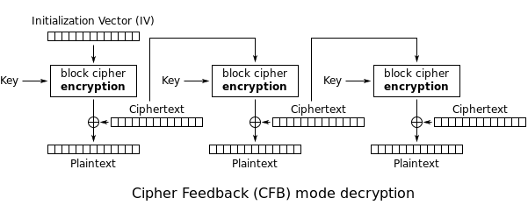
Cipher feedback mode Decryption
IV = initialization vector
Plain texti = Encryption with key (Cipher text i-1 ) XOR cipher text

Slide 20
Cipher feedback mode Security issues
Just like CBC , patterns at the block level are not preserved.
More than one message can be encrypted with the same key , but the value of the IV should be changed for each message.
This means that sender needs to use a different IV each time sender sends a message.
Attacker can add some cipher text block to the end of the cipher text stream.

Slide 21
Cipher output feedback mode
Output feedback mode is very similar to CFB mode , with one difference: each bit in the cipher text is independent of the previous bit or bits.
This avoids error propagation.
If an error occur in transmission , it does not affect the bits that follow.
Note that , like cipher feedback mode , both the sender and the receiver use the encryption algorithm.

Slide 22
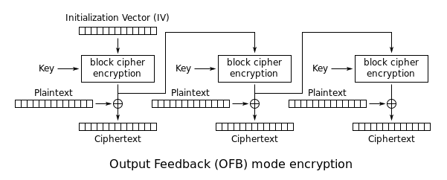
Cipher output feedback mode encryption
IV = initialization vector cipher texti =
plain texti XOR Encryption
(k , [cipher text i-1 XOR plain text i-1] )

Slide 23
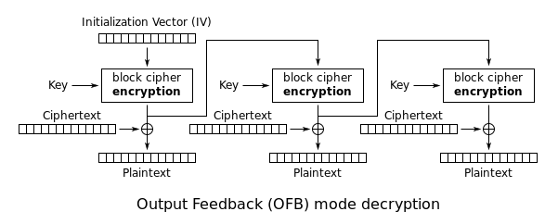
Cipher output feedback mode Decryption
IV = initialization vector Plain texti =
cipher texti XOR Encryption
(k , [cipher text i-1 XOR plain text i-1] )

Slide 24
Cipher output feedback mode Security issues
Just like CBC , patterns at the block level are not preserved.
Any change in the cipher text affects the plain text encrypted at the receiver side.

Slide 25
Counter
In the counter mode , there is no feedback.
The pseudo randomness in the key streams achieved using a counter.
An n bit counter is initialized to a predetermined value(IV) and incremented based on a predefined rule(mod 2^{n})
To provide a better randomness , the increment value can depend on the block numbers to be incremented.
The plain text and cipher block text block have same block size as the underlying cipher.
Both encryption and decryption can be performed fully in parallel on multiple blocks .
Provides true random access to cipher text blocks

Slide 26
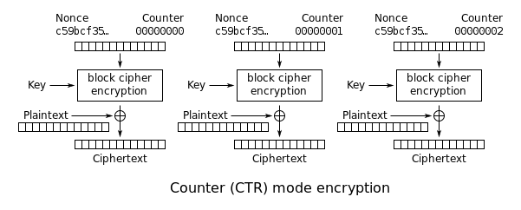
Counter Encryption process
Nonce = IV
Cipher texti = Plain texti XOR Encryption with key(counter)

Slide 27

Counter Decryption process
Nonce = IV
Plain texti = Cipher texti XOR Encryption with key(counter)

Slide 28


