Slide 1
International Data Encryption Algorithm
Made by
Akash Pahari
Stream-IT,
Roll no-16800216009

Slide 2

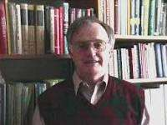
History…
◆ IDEA is a symmetric block cipher algorithm.
◆ It was developed by Xuejia Lai and James L. Massey.
◆ Its patents are held by the Swiss company "Ascom-Tech AG".

Slide 3

Contd…
◆ It was meant to be a replacement for the Data Encryption Standard.
◆ IDEA was used in Pretty Good Privacy (PGP) v2.0 .
◆ It is developed at ETH(Eidgenossische Technische Hochschule) in Zurich, Switzerland in 1990.

Slide 4
Basic idea about IDEA…
◆ Here Plain text is of 64 bit.
◆ Key is of 128 bit. And it is divided in 52 sub keys (how?? Thhat we will see in next slide.)
◆ Cipher text is also as same as plain text in size that is of 64 bit.
◆ Number of identical rounds are 8 where in each round 6 keys are used.
◆ Like this 48 keys and in last round another 4 keys (6 * 8 = 48 + 4 =52 total) are being used in both the encryption and decryption process.

Slide 5
Design issue
◆ The design philosophy behind the algorithm is one of “ mixing operation from different algebraic groups”
◆ Lets take a look which different operations are used.
◆ 1) XOR
◆ 2) Addition
◆ 3) Multiplication

Slide 6
Key generation process
◆ First of all we will see how these 52 keys are generated.
◆ The 128 bit key is divided into 8 sub parts that is 16 bits each.
◆ Then the 128 bit key is cyclically shifted to the left by 25 position, so by doing this we will have one new 128 bit key.
◆ Now similarly as above it is divided into 8 sub blocks and will be used in next round.
◆ The same process is performed 9 times ans 56 keys are generated from which
the first 52keys will be used.
◆ So likewise from K1 to K52 keys are generated.

Slide 7
Sequence of operation in one round
◆ 1) Multiply P1 and K1
◆ 2) Add P2 and second K2
◆ 3) Add P3 and third K3
◆ 4) Multiply P4 and K4
◆ 5) Step 1 ⊕ step 3
◆ 6) Step 2 ⊕ step 4
◆ 7) Multiply step 5 with K5

Slide 8
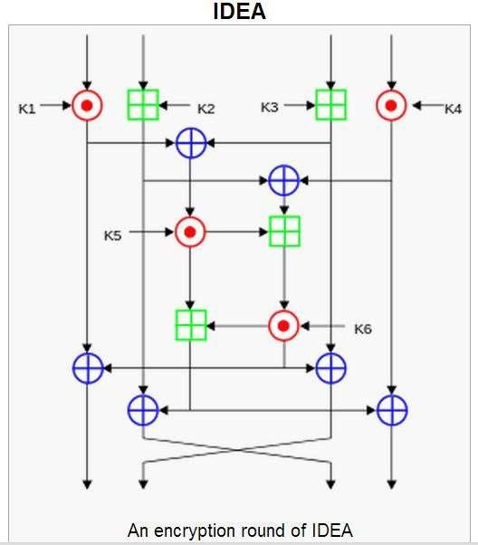

Slide 9
Sequence of operation in one round
◆ 8) Add result of step 6 and step 7
◆ 9) Multiply result of step 8 with K6.
◆ 10) Add result of step 7 and step 9.
◆ 11) XOR result of steps 1 and step 9.
◆ 12) XOR result of steps 3 and step 9.
◆ 13) XOR result of steps 2 and step 10.
◆ 14) XOR result of steps 4 and step 10.
Same operations are performed in 8 rounds…

Slide 10
Sequence of operation in last round
◆ 1) Multiply P1 with K49.
◆ 2) Add P2 and K50.
◆ 3) Add P3 and K51.
◆ 4) Multiply P4 and K52.

Slide 11
Encyption
◆ First of all 64 bit plain text is divided into 4 16-bit parts and they are taken as an input in first round.
◆ At the end of the first encryption round four 16-bit values are produced which are used as input to the second encryption round
◆ The process is repeated in each of the subsequent 8 encryption rounds
◆ Note that in 9th round we have to use only 4 key( K49, K50, K51,K52) and have to perform different operation as guided in previous slide.

Slide 12
Decryption
◆ The computational process used for decryption of the ciphertext is essentially the same as that used for encryption
◆ The only difference is that each of the 52 16-bit key sub-blocks used for decryption is the inverse of the key sub-block used during encryption
◆ Do remember that the sub blocks must be used in reverse order than of the
encryption round.

Slide 13
Applications of IDEA
◆ Today, there are hundreds of IDEA-based security solutions available in many market areas, ranging from Financial Services, and Broadcasting to Government
◆ The IDEA algorithm can easily be combined in any encryption software.
Data encryption can be used to protect data transmission and storage.
◆ Typical fields are:
Audio and video data for cable TV, video conferencing, distance learning
Sensitive financial and commercial data
Email via public networks
Smart cards

Slide 14






Hey all mature people please
attention here:
Don’t forget to go for vote on the day after tomorrow that is
on 30th april… ☺
Heartly thank you for your time and
attention…
presented by:
Akshay ( 110750107020 ) Akash ( 110750107005 ) Saurabh ( 110750107021 )
G_{G}uid_{u}e_{i}d_{d}b_{e}y_{d}:
by:
Anand sir.
Anand sir.

