Slide 1

A
Presentation
on
DIGITAL SIGNATURE
Department of Computer Science and Engineering
Saroj Mohan Institute Of Technology(Degree Division)
Guptipara . Hooghly
Submitted By : Rintu Pratihar
Roll no : 16800116049
Sem : 8th , Year : 4th

Slide 2
Content
Introduction
What is Digital Signature ??
Why Digital Signature ??
Basic Requirements....
How the Technology works
Approaches
Algorithm of Digital Signature
Challengs and Opportunities
Application
Drawbacks
Conclusion

Slide 3
Introduction
The authenticity of many legal, financial, and other documents is done by the presence or absence of an authorized handwritten signature.
“ Digital Signature” is the best solution for authenticity in various fields.
A Digital Signature is nothing but an attachment to any piece of electronic information, which represents the content of the document and the identity of the owner of that document uniquely.

Slide 4
What is Digtal Signature ??
Hash value of a message when encrypted with the private key of a person is his digital signature on that e-Document.
Digital Signature of a person therefore varies from document to document thus ensuring authenticity of each word of that document.
As the public key of the signature is known, anybody can verify the message and the digital signature.

Slide 5
Why Digital Signatures??
To provide Authenticity, Integrity and Non-repudiation to electronic documents.
To use the Internet as the safe and secure medium for e-Commerce and e-Governance.

Slide 6
Basic Requirements...
Private Key
The private key is one which is accessible only to the signature. It is used to generate the digital signature which is then attached to the message.
Public Key
The public key is made available to all those who receive the signed messages from the sender. It is used for verification of the received message.

Slide 7
Basic Requirements...
Digital Signature Certificate
A subscriber of the private key and public key pair makes the public key available to all those who are intended to receive the signed messages from the subscriber.
But in case of any dispute between the two sides there must be some entity with the receiver which will allow the receiver of the message to prove that the message was sent by the subscriber of the key pair. This can be done with the Digital Signature Certificate.

Slide 8
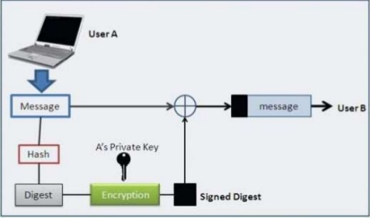
How the Technology works ???

Slide 9
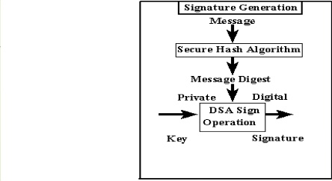
Digital Signature Algorithm Digital Signature Generation

Slide 10
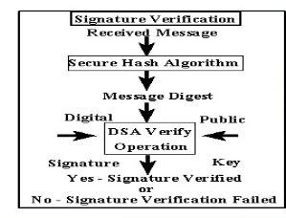
Digital Signature Algorithm Digital Signature Verification

Slide 11
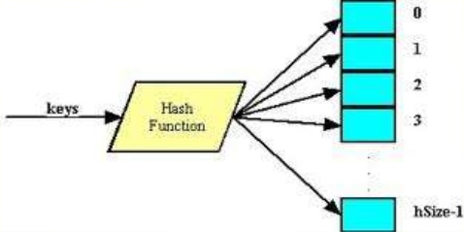
Digital Signature Algorithm Secure Hash Algorithm

Slide 12
Challenges and Opportunities
Institutional overhead :
The cost of establishing and utilizing certification authorities, repositories, and other important services, as well as assuring quality in the performance of their functions.
Subscriber and Relying Party Costs :
A digital signer will require software, and will probably have to pay a certification authority some price to issue a certificate. Hardware to secure the subscriber’s private key may also be advisable.

Slide 13
Applications....
Electronic Mail
Data storage
Electronic funds transfer
Software Distribution
Smart Cards
MITRENET
ISDN
Time Stamped Signature
Blind Signatures

Slide 14
Drawbacks
The private key must be kept in a secured manner.
The process of generation and verification of digital signature requires considerable amount of time.
For using e digital signature the user has to obtain private and public key, the receiver has to obtain the digital signature certificate also.

Slide 15
Conclusion
Digital signatures are difficult to understand. Digital signatures will be championed by many players that the public distrusts, including national security agencies, law enforcement agencies, and consumer marketing companies.

Slide 16
References
https://en.m.wikipedia.org/wiki/Digital Signature
www.google.com
www.computerfun4u.blogspot.com
www.slideshare.net
Cryptography and network security : Principal & Practise, William Stallings

Slide 17
Thank You......

