Slide 1

Presented by:
JAYEETA AICH
STREAM:CSE
ROLL:16800116072
YEAR: 4
SEM: 8

Slide 2
CONTENTS
Biometric Authentication
What is a Biometric?
Why Biometrics?
Types of Biometrics
Biometric System Architecture
Applications of Biometric Authentication
Advantages of Biometrics
Disadvantages of Biometrics
Three main types of authentication available today are:
Conclusion

Slide 3
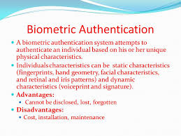

Slide 4
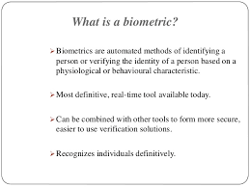

Slide 5
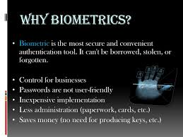

Slide 6
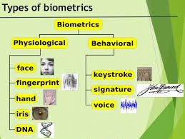

Slide 7
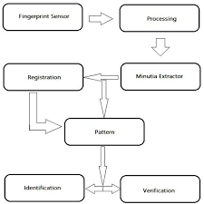
Biometric System Architecture

Slide 8
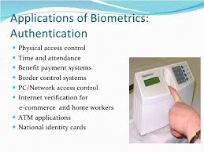

Slide 9
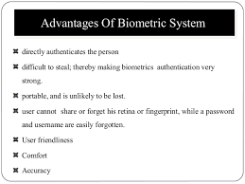
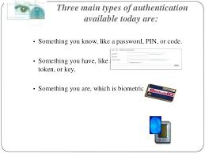

Slide 10
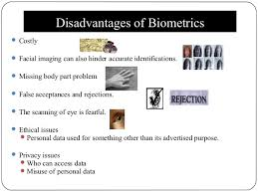

Slide 12
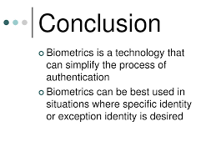

Slide 13
THANK YOU

