Slide 1
Online Banking System
Presented By:- Mayank Kumar Jha
College:- Saroj Mohan Institute of Technology
Stream:- Computer Science and Engineering
Paper:- E-Commerce
Paper Code:- CS802E
Year- 4th
Semester- 8th
Roll:- 16800116066
Reg. No.:- 161680110031

Slide 2

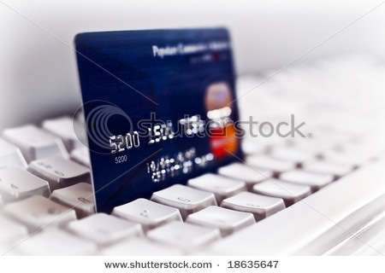
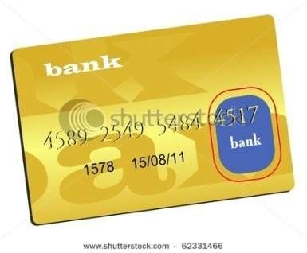
What is Internet banking?
A system allowing individuals to perform banking activities at home, via the internet.
The automated delivery of new and traditional banking products and services directly to customers through electronic, interactive communication channels.
Some online banks are traditional banks which also offer online banking, while others are online only and have no physical presence.

Slide 3

Development of E-banking
The concept of Internet banking has been simultaneously evolving with the development of the world wide web.
Programmers working on banking data bases came up with ideas for online banking transactions, some time during the 1980's.
The online shopping promoted the use of credit cards through Internet.
The first online banking service in United States was introduced, in October 1994.

Slide 4
Development of E-ban king
Contd…
The service was developed by Stanford Federal Credit Union, which is a financial institution.
In May 1995 : Wells Fargo - the first bank in the world to offer customer access to their accounts over the internet(allows customer to see their accounts online)
The online banking services are becoming more and more prevalent due to the well developed systems

Slide 5
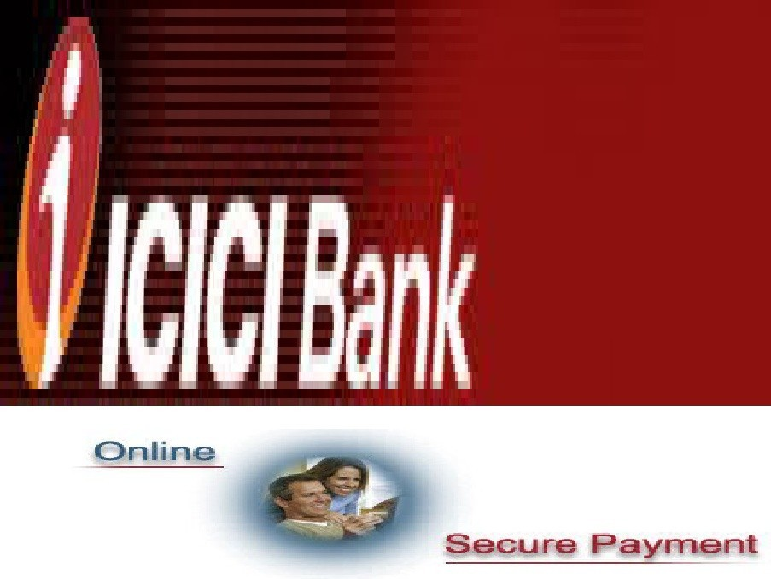
Development of E-banking
in India
ICICI was the first bank to initiate the Internet banking revolution in India as early as 1997 under the brand name 'Infinity‘.
ICICI Bank kicked off online banking way back in 1996 . But even for the Internet as a whole, 1996 to 1998 marked the adoption phase, while usage increased only in 1999- due to lower ISP online charges, increased PC penetration and a tech-friendly atmosphere

Slide 6
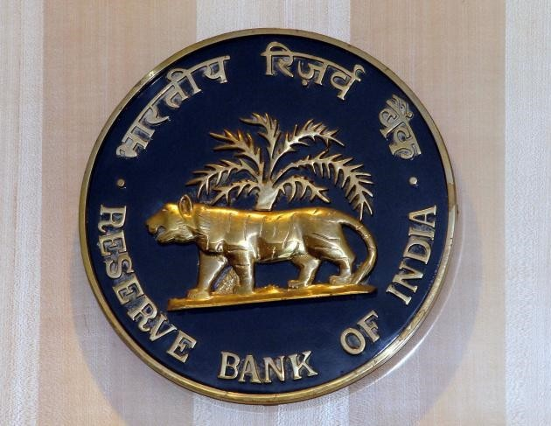
RBI & E-Banking
The Reserve Bank of India constituted a working group on Internet Banking.
The group divided the internet banking products in India into 3 types based on the levels of access granted.
They are:- i) Information Only System: ii) Electronic Information Transfer System: iii) Fully Electronic Transactional System:

Slide 7
Information Only System
General purpose information like interest rates, branch location, bank products and their features, loan and deposit calculations are provided in the banks website.
There exist facilities for downloading various types of application forms.
The communication is normally done through e-mail.

Slide 8
Contd..
There is no interaction between the customer and bank's application system.
No identification of the customer is done. In this system, there is no possibility of any unauthorized person getting into production systems of the bank through internet.

Slide 9
Electronic Information
Transfer System
The system provides customer- specific information in the form of account balances, transaction details, and statement of accounts.
The information is still largely of the 'read only format. Identification and authentication of the customer is through password.
The information is fetched from the bank's application system either in batch mode or off- line.
The application systems cannot directly access through the internet.
'

Slide 10
Fully Electronic Transactional
System
This system allows bi-directional capabilities.
Transactions can be submitted by the customer for online update.
This system requires high degree of security and control. In this environment, web server and application systems are linked over secure infrastructure.
It comprises technology covering computerization, networking and security, inter-bank payment gateway and legal infrastructure .

Slide 11
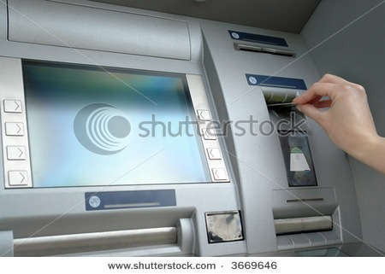
Automated Teller Machine
(ATM)
ATM is designed to perform the most important function of bank.
It is operated by plastic card with its special features.
The plastic card is replacing cheque, personal attendance of the customer, banking hours restrictions and paper based verification

Slide 12

Different services provided
under e-banking
ONLINE BILL PAYMENT
SHOPPING
TICKET BOOKING
PRE PAID MOBILE RECHARGE
INVESTMENT SERVICES
ONLINE APPLICATIONS

Slide 13


Advantages of E-banking
Benefits for Banks
Benefits for Small to Medium Businesses
Benefits for Customers

Slide 14
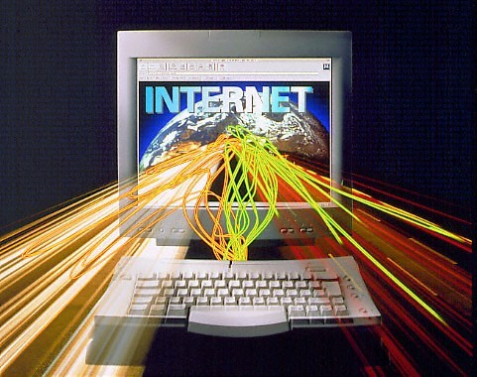
_{B}Benefits for Banks
Larger customer coverage Reducing the costs of operations
Promoting their services and products internationally
Increasing the customer satisfaction and providing a personalized relationship with customers

Slide 15
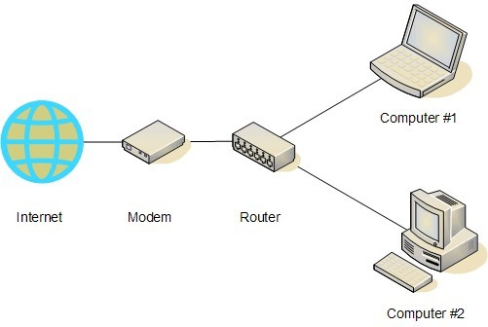
Benefits for Small to Medium
Businesses
To run its operations more effectively
Lower cost than traditional financial management mechanisms

Slide 16
Benefits for Customers
Convenience 24 hours a day, seven days a week
Cost Reducing transfer fees
Speed Faster circulation of assets
Competitiveness - Fostering competition in financial market
Communicate easily
Abolishing the uses of paper
Offering one-stop-shop solutions

Slide 17
Disadvantages OF E-banking
A need for customer skill to deal with computers and browsers.
Many people who are not comfortable with computers and the Internet, often find it difficult to use internet banking
For beginners, internet banking is really time consuming
In many instances, a simple mistake, like clicking a wrong button, may create a big problem.

Slide 18

Security Risk
Increasing number of fraudulent bank websites
For Eg. A suspicious bank website:www.sbionline.com Original bank websitewww.onlinesbi.com
Fake emails purporting to be sent from banks
Email send from Fraudulent bank
Verify the personal information
Guide customer enter the fraud link
Disclosing their ATM card numbers and their passwords

Slide 19
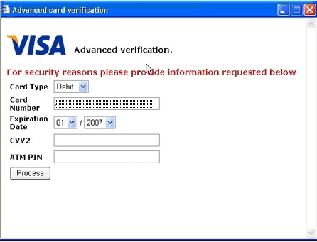
Persecutions For Bank
Should provide specific guidance to their customers
Should take the adequate measures to ward off any problems related to the security of internet banking
Online banking tutorials should be provided to help familiarize people with internet banking

Slide 20
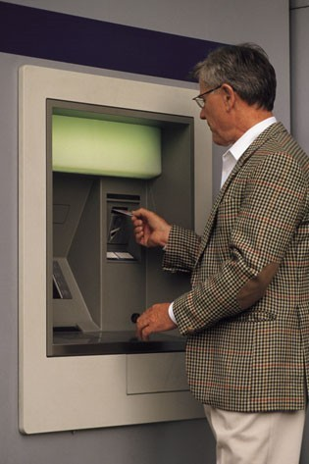
Persecutions For Customers
Should not disclose their customer IDs (e.g., account numbers) or passwords to anyone else.
Periodically change their passwords
Should promptly log out from the service
Should regularly check their account balances and statements to identify unusual transactions.

