Slide 1
EDIFACT
Why use EDI Standards?
EDI standards facilitate electronic data interchange (EDI) by providing
Rules of syntax .
Definition of the data organization.
Editing rules and conventions .
Published public documentation .
EDI standards:
Allow an ‘open’ system .
Reduce implementation effort .
Provide ‘third-party interfaces’ .

Slide 2
What is EDIFACT?
EDIFACT is an acronym for EDI For
A dministration, C ommerce and T ransport. It
coordinates international standardization by working through the UN/ECE (United Nations/Economic Commission for Europe). It provides:
an international EDI standard.
a set of syntax rules .
data elements, segments and codes.
messages.
EDIFACT is the product of the evolution in bringing the Proprietary Standards of the U.S. and Europe together to form a single international EDI standard.

Slide 3
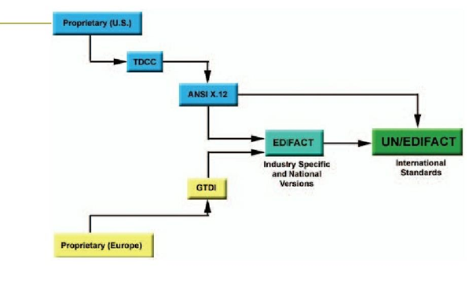

Slide 4
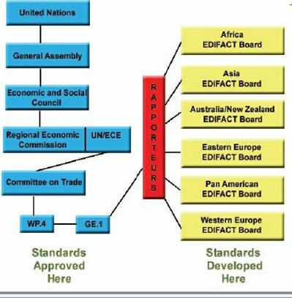
In order to bring about the evolution of the EDIFACT standard, the UN has created UN/ECE to coordinate this effort. The organizational structure of the UN/ECE is made up of the following board

Slide 5
Message Definition
A Message is a single business document. Each
message is identified by a six character name.
From the buyer-side these include:
ORDERS-Purchase Orders .
CUSDEC-Customs Declaration.
IFTMIN-Instruction Message.
REMADV-Remittance Advice.
PAYORD-Payment Order.
Seller-side messages include:
IFTMAN-Arrival Notice.
CUSRES-Custom Response.
INVOIC-Invoices.

Slide 6
Messages are made up of a collection of sequenced segments within defined areas . Some segments may be used in more than one area. The segments that can be used in each area are defined by the EDIFACT documentation. EDIFACT provides a hierarchical structure for messages.
Messages begin with the Message Header (UNH)
Segment and end with the Message Trailer (UNT)
Segment. These two segments are the first, and innermost, level of the three levels of “electronic envelopes” within EDIFACT. Here is an example of an Extended Payment Order (PAYEXT) message that illustrates this structure:

Slide 7
Message Structure: Segment Tables
The message structure is defined in segment tables . These give the ‘rules’ of the message. They also show which segments are used in a particular message and the order in which the segments must appear.
Here is an example of a segment table for the Extended Payment Order (PAYEXT):

Slide 8
THANK YOU

