Slide 1
Name: Debanjan Bhattacharyya
Roll No: 16800116076
Dept: CSE
Subject: E-Commerce
Sem: 8th
Paper Code: CS802E
Online Payment

Slide 2
Online Payment System
Online Payment or Electronic Payment is any digital financial payment transaction involving currency transfer between two or more parties
Implementation of electronic payment systems is in its infancy and still evolving
Electronic payments are far more cheaper than the traditional method of mailing out paper invoices and then processing payments received.

Slide 3
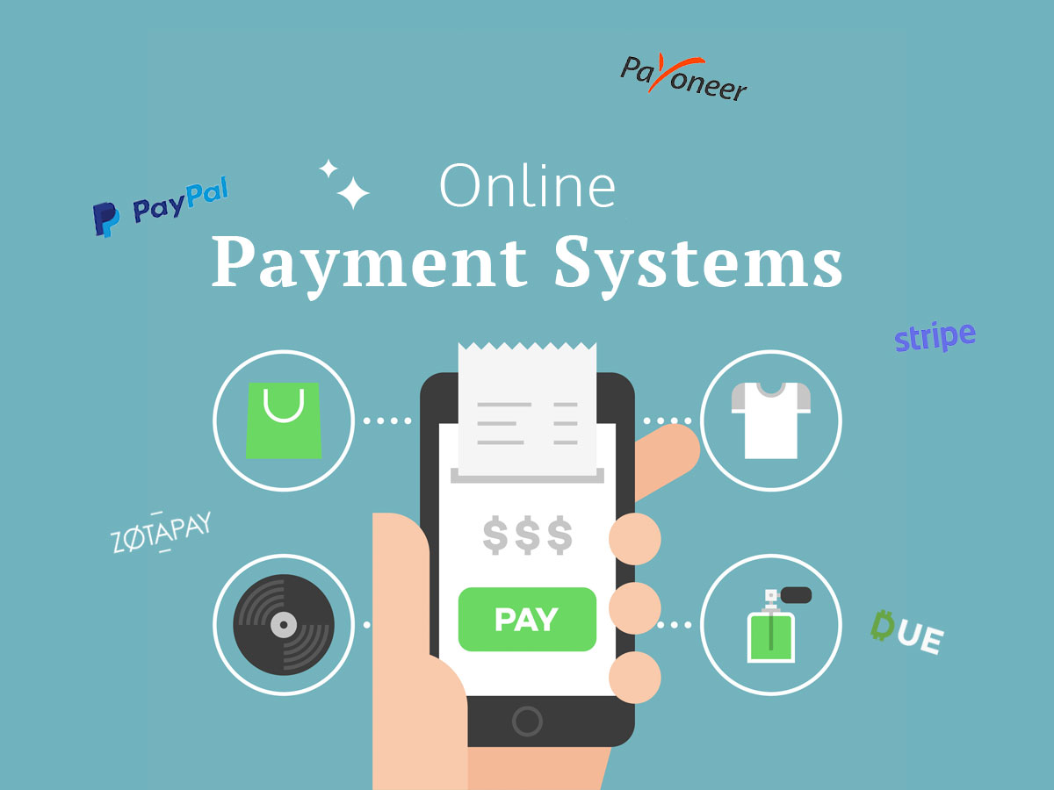
Modes of Online Payment
Debit Card
Credit Card
Electronic Cash
E-Payment Apps
Smart Cards

Slide 4
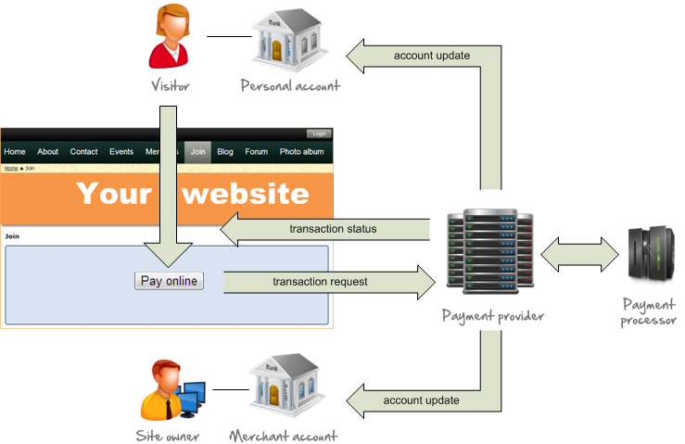
Online Payment Process

Slide 5
Advantages and Disadvantages
Advantages:
Time Saving
Low transaction Cost
Reduced risk of money lost
Disadvantages:
Password threats
Necessity of Internet
Security Concern

Slide 6
THANK YOU!

