Slide 1
DIGITAL CERTIFICATE
E-COMMERCE
presented by-
ANKIT KUMAR
Roll- 16800116093
CSE - 4th Year (8th sem)
CS 802-E

Slide 2

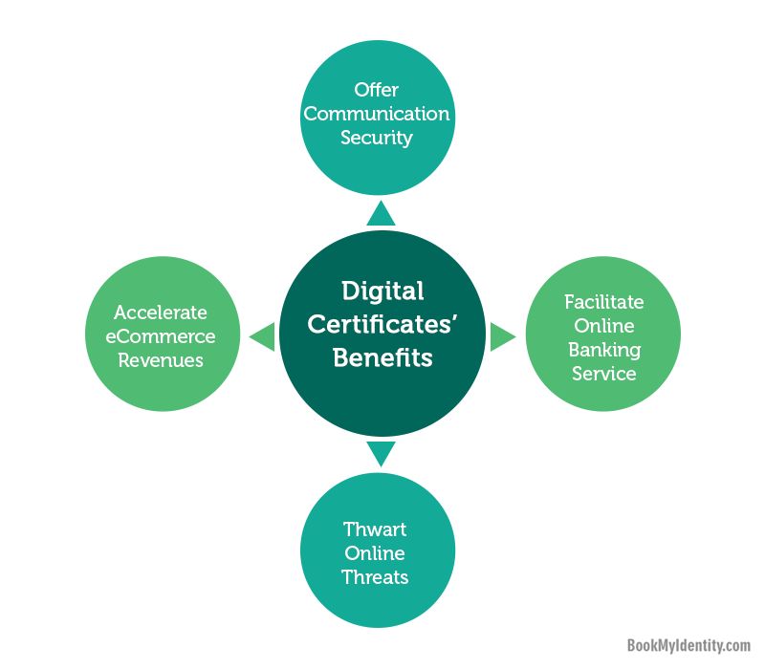



Introduction
A DIGITAL CERTIFICATE IS AN ELECTRONIC “PASSWORD” THAT ALLOWS A PERSON, ORGANISATION TO EXCHANGE DATA security over the internet using the public key infrastructure (pki).
Digital certificate is also known as a public key certificate or identity certificate.
PKI comprises of the technology to enables secure e-commerce and Internet based communication

Slide 3
Types of digital certificate
There are three main types of digital certificate :-
Secure Socket Layer Certificate [SSL]
Code Signing Certificate
Client Certificate

Slide 4
Types of digital certificate
Secure Socket Layer [SSL] server Certificates are installed on a server. This can be a server that hosts a website like www.digi-sign.com, a mail server, a directory or LDAP server, or any other type of server that needs to be authenticated, or that wants to send and receive encrypted data.
Code Signing Certificates are used to sign software or programmed code that is downloaded over the Internet. It is the digital equivalent of the shrink-wrap or hologram seal used in the real world to authenticate software and assure the user it is genuine and actually comes from the software publisher that it claims.
Client Certificates or Digital IDs are used to identify one person to another, a person to a device or gateway or one device to another device. Client Certificates are issued in their thousands and millions each year and would be the principle reason for purchasing a CA.

Slide 5

Who can issue a digital certificate ?
WHILE IT IS POSSIBLE FOR AN ENTITY TO CREATE ITS OWN PKI AND ISSUE ITS OWN DIGITAL CERTIFICATES – AND IN SOME CASES THIS APPROACH MIGHT BE REASONABLE, FOR EXAMPLE WHEN AN ORGANIZATION MAINTAIN ITS OWN PKI TO ISSUE CERTIFICATES FOR ITS OWN INTERNAL USE – THE VAST MAJORITY OF DIGITAL CERTIFICATES ARE ISSUED BY A CERTIFICATE AUTHORITY (CA ).

Slide 6
References
https://www.wikipedia.org/
https://www.slideshare.net/
http://www.digi-sign.com//
https://www.google.co.in/imghp?hl=en

Slide 7


