Slide 1
TRADE CYCLE
E-COMMERCE
presented by-
SOUVIK CHATTERJEE
Roll- 16800116022
CSE - 4th Year (8th sem)
CS 802-E

Slide 2
Introduction
A Trade CYCLE IS THE Series of exchange between a customer and a supplier that
takes place when an exchange is executed. A general trade cycle consists of:
Pre-Sales: Finding a supplier and agreeing the terms.
Execution: Selecting goods and taking delivery.
Settlement: Invoice (if any) and payment.
After-Sales: Following up complaints or providing maintenance.

Slide 3
Definition
“A Trade Cycle is composed of periods of trades characterized by rising prices and low
unemployment percentages altering with periods of bad trade characterized by falling prices and high unemployment percentages “ - Keyles

Slide 4

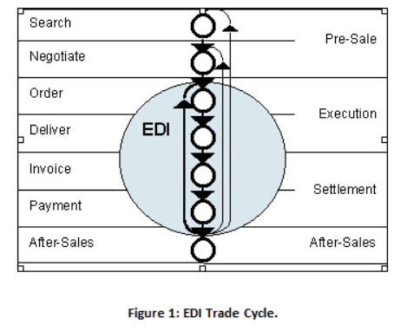
EDI Trade Cycle
Commercial transactions that are repeated on a regular basis, such as supermarkets replenishing their shelves, is one category of trade cycle. EDI is the e-Commerce technology appropriate to these exchanges, see Figure 1.

Slide 5
Phases of trade cycle
Pre-sales
Execution
Settlement
After-sales

Slide 6





Pre-sales Finding a supplier and agreeing the terms. It is a search and negotiate phase.

Slide 7
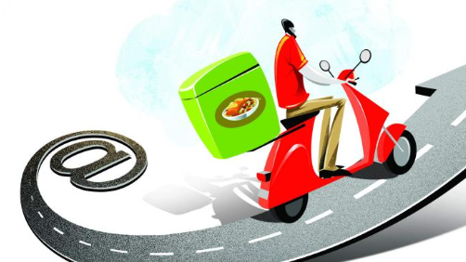
Execution Selecting goods and taking delivery. It is order and delivery phase.

Slide 8
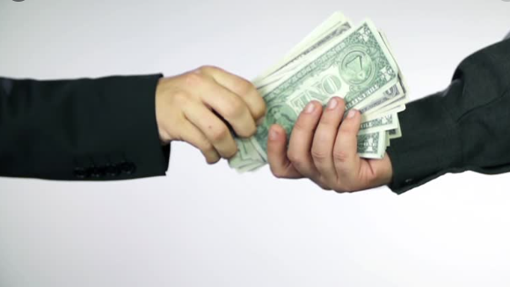
Settlement Payment and get invoice.

Slide 9

After-sales Following up complaints or providing maintenance. It is a service warrantee phase.

Slide 10
References
https://www.wikipedia.org/
https://www.slideshare.net/
https://www.ques10.com/
https://www.google.co.in/imghp?hl=en

Slide 11


