Slide 1

A
Presentation
on
EDIFACT
Department of Computer Science and Engineering
Saroj Mohan Institute Of Technology(Degree Division)
Guptipara . Hooghly
Submitted By : Ritwik Chakraborty
Roll no : 16800116047
Sem : 8th , Year : 4th

Slide 2
Contents:
Why use EDI standards?
What is EDIFACT?
Message definition
Message structure:segment table
Message structure:segment group
Segments
Service and generic segments
Data elements:Simple & Composite
Data elements types:Numeric
Data elements types:Alphabetic
Message structure and electronic enveloping
Envelop architecture
Electronic enveloping
The messasge envelop
The interchange envelop
The control message
Conclusion

Slide 3
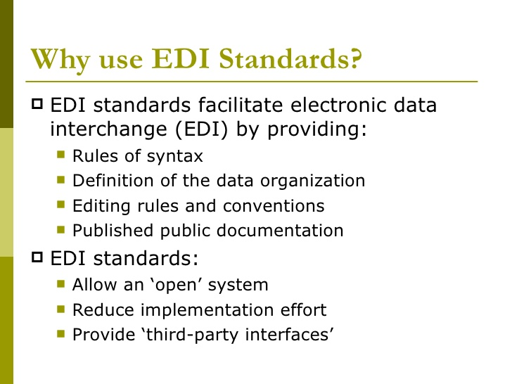

Slide 4
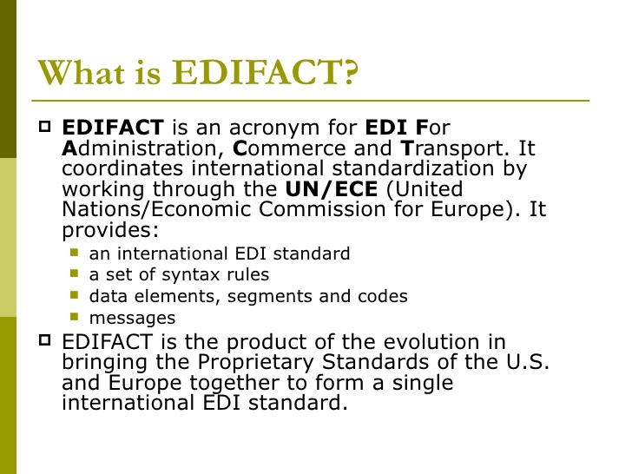

Slide 5
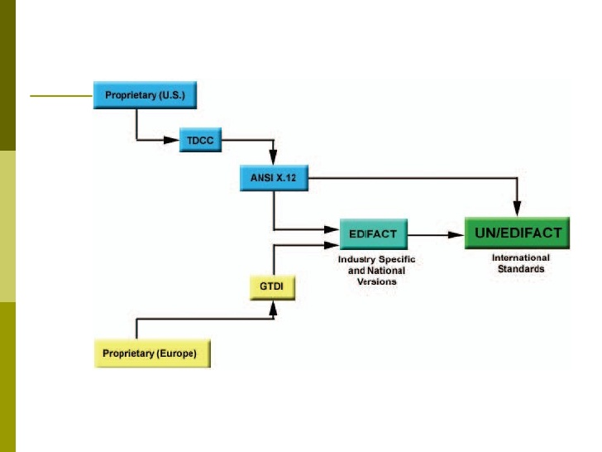

Slide 6
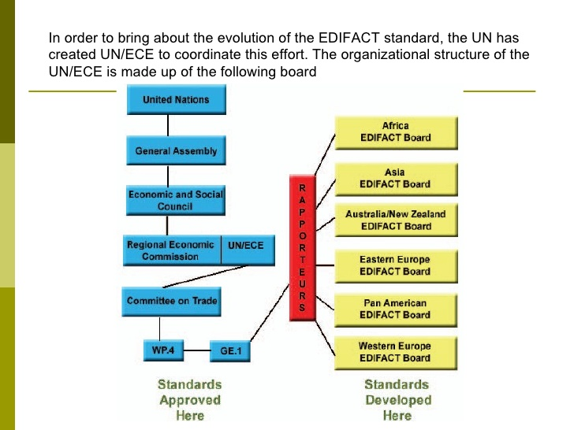

Slide 7
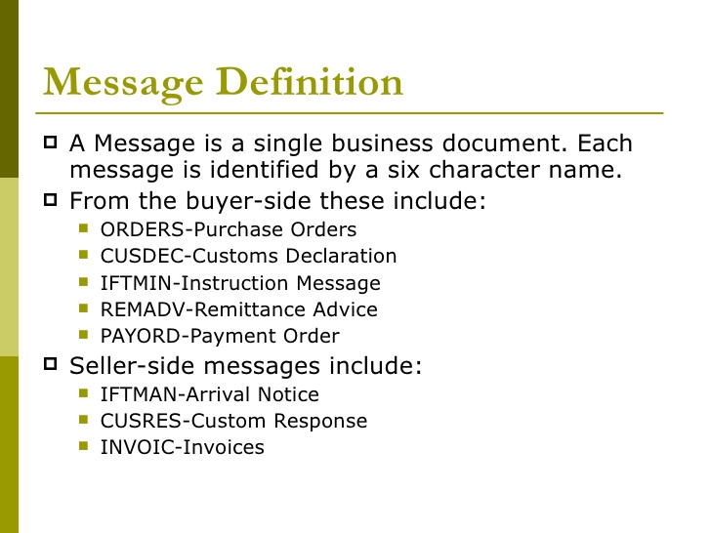

Slide 8
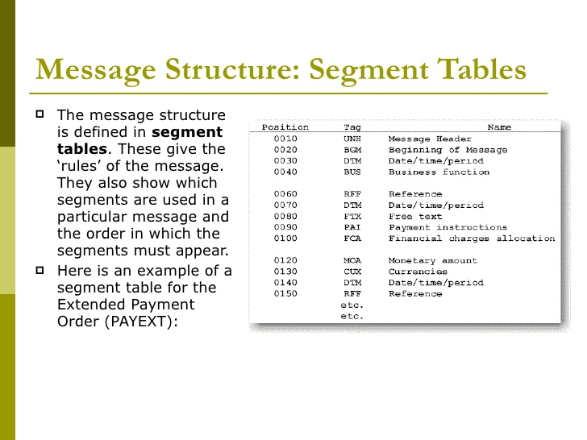

Slide 9
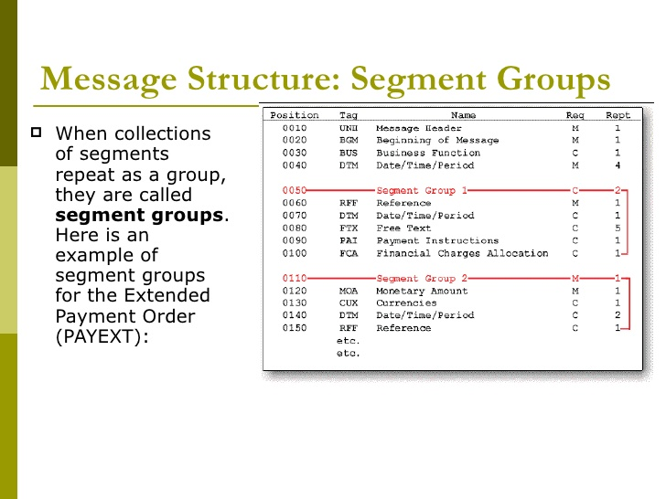

Slide 10
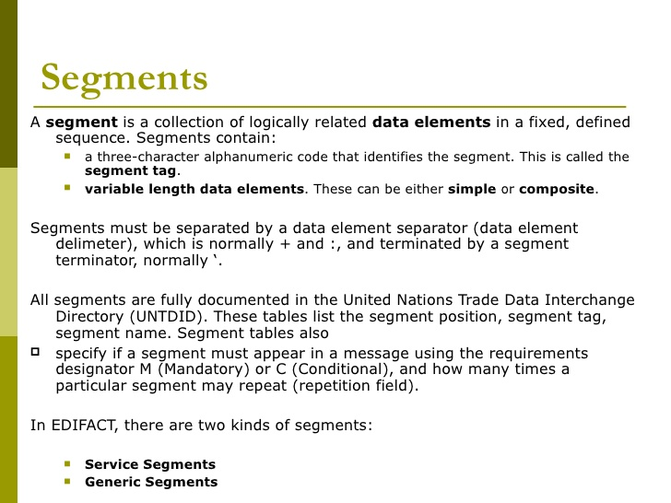

Slide 11
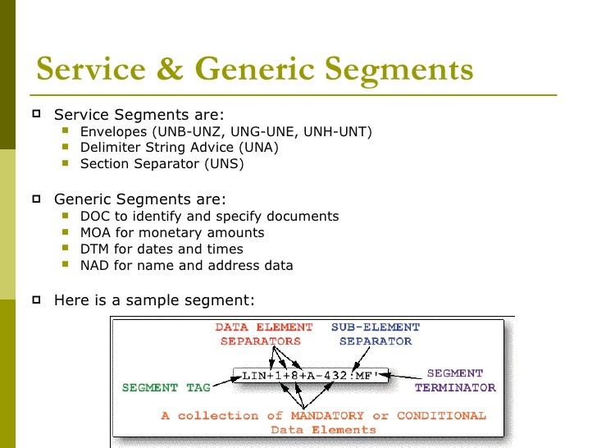

Slide 12
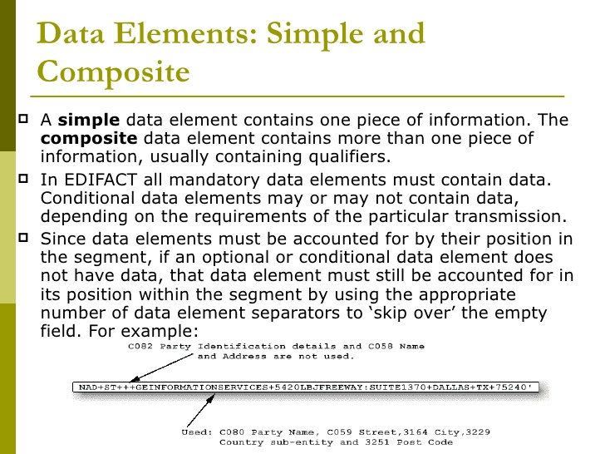

Slide 13
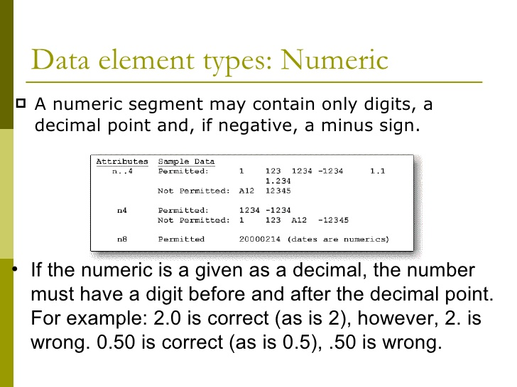

Slide 14
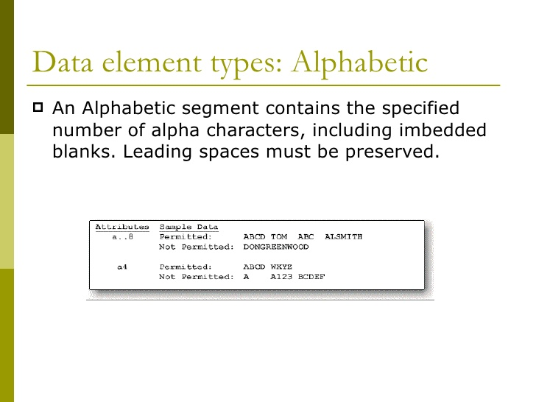

Slide 15
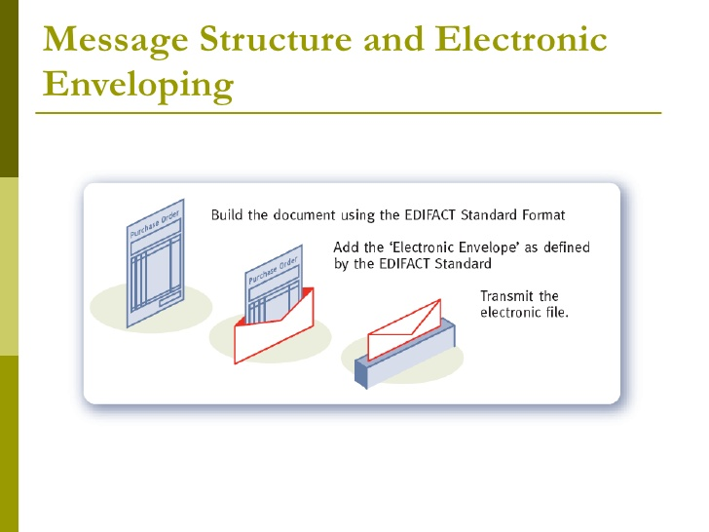

Slide 16
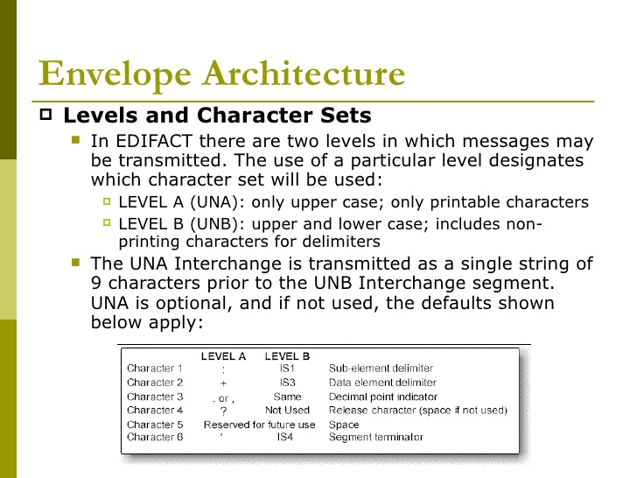

Slide 17
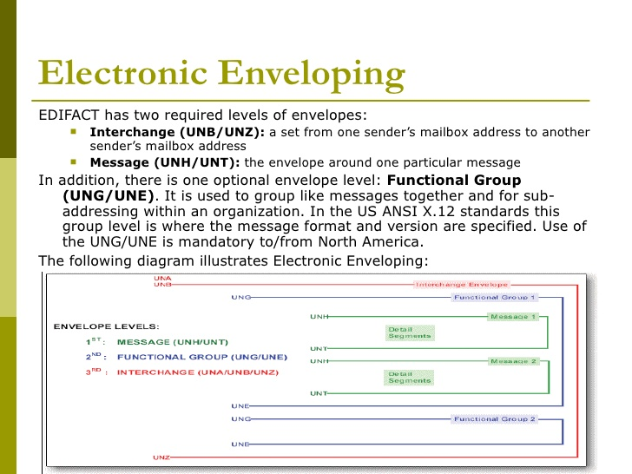

Slide 18
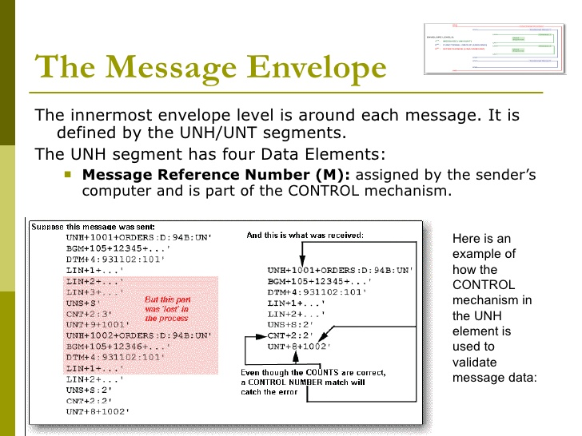

Slide 19
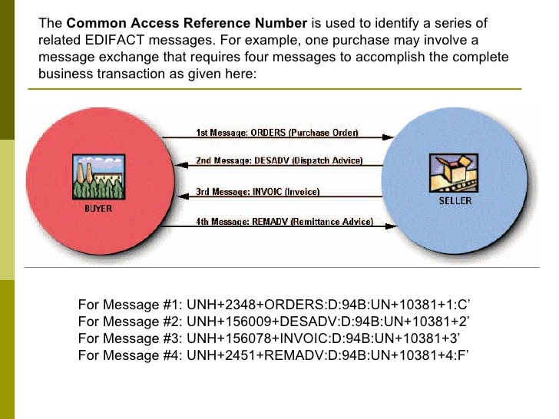

Slide 20
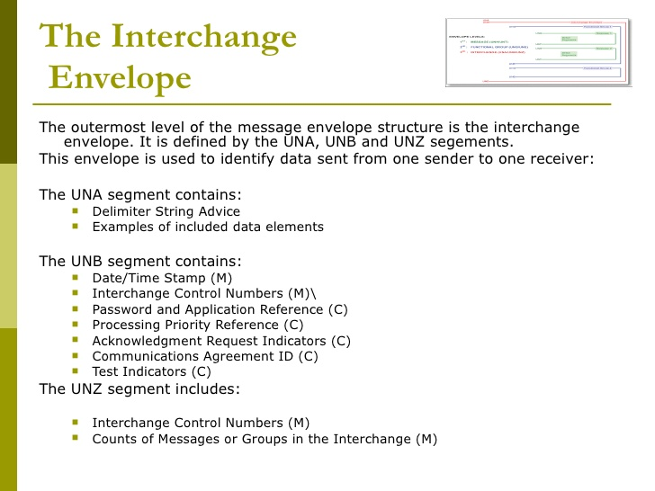

Slide 21
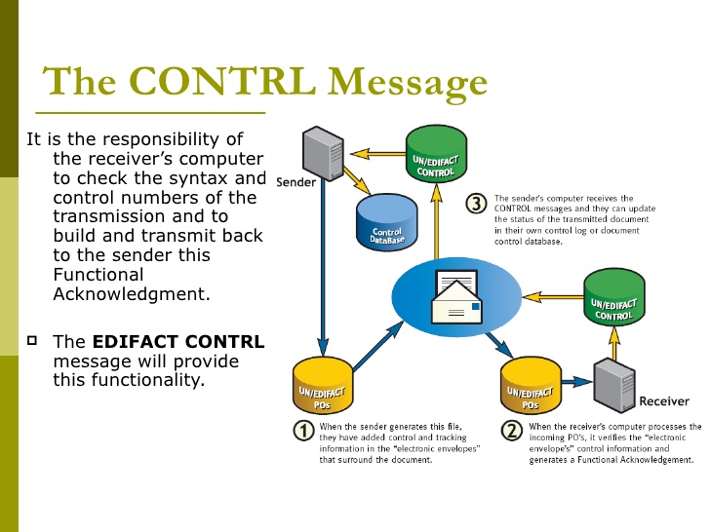

Slide 22
Thank You.......

