Slide 1

A
Presentation
on
Enterprise Resource Planning(ERP)
Department of Computer Science and Engineering Saroj Mohan Institute Of Technology(Degree Division)
Guptipara . Hooghly
Submitted By : Rintu Pratihar
Roll no : 16800116049
Sem : 8th , Year : 4th

Slide 2
Content
What is ERP ??
Evolution of ERP
Major Reason for adapting ERP
How ERP System Work
Components of ERP System
Before ERP & After ERP\
Potential Benefits of ERP
Risk with ERP Implementation
Popular ERP Modules
Major Phases Of ERP Implementation
Advantages of ERP
Disadvantages of ERP
Conclusion

Slide 3
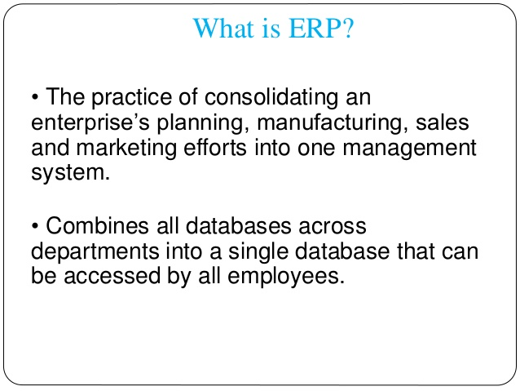

Slide 4
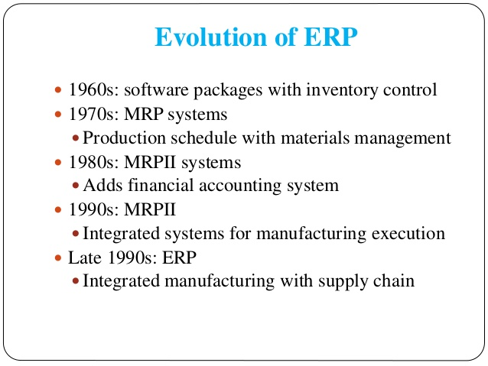

Slide 5
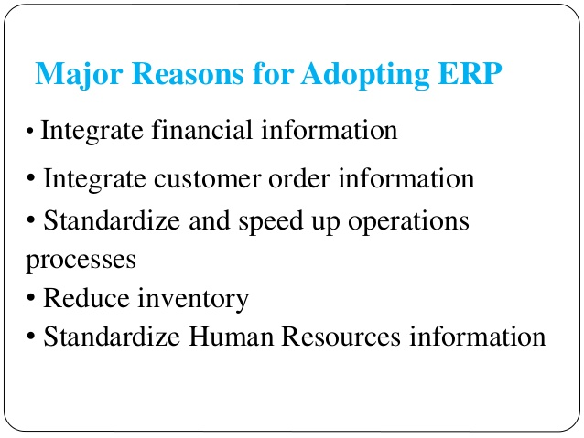

Slide 6
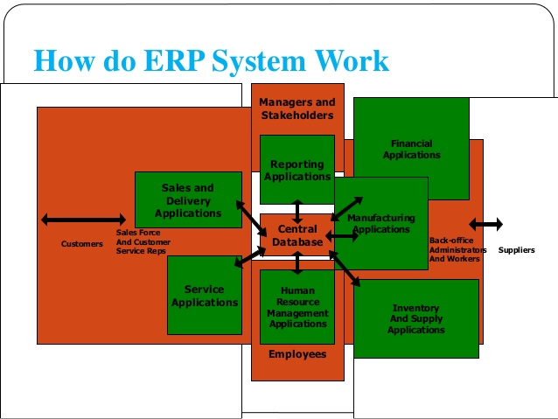

Slide 7
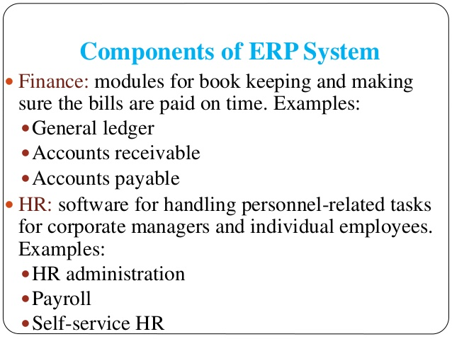

Slide 8
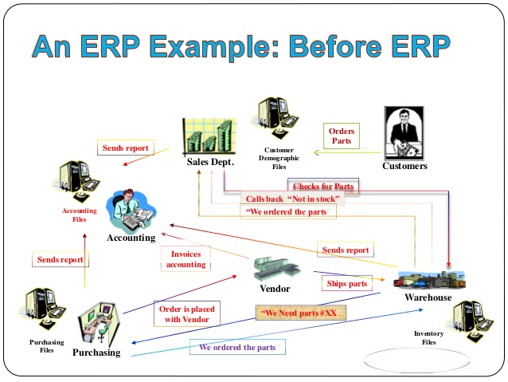

Slide 9
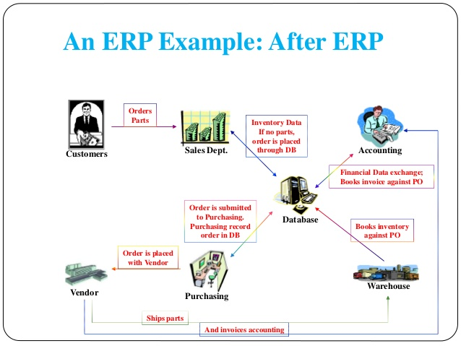

Slide 10
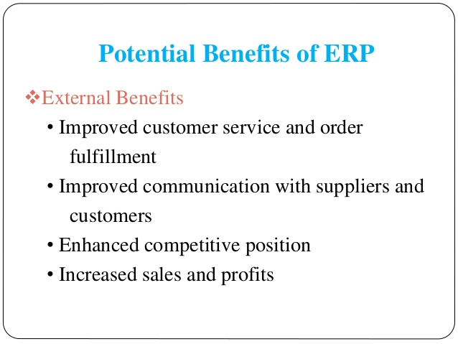

Slide 11
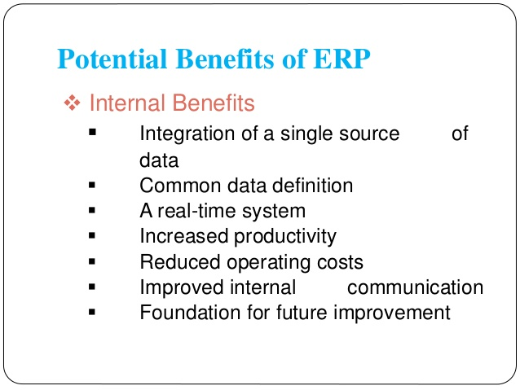

Slide 12
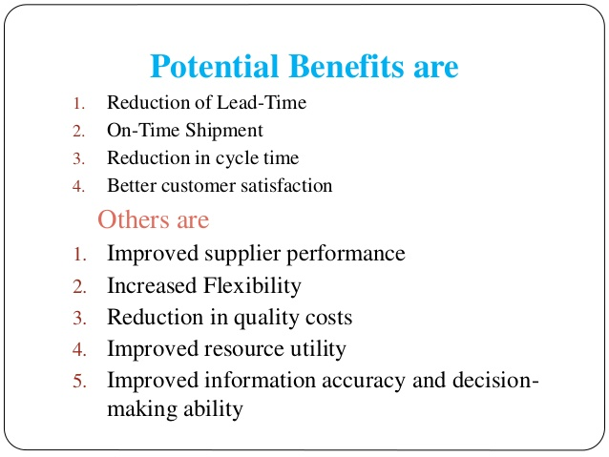

Slide 13
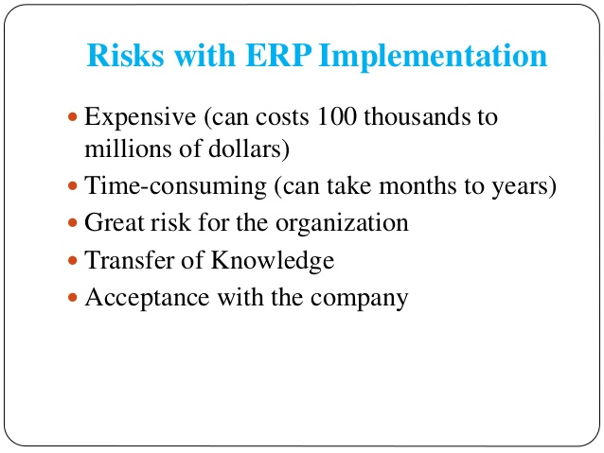

Slide 14
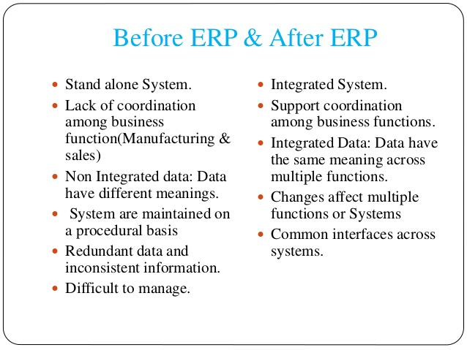

Slide 15
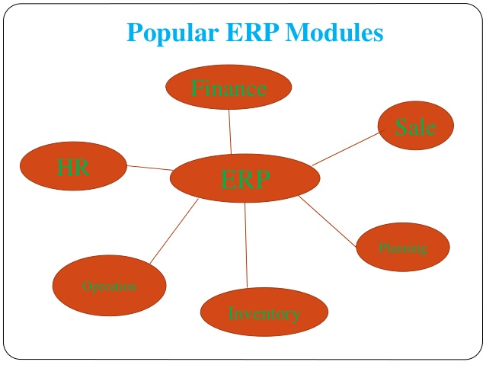

Slide 16
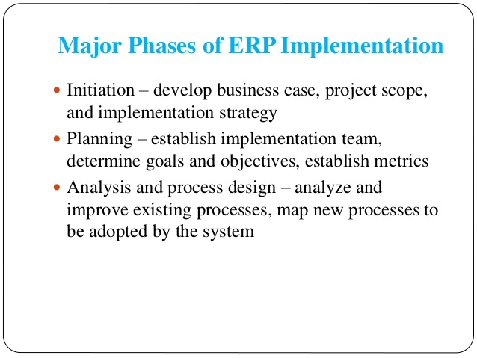

Slide 17
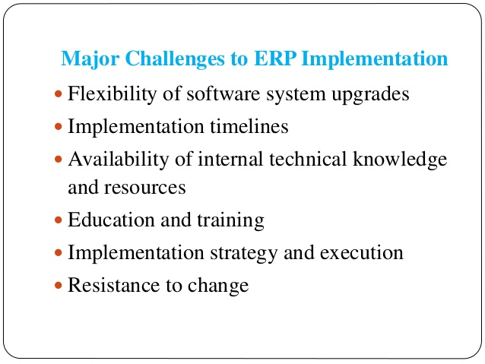

Slide 18
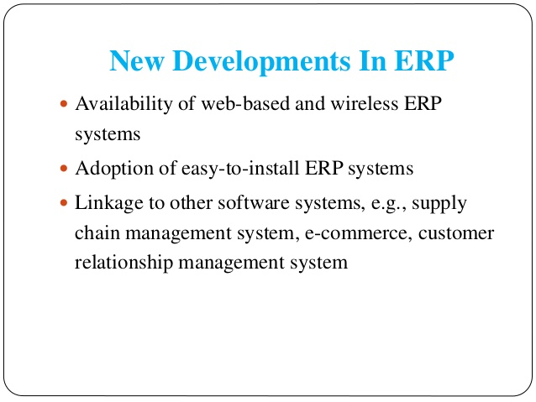

Slide 19
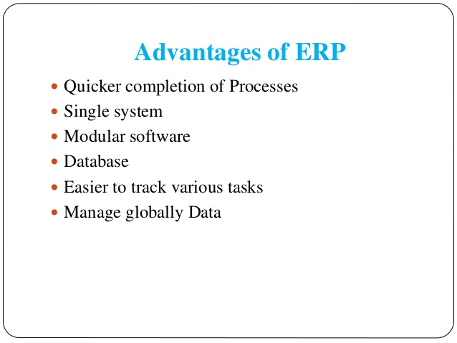

Slide 20
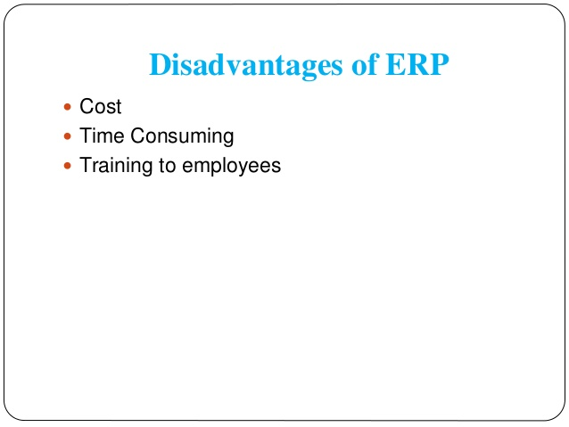

Slide 21
Conclusion
The benefits of properly selected and implemented ERP system can be significant.
An average,25 to 30% reduction on inventory costs; 25% reduction on raw material costs.
Lead-time for customers, production time, and production costs can be reduced.
BUT cost of implementing can be quite high and risk are great.

Slide 22
Thank You........

