Slide 1
topic: Supply chain management(SCM)
Presented By-SHILPA BISWAS
Roll-16800116033
Sub:E – Commerce(CS802E)

Slide 2
What do we mean by the term “Supply Chain”?
Supply Chain Management(SCM) is the backbone of E-Commerece.
Supply chain management is the process of planning,implemeting and controlling the operations of supply chain with the purpose to satisfy customers requirements as efficiently as possible.In simpler terms, SCM is the management of the flow of goods and services and includes all processes that transform raw materials into final products.
All stages involved,directly or indirectly,in fulfilling a customer’s request.
Includes manufactures,suppliers,transporters,warehoses,retailers
and customers.
Examples of supply chain activities include farming, refining, design,manufacturing, packaging, and transportation.

Slide 3
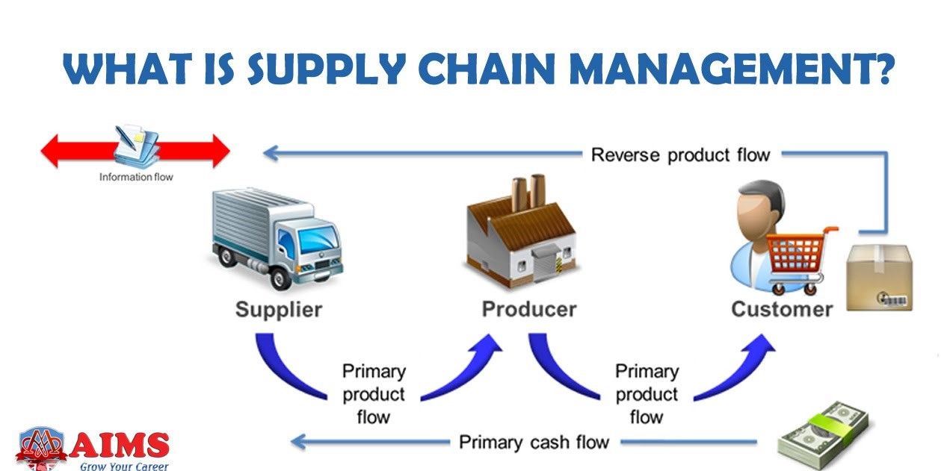

Slide 4
1. Planning
This is one of the most important stages. Before the beginning of the entire supply chain, it is essential to finalise the strategies and put them into place. Checking the demand for the product or service, checking the viability, costing, profit, and manpower etc., are vital. Without a proper plan or strategy in place, it will be well-nigh impossible for the business to achieve effective and long term benefits. Therefore, enough time has to be devoted to this phase. Only after the finalisation of the plans and consideration of all pros and cons, can one proceed further. Every business needs a plan or blueprint or a roadmap based on which the strategies are made. Planning helps to identify the demand and supply trends in the market and this, in turn, helps to create a successful supply chain management system.
2. Information
The world today is dominated by a continuous flow of information. In order to be successful, it is essential that a business stays abreast with all the latest information about the various aspects of its production. The market trends of supply and demand for a particular product can be best understood if the information is properly and timely disseminated through the many levels of the business. Information is crucial in a knowledge-based world economy, and ignorance about any aspect of business may actually spell doom for the prospects of the business.
3. Source
Suppliers play a very crucial role in supply chain management systems. Products and services sold to the end user are created with the help of different sets of raw materials. It is therefore necessary that suitable quality raw materials are procured at cost effective rates. If a supplier is unable to supply on time, and within the stipulated budget, the business is bound to suffer losses and gain a negative reputation.
It is crucial that a company procures good quality resources so it can create good quality products and maintain its reputation in the market. This necessitates a strong role for suppliers in the supply chain management system.

Slide 5
4. Inventory
For a highly effective supply chain management system it is essential that an inventory is kept and thoroughly maintained. An inventory means the ready list of items, raw materials and other essentials required for the product or service. This list has to be regularly updated to demarcate available stock and required stock. Inventory management is critical to the function of supply chain management, because without proper inventory management the production, as well as sale of the product, is not possible. Businesses have now started to pay more attention to this component simply because of its impact on the supply chain.
5. Production
Production is one among the most important aspects of this system. It is only possible when all the other components of the supply chain are in tandem with each other. For the process of production to start it is essential that proper planning and supply of goods, as well as the inventory, are well maintained. The production of goods is followed by testing, packaging and the final preparation for delivery of the finished product.
6. Location
Any business, that wants to survive as well as flourish, needs a location which is profitable for the business. Take for example, a carbonated drink factory is set up in an area where water supply is scarce. Water is a basic necessity of such business. The lack of water could hamper the production as well as affect the goodwill of the company. A business cannot survive if it has to share an already scarce raw material with the community. Hence, a suitable location, which is well connected, and very close to the source of essential resources for production is vital to a business’ prosperity. The requirement and availability of manpower must also be considered while setting up a business unit.
7. Transportation
Transportation is vital in terms of carrying raw materials to the manufacturing unit and delivering the final product to the market. At each stage, timely transportation of goods is mandatory to sustain a smooth business process. Any business which pays attention to this component, and takes good care of it, will benefit from the production and transportation of

Slide 6
its goods on time.
It is essential that a company works towards a safe and secure transportation process. Be it in-house or a third-party vendor, the transportation management system must ensure zero damage and minimal loss in transit. A well-managed logistics system along with flawless invoicing are the two pillars of secure transportation.
8. Return of goods
Among the various components that create a strong supply chain is the facility for the return of faulty/malfunctioning goods, along with a highly responsive consumer grievance redress unit.
No one is infallible. Even a machine may malfunction once in a million times if not more. As a part of a strong business process, one may expect the return of goods under various circumstances. Even the best quality control processes may have unavoidable momentary lapses. In the case of such lapses, inevitably followed by consumer complaints, a business must, instinctively, recall the product/s and issue an apology. This not only creates a good customer bonding, but also maintains goodwill in the long run.

Slide 7
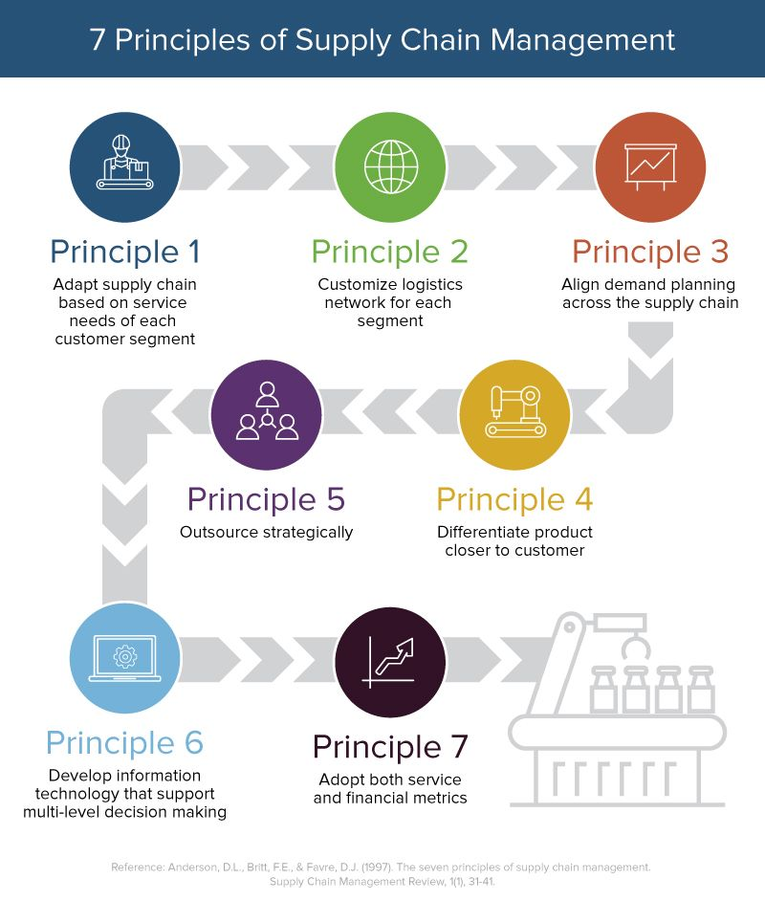

Slide 8
There are four major elements of supply chain management:
Integration : As with any project, planning is essential to long-term success. Part of good planning is setting up integration, which means that everyone involved in the manufacturing process communicates and collaborates. Instead of functioning in separate divisions, or silos, integrated teams work together to make sure the product gets to the distribution phase. This improved communication reduces errors that cost time and money. Since everyone is working together, leaders can also monitor the entire operation and easily identify areas along the supply chain that can be improved.
Operations : Many of today’s manufacturers operate using lean manufacturing strategies, which means that processes are constantly evaluated to identify where things can be done more efficiently. Whether it’s monitoring equipment to make sure you’re getting the most out of it or cutting back work hours when production slows down, the operations team can bring major improvements to the supply chain.
Purchasing : The purchasing area of supply chain management makes sure a company has everything it needs to manufacture products, including materials, supplies, tools and equipment. This means often staying ahead of the process so that you have everything you need on hand well before you actually need it. Without the right purchasing personnel, you could find that you end up running out of the materials you need, delaying production, or that you overbuy and strain the company’s budget.
Distribution : The supply chain ends when the product lands on store shelves where customers can buy them or their front door (if they purchase them online). But getting products there means having a well-planned shipping process. Most companies today use logistics software to manage their shipments, whether they handle it on their own or source shipping to a third-party provider. When handled correctly, products are moved expeditiously from the warehouse to the customer.

Slide 9
What are the types of supply chain?
The 6 supply chain models are:
The continuous flow models.
The fast chain models.
The efficient chain models.
The custom configured model.
The agile model.
The flexible model.

Slide 10
THANK YOU

