Slide 1
COPYRIGHT
A part of Intellectual Property Right
1
By Shayan Mukherjee

Slide 2
Contents
2
Definition & scope of copyright
Indian Copyright Act & Its perspective
Assignment of copyright
Infringement to Copyright
Remedies for infringement
Limitation to copyright

Slide 3
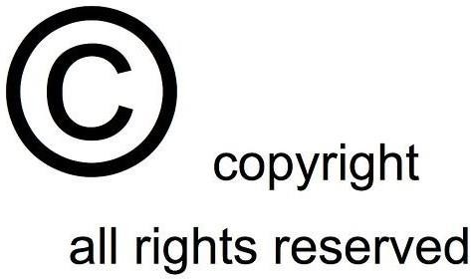
What is Copyright ?
3
“The exclusive right given by law for a certain term of years to an author, composer etc. (or his assignee) to print, publish and sell copies of his original work”
(Oxford English Dictionary)

Slide 4
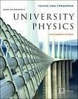
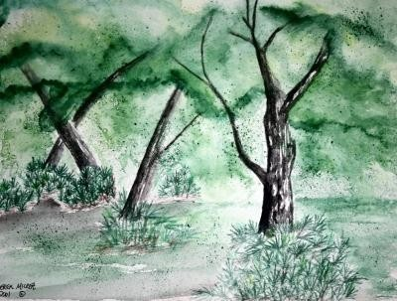
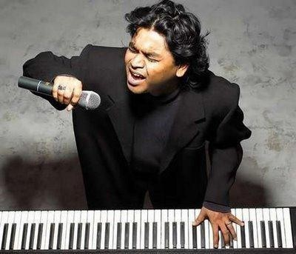
What can be Protected ?
4
literary or dramatic work
a musical work
an artistic work
a cinematograph film
a sound recording
a photograph
a computer generated work

Slide 5
Whose Rights are protected ?
5
Copyright protects the right of Author, i.e. creator of Intellectual Properties.
He/She is also called the First Owner of Copyright.
◉
However, in course of employment, the employer is the first owner of these rights.
Work | Creator of work
Literary or dramatic work | Author
Musical work | Composer
Cinematograph | Producer
Sound recording | Producer
Photograph | Photographer

Slide 6
Why Copyright ?
6
Favour
Against
Rewards creative efforts.
Protects corporate interests only
Protects interest of the creator
Criminalizing legitimate use

Slide 7
Copyright: National Vs International
7
No single “international copyright” for whole world.
The Copyright Act of each country is compliant with most international conventions and treaties.
In India, the Copyright Act, 1957 is compliant with these international conventions and treaties-
Berne Convention of 1886
Universal Copyright Convention of 1951
Agreement on Trade Related Aspects of Intellectual Property Rights (TRIPS)

Slide 8

Indian Copyright Act, 1957
8
First right in India in 1914
Now, Indian Copyright Act,1957; w.e.f. 1958
Further amendments in 1983,1984,1992,1994,1999
adopted many English provisions, introduced new ideas and concepts.
Created Copyright Office and Copyright Board
Introduced civil and criminal remedies against infringement

Slide 9
Indian Perspective on Copyright
9
The Copyright Act, 1957 confers copyright protection in the following two forms:
Economic Rights
Moral Rights

Slide 10
Economic Rights
10
Several exclusive rights typically attach to the holder of a copyright:-
to produce copies or reproductions of the work and to sell those copies (including, typically, electronic copies)
to import or export the work
to create derivative works (works that adapt the original work)
to perform or display the work publicly
to sell or assign these rights to others
to transmit or display by radio or video

Slide 11
Moral Rights
11
Right of paternity
to claim authorship of work and to prevent all others from claiming authorship of his work.
Right of integrity.
to prevent distortion, mutilation or other alterations of his work, or any other action in relation to said work, which would be prejudicial to his honour or reputation.

Slide 12
Term of Copyright
12
The general rule is that copyright lasts for 60 years.
It is counted-
From the death of the author
Literary
Dramatic
Musical
Artistic work
From the date of publication
Cinematograph films
Sound recordings
Photographs
Posthumous publication
Works of government & international organizations

Slide 13


Registration of Copyright
13
Berne Convention: registration is not needed
Acquisition of Copyright is automatic with the creation the work
Registration as prima facie evidence

Slide 14
Copyright Symbol ©
14
Use of the "©" symbol
Anyone who claims copyrights can use it
not necessary to have a registration to use the designations
highly advisable to incorporate a copyright notice
Example:
Copyright © 2009 Microsoft Corporation

Slide 15
Assignment of Copyright
15
The owner of the copyright may assign to any person the copyright either wholly or partially.
Duration, in case of default
◉ 5 years
The moral rights are independent of the author’s copyright and remains with him even after assignment of the copyright.

Slide 16
Counterfeiting to Copyright
16
Counterfeit mark:
the production of certain brand bags by putting a false label, and sold at low prices.
Counterfeit products:
Infringement "mixed :
copies of articles, similar to the original under a different name
copy for both the model and brand. Ex. Fake Louis Vuitton bags or Rolex watches for instance.
Infringement of copyright :
copying or using the work of another creator, without his prior permission

Slide 17
Acts resulting Infringement
17
Making infringing copies for sale or hire;
Permitting any place where performance constitutes infringement of copyright;
Distributing infringing copies for the purpose of trade;
Public exhibition of infringing copies by way of trade; and
Importation of infringing copies.

Slide 18
Remedies for Copyright Infringement
18
Remedies for Copyright Infringement
Civil
Criminal
Administrative

Slide 19

Civil Remedies
19
Civil remedies
Injunction
Damages
Accounts
Delivery of infringing copy
Damages for conversion
Jurisdiction in District Court

Slide 20

Criminal Remedies
20
Criminal offences, if done knowingly
Imprisonment
◉ 6 months – 3years
◉
Fine
◉ Rs.50,000 – Rs.200,000
Seizure of infringing copies

Slide 21
Limitations to Copyright
21
Idea-expression dichotomy
protects only the original expression of ideas, and not the ideas themselves
The first-sale doctrine
does not restrict the owner of a copy from reselling legitimately obtained copies of copyrighted works

Slide 22
Limitations to Copyright (contd..)
22
Fair use and fair dealing
For the purpose of research or private study
For learning & teaching in a class room
For criticism or overview
For reporting current events
In connection with judicial proceeding
Performance to non-paying audience
Other specific conditions

Slide 23
Limitations to Copyright (contd..)
23
Some Government works are exempted in India
Act of a Legislature.
Report of a committee, commission, council, board or other like body appointed by the Government.
Judgement or order of a court, tribunal or other judicial authority

Slide 24
Summary
24
Each country has own law compliant to any international convention
Copyright prevents distribution of Idea, not Idea itself
It safeguards interest of the creators
It encourages people to create something new
Registration is not compulsory
Economic rights can be assigned to another person
Infringement is a criminal offence, if done knowingly

Slide 25


25

